Slide 1
BQ24095 Issue Test

Slide 2
1. BQ24095 Test Issue
After Booting without Battery, if current consumption is over 500mA, there is no Vout.
During Battery Charging, Charge current decreased in Constant Current Mode.

Slide 3
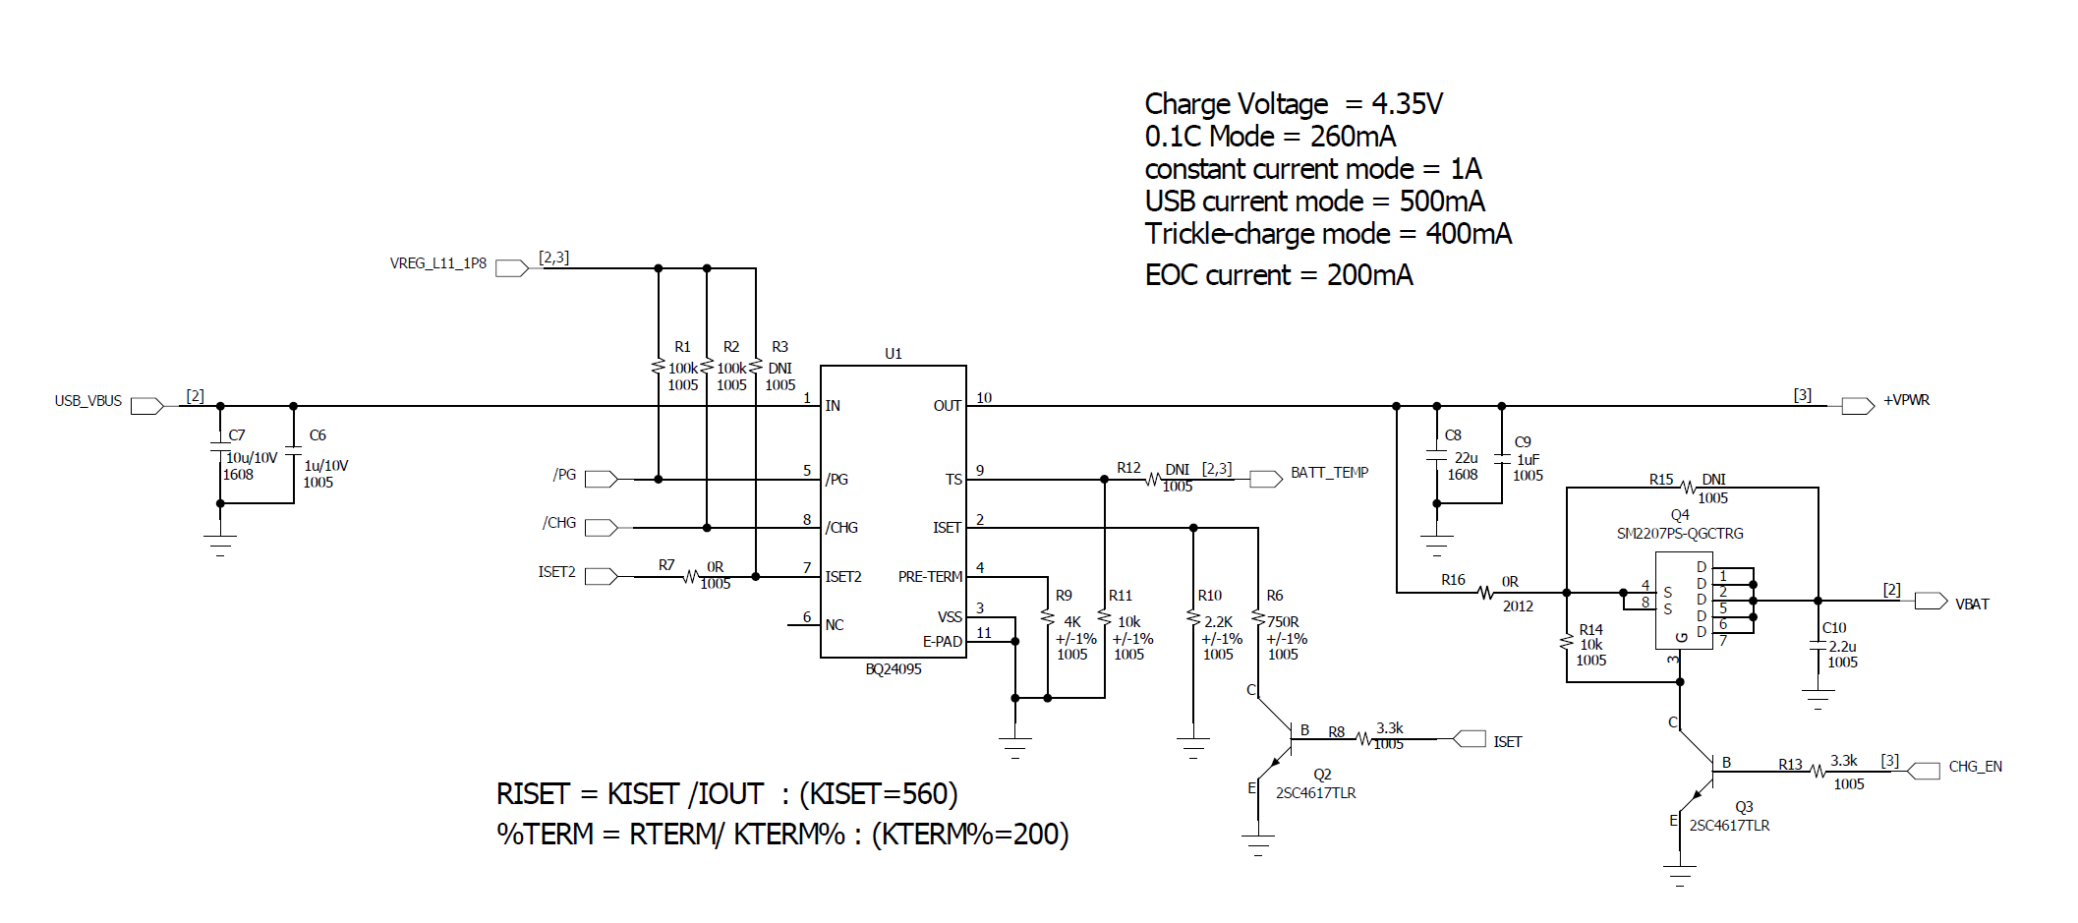
2. BQ24095 schematic

Slide 4
3. BQ24095 Issue
After Booting without Battery, if current consumption is over 500mA, there is no Vout.
Test condition.
Booting by Adaptor 5V power without Battery.
ISET2 → Low = ISET
ISET → 560Ω = 1A
TS → 10KΩ pull down
Issue Symptom.
Booting by Adaptor 5V power without Battery, there is Vout at first..
After system booting and current consumption is over 500mA, Vout doesn’t come out any more.
Does it normal operation of BQ24095?

Slide 5
3. BQ24095 Issue
During Battery Charging, Charge current decreased in Constant Current Mode.
Test condition.
Low Battery(3V) connect, and test charging.
Battery capacity = 2600mAh
ISET2 → Low = ISET
ISET → 560Ω = 1A
PRE-TERM → 4K = 200mA(Termination Current)
TS → 10KΩ pull down
Issue
During Battery charging, Current decreased under ISET setting in CC Mode.
1A charging about to 3.9V, but Battery voltage goes up, current goes down.
Refer test result in next slide. (Test both of customer board & EVM, the result is the same.)
Does it normal operation of BQ24095 during 1A charging?

Slide 6
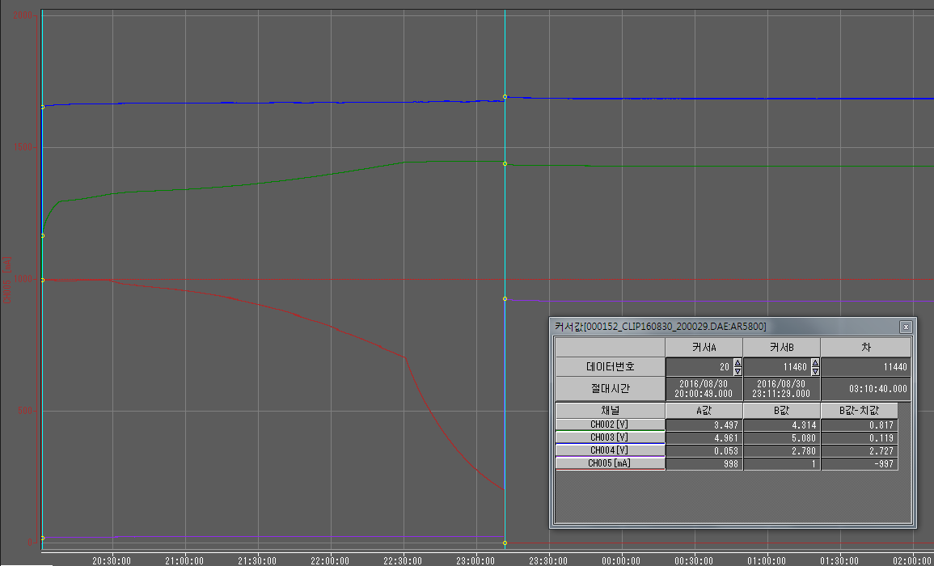
3. BQ24095 Issue
1A charging Test on EVM board.
Cursor A
Cursor B
TA output voltage
Battery voltage
TA output current
Battery FET_EN

Slide 7
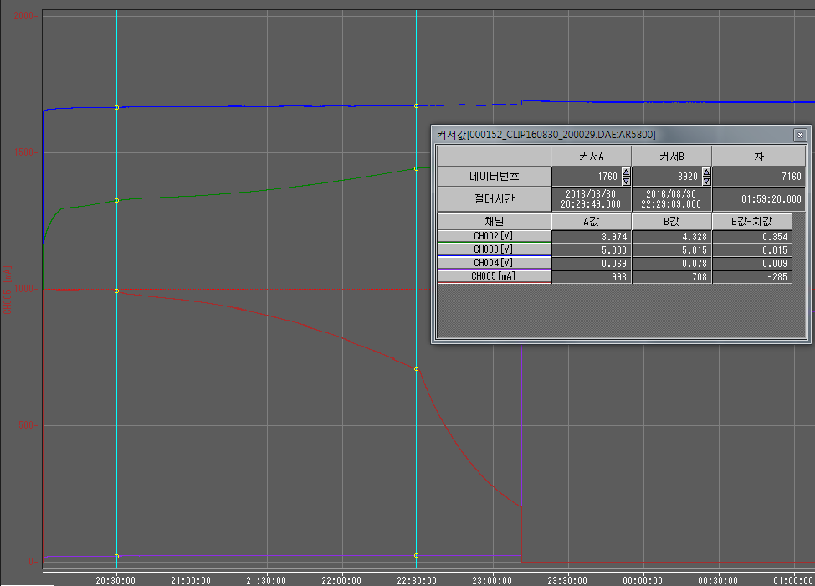
3. BQ24095 Issue
Cursor A
Cursor B
TA output voltage
Battery voltage
TA output current
Battery FET_EN
In CC mode, Current decreased from 3.97V. (Cursor A)
About 700mA decreased until entering CV Mode after ISET Mode. (Cursor B)

Slide 8
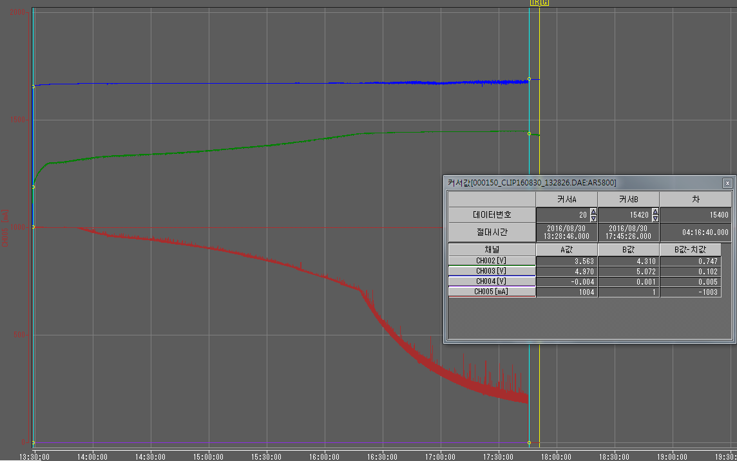
3. BQ24095 Issue
1A charging Test with AR5800(customer board) connect to EVM board
커서A
커서B
TA output voltage
Battery voltage
TA output current

Slide 9
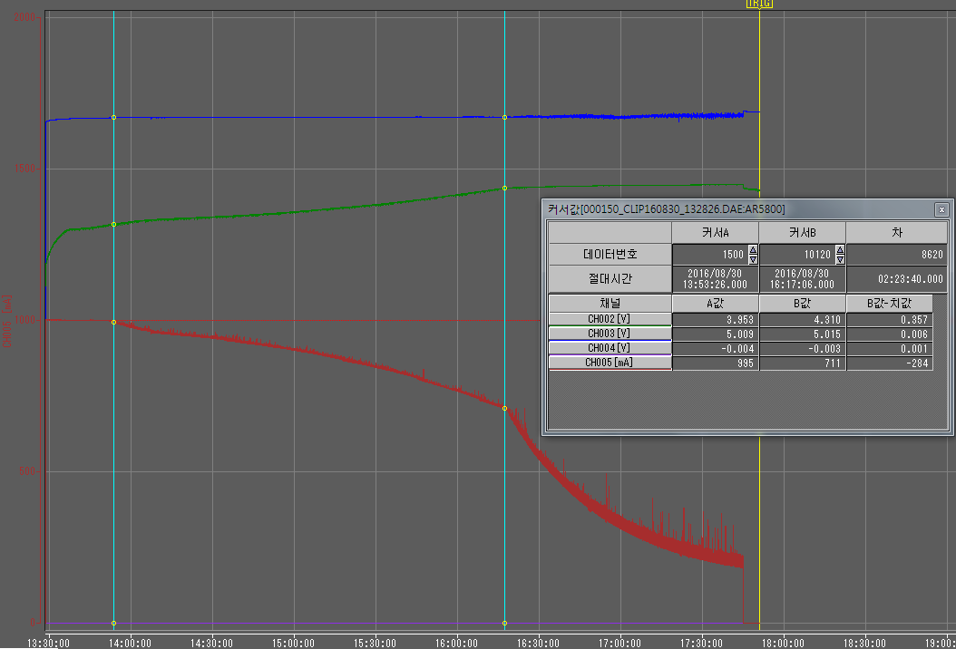
3. BQ24095 Issue 확인
커서A
커서B
TA output voltage
Battery voltage
TA output current
In CC mode, Current decreased from 3.95V. (Cursor A)
About 700mA decreased until entering CV Mode after ISET Mode. (Cursor B)

