Slide 1
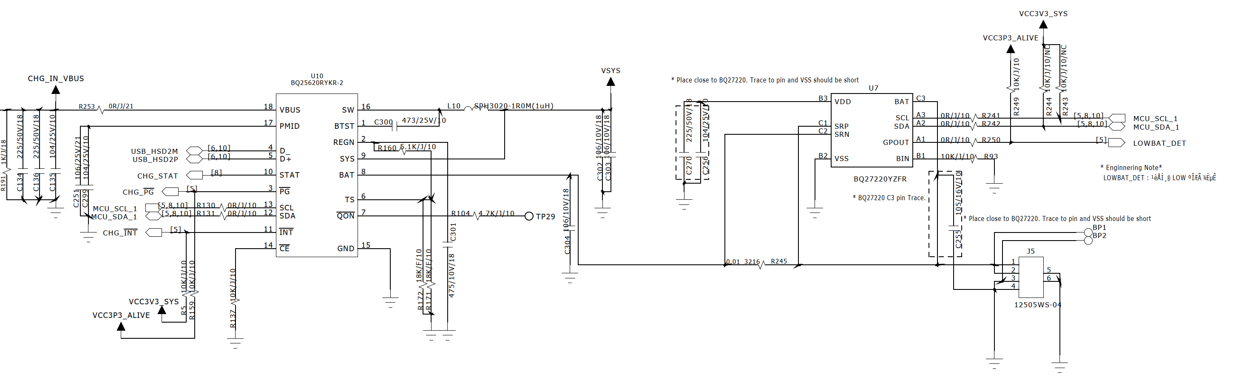
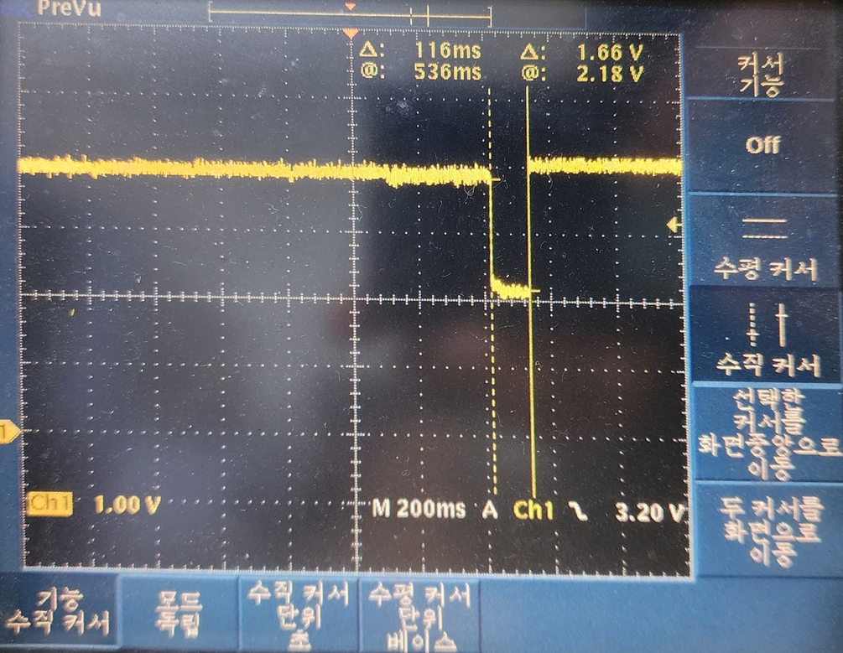
System load(VSYS) -> 0.5~1A
About 30sec~5min, VSYS falls to low about 120ms.
Battery
=4.35V/3,300mAh
CH1 SYS Waveform
(BAT pin remains high.)
A-B-A Swap test is done.
(only the ICs which top marking is BQ25620 have this problem.)
System load current is 0.5A ~1A. (typical 700mA)
Falling duration is about 120ms.
The time from bootup to failure is shorter if I2C communication happens more often.

Slide 2
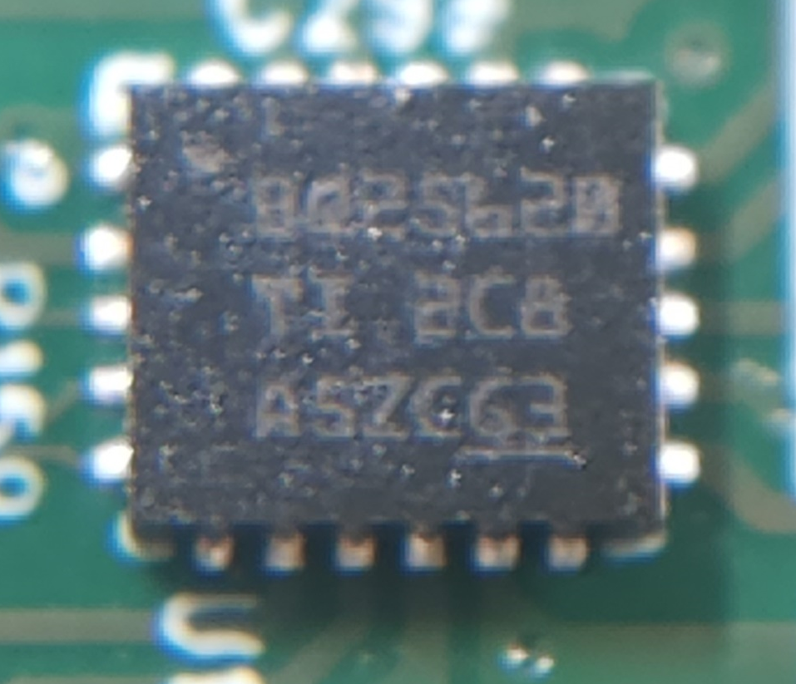
Top marking of IC which supplied by Arrow Electronics

Slide 3
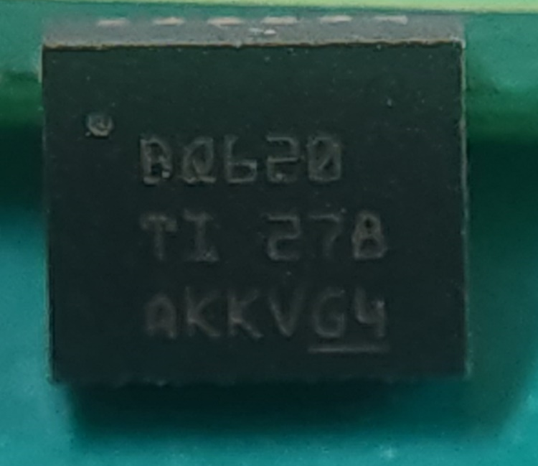
Top marking of IC which supplied by Digi-key

