Slide 1
BQ25895M_Question
Jun/03, 2016

Slide 2
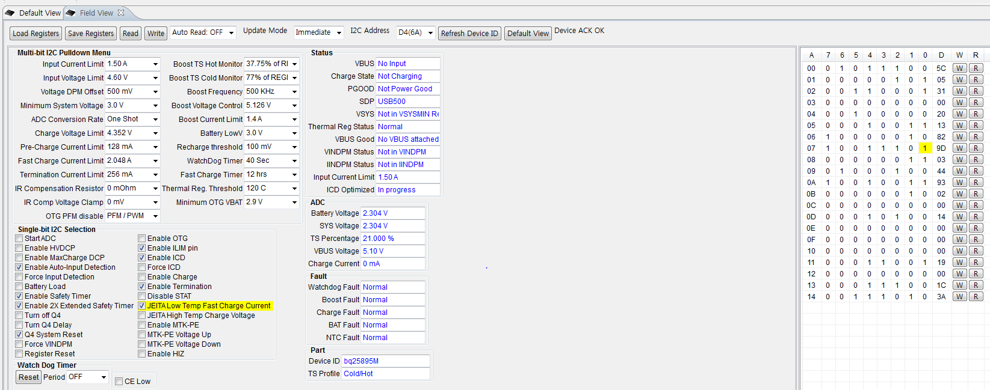
Q1>REG07,bit0
REG07: 9D(default)
REG07,bit0 is 1,JEITA Low temp fast change current.
Customer want to change bit0(1or0) and is this available change value?

Slide 3
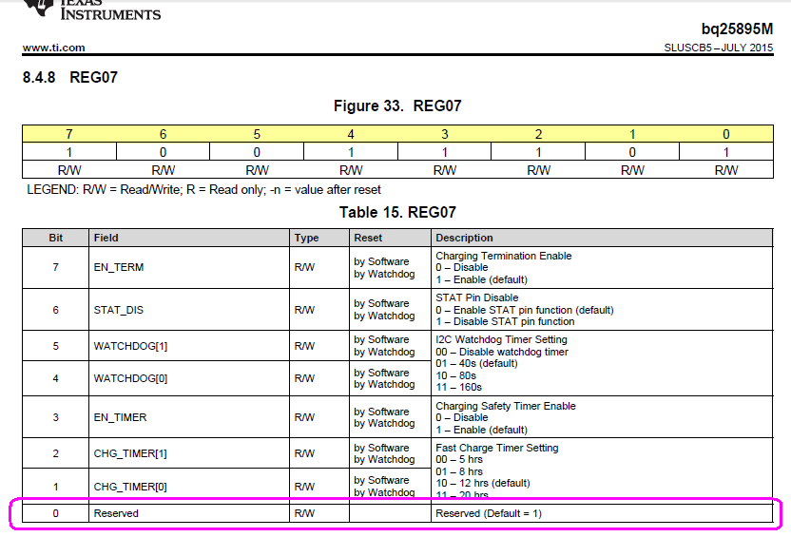
Q1>REG07,bit0

Slide 4
Q2>Battery Leakage current
TA ( Eject) + Battery (insert) ➔ Battery Operating
System Power ON state (SYSTEM ON ) → System Power OFF state (SYSTEM OFF)
System OFF+Battery connection Current consumption : about 2.4~2.5mA@4V battery leakage
Battery discharge : Boost mode is 3mA current flow.
Customer using 3000mAh,battery and product inside Battery connected and Boost mode at power On.
Maybe, after 1000hr is not work for battery and this is weak point.
Is this more improving method?

Slide 5
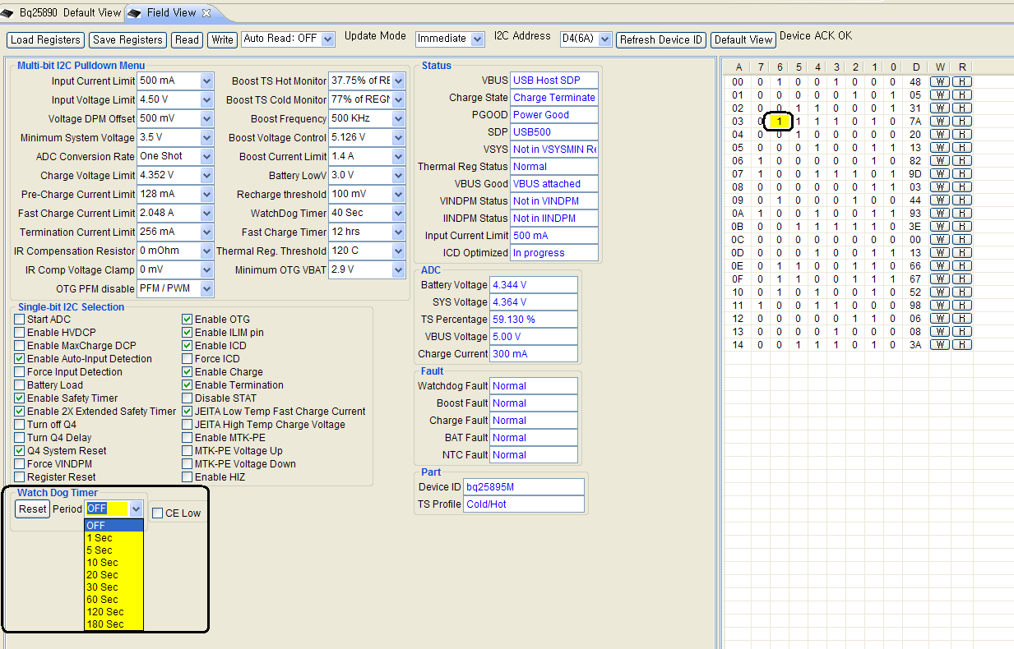
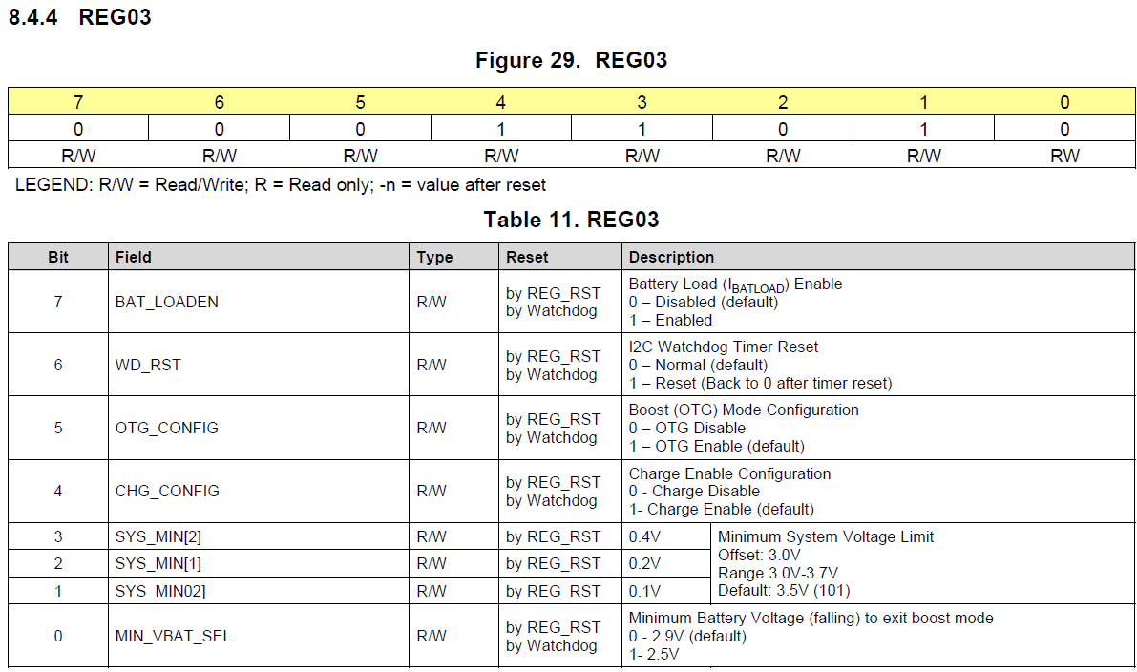
Q3>REG03 & REG07
REG03,I2C Watch Dog Timer reset & REG07,I2C Watch dog Timer setting
Please easy explanation of REG03&REG07 different point or function.

Slide 6
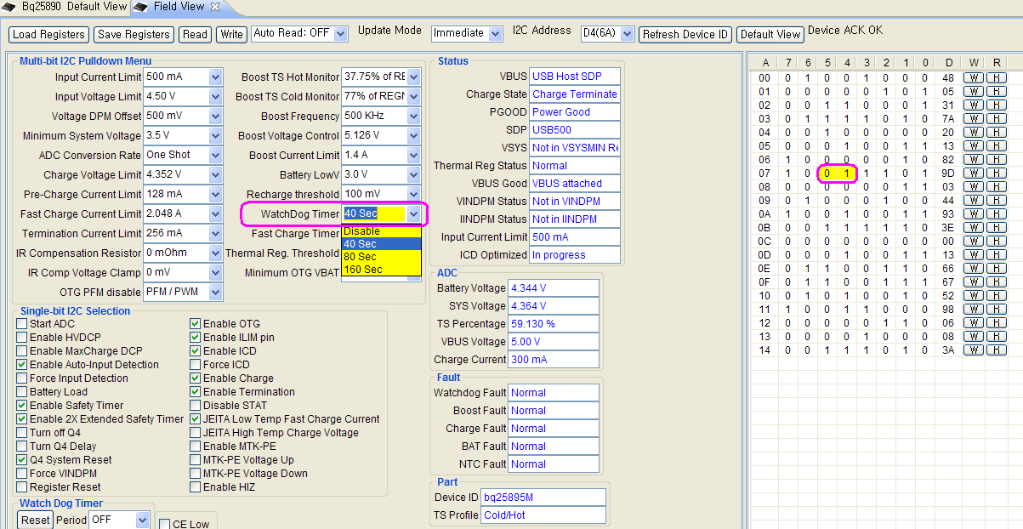
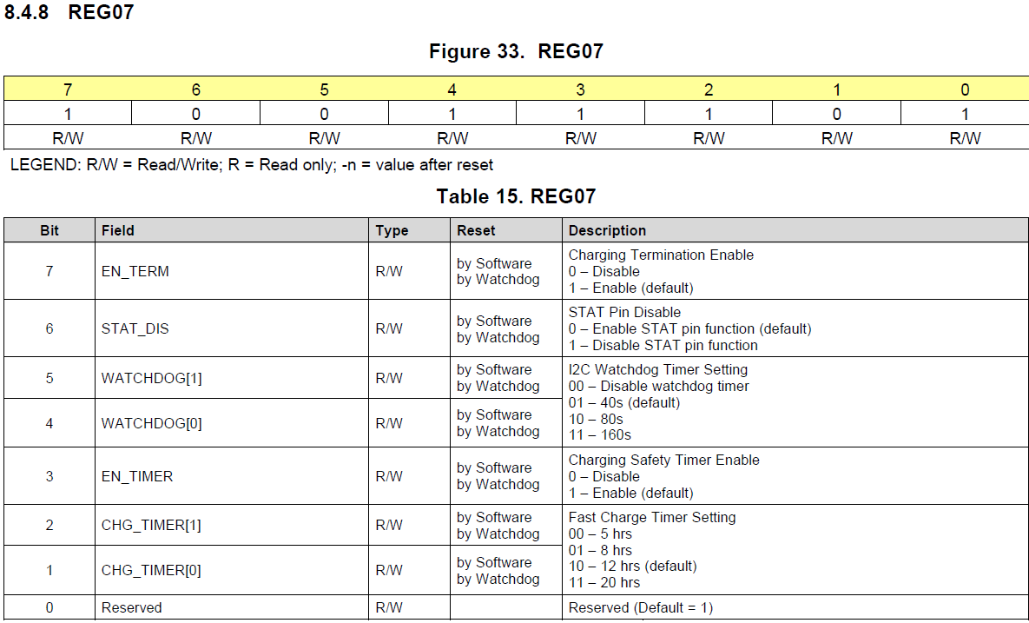
Q3>REG03 & REG07

Slide 7
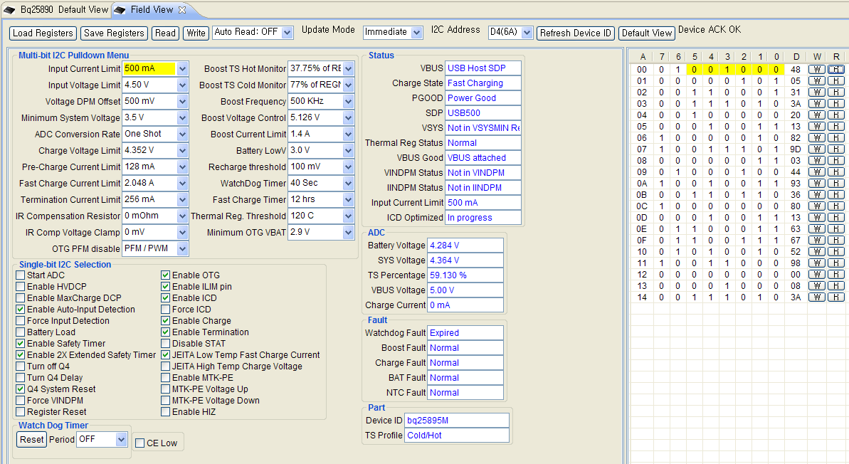
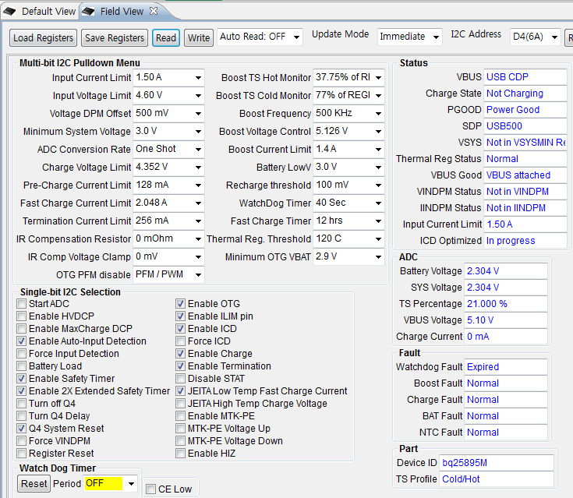
Q4>REG0B : usb2.0&3.0 detection
Customer Notebook : Sony,Vaio,41411p(model) is VBUS showed USBHost SDP and USB3.0&USB2.0.
But I checked other notebook is USB CDP at Lenovo or Samsung notebook.
Please send me your opinion about below issue.

Slide 8
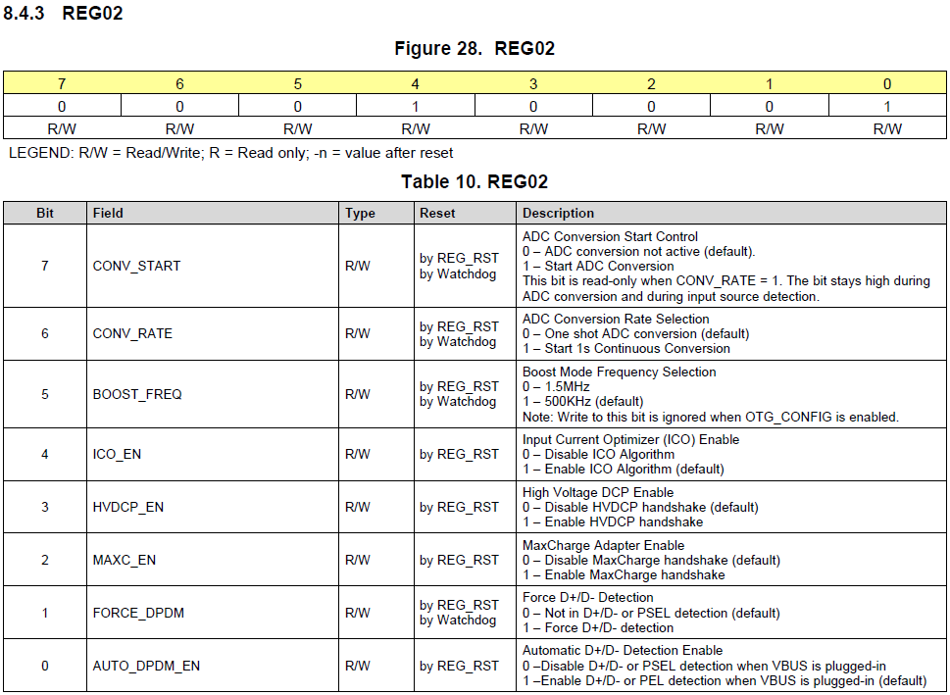
Q5>REG02,ADC conversion rate
REG02,bit7,bit6 : 0(default), ADC conversion not active. 0(default).One shot ADC conversion.
Please send me easy explanation this function.

Slide 9
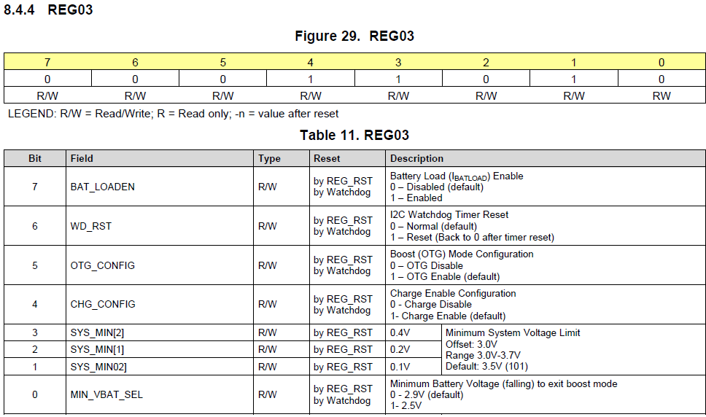
Q6>REG03 : Battery Load
REG03,bit7: 0(default)
I wondering Battery load Enable function. Actually battery is not connected something load.
Please send me easy explanation of this function.

Slide 10
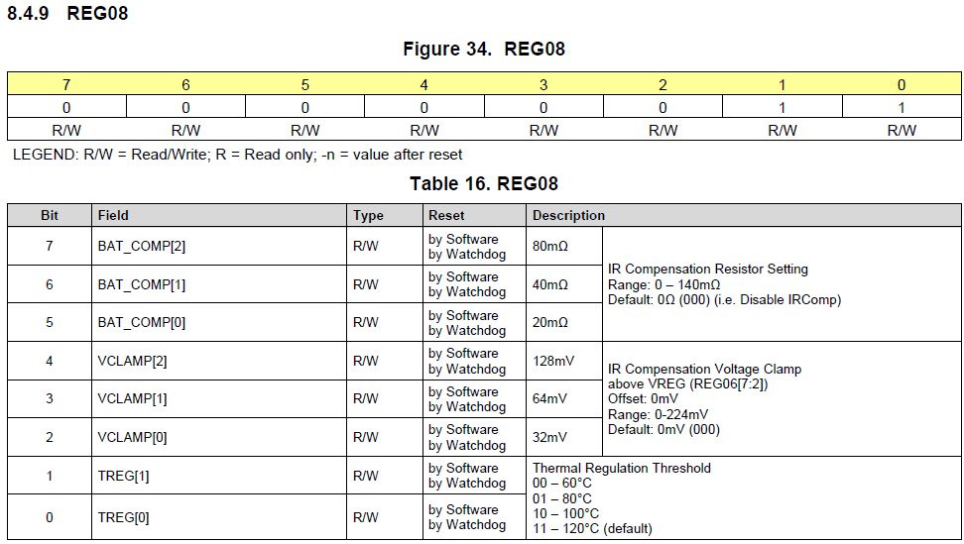
Q7>REG08 : IR Compensation Resistor Setting
REG08,bit7~5,bit1~0: 000(default),11(default)
Maybe this function need battery temperature test at chamber.
Please send me easy explanation of this function.

