Slide 1
Setting parameters

Slide 2
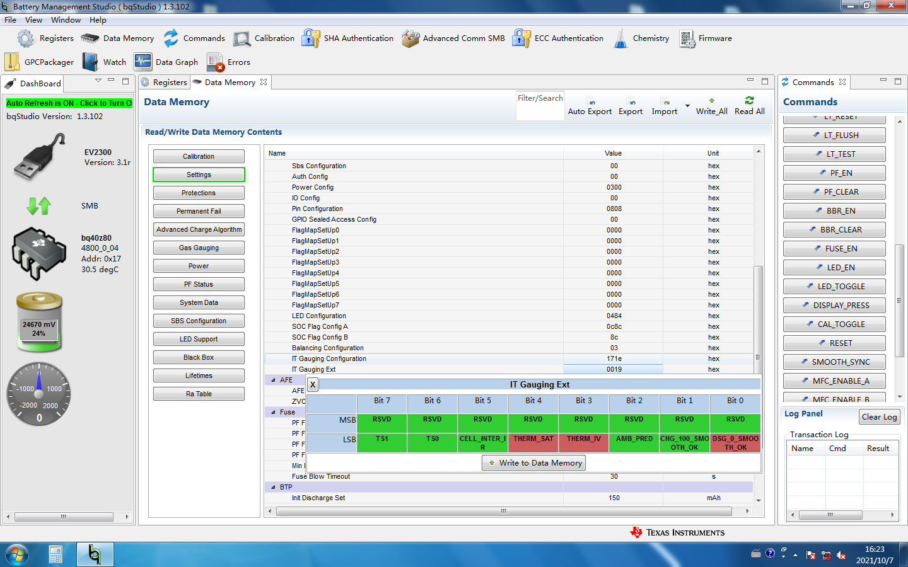

Slide 3
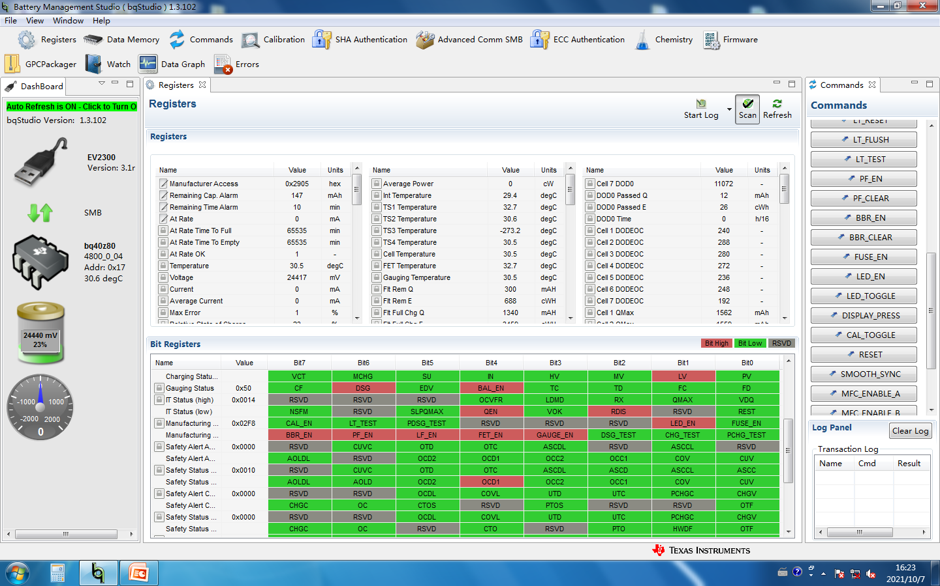

Slide 4


Slide 5
After the OCD1 and OCD2 tests, the SOC began to be abnormally smooth to 0% within 1 minute

Slide 6


Slide 7


Slide 8
