Slide 1
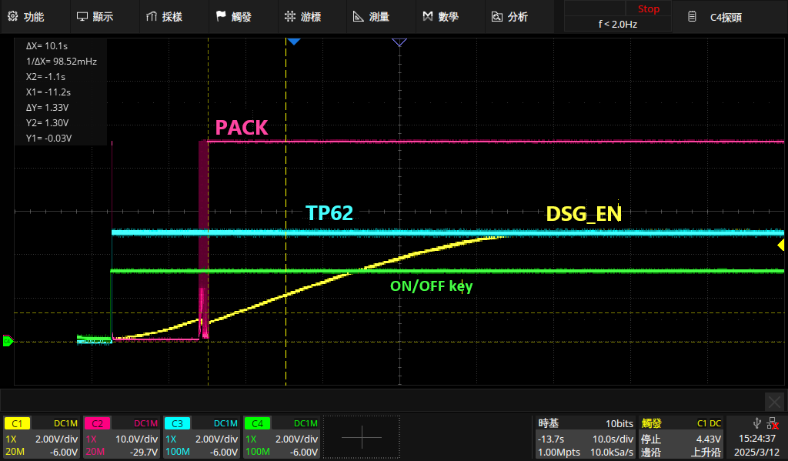
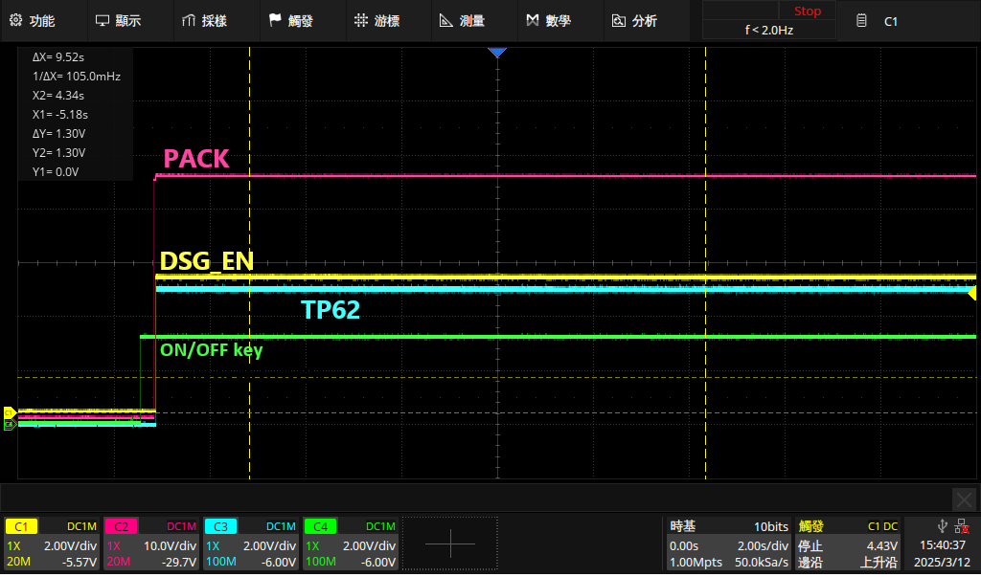
Waveform
Before downloading the program for BQ76952 | After downloading the program for BQ76952
DSG_EN rises slowly, taking 10 seconds from power-on to PACK output. | DSG_EN, PACK, TP26, and ON/OFF Key are activated simultaneously.

Slide 2
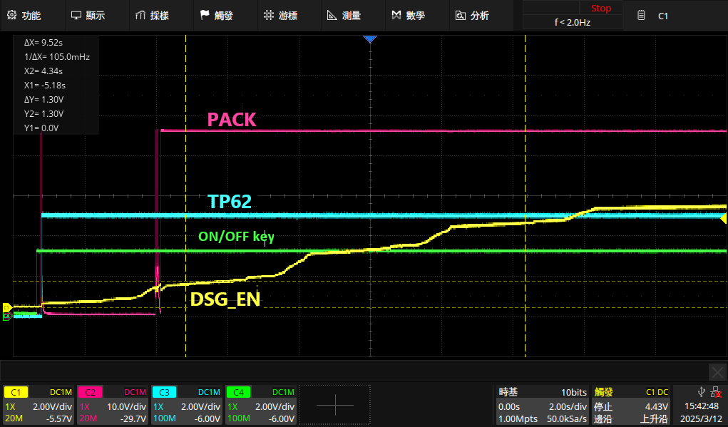
Connect EV2400 without programming.
The ramp-up waveform of DSG_EN is step-like; the time from power-on to PACK output is 2.6 seconds.

Slide 3
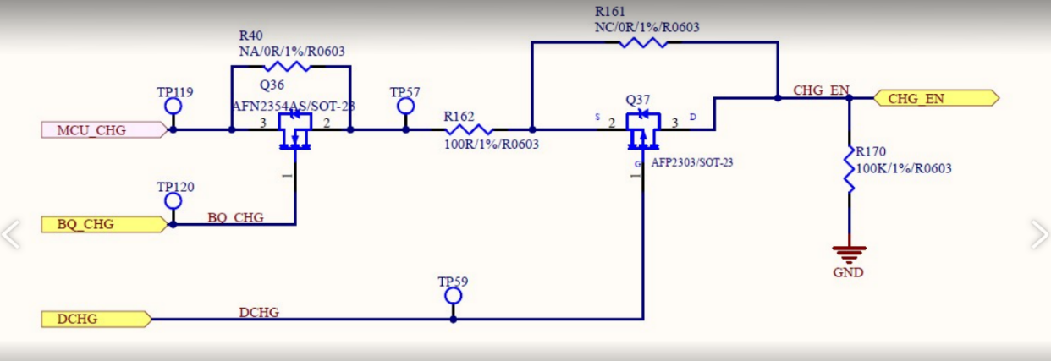
Schematic
7

