Slide 1
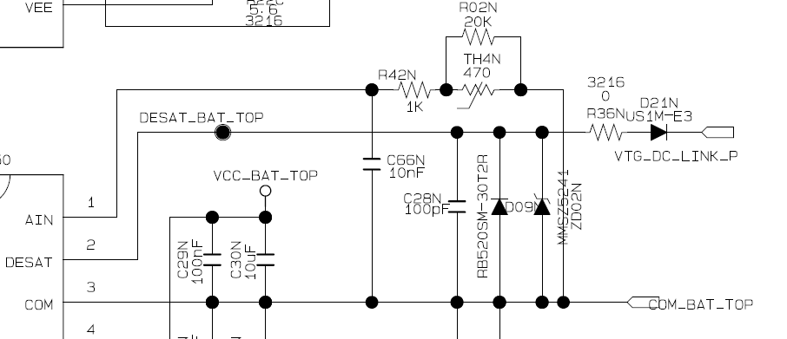
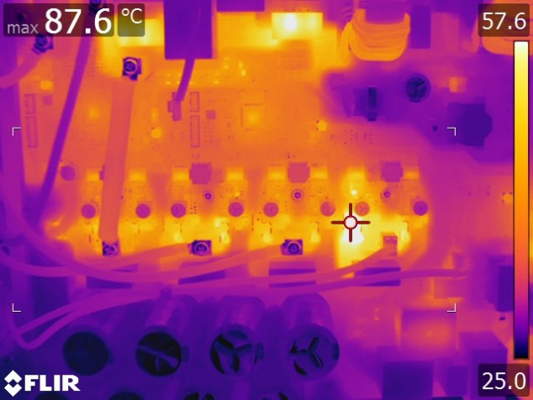
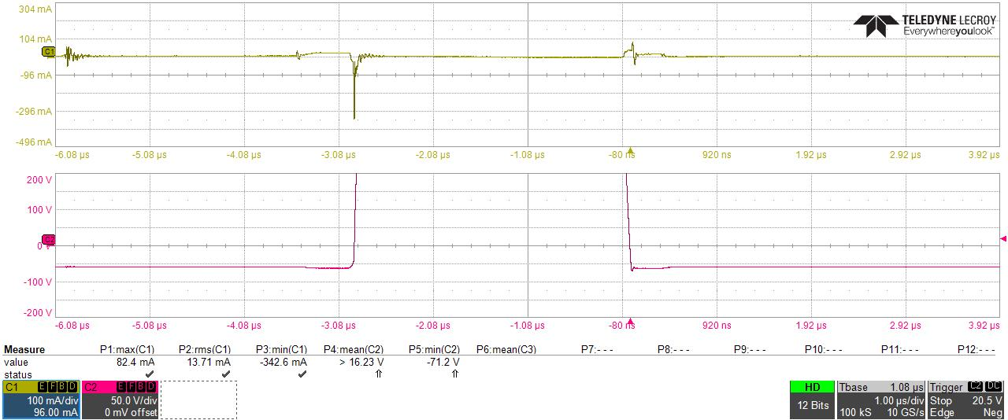
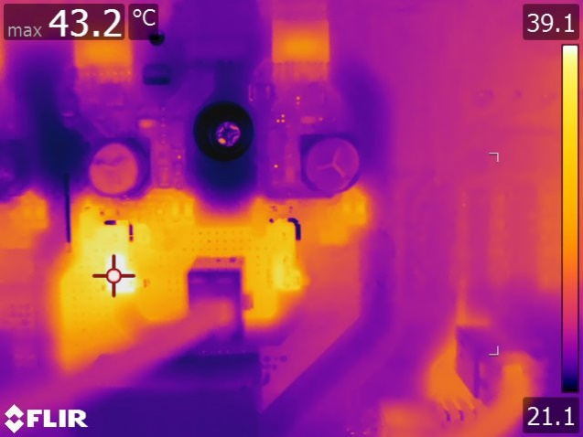
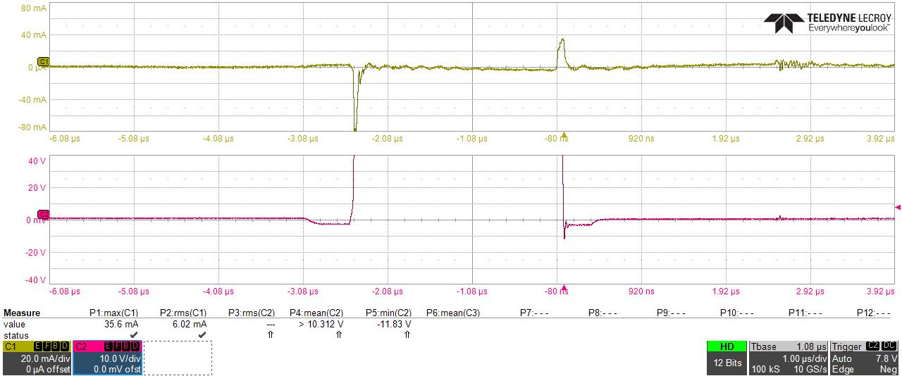
Bat Gate Desat Diode thermal Issue
■ Schematic
- Rlim : R36, HV diode D21N
■ test result
before and after Rlim is removed , 87.6 C vs 43.2 C
■ Current waveform
FET Turn On/Off, Peak current
Desat Resistor : 0ohm
82mA
-342mA
Diode current
D21N
N Top/ Bot
L1 Top/ Bot
FET Vds
Bat TOP FET
Rlim : 0ohm
Desat 저항 : 0ohm 적용
Desat Resistor : 1kohm
35mA
N Top/ Bot
L1 Top/ Bot
Diode Current
D21N
FET Vds
Bat TOP FET
Rlim : 1kohm
Desat 저항 : 1kohm 적용

