Slide 1
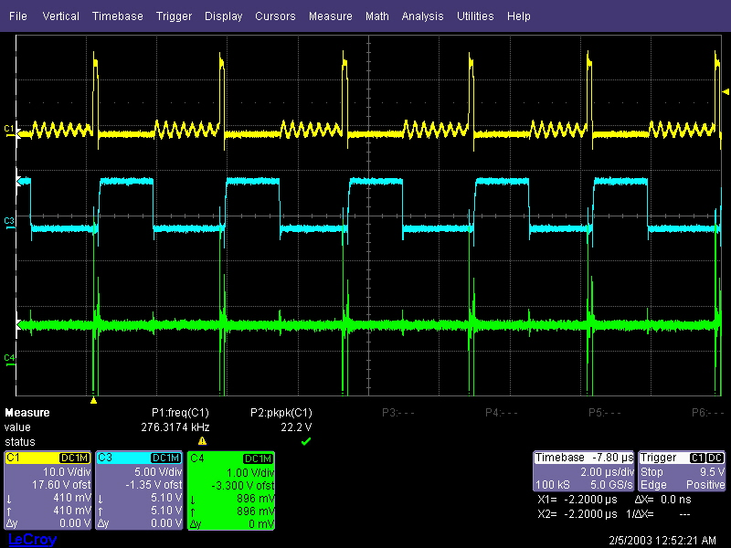
<1. Q6 (CSD87384M)>
Q6_Pin_4/LG
Q6_Pin_1/UG
+VCC_VNN (Vout)

Slide 2
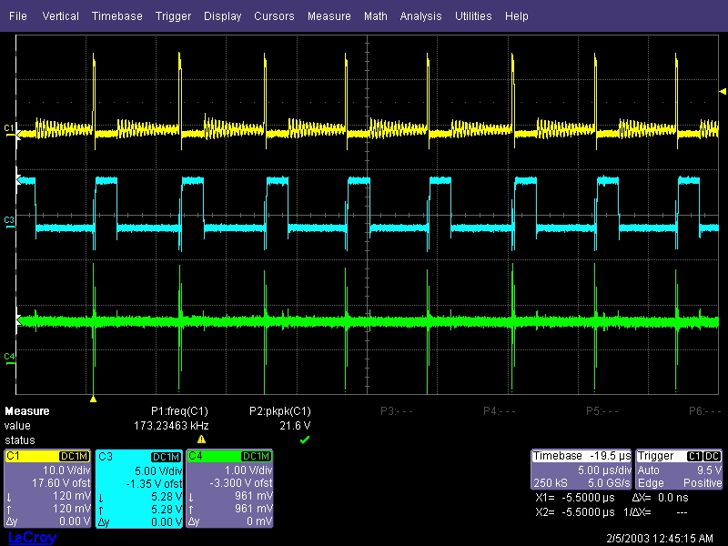
<2. Q3 (CSD87384M)>
Q3_Pin_4/LG
Q3_Pin_1/UG
+VDDQ (Vout)

Slide 3
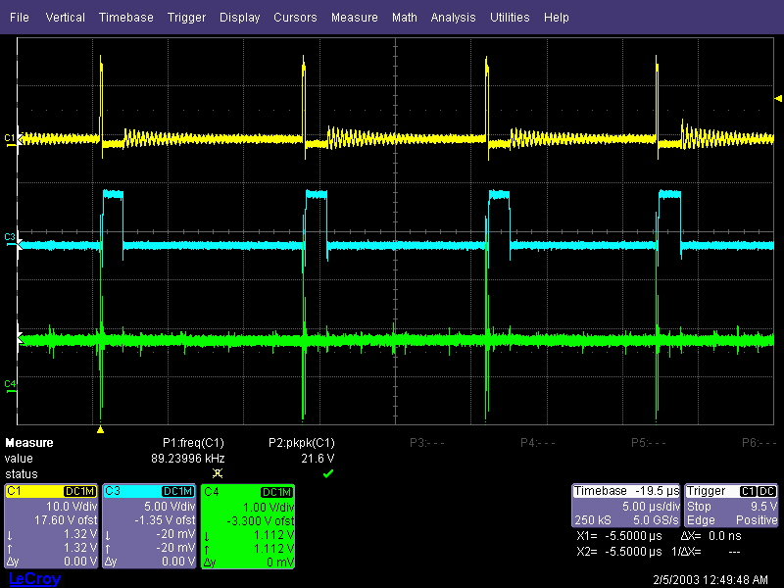
<3. Q9 (CSD87384M)>
Q9_Pin_4/LG
Q9_Pin_1/UG
+VCC_CPU (Vout)

Slide 4
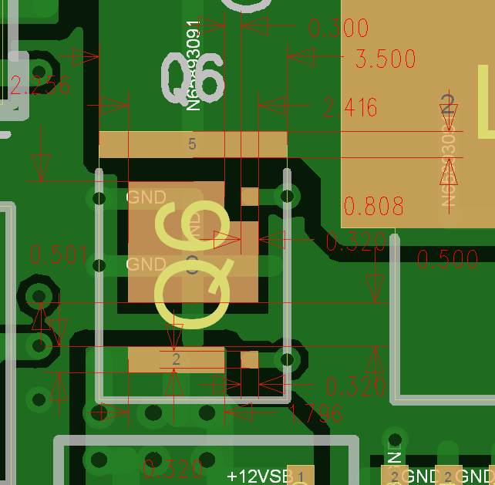
<4. CSD87384M PCB CAD Library Check>

Slide 5
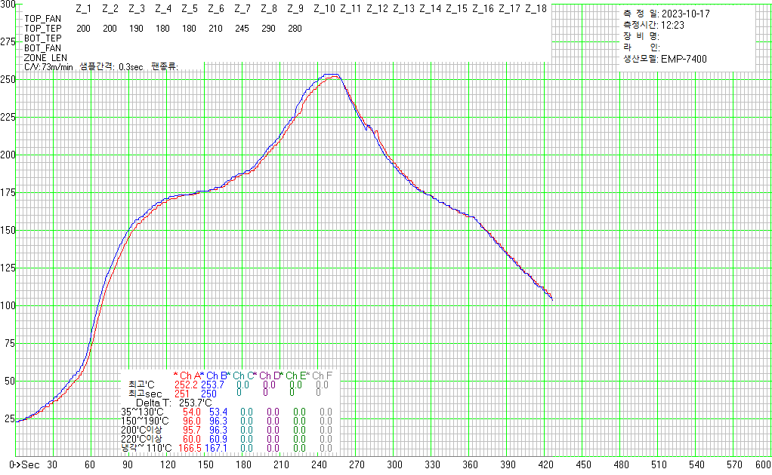
<5. CSD87384M Reflow Temperature profile>

