Slide 1
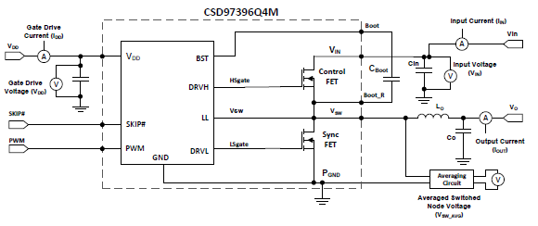
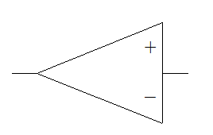
Specification Constant current
Vin=16.8～12.0V
Iout=4A
VDD=5V
Fsw=50～100KHz
Ambient temperature：45℃
Target temperature rise : under 20 degreeC
0.1uF
100uF
220uF
Iout
MCU
33uH
PWM
0.1uF
Load
AD
Rcs

