Slide 1
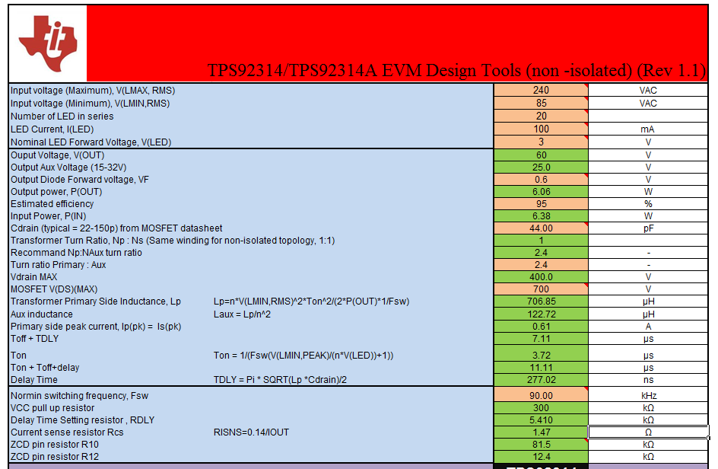
Why RISNS=1.47 ohm? ( RISNS=0.14/IOUT=1.4ohm should be correct?)

