Slide 1
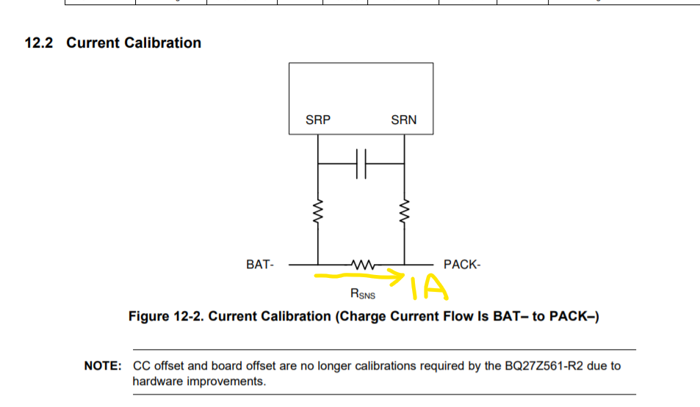
1. To apply 1000mA current flow throught 1mohm sense resistor

Slide 2
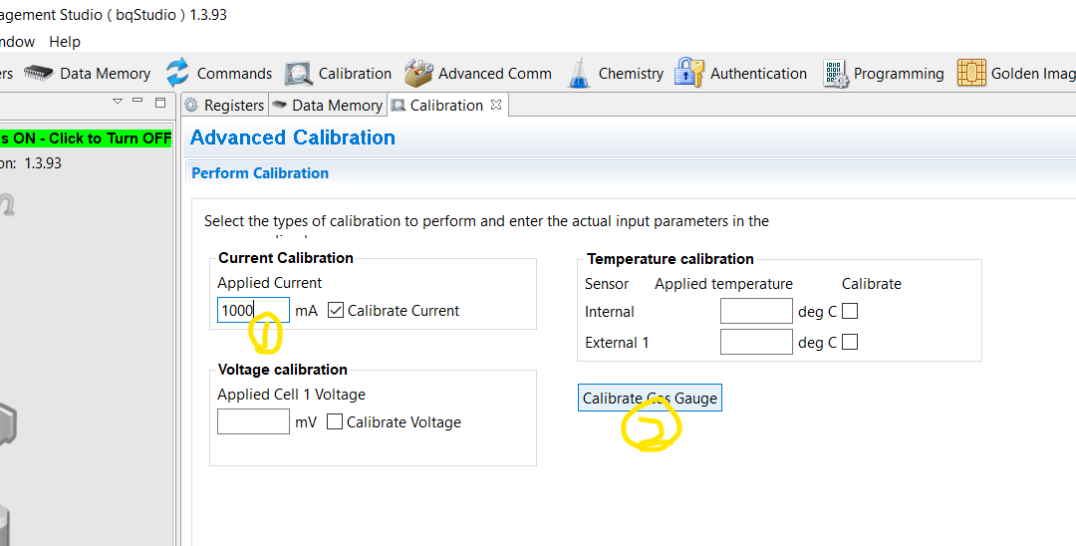
To key in 1000 in current calibration tab
To click “Calibration Gas Gauge” button
Then I can see bqstudio show success

Slide 3
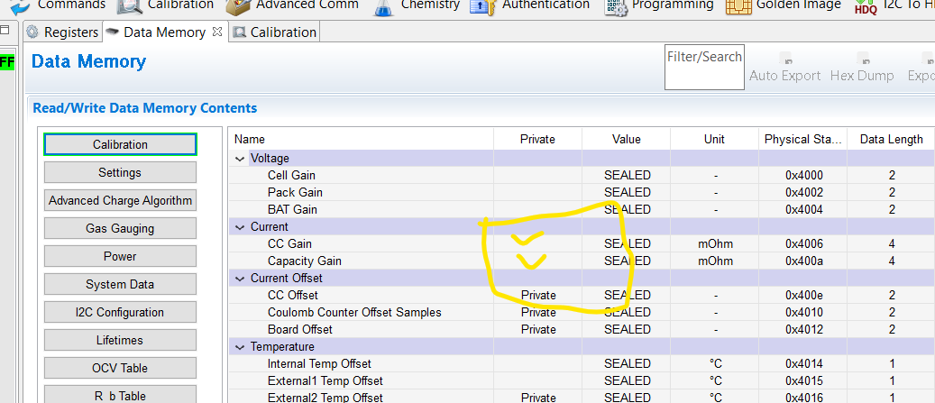
To open Data Memory tab and check Calibration display
Then you can see there are number appeared in CC Gain and Capacity Gain

