Slide 1
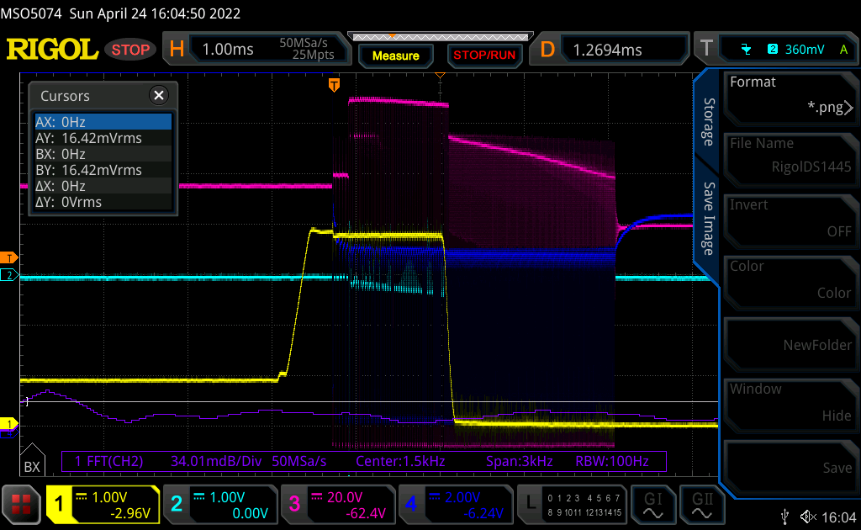
Start Up Failure
AAM
LPM?
Survival Mode?
PC Collector
TransCurrent
HFET Gate
SWS

Slide 2
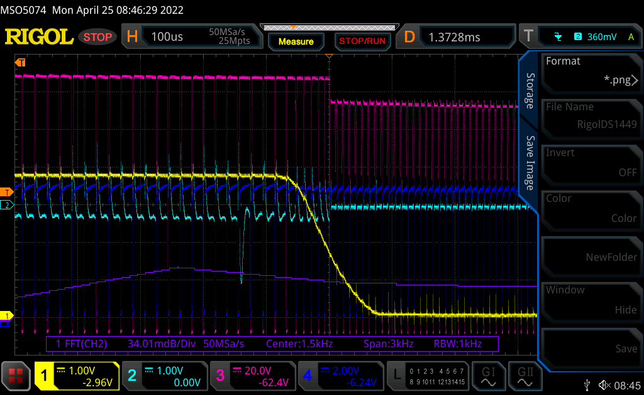
Start Up Failure
AAM
LPM?
Survival Mode?
PC Collector
TransCurrent
HFET Gate
SWS

Slide 3
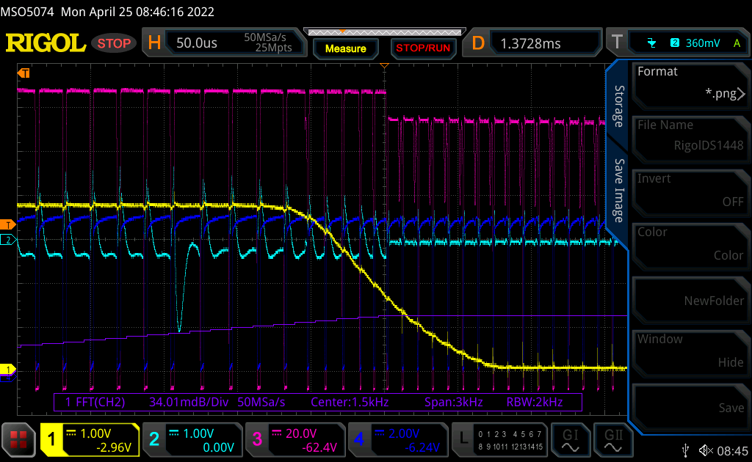
Start Up Failure
AAM
LPM?
Survival Mode?
PC Collector
TransCurrent
HFET Gate
SWS

Slide 4
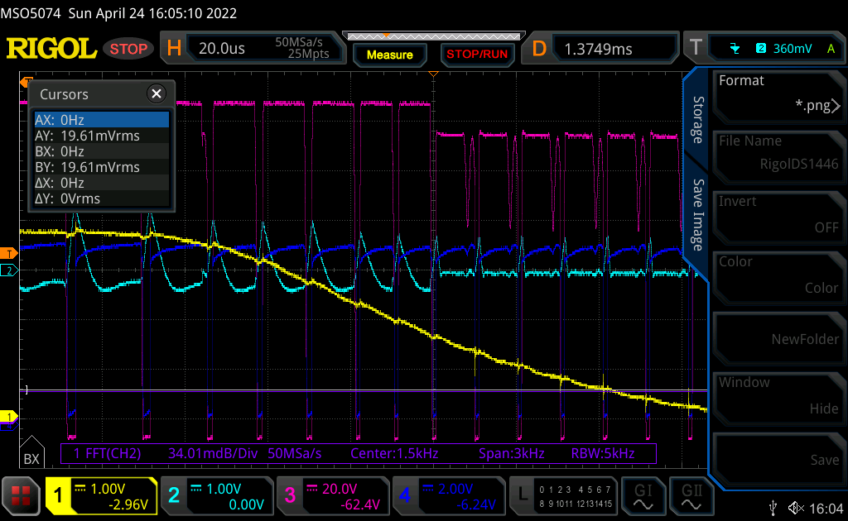
Start Up Failure
AAM
LPM?
Survival Mode?
PC Collector
TransCurrent
HFET Gate
SWS

Slide 5
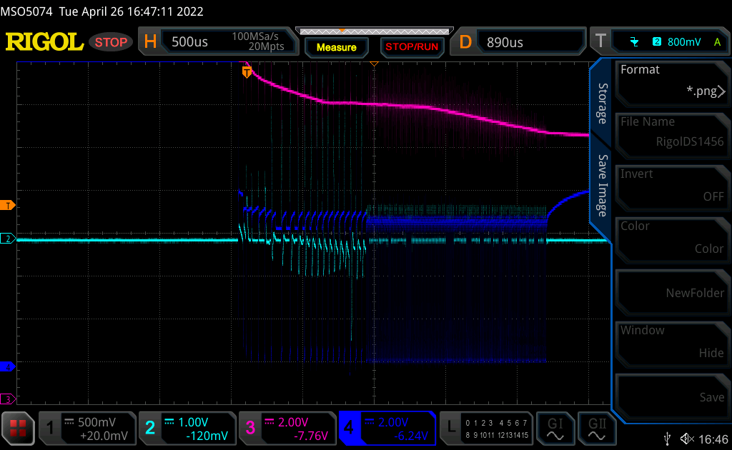
Figure1
LPM?
Survival Mode?
AAM
VDD≒14V
TransCurrent
VDD
SWS

Slide 6
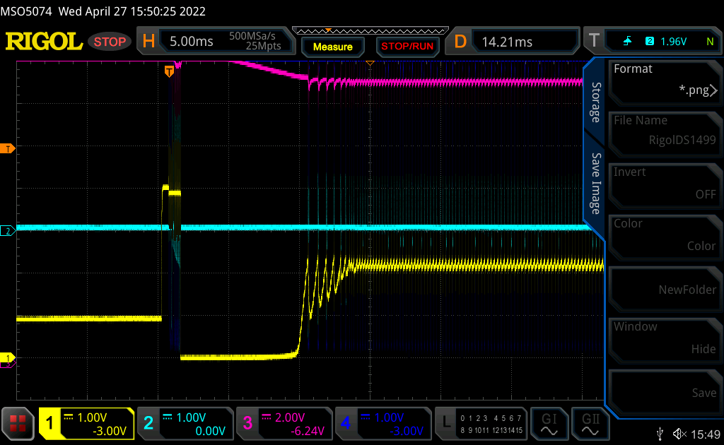
Figure2
PC Collector
TransCurrent
VDD
SWS

Slide 7
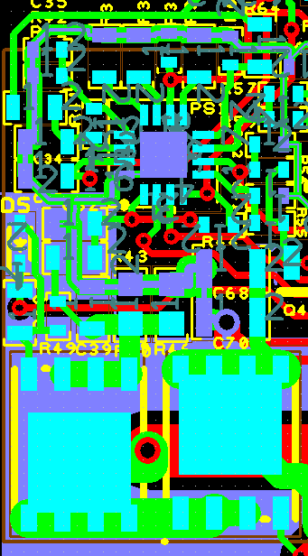
Artwork
CVDD
VS

