Slide 1
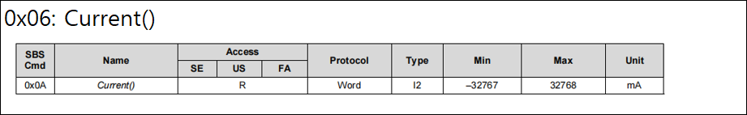
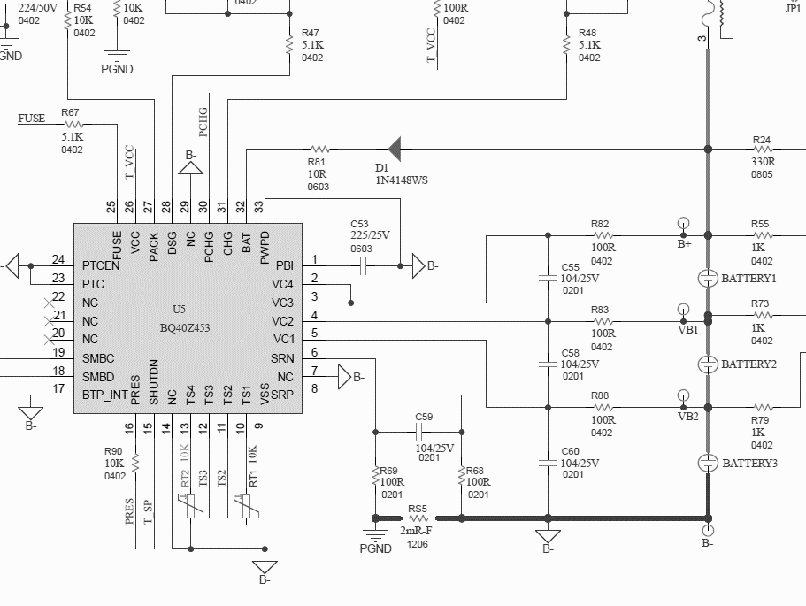
Cell Current issue

Slide 2
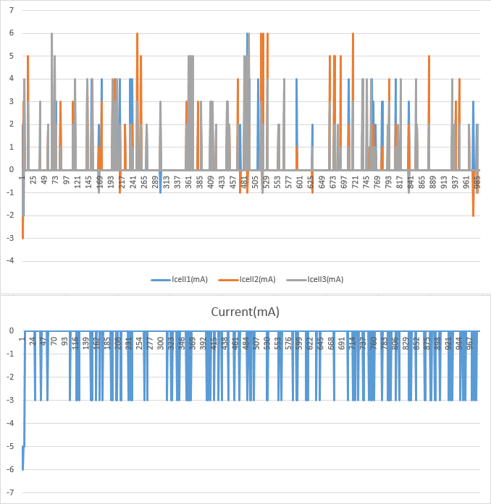
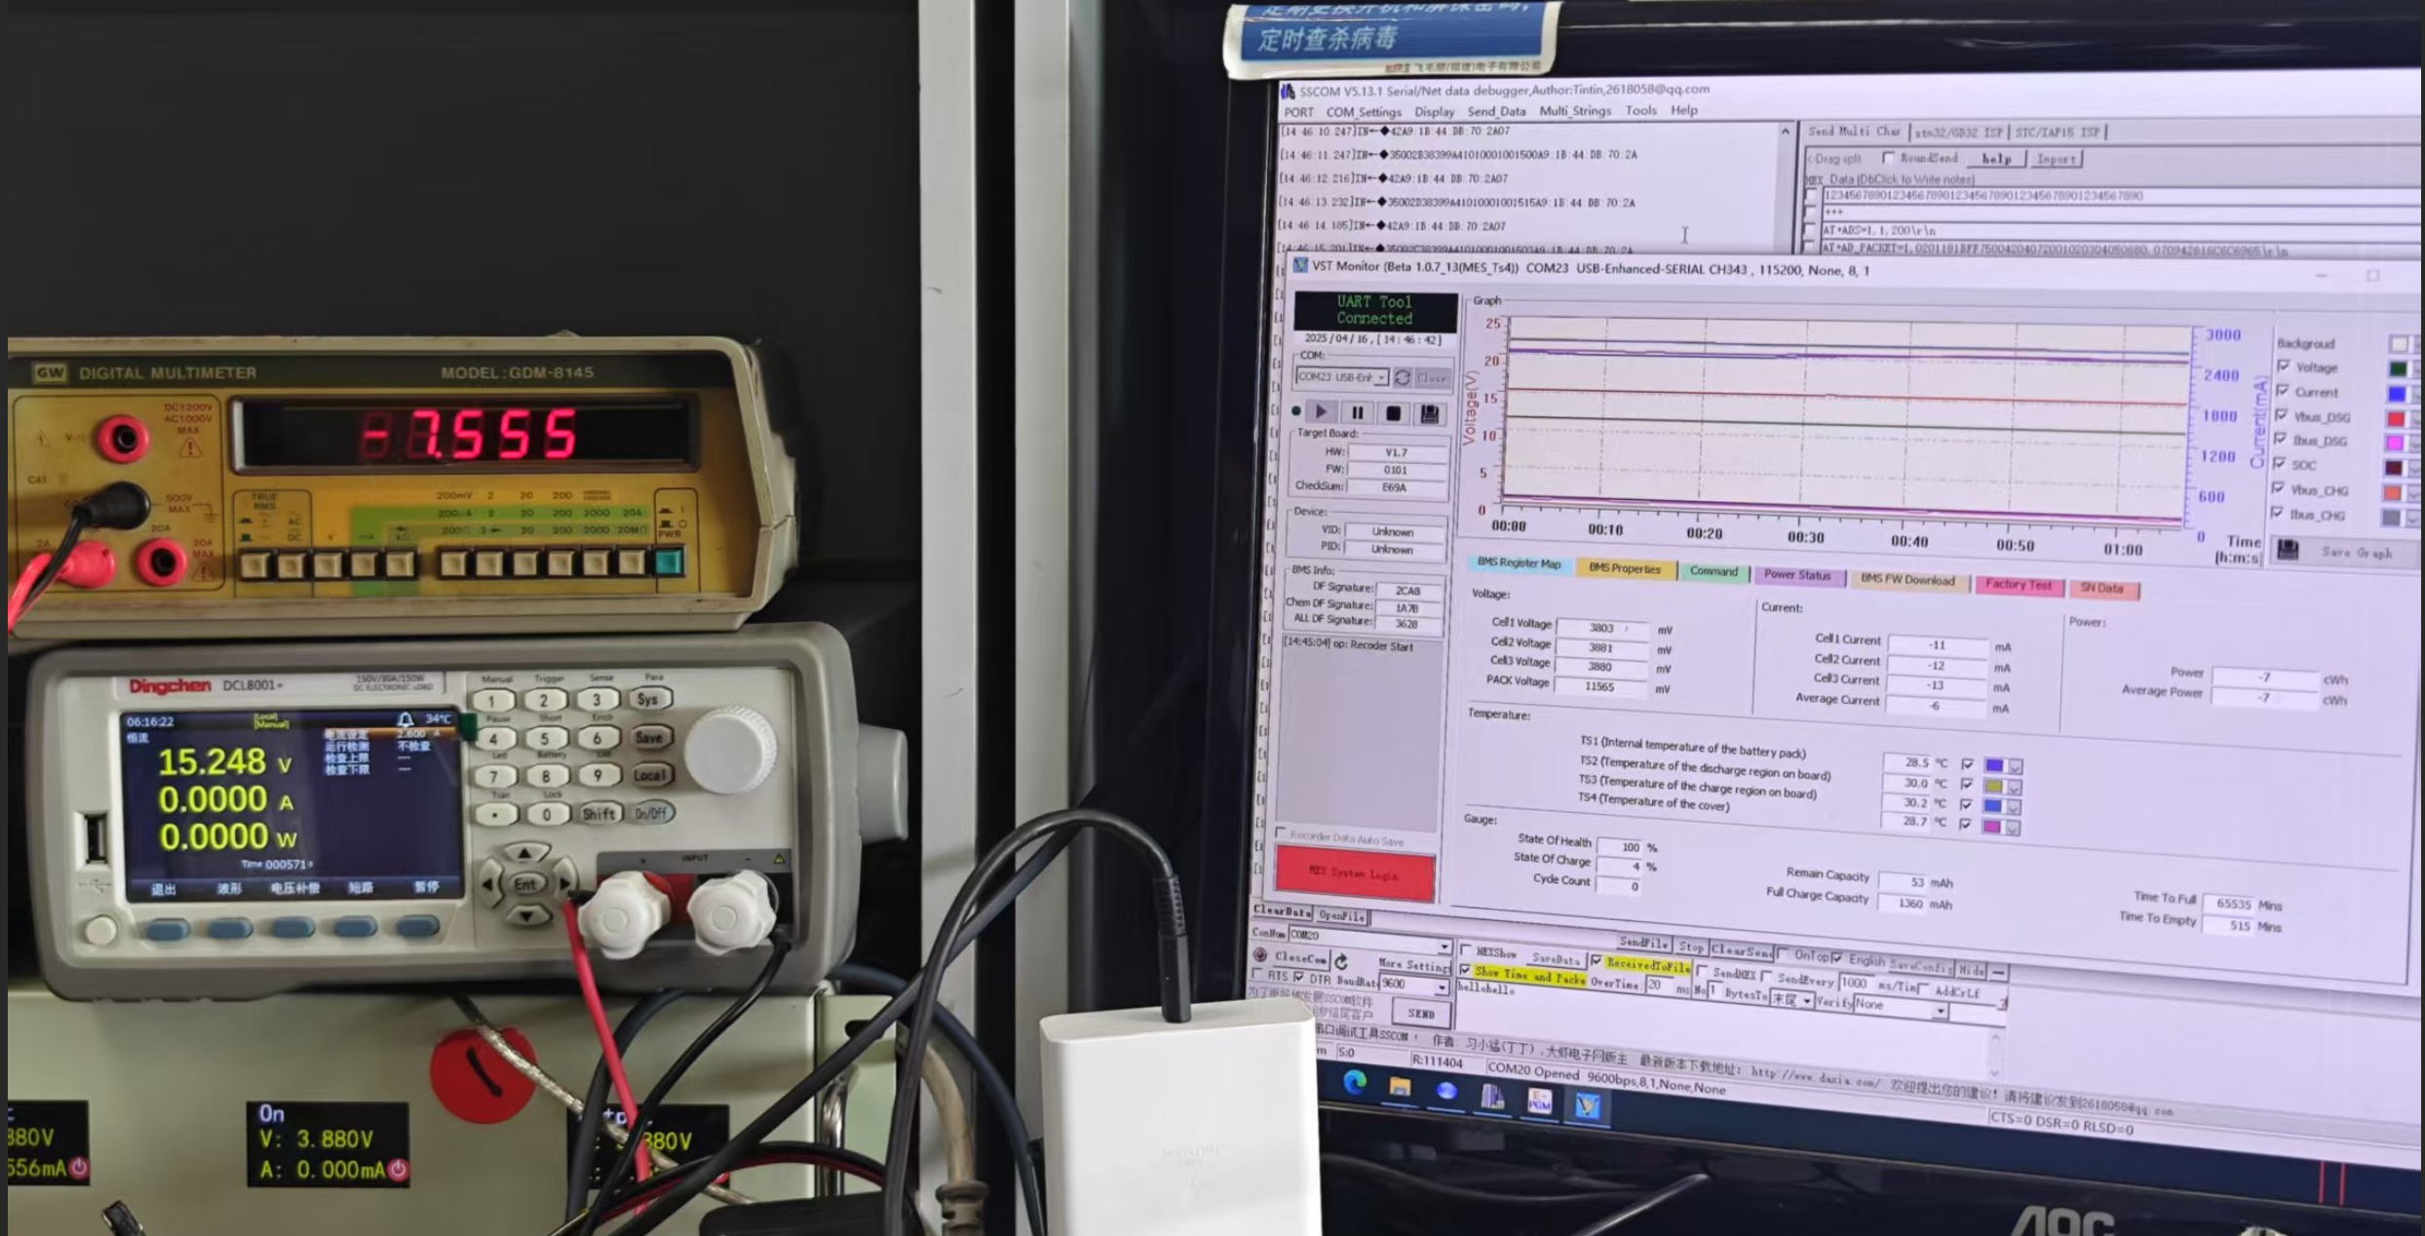
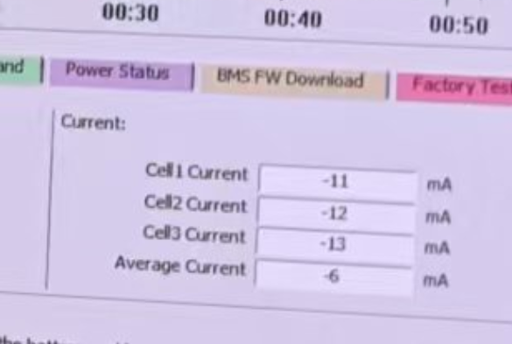
Cell Current issue
Check 1) Cell current 1, 2, 3 or Current
I Cell 1, 2, and 3 are confirmed as positive values
Current value is confirmed as a negative value.
Check 2) : when checked with an ammeter
When the actual cell is connected and communicated to the P3910 Main Board,
power is supplied
Current values are expressed in negative numbers.
measured current value
The notation is average current, but in reality, the current item is read

Slide 3
Cell Current issue
Check 3) : When checking the current (current) value, there are many values of 0 to -6 and -3 mA.
1
2
3
4
5
6
7
8
9

