Slide 1
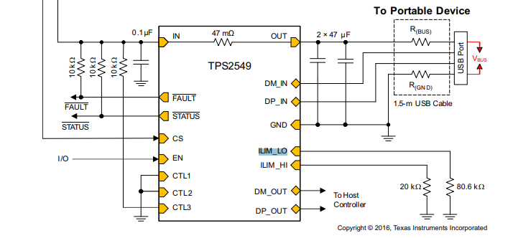
Circuit configuration
Vin
10kohms
open
19.1kohms

