Slide 1
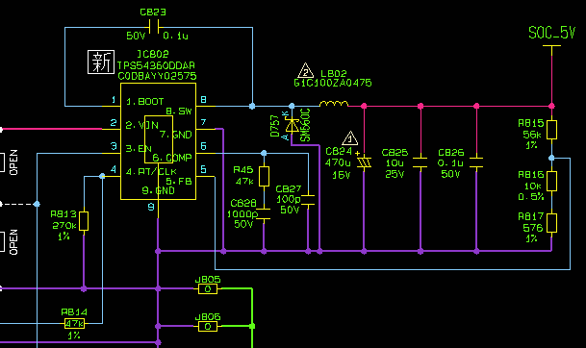
Inductance:10 uH+/-30%
DCR:36 mohms MAX
TPS54540

Slide 2
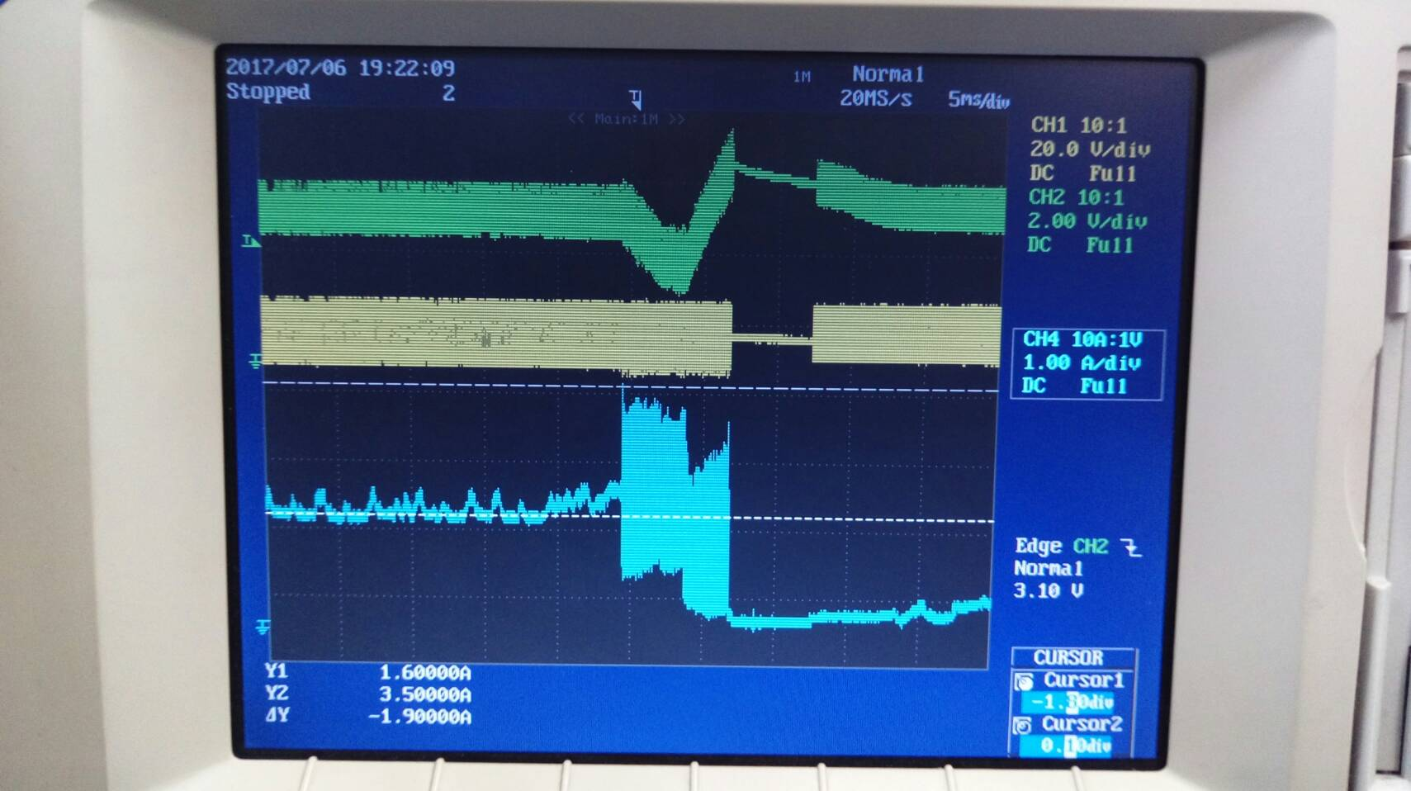
Soc 5V
SW
Iout

Slide 3
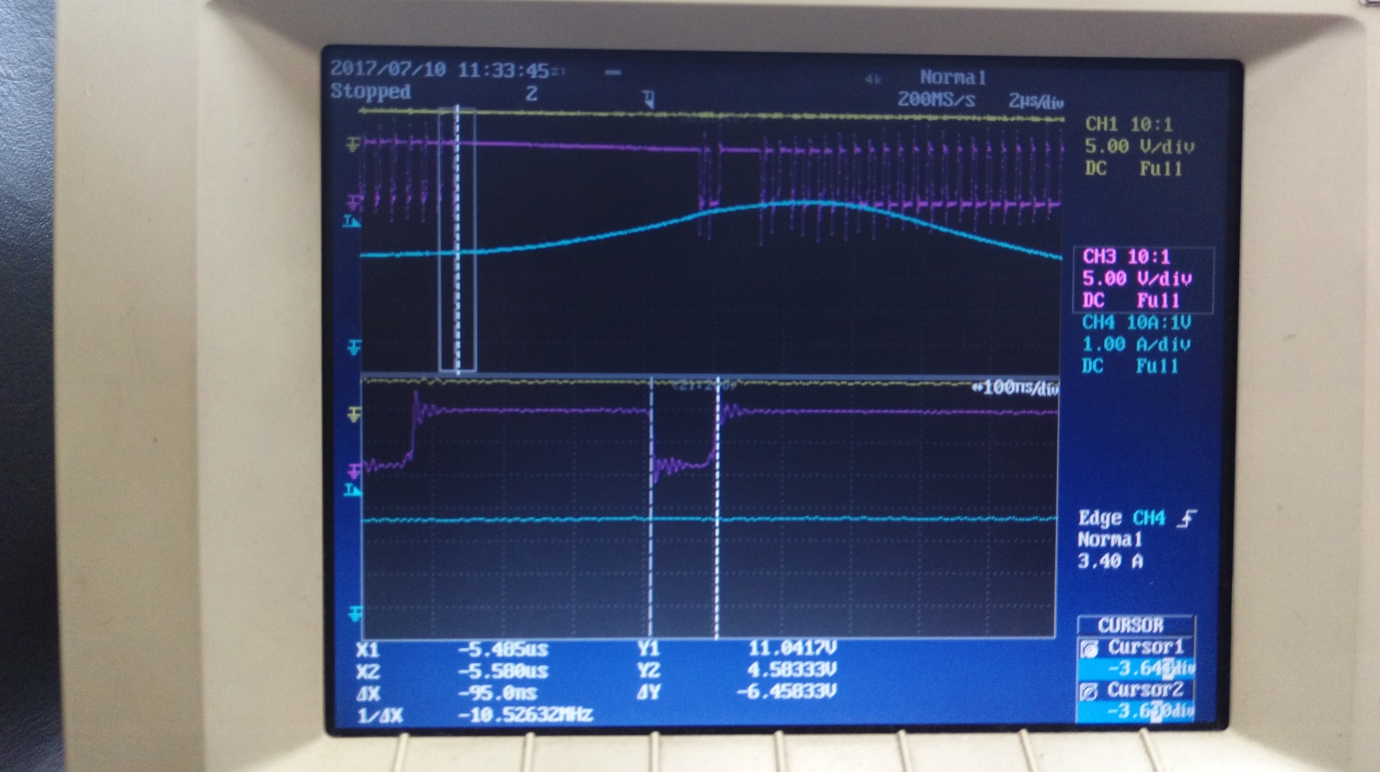
Don’t use
SW
Iout
SW
Iout

