Slide 1
Creating Full DMC FW images

Slide 2
Goal
The Goal of this slide deck is to go over the creation of the full DMC image which contains the firmware for the PD controller and the DMC itself.
The following are the steps for creation of a full DMC image:
Open a new Bull shark TPS65994BG project file
Save the PD firmware as a low region file
Open a new Bull shark DMC project file
Save DMC image and use previous low region files as inputs

Slide 3
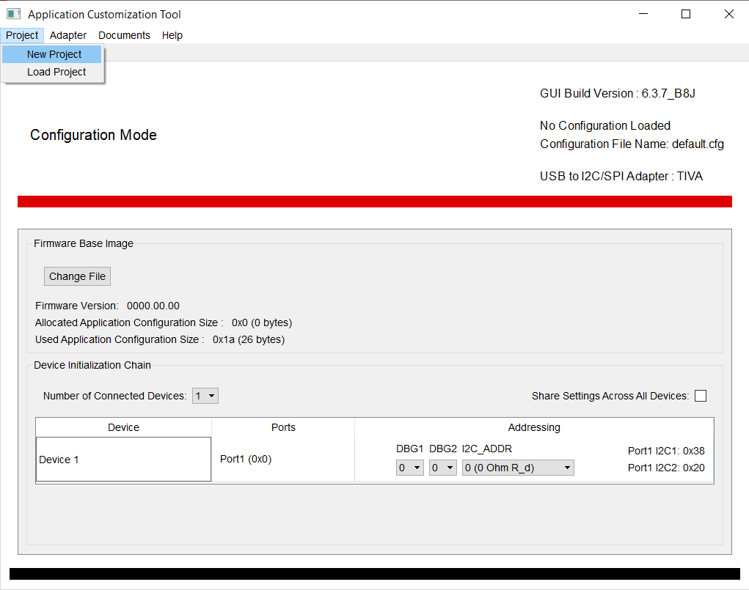
Opening a new PD Project file
Select New project at the top
Right hand corner

Slide 4
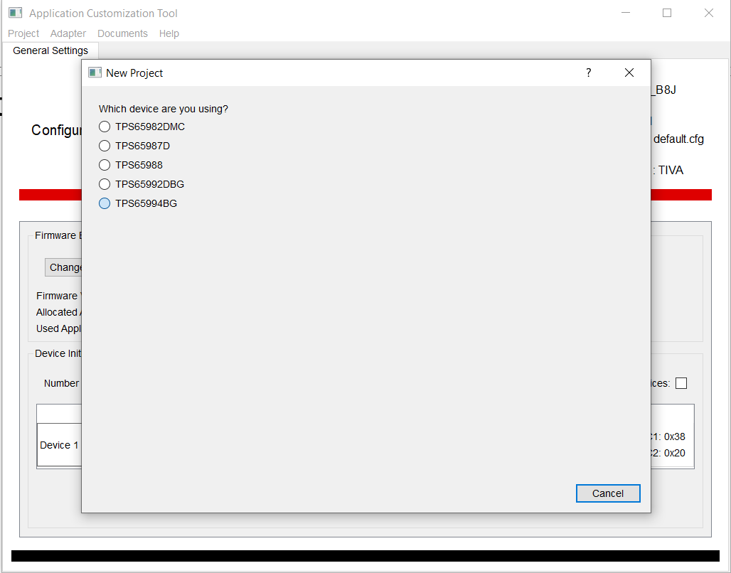
Opening a new PD Project file
Select the TPS65994BG

Slide 5
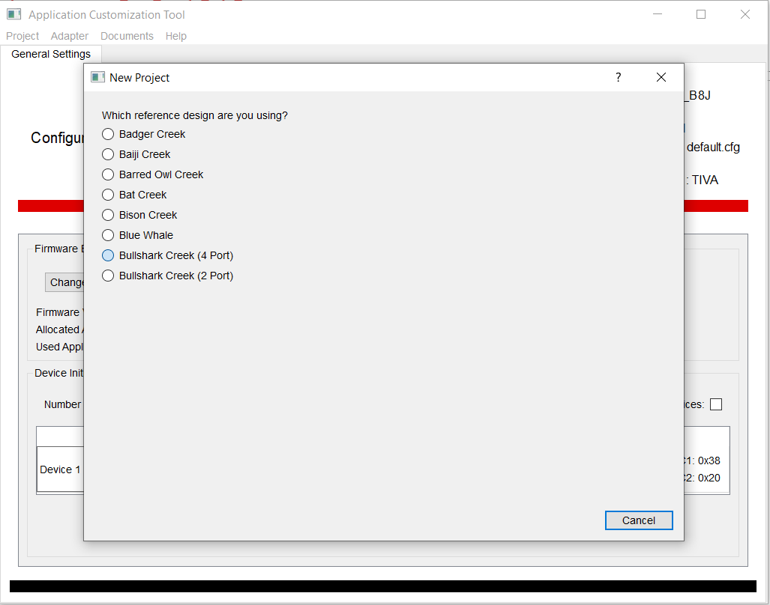
Opening a new PD Project file
Select Bull Shark Creek

Slide 6
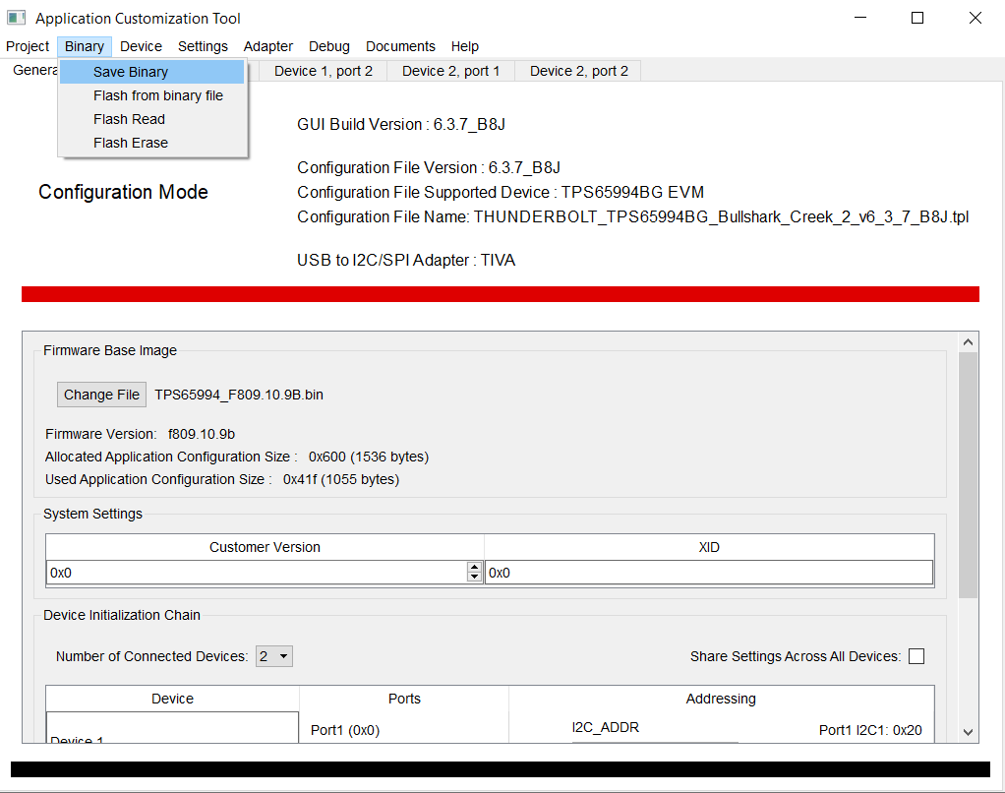
Saving a low region binary
The Project file is configured to work out of the box so save the low region binary

Slide 7
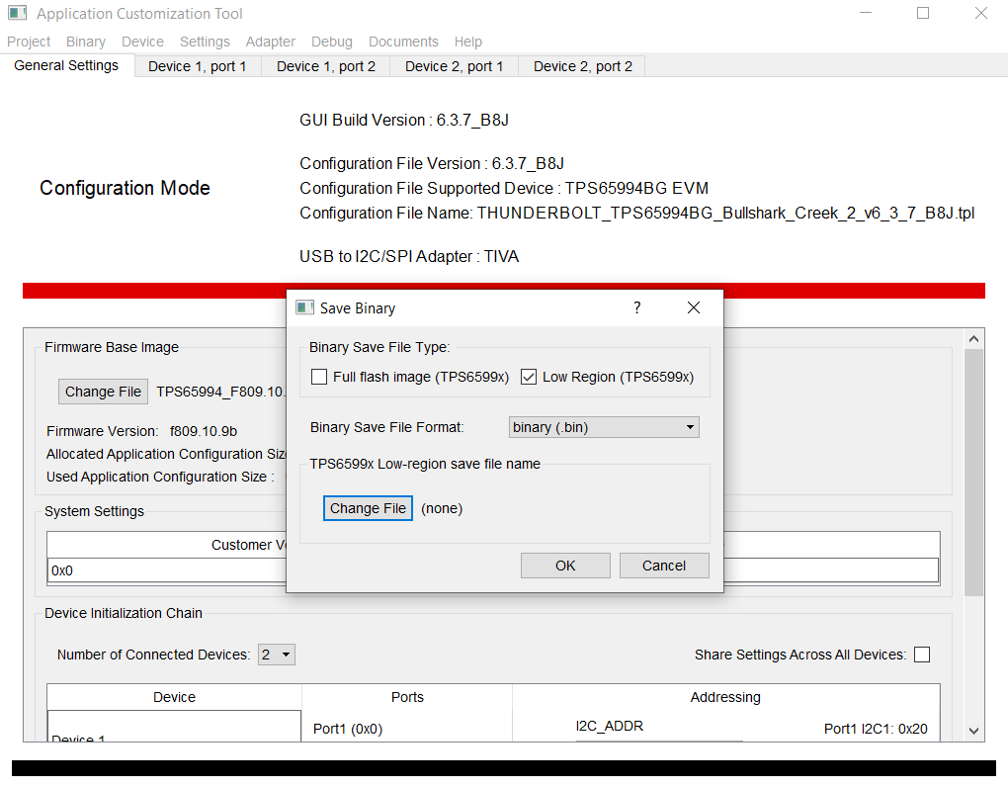
Saving a low region binary
Select low region when saving the binary and name it. This firmware image is a target for flashing the PD from the DMC

Slide 8
Saving a low region binary
The Project file is configured to work out of the box so save the low region binary

Slide 9
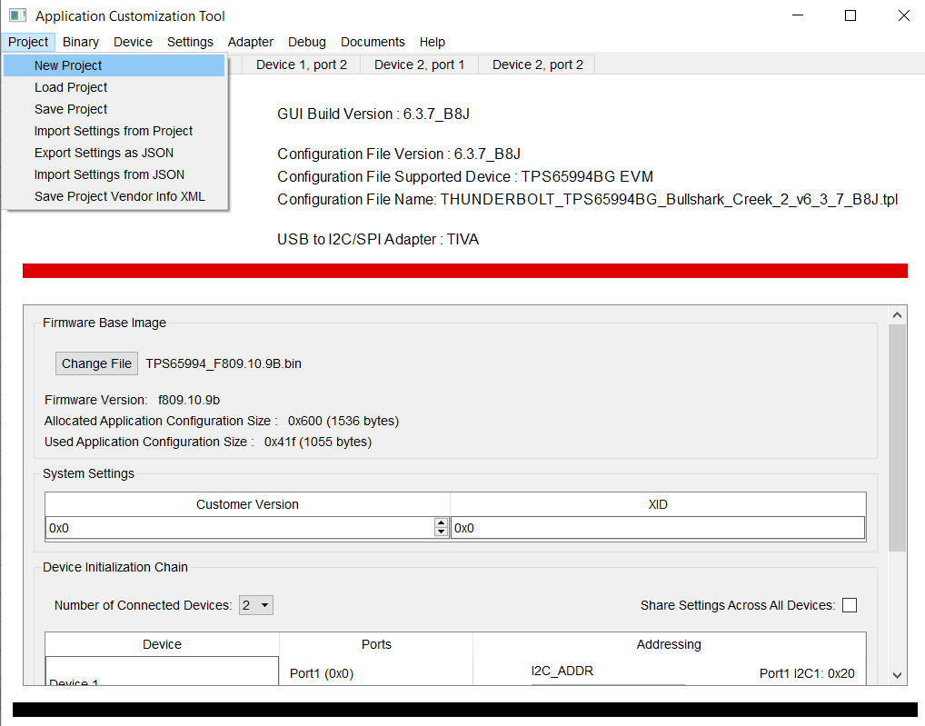
DMC project file
Once done with generating
The PD low region image we
Can now select New Project
In order to generate the DMC
Image

Slide 10
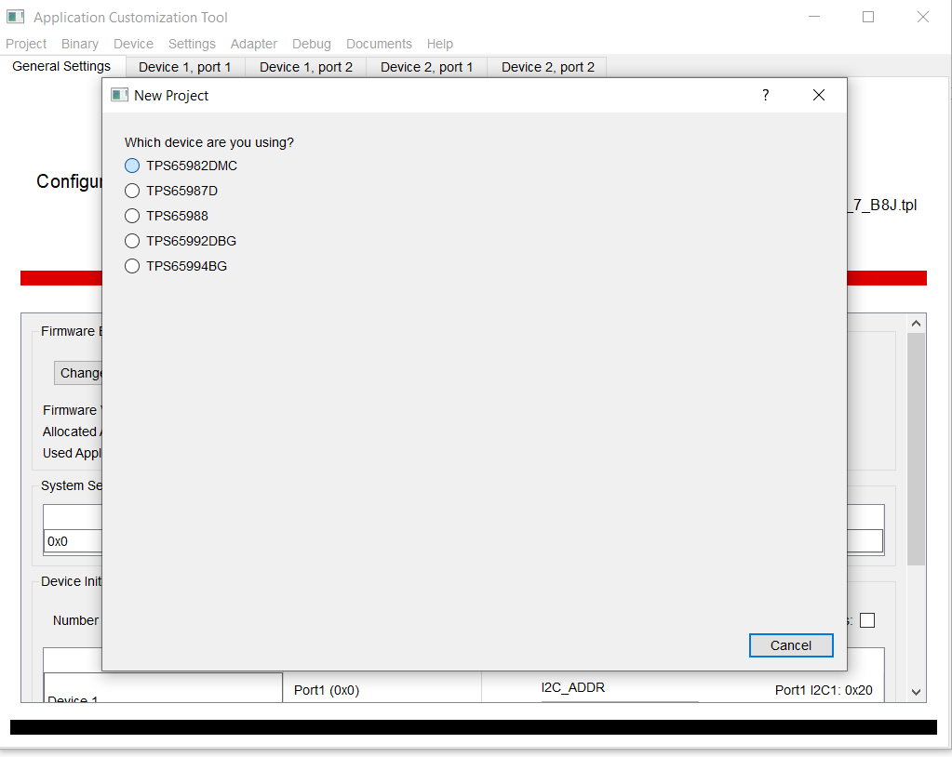
DMC project file
Select TPS65982DMC

Slide 11
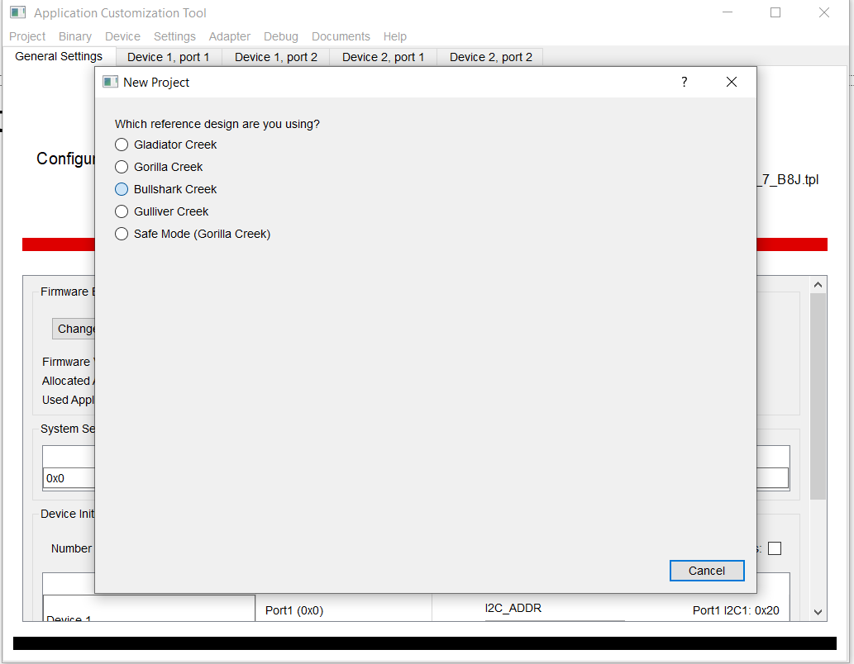
DMC project file
Select Bull Shark Creek

Slide 12
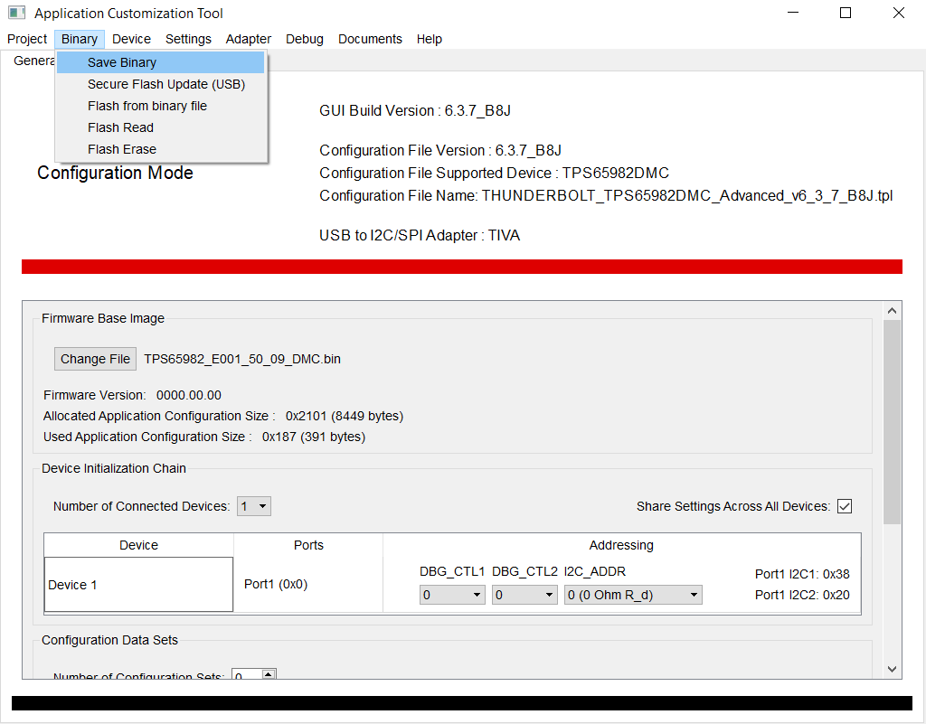
DMC project file
Click Save Binary
Again this is already
Configured to work without
Having to modify the file

Slide 13
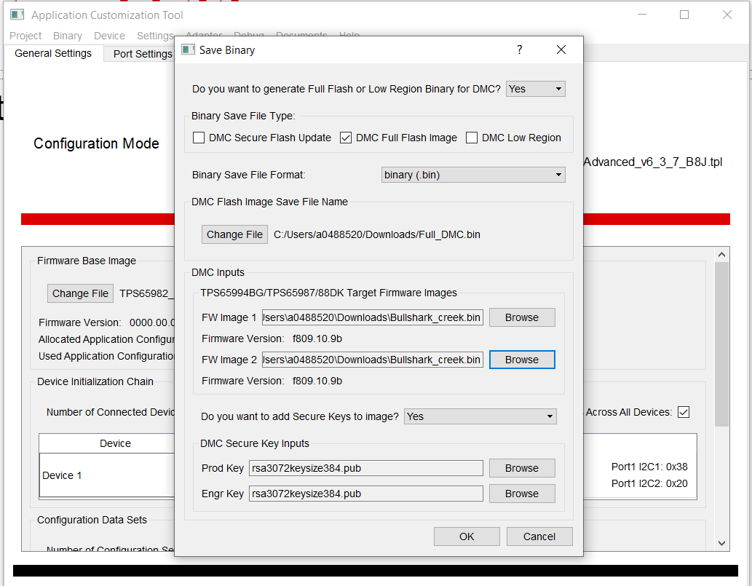
DMC project file
Select DMC Full Flash Image
Give your file a path and name
For the DMC inputs please select the low region files we generated earlier from the PD
This full image that is generated is what will go on to the DMC NVM

