Slide 1
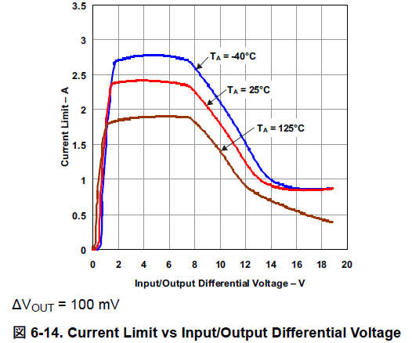
You mentioned “the current limit graph is more applicable to startup (when VOUT is much lower than its programmed value & VIN) or to an output fault/short scenario
(which the current limit would help protect against).”
Base on this statements, we understood that the <1A current limitation shown at the figure 6-14 happens only at startup, not at normal operation.
At startup, there are two cases, ① and ② as follows. ①:VIN is connected to EN, ②:EN gets high after Vin ramps up. And we think case ① has more risk to get the current limit at startup.
①EN is connected to VIN: Input/Output differential Voltage gets 0.9V, because VEN threshold for Vout=OFF to ON uis 0.9V.
2V
VIN
0
2V
0.9V
EN
0
1.5V
0.9V
VOUT
0
When inrush current reaches 1A, current limit works.
IOUT
0
Load current
0.9V
Inrush

Slide 2
② EN gets high after Vin ramps up: Input/Output differential Voltage gets just VIN
2V
VIN
0
ex. 3.3V
EN
0
1.5V
VOUT
0
If inrush current reaches 1.8A, then current limit works.
IOUT
0
Load current
inrush
ex. 2V

