Slide 1
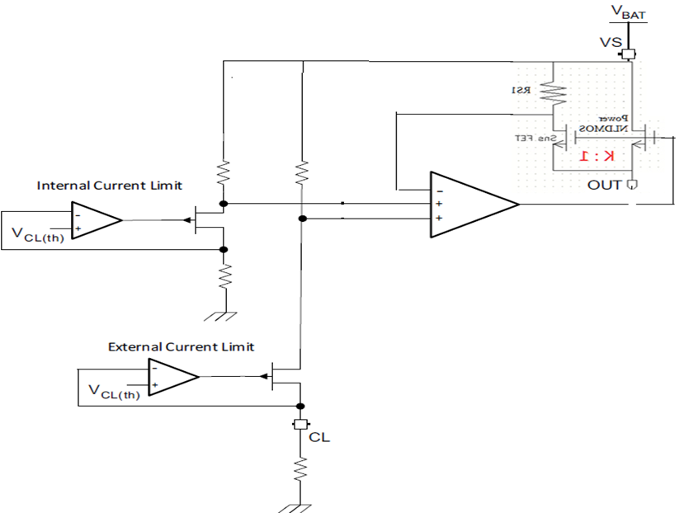
Current limit circuit block diagram

