Slide 1
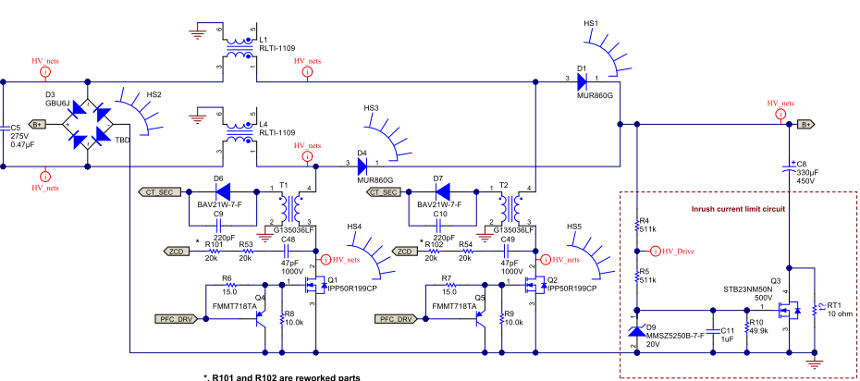
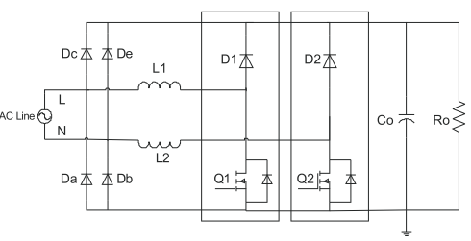
Current path comparison between PMP9640 and UCC28070 interleave
(1) When the L1 side is positive (when FET is ON)
◆PMP9640
◆ UCC28070 interleave
・In PMP9640, both FETs are current paths.
・In the UCC28070 interleave, the return path is the bridge diode and the body diode of the phase FET.
(2) When the L1 side is positive (when FET is OFF)
◆PMP9640
◆ UCC28070 interleave
・Since both FETs of the PMP9640 are turned off, the return path is a bridge diode and a body diode of the FET.
・ Since the UCC28070 interleave has the anti-phase FET turned on, the anti-phase FET becomes the return path.
(3) When the L1 side is negative (when FET is ON)
◆PMP9640
◆ UCC28070 interleave
・In PMP9640, both FETs are current paths.
・In the UCC28070 interleave, the return path is the bridge diode and the body diode of the phase FET.
(4) When the L1 side is negative (when FET is OFF)
◆PMP9640
◆ UCC28070 interleave
・In the PMP9640, both FETs are turned off, so the return path is the bridge diode and the body diode of the FET.
・ In UCC28070 interleave, since the anti-phase FET is on, the anti-phase FET becomes the return path.

