Slide 1
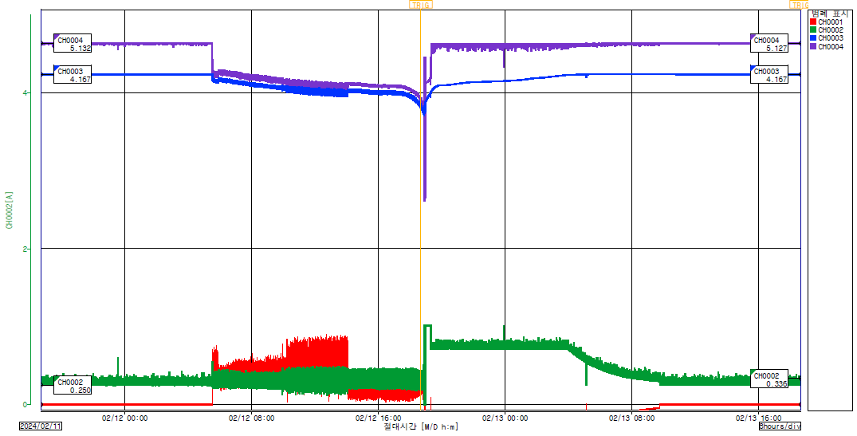
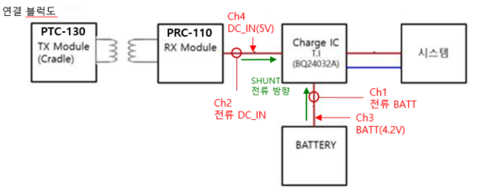
▣ Charger IC input/output voltage, current graph in case of defect reproduction.
Ch4_Voltage(AC)
Ch3_Voltage(BAT)
Ch2_Current(AC)
Ch1_Current(BAT)
BAT full and close to current level 0.
AC load current is approximately 200 to 300 mA.
(Product Standby Mode Status)
Product operation with BAT, BAT consumption current rises to about 700 mA.
AC load current also rises to approximately 300-400 mA.
(AC input voltage follows BAT voltage)
BAT completely discharged, Rebooted and charged (BAT Charge Progress)
Product Standby Mode Status (BAT Full)

