Slide 1
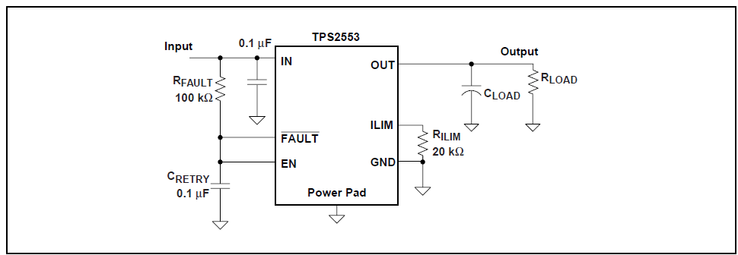
Customer’s Use Case
When between Out_Pin and Ilim_Pin were shorted.
5V
5V
Ios
R
22k
R:2.2Ω （Shorted resistance value）
RILIM:22kΩ
Input:5V
Output:5V
Setting of Ios＝２５２３０Ｖ／２２kΩ＝１．１A
Is it thought that this setting value changes how?
Ios will be…
1)big than setting value.
2)small than setting value.
3)other

