Slide 1
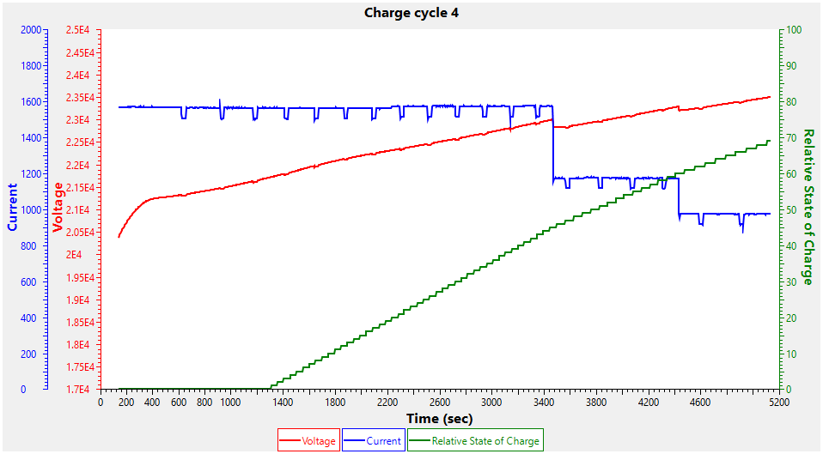
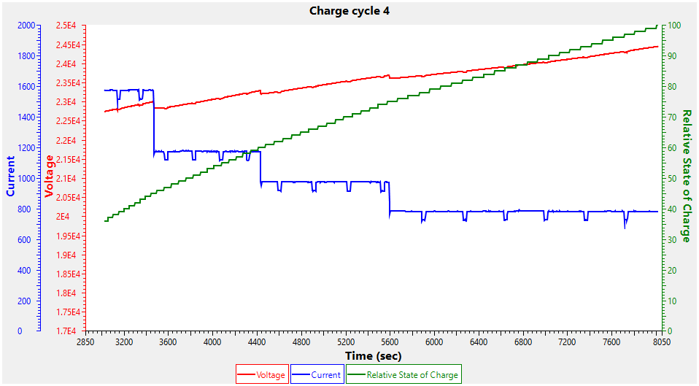
Full battery pack charging cycle
Start at fully discharged 0% at 15.0v low voltage cutoff
Finish at 100% RSoC
Total charge time : 134 minutes (2 ¼ hours)

Slide 2
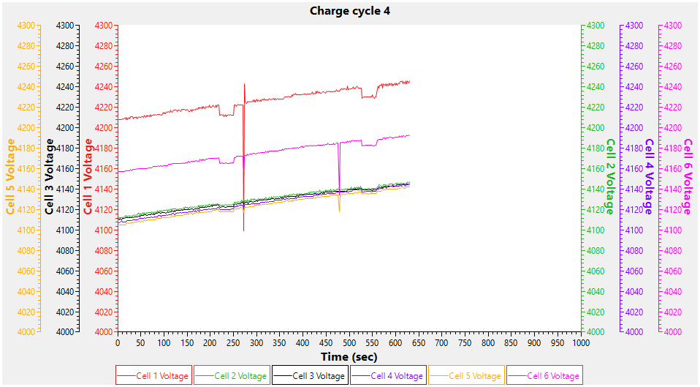
Battery continued to take more charge after hitting 100%
Cell voltage on #1 & #6 were particularly high – all cells were > 4100mV but BMS did not shut down charging ?

Slide 3
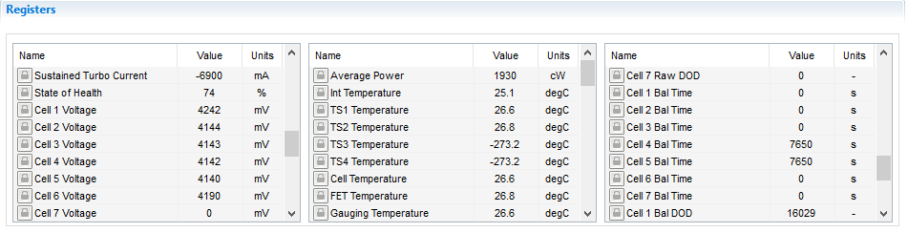
Battery continued to take more charge after hitting 100%
Cell voltage on #1 & #6 were particularly high – all cells were > 4100mV but BMS did not shut down charging ?

Slide 4
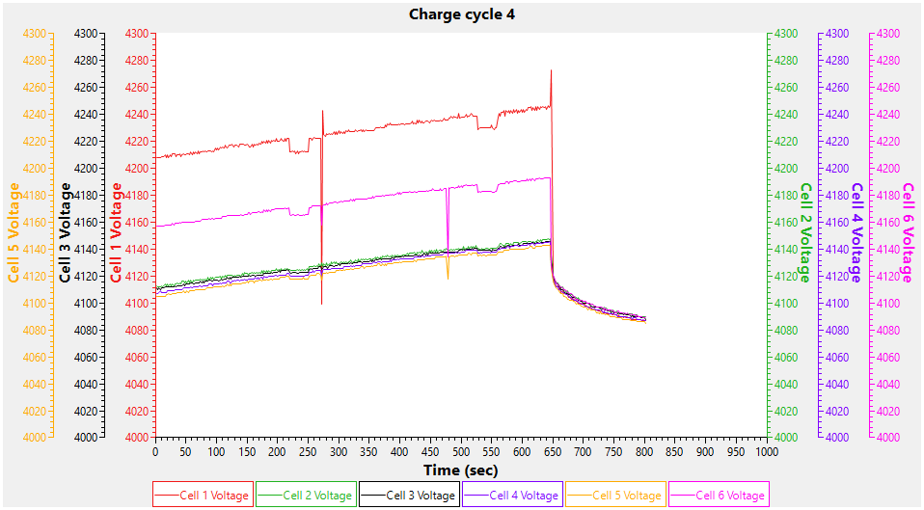
Charger disconnected – all cells came back to very close to perfectly balanced state

