Slide 1
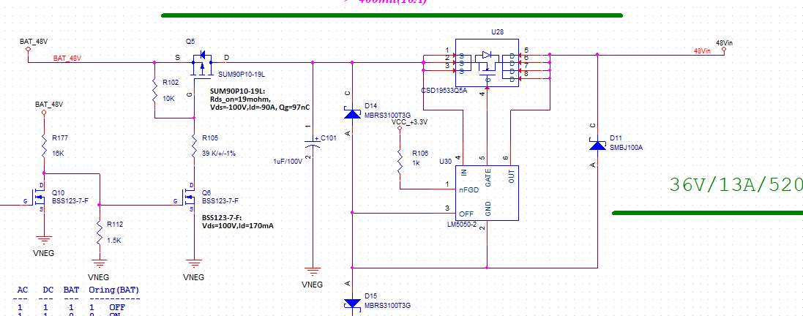
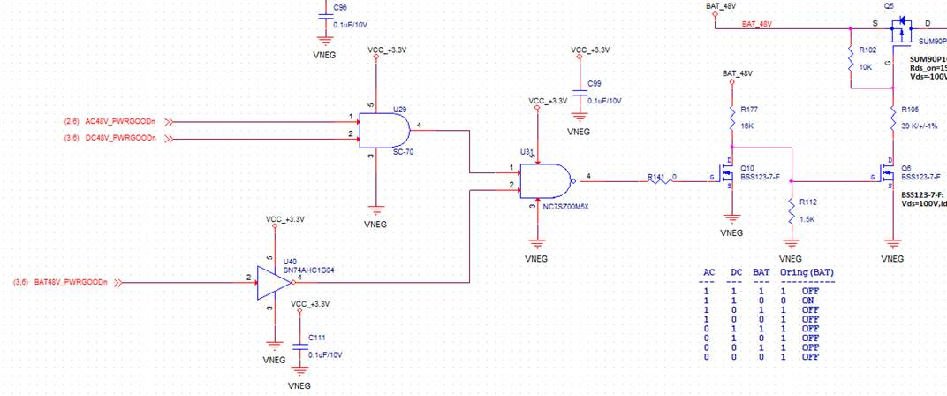
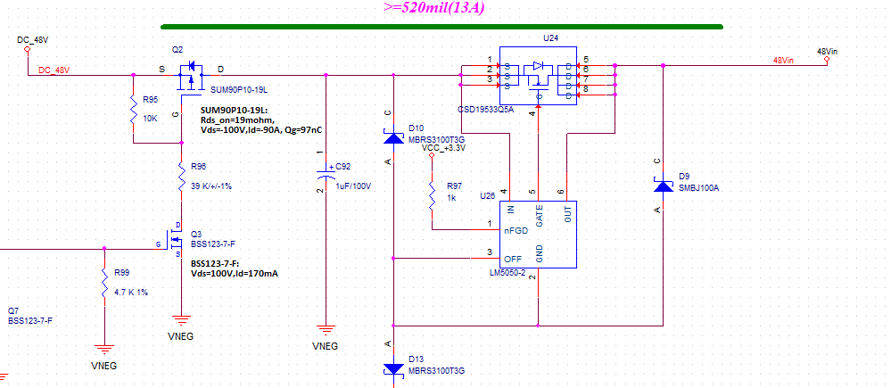
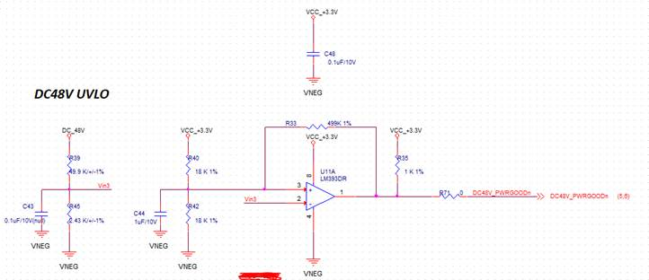
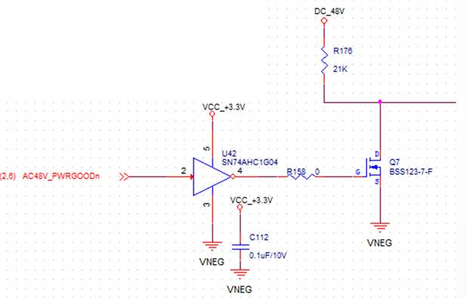
BAT GATE
VIN3
DC GATE
AC is not used. AC powergoodn is HIGH.

Slide 2
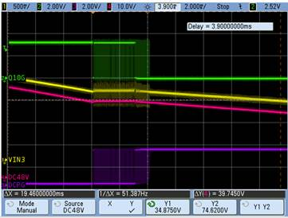
Q10 Vgs
VIN3 is measured at input of DC48 divider. The fluctuation happened at about 36Vin indeed.
DC PG is input of comparator
Fig.1

Slide 3
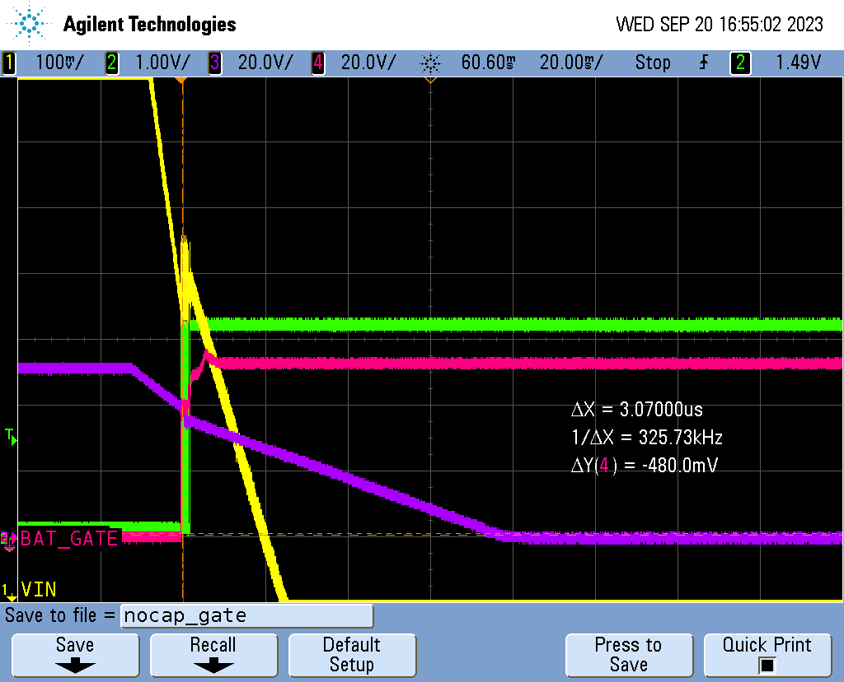
R42 = 19.1K, without cap
Fig.2
DC PG
DC gate

Slide 4
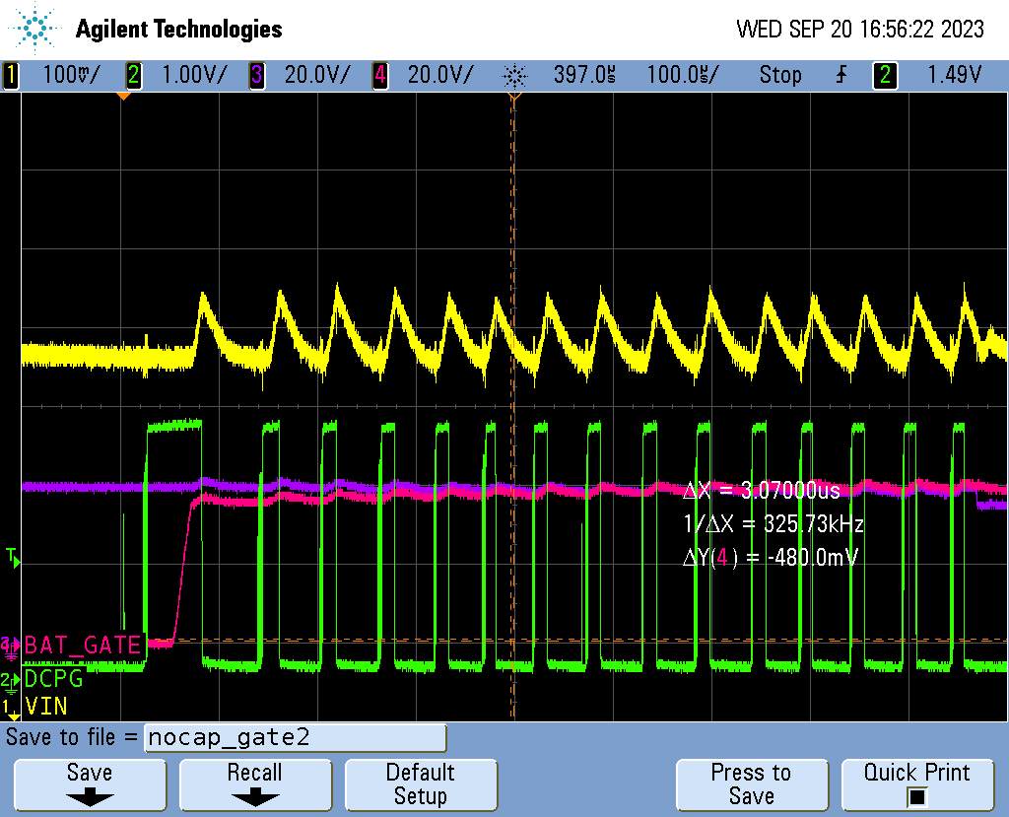
R42 = 19.1K, without cap
Fig.3
DC gate

Slide 5
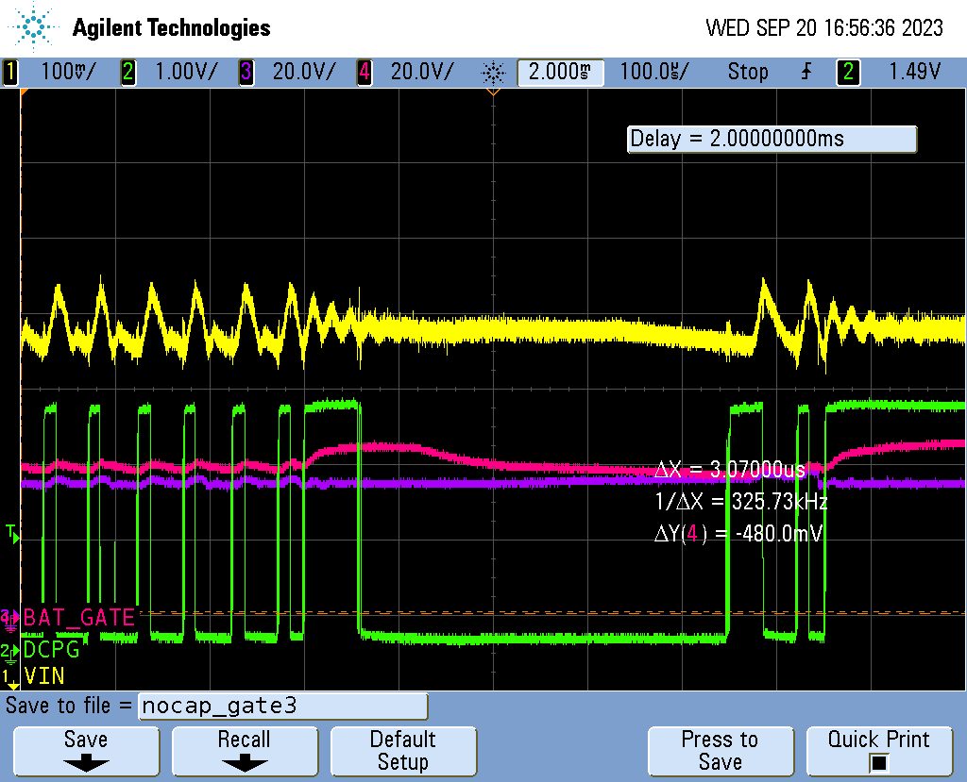
R42 = 19.1K, without cap
Fig.4
DC gate

Slide 6
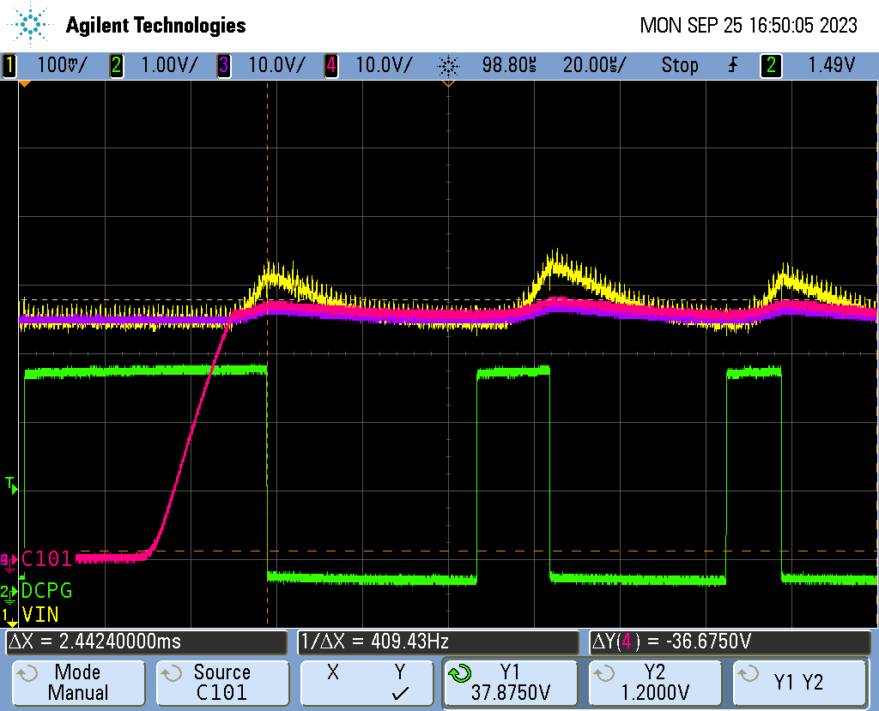
Fig.5
C92

