Slide 1
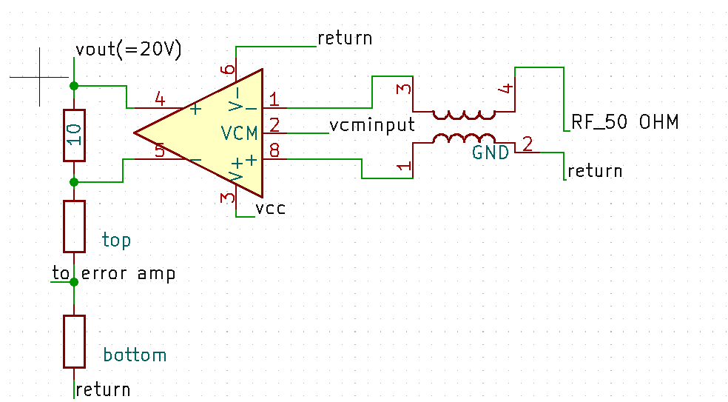
Direct driving loop measuring signal from Network Analyzer to injection nodes.
SMPS

Slide 2
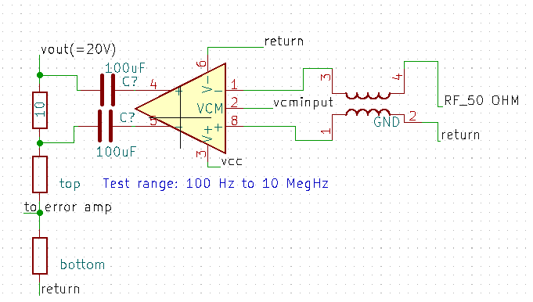
DC Decoupled: Direct driving loop measuring signal from Network Analyzer to injection nodes.
SMPS

