Slide 1
Circuit
PSU
TPS7A3701DRVR
5.V
5V
VIN
OUT
4.7uF
EN
78.7kΩ
0.1uF
10uF
0.1uF
FB
22Ω
GND
24.9kΩ

Slide 2
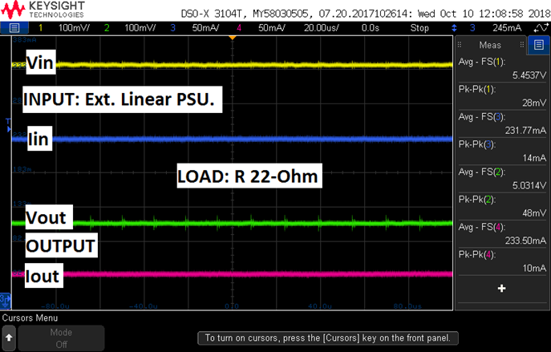
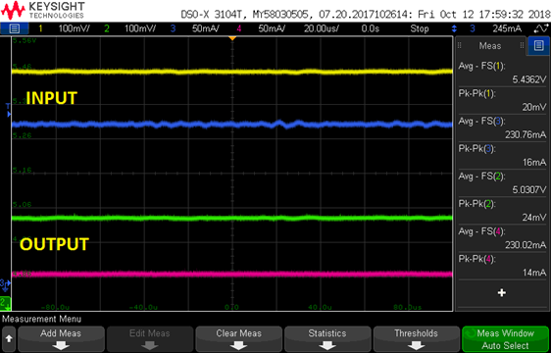
Waveform
PSU
30cm
Why does Input current have the ripple?
30cm and 15cm
15cm

