Slide 1
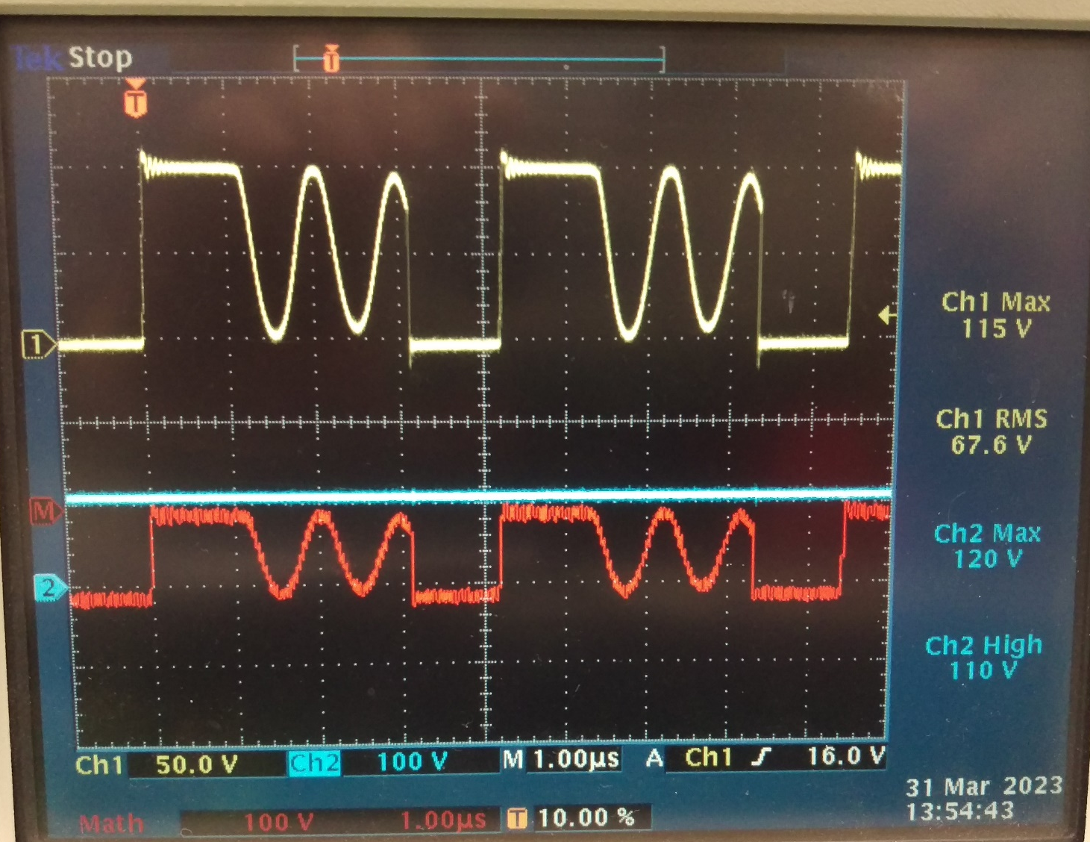
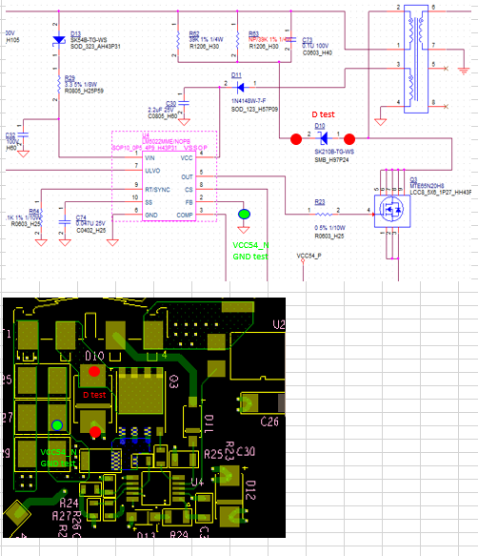
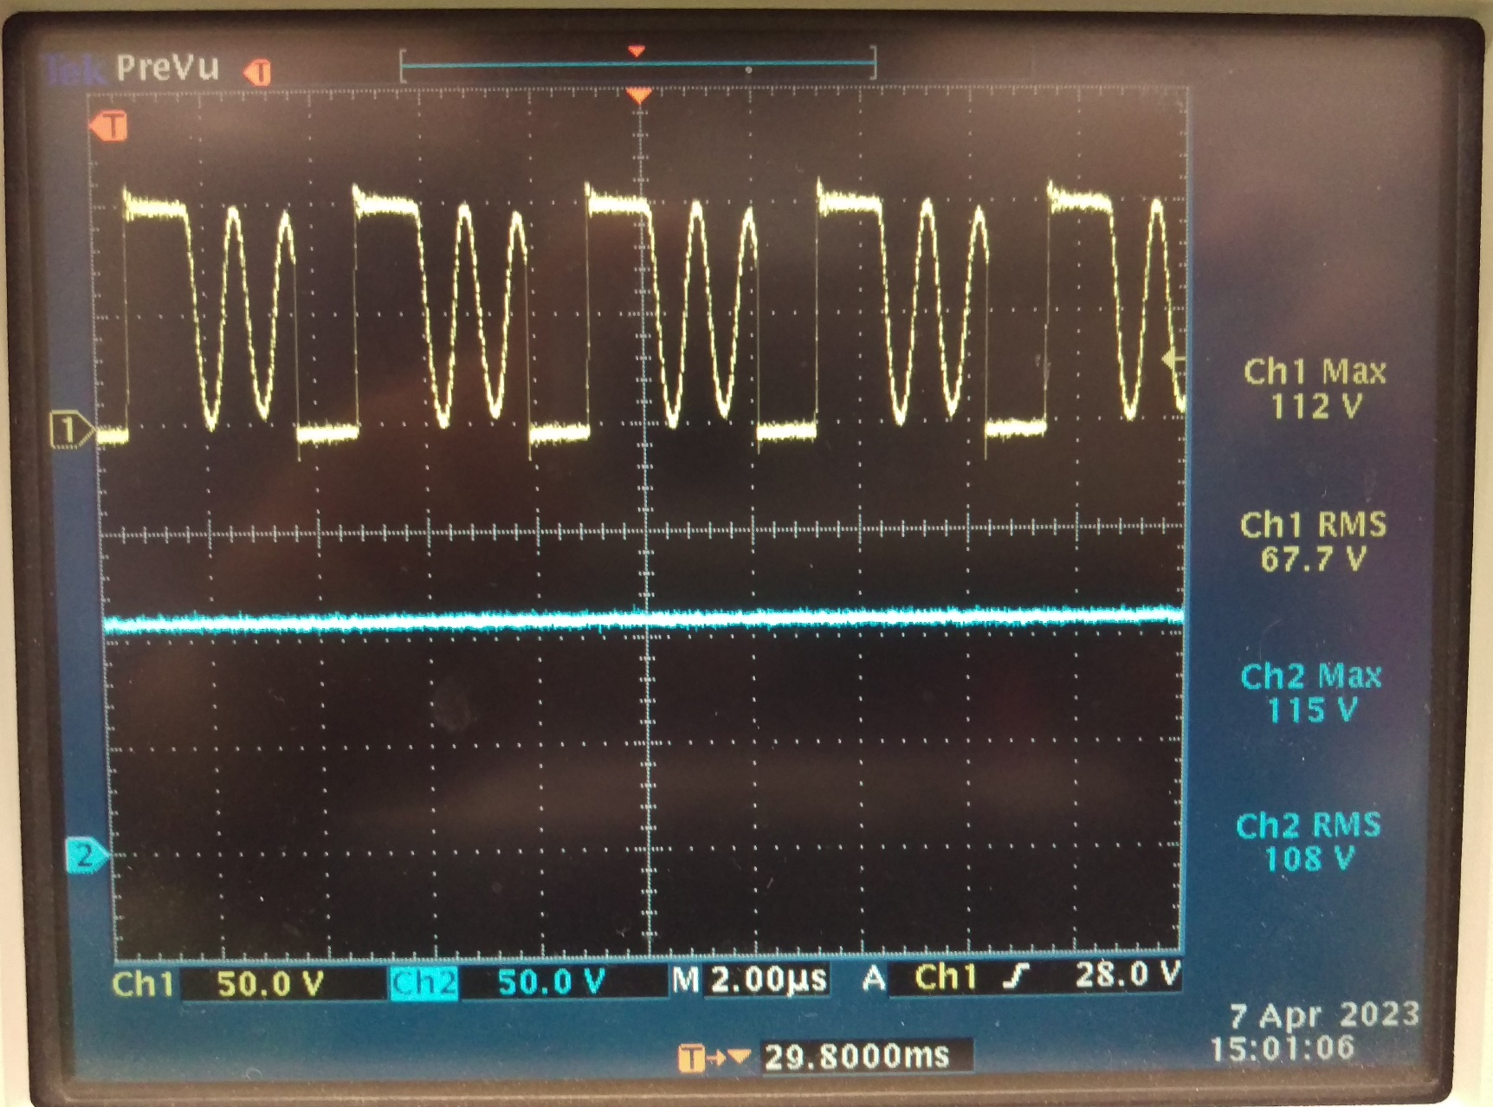
diode D10 voltage test
2023/3/31 test result
Ch1 : V+
The 2023/3/31 and 2023/4/07 test result picture is the test result for D10 diode.
The ch1 is V+ point of D10 and the ch2 is V- point of D10.
The test point of D10 is shown in schematic.
2023/3/31 result shows the ch2 voltage
scale is set to 100V.
2023/4/07 result shows the ch2 voltage
scale is set to 50V.
According these result and compared with D10
specification , please help to advise
D10 voltage test result.
Ch2 : V-
Ch2 : V-
Ch1 : V+
2023/4/07 retest result
Ch1 : V+
Ch2 : V-
D10 specification

