Slide 1
E2E Layout Review

Slide 2
Schematic

Slide 3
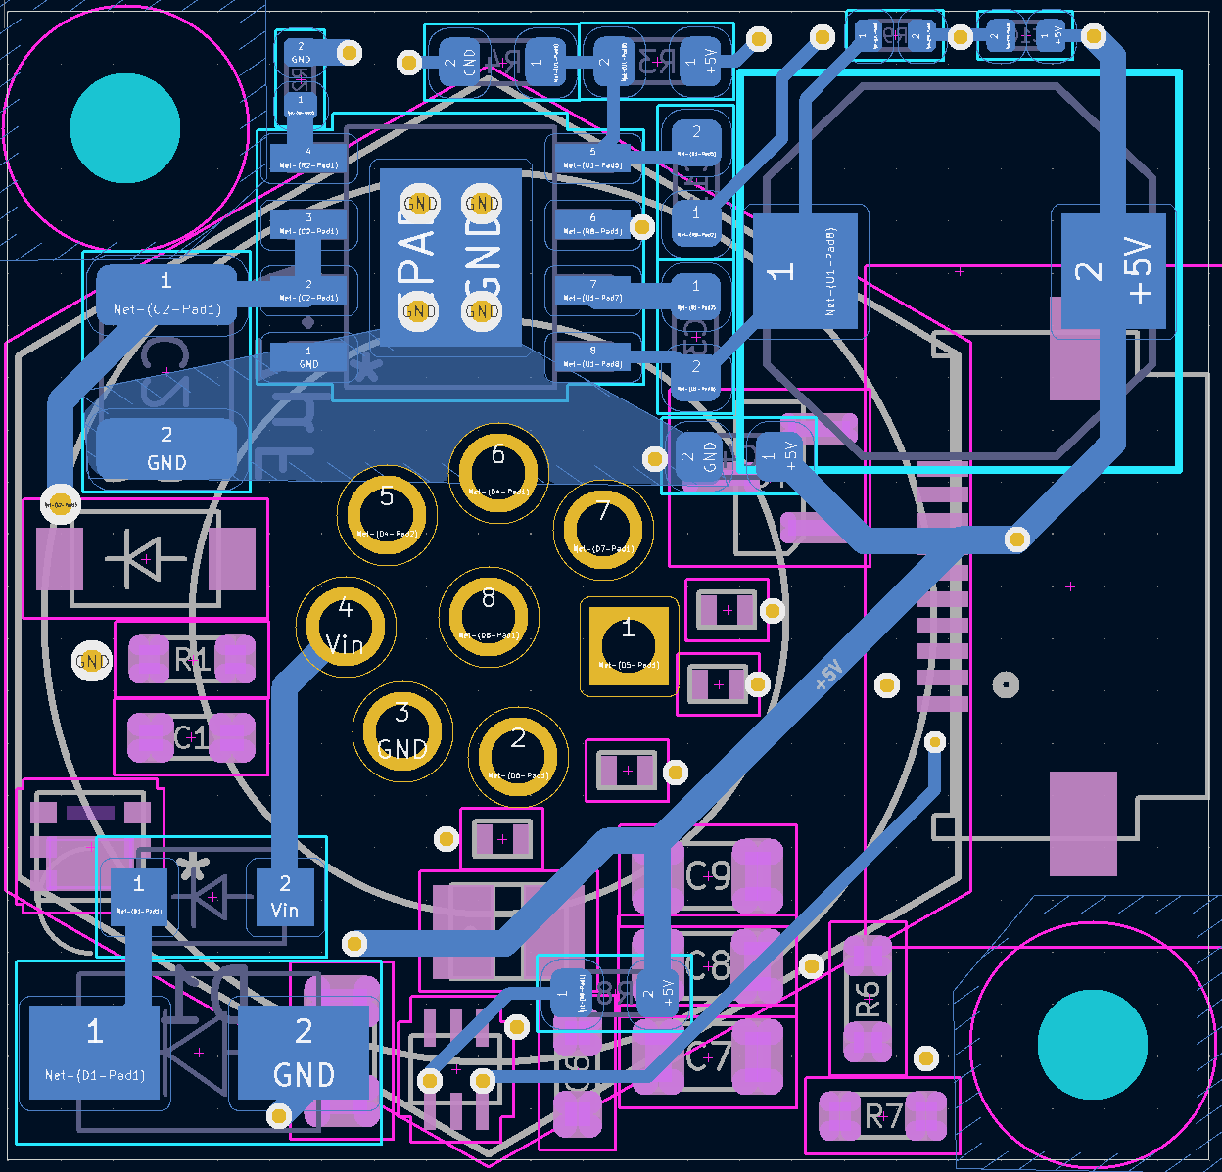
LM5168 Layout
General guidelines: For SMPS layout, for stuff in the power-stage, it’s easier to do polygons, like SW node, GND plane, VIN plane instead of traces. Traces should be used for small signals. I would recommend having two internal layers, so a 4 layer board. This is a good video: https://www.ti.com/video/4810557378001
If possible, I would follow figure 9-39 in datasheet.
Feedback network seems ok. Looks like there’s a third component connected to the FB outside of R3/R4?
Connect to SW with a wide trace. If you can shift inductor down a little bit, it can align up with pin 8 pretty well. And then the boot cap can stay as is.
Create a polygon that covers each layer of the board and make it GND. The triangle you currently have is too small, and does not help with thermals yet. The GND plane you have in the middle layer is good.
Output cap (C5?) should be closer to output instead of wiring through a trace. I suggest using a plane for VOUT to reduce any efficiency drops and prevent any long traces which may affect performance
Add GND vias that fan out from the GND pad in order to spread out thermals.

Slide 4
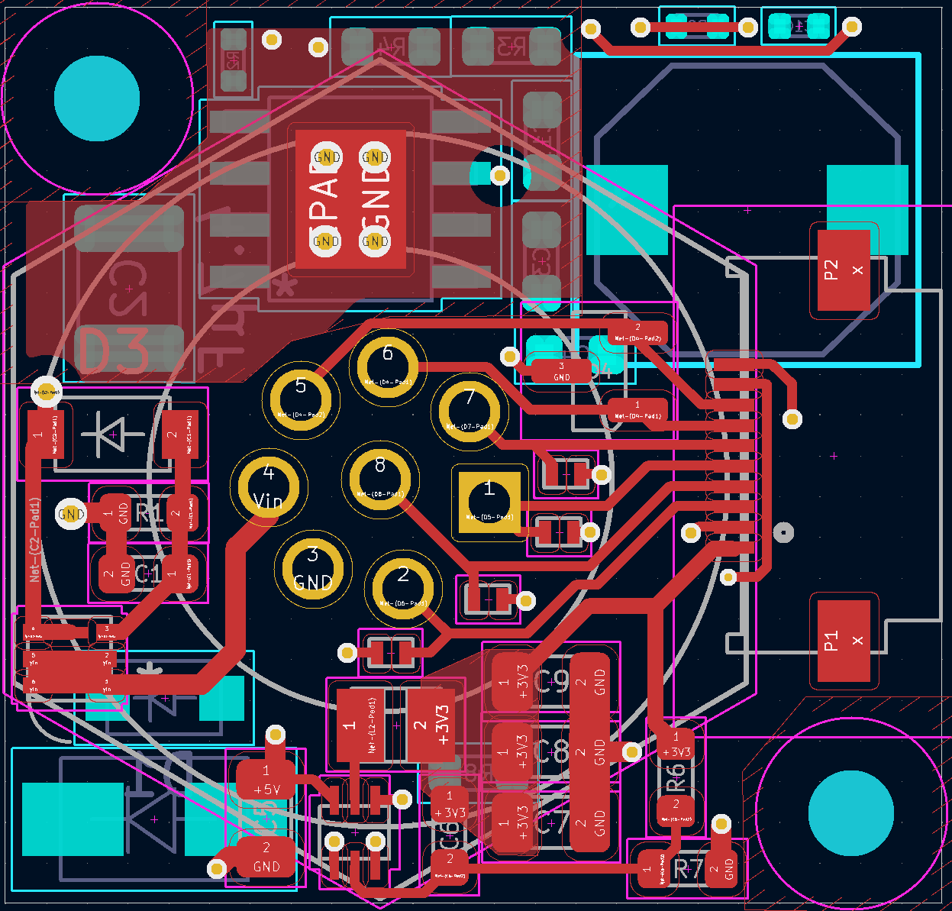
TPS62A01 Layout
Similar guideline to the LM5168
I would refer to Figure 11-1 in TPS62A01 for reference.

Slide 5
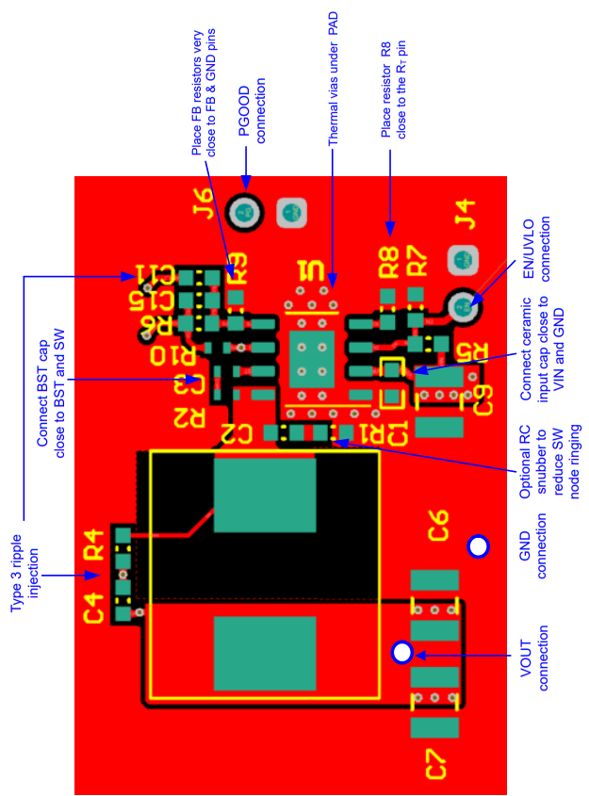
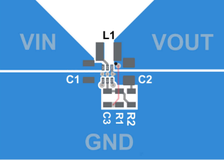
Combining both layouts
LM5168
TPS62A01

