Slide 1
SEMCO
LP8865Y-Q1 EMI test result
May/27 2024

Slide 2
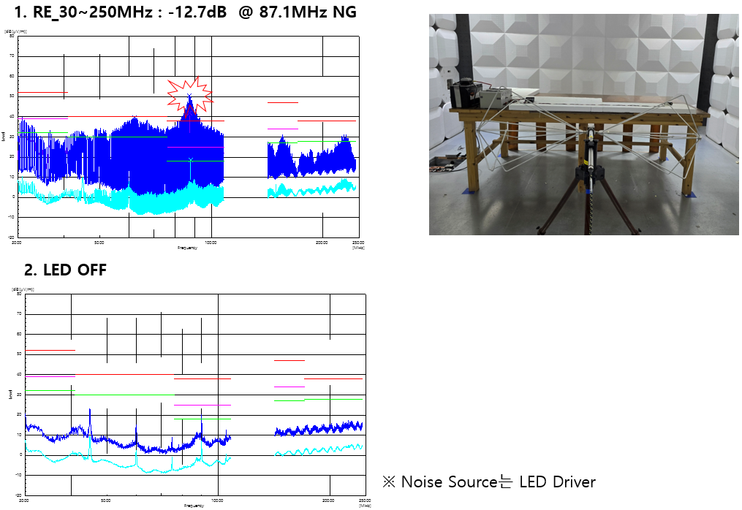
There is only NG at 87Mhz but Noise level is high on all bancwith.
Plesae guide to reduce the noise like Noise filter etc.

Slide 3
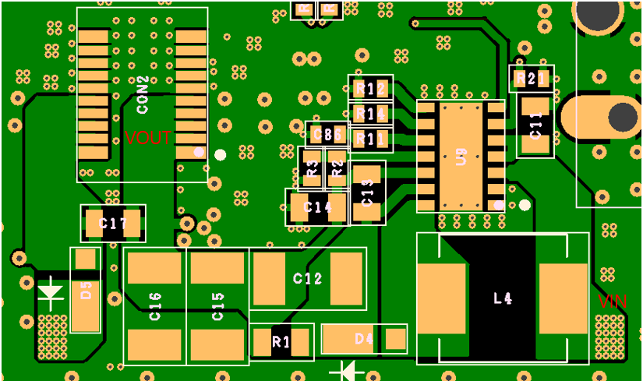

Slide 4
