Slide 1
EPD PM-IC control schematic
2021. 01. 04
HAJEN

Slide 2
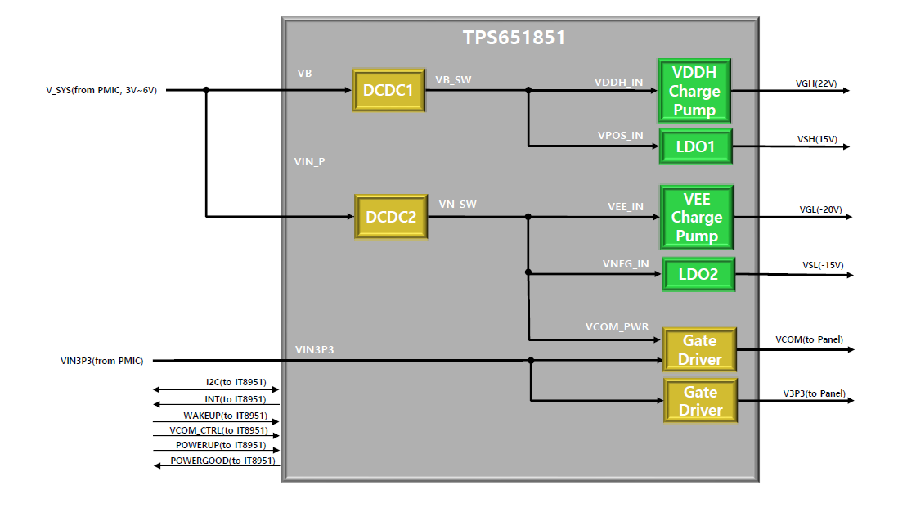
EPD Power Control Block (TPS651851)

Slide 3

EPD Control Block (IT8951 + TPS651851+ LED DRIVER)
I2C_1
LED Driver
LED_DRIVE
V_SYS
VGH(22V)
3.3V
VSH(15V)
VGL(-20V)
INT
TPS651851
VSL(-15V)
3.3V
WAKEUP
VCOM(to Panel)
1.8V
VCOM_CTRL
V3P3(to Panel)
POWERUP
HOST
PCB
(AP CHIPSET)
POWERGOOD
IT8951
I2C_3
NTC
Sensor
Thermal_control
(to Panel)
SPI_1
SDD0~15
READY
GDCLK
GDSPV
SDCLK
Flash
SPI_2
SDCE_N0
SDLE
XOE
I2C_2
Touch
1.8V

Slide 4
PM-IC and the others schematic
1. PMIC & EPD CONNECTOR Schematic
2. < Reference > EPD DRIVER IC CONTORL Schematic
3. < Reference > led front light Schematic
4. EPD DISPLAY Specification

Slide 5
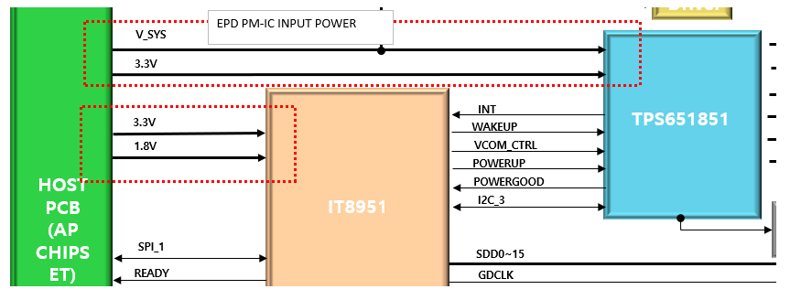
Request contents
POWER CONTORL
EPD PM-IC POWER: It will receive power from system PM-IC(ALL Voltage control)
Is there no problem? VSYS=5V

Slide 6
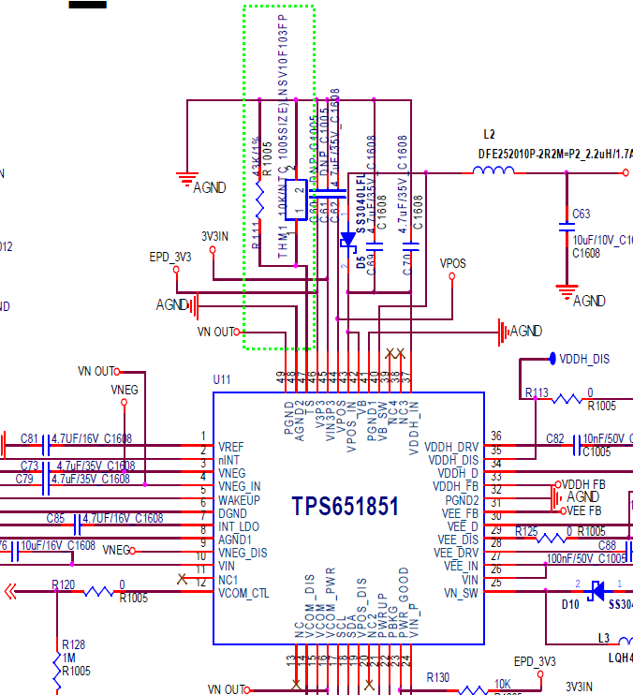
Request contents
2. EPD DISPLAY Temperature control
Can I use the NTC circuit for EPD DISPLAY THERMAL CONTROL?
Is it programmed to enable NTC control in TPS651851PM-IC?
Is it possible to I2C control with EPD DRIVER IC?
■EPD Temperature design notice

