Slide 1
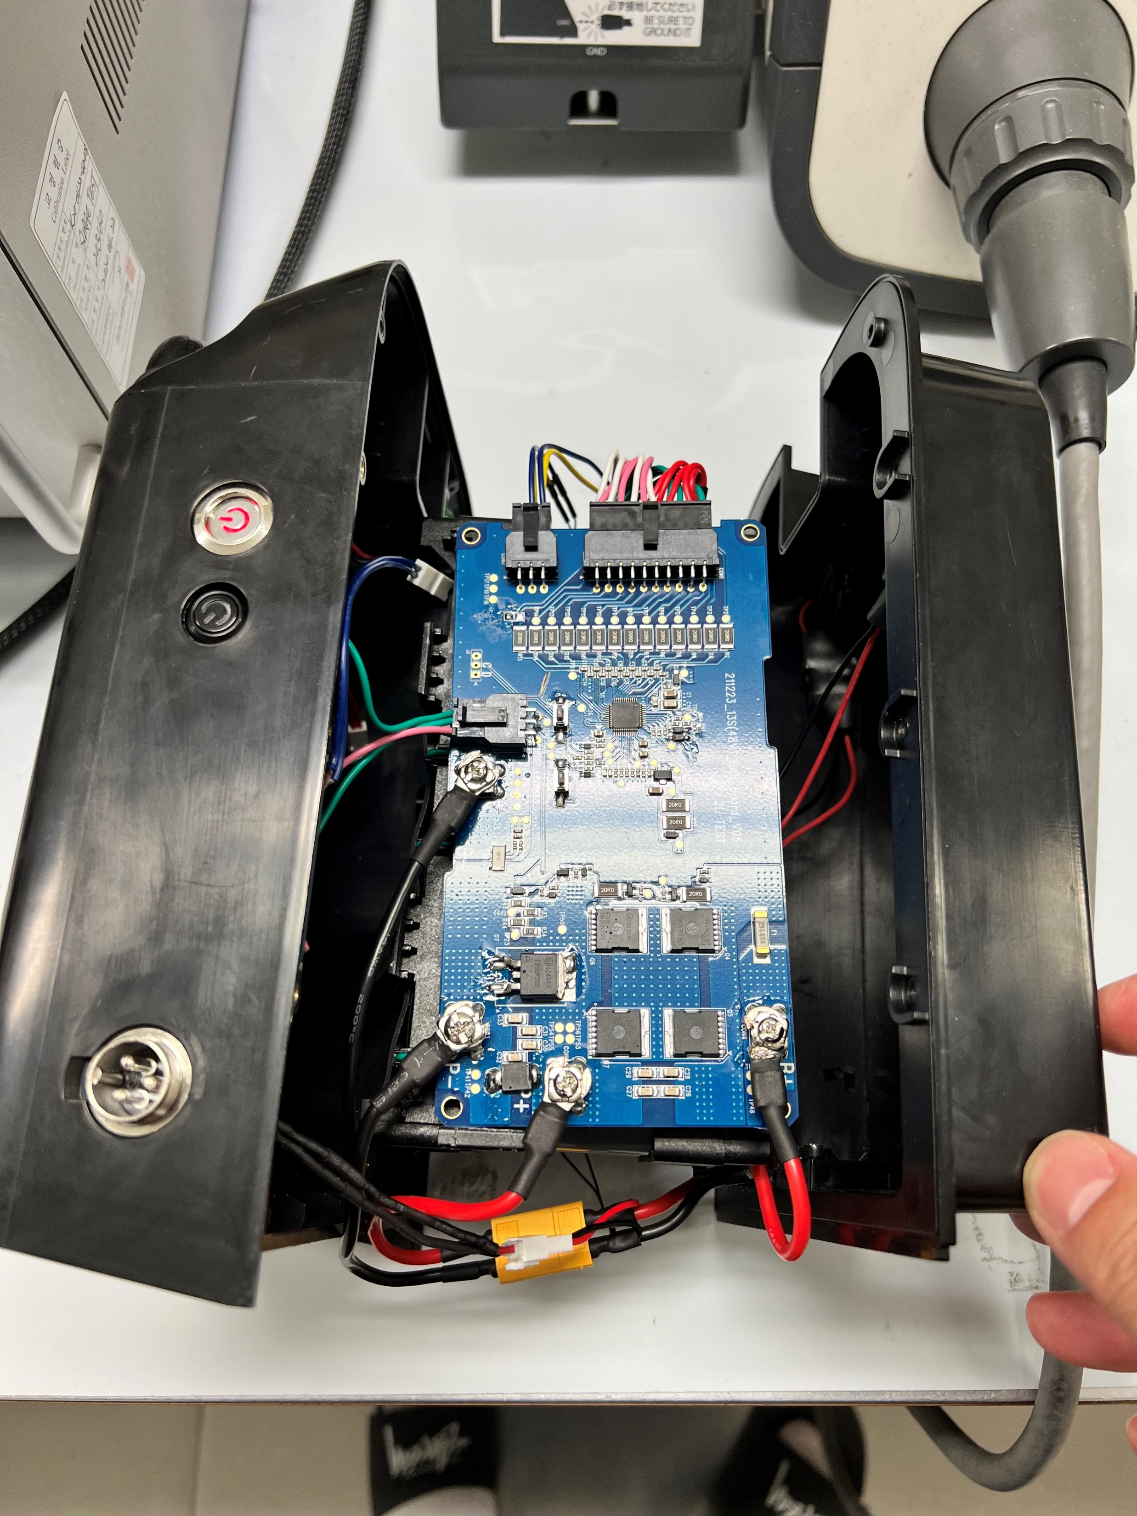
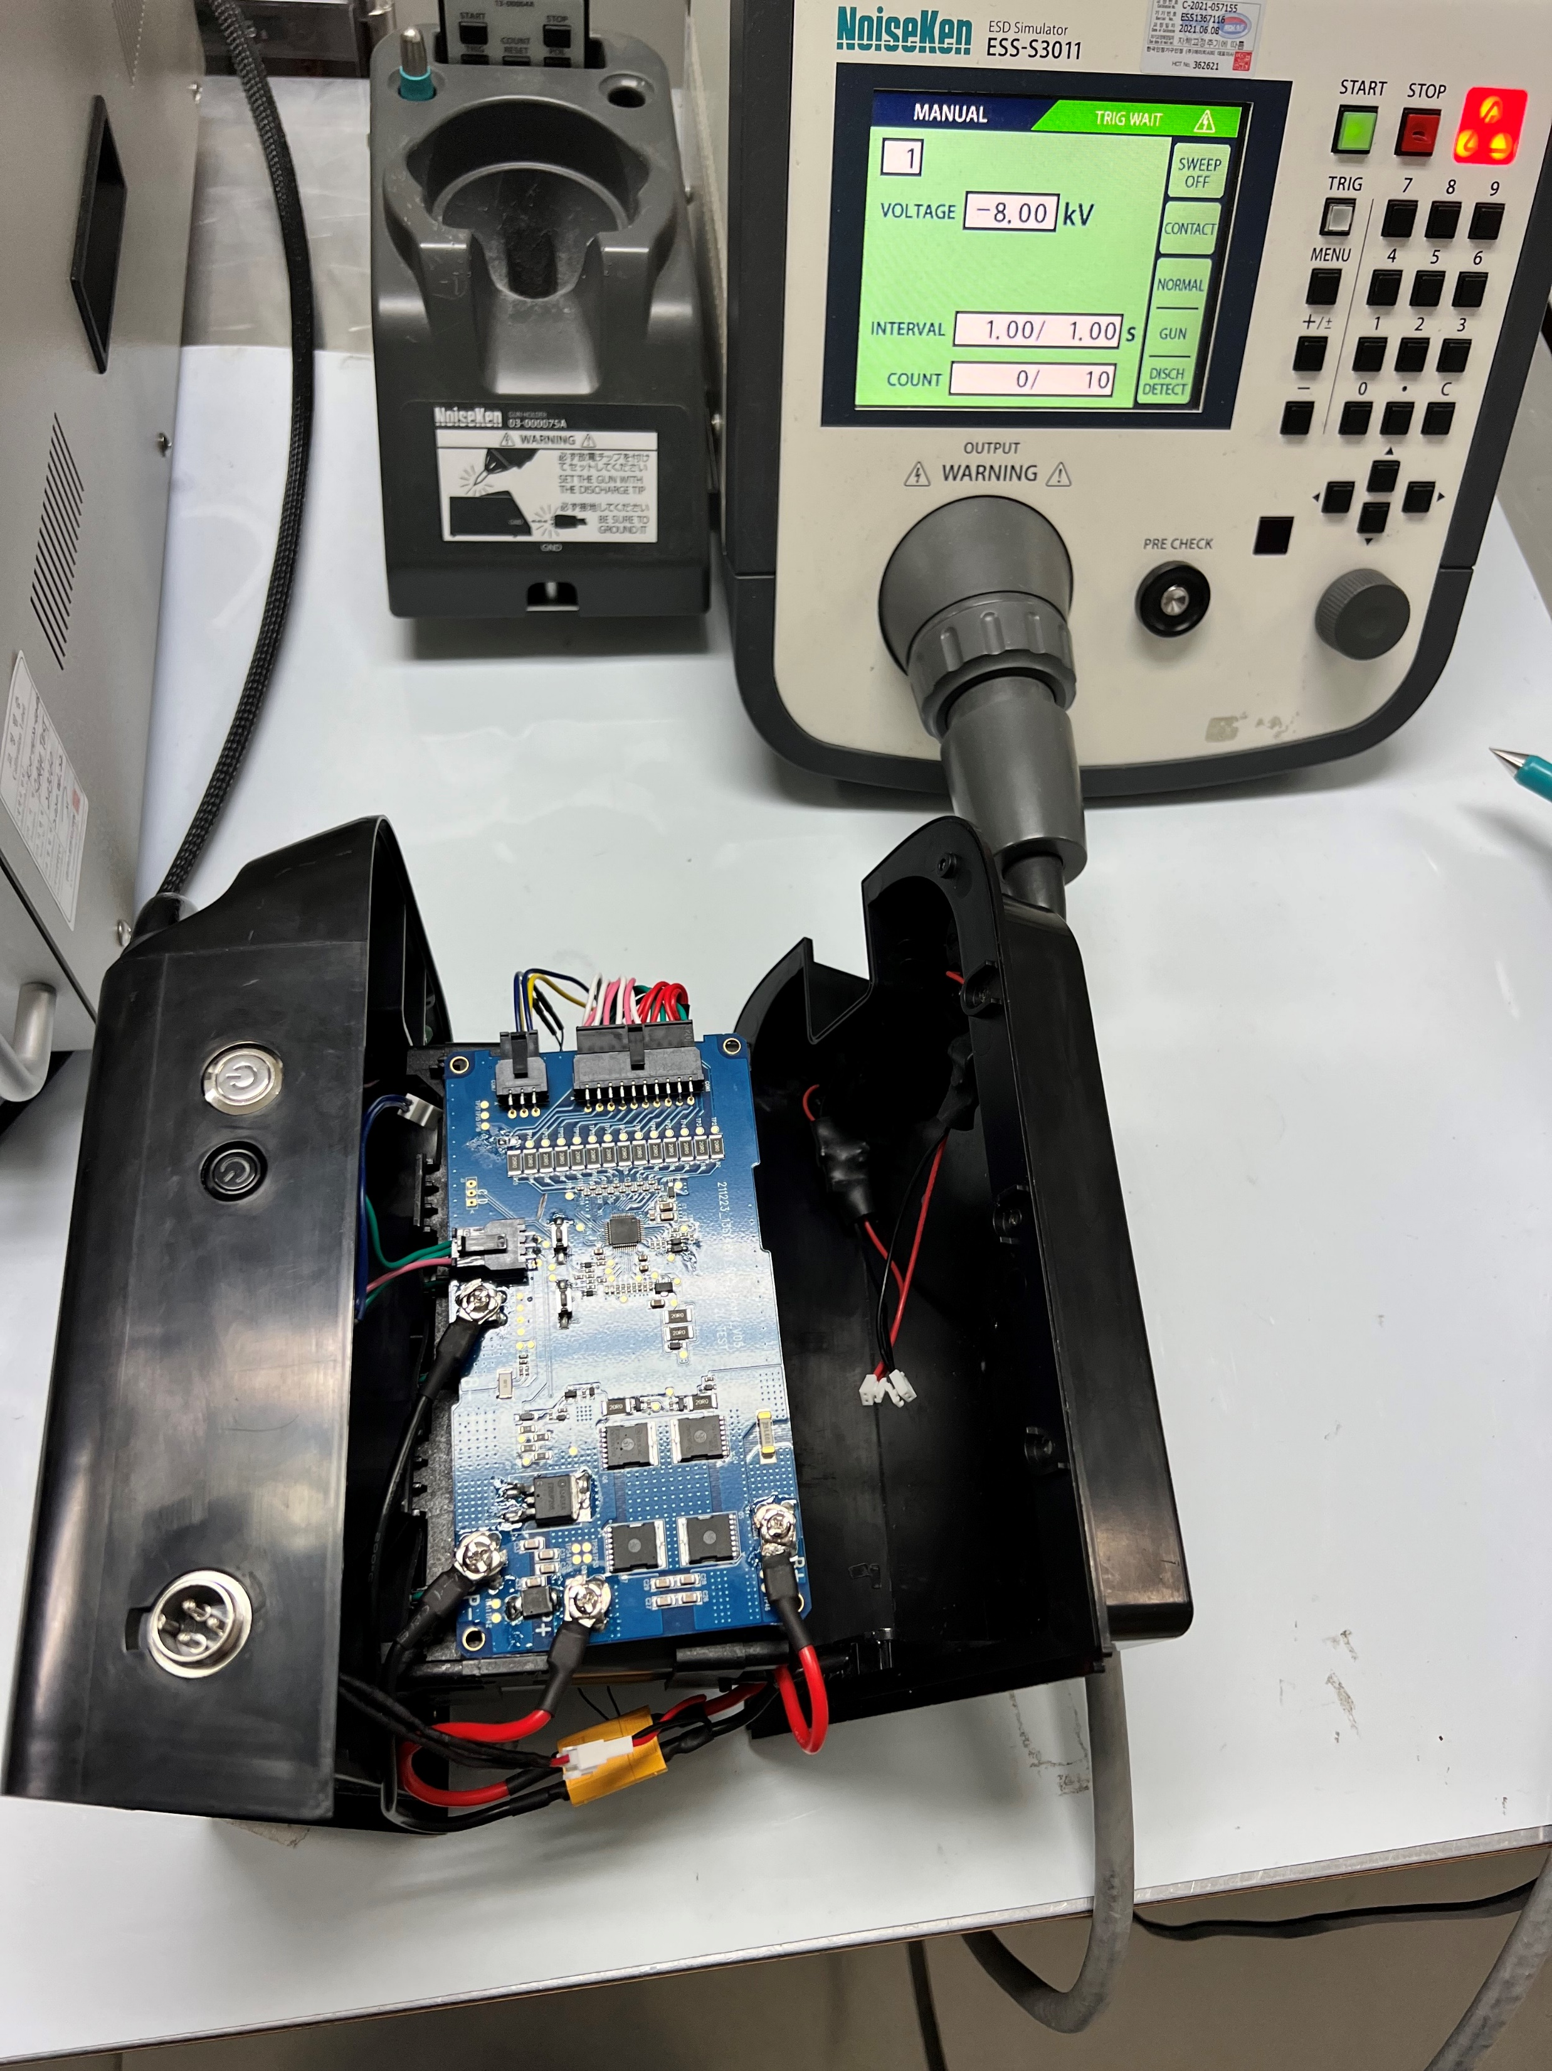
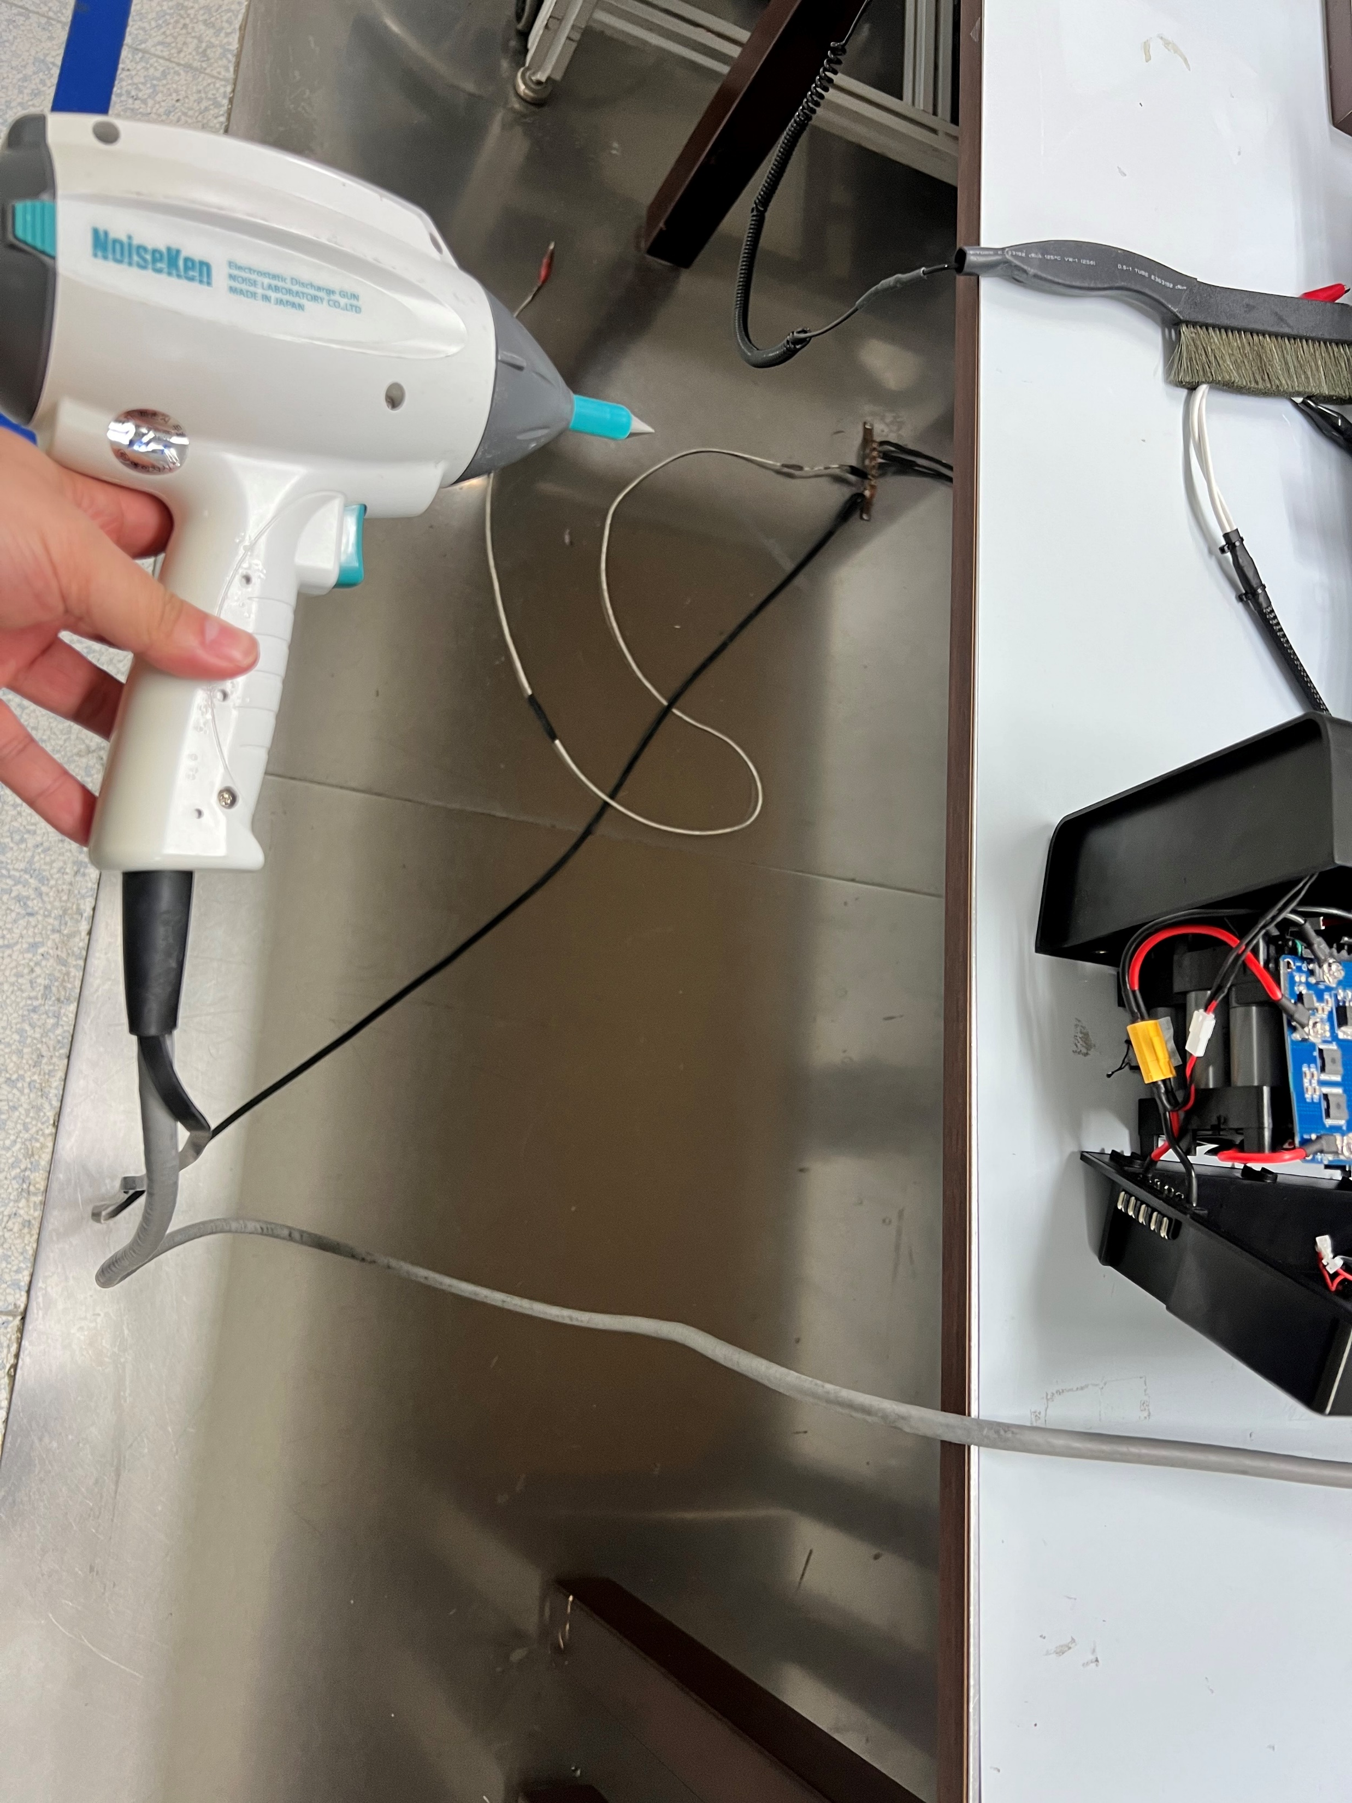
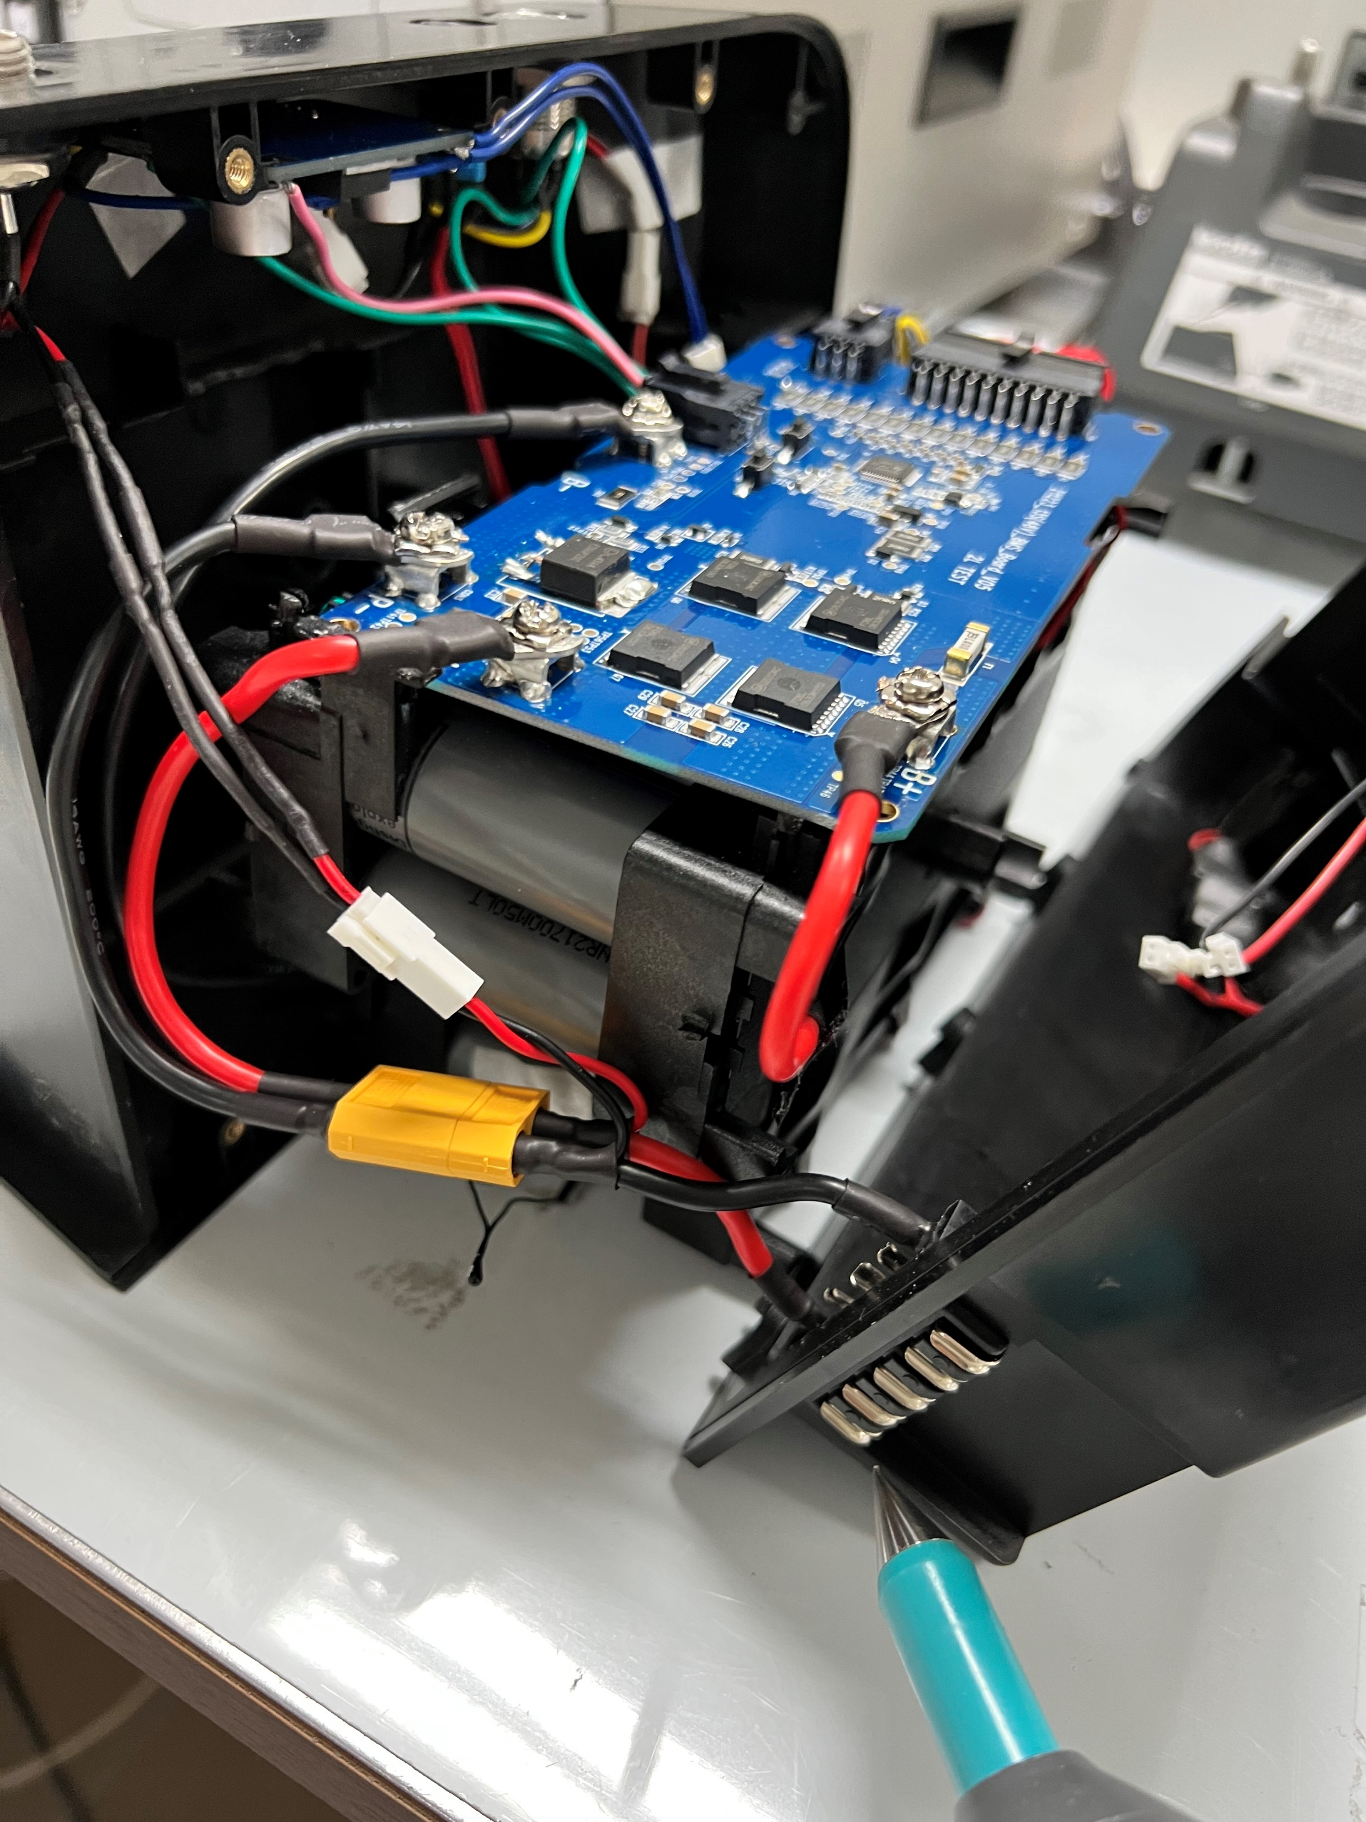
ESD TEST Condition
After applying the ESD, check whether the LED is ON or OFF
Resistance or IC broken due to ESD
The conditions before the ESD test:
- Check the Switch On
- Chg/D-Chg MOSFET ON
ESD GUN -8KV SETTING
ESD gun is not grounded.
The P+/P- of the BMS has no ground. Applying the ESD(8KV) to P+

