Slide 1
Efficiency comparison test between TPS63805 and TPS631000

Slide 2
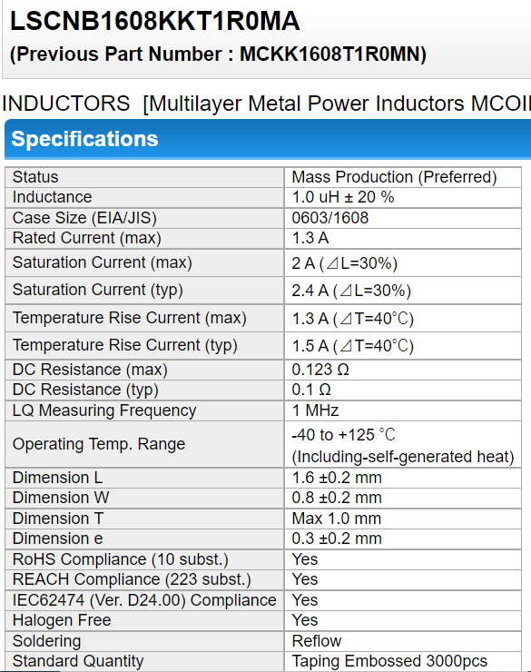
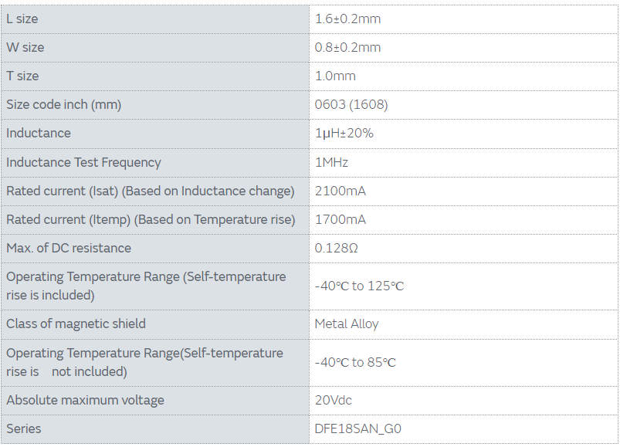
Information of inductor
2

Slide 3
Test results
 | Vin | Iin | Vout | Iout | Eff
TPS63805 | 3.699 | 0.01577 | 3.35 | 0.0152 | 87.3%
TPS631000 | 3.699 | 0.0146 | 3.279 | 0.0152 | 92.3%

Slide 4
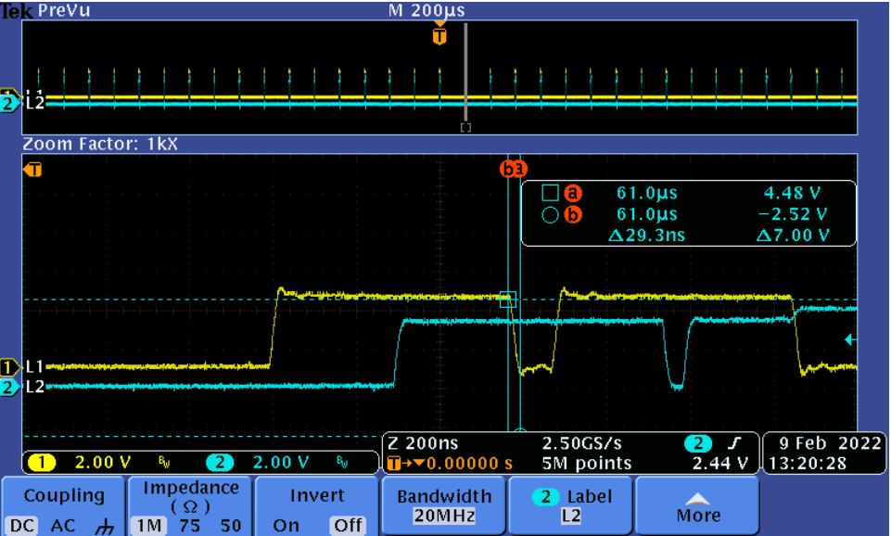
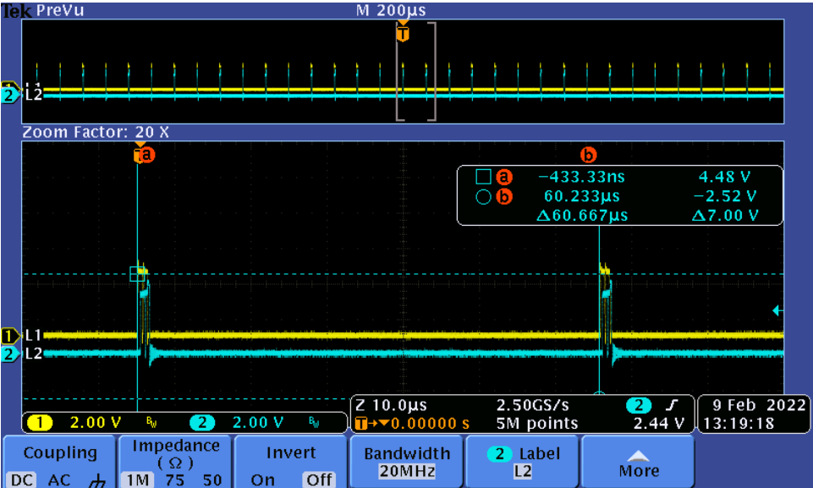
PFM working-TPS63805
Switching time—1.6us
Pause time—59us
Quiescent current—11uA
Buck-boost switching
Rising time and falling time are almost all 29nS

Slide 5
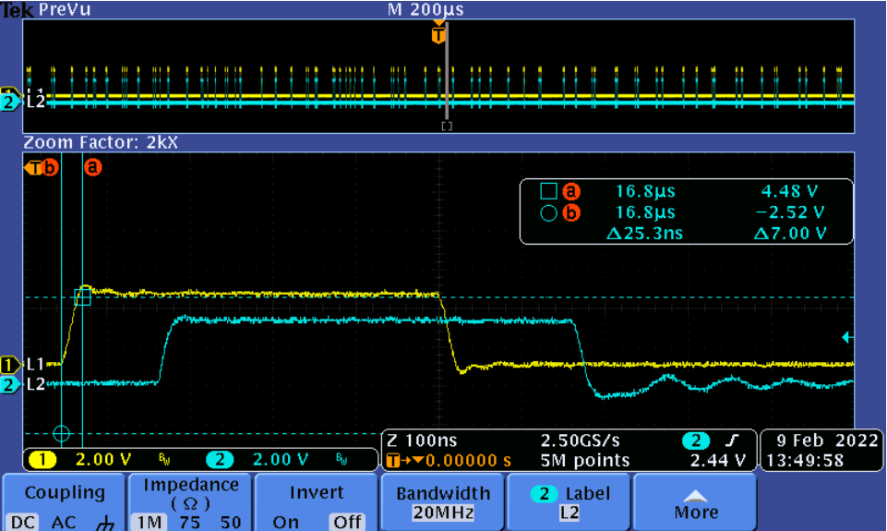
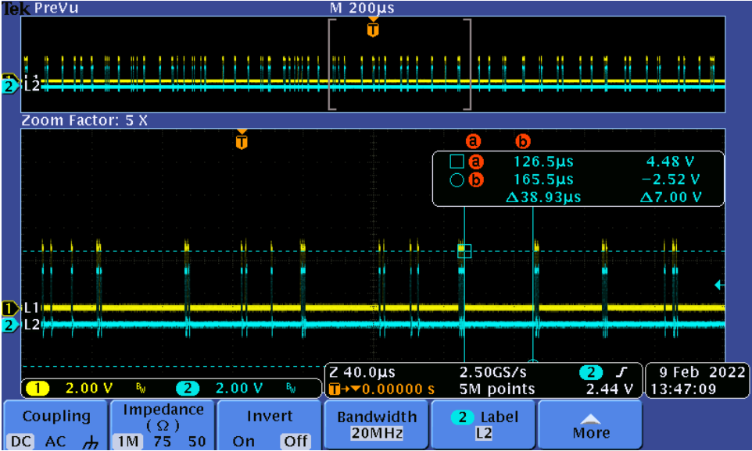
PFM working-TPS631000
Switching time—changing due to skip mode
Pause time—changing due to skip mode, but much smaller than TPS63805
Quiescent current—8.5uA
Buck-boost switching
Rising time and falling time are almost all 25nS

Slide 6
 | Rdson | Rising time/switching time | Falling time/switching time | Peak current/switching time | Switching loss/switching time | Switching mode
TPS63805 | Better |  |  |  |  | Burst
TPS631000 |  | Better | Better | smaller | Better | Skip
TPS631000 has a much smaller pause time which means much less energy transferred to output during each switching period. Then we will get smaller peak current and much less switching loss during switching. That is why TPS631000 has a better efficiency performance in this case

Slide 7
Ripple performance of TPS631000

Slide 8
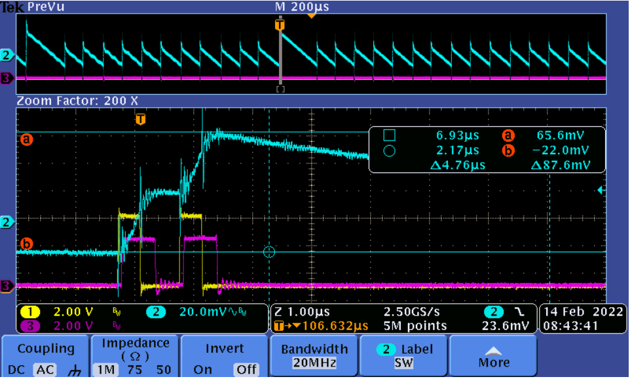
Ripple test Vin=5V Vout=3.3V Iout=0.0048A Capacitor:22u/10V X5R without feedforward capacitor PFM
Two pulses during switching, the maximum output ripple is 83mV
Notes:
When studying a converter schematic prior to PCB layout, it’s often convenient to highlight the high current traces, the high dv/dt circuit nodes, and the noise-sensitive nets as shown in this slide. This example shows a voltage-mode controlled regulator intended for noise-sensitive communications applications that uses TI’s LM5145 100V synchronous buck controller.
Various noise reduction features integrated in the LM5145 include external clock synchronization, internal oscillator. Pulse skipping at light loads is inhibited during synchronization or when the SYNCIN pin is pulled low to reduce noise and RF interference. For added reliability, the LM5145 is rated for negative SW and gate drive transients of -5V up to 20ns duration.

Slide 9
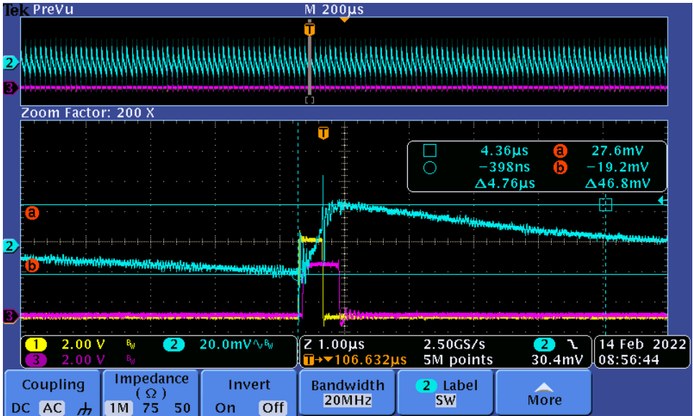
Ripple test Vin=5V Vout=3.3V Iout=0.02A Capacitor:22u/10V X5R without feedforward capacitor PFM
One pulse only and the maximum ripple is 46.8mV
Notes:
When studying a converter schematic prior to PCB layout, it’s often convenient to highlight the high current traces, the high dv/dt circuit nodes, and the noise-sensitive nets as shown in this slide. This example shows a voltage-mode controlled regulator intended for noise-sensitive communications applications that uses TI’s LM5145 100V synchronous buck controller.
Various noise reduction features integrated in the LM5145 include external clock synchronization, internal oscillator. Pulse skipping at light loads is inhibited during synchronization or when the SYNCIN pin is pulled low to reduce noise and RF interference. For added reliability, the LM5145 is rated for negative SW and gate drive transients of -5V up to 20ns duration.

Slide 10
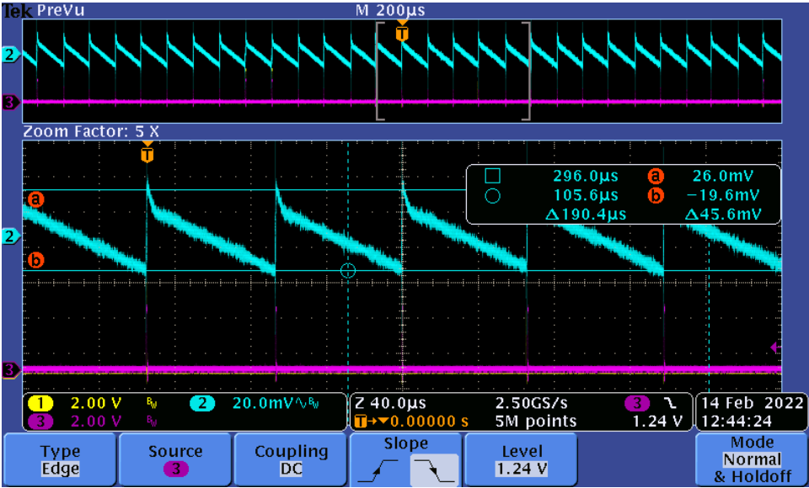
Ripple test Vin=5V Vout=3.3V Iout=0.0048A Capacitor:22u/10V X5R with Cff=51pF PFM
Single pulse during switching, the maximum output ripple is 46mV. Also we did test in the range of Iout=0.003-0.025A Vin=2/3.3/5V. The ripple always smaller than 60mV
Notes:
When studying a converter schematic prior to PCB layout, it’s often convenient to highlight the high current traces, the high dv/dt circuit nodes, and the noise-sensitive nets as shown in this slide. This example shows a voltage-mode controlled regulator intended for noise-sensitive communications applications that uses TI’s LM5145 100V synchronous buck controller.
Various noise reduction features integrated in the LM5145 include external clock synchronization, internal oscillator. Pulse skipping at light loads is inhibited during synchronization or when the SYNCIN pin is pulled low to reduce noise and RF interference. For added reliability, the LM5145 is rated for negative SW and gate drive transients of -5V up to 20ns duration.

Slide 11
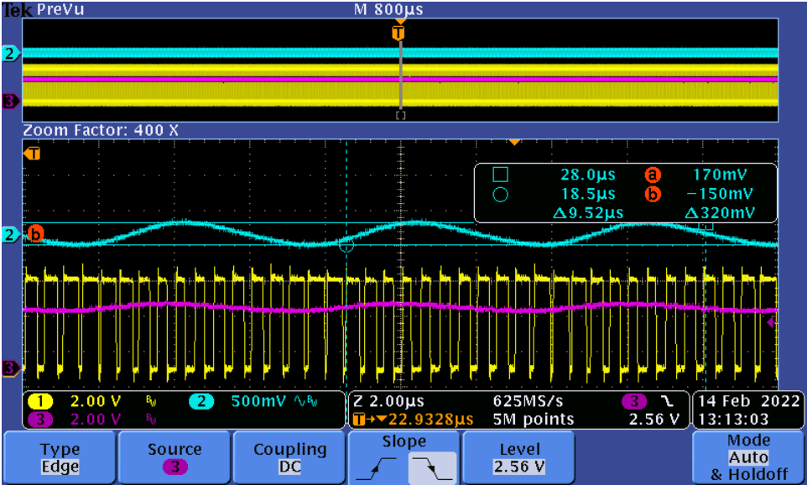
Loop is unstable Vin=5V Vout=3.3V Iout=0A Capacitor:22u/10V X5R Cff=51pF FPWM
Warning: loop is not stable with Cff=51pF. Make sure the output current should no more than 0.1A(PFM working only) if Cff=51pF used.
Notes:
When studying a converter schematic prior to PCB layout, it’s often convenient to highlight the high current traces, the high dv/dt circuit nodes, and the noise-sensitive nets as shown in this slide. This example shows a voltage-mode controlled regulator intended for noise-sensitive communications applications that uses TI’s LM5145 100V synchronous buck controller.
Various noise reduction features integrated in the LM5145 include external clock synchronization, internal oscillator. Pulse skipping at light loads is inhibited during synchronization or when the SYNCIN pin is pulled low to reduce noise and RF interference. For added reliability, the LM5145 is rated for negative SW and gate drive transients of -5V up to 20ns duration.

Slide 12
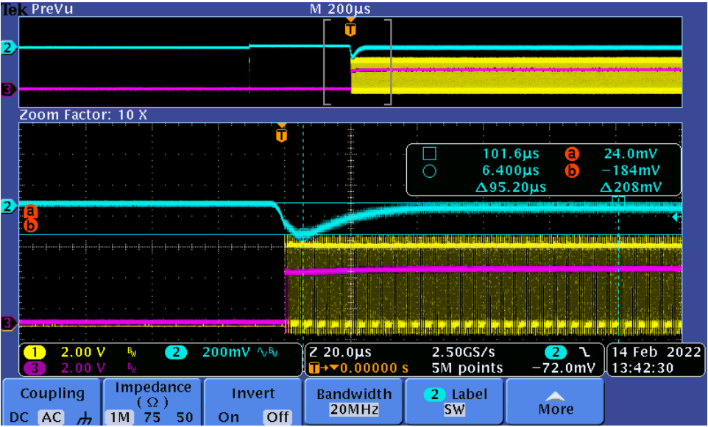
Load transient Vin=5V Vout=3.3V Iout=0-1A 250mA/us Capacitor:22u/10V X5R PFM
loop is stable without Cff when Cout=22uF.
Notes:
When studying a converter schematic prior to PCB layout, it’s often convenient to highlight the high current traces, the high dv/dt circuit nodes, and the noise-sensitive nets as shown in this slide. This example shows a voltage-mode controlled regulator intended for noise-sensitive communications applications that uses TI’s LM5145 100V synchronous buck controller.
Various noise reduction features integrated in the LM5145 include external clock synchronization, internal oscillator. Pulse skipping at light loads is inhibited during synchronization or when the SYNCIN pin is pulled low to reduce noise and RF interference. For added reliability, the LM5145 is rated for negative SW and gate drive transients of -5V up to 20ns duration.

Slide 13
Test results
 | Vin | Iin | Vout | Iout | Eff
TPS631000(with Cff) | 3.698 | 0.0143 | 3.281 | 0.0152 | 94.3%
TPS631000 | 3.699 | 0.0146 | 3.279 | 0.0152 | 92.3%

