Slide 1
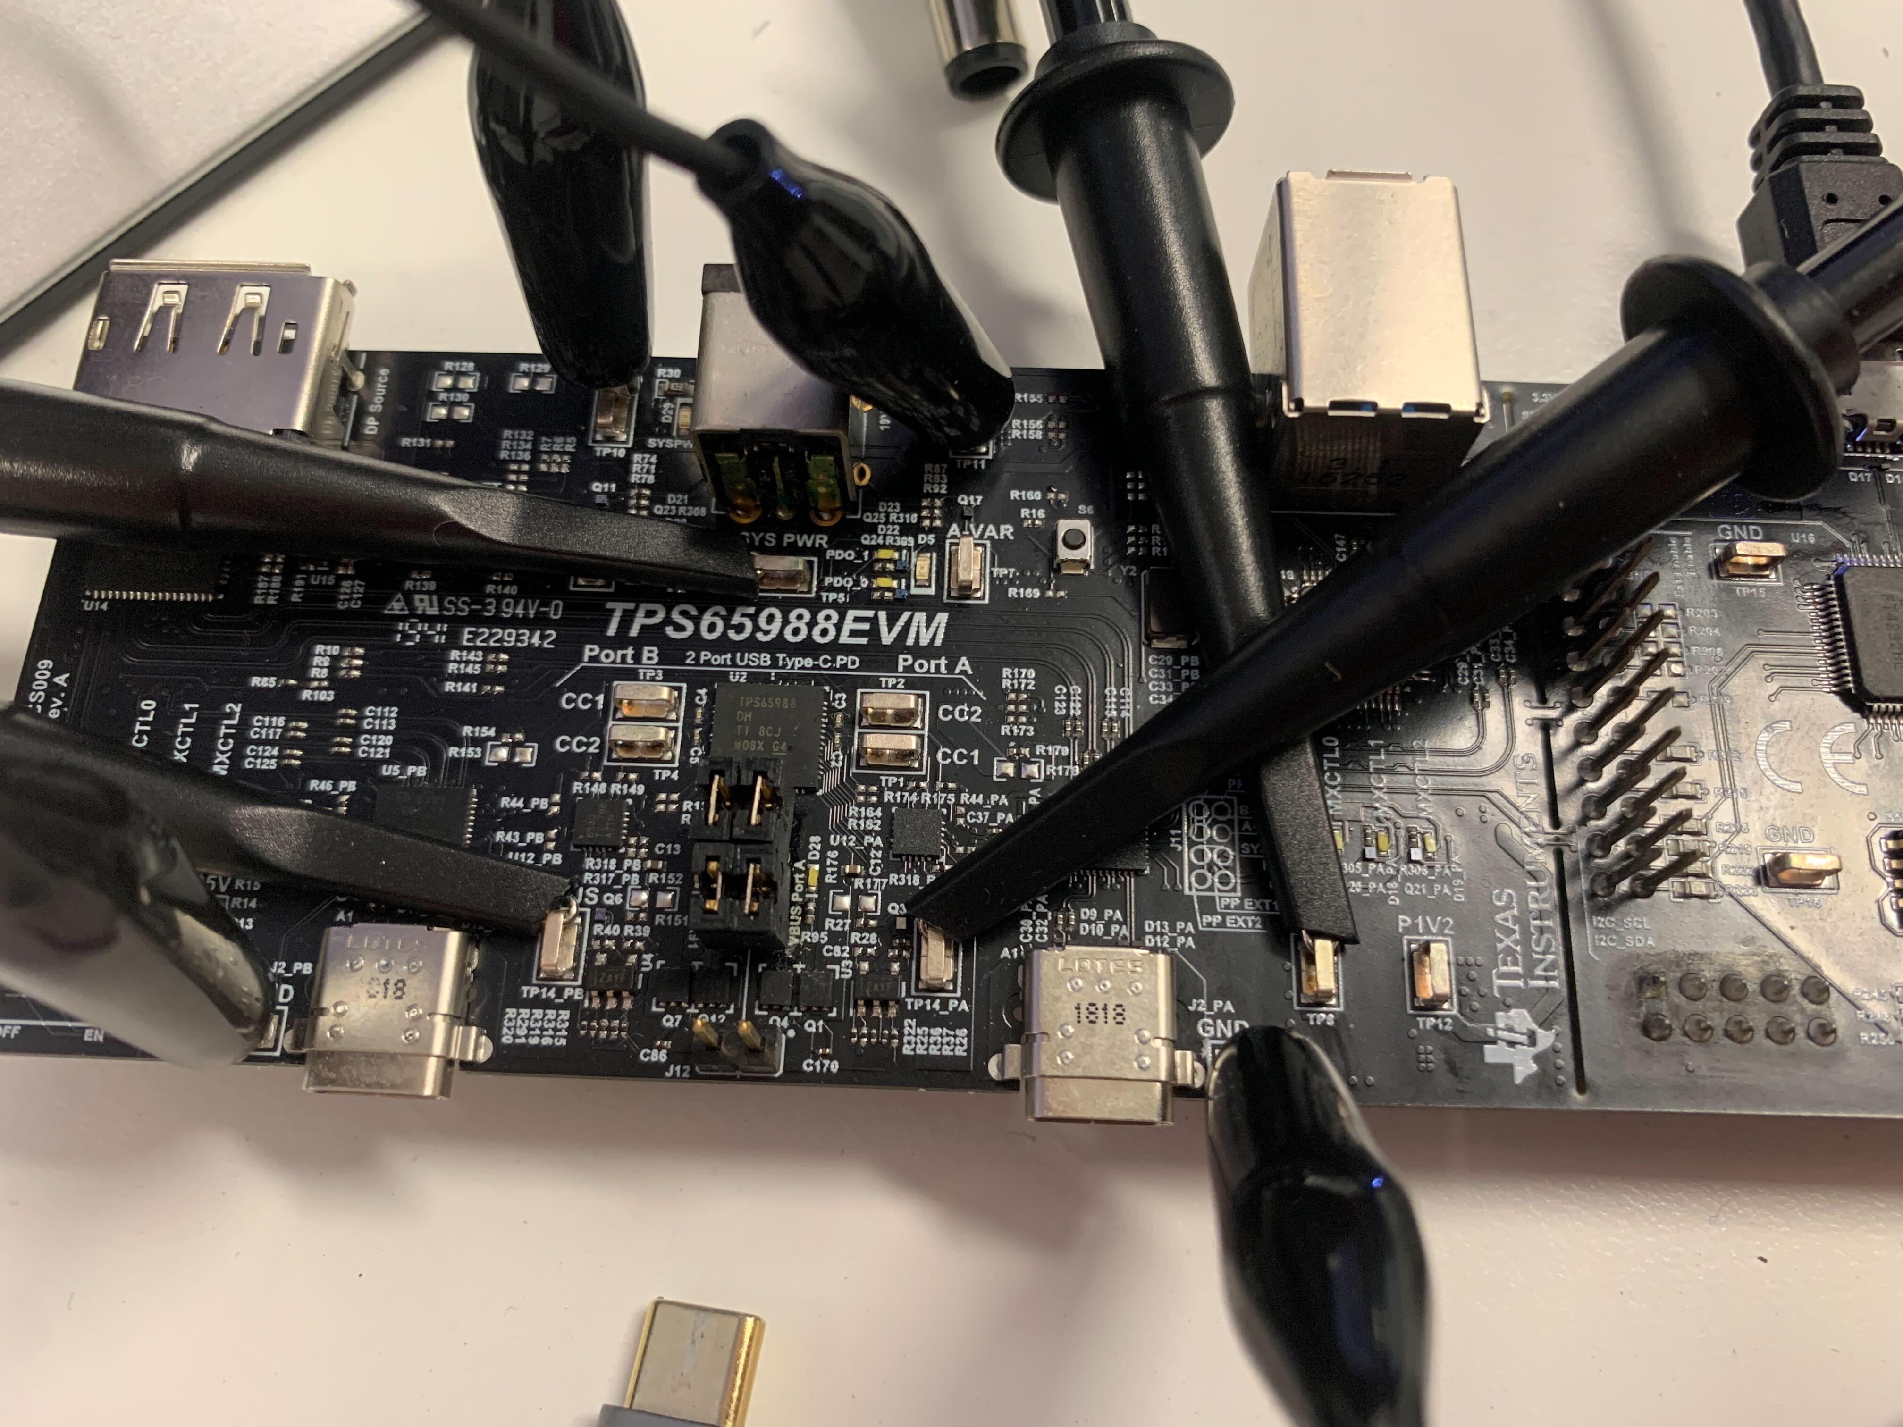
[EXTENDED] Test Setup
SYSPWR
P3V3
VBUS Port1
VBUS Port2
Port 2
Port 1

Slide 2
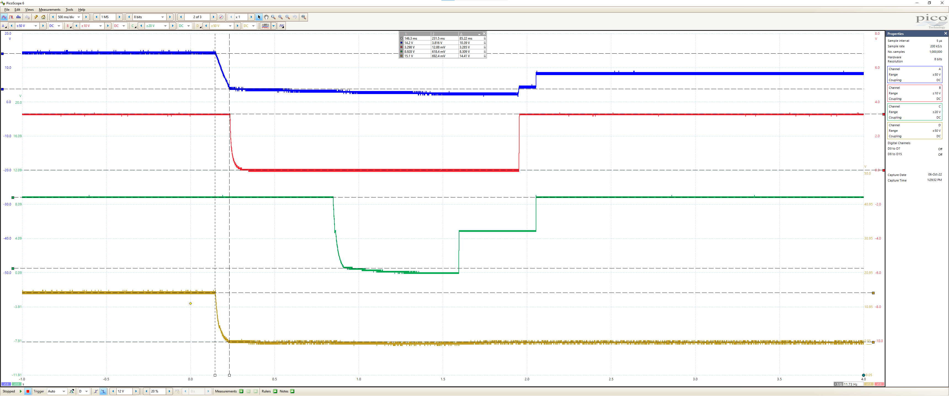
SYSPWR
P3V3
VBUS Port1
Step 3: [EXTENDED] Disconnect second battery from Port2 (with battery still connected to Port 1)
VBUS Port2

