Slide 1
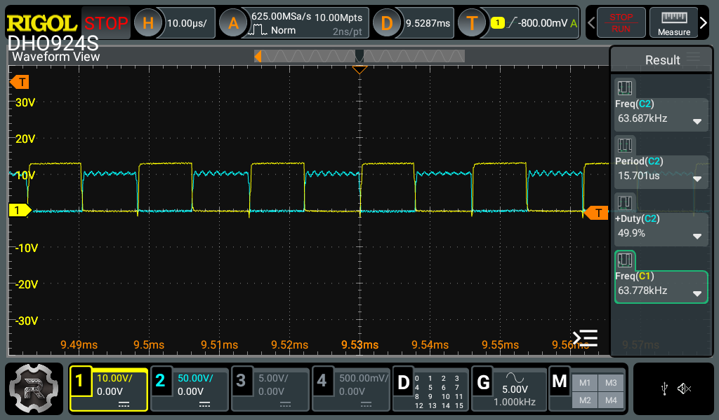
FQP8N60C Swtiching

Slide 2
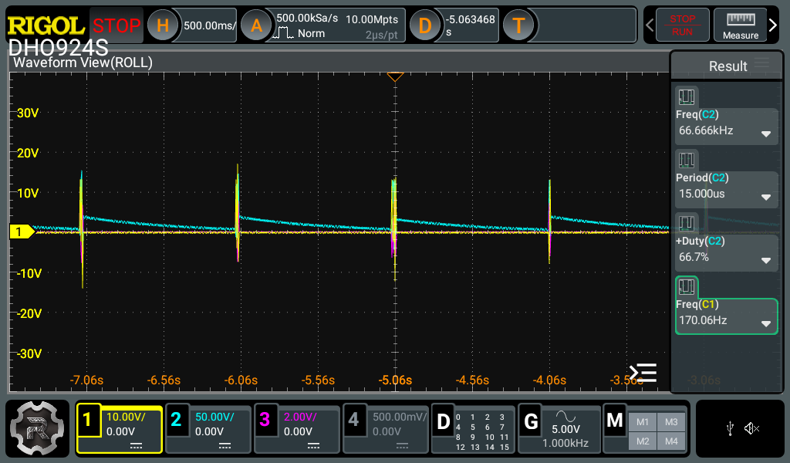
IPA60R180P7 Swtiching

Slide 3
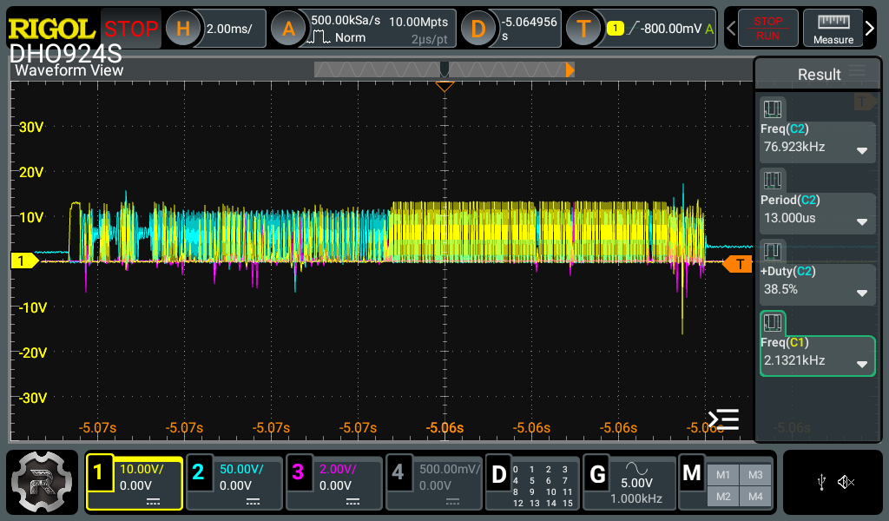
IPA60R180P7 Switching Enlarged
1
2
3
4

Slide 4
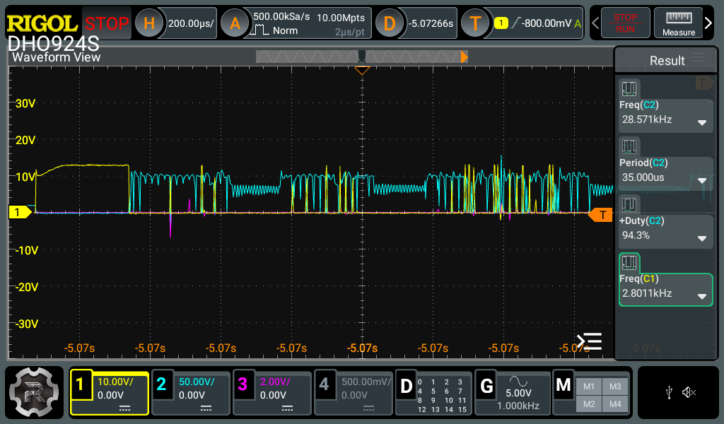
Zone 1 waveform

Slide 5
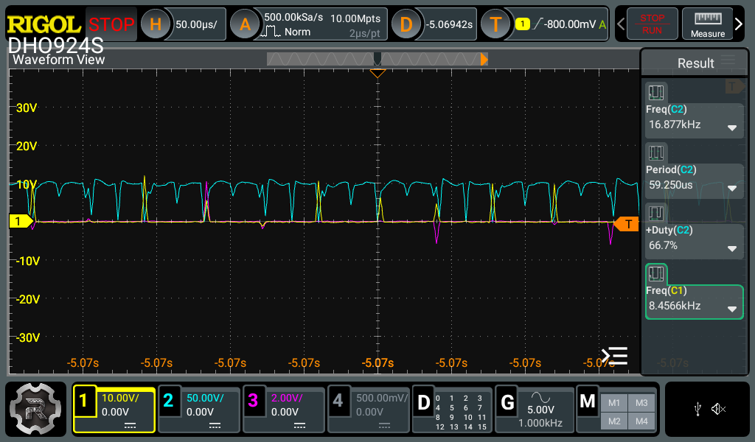
Zone 2 waveform

Slide 6
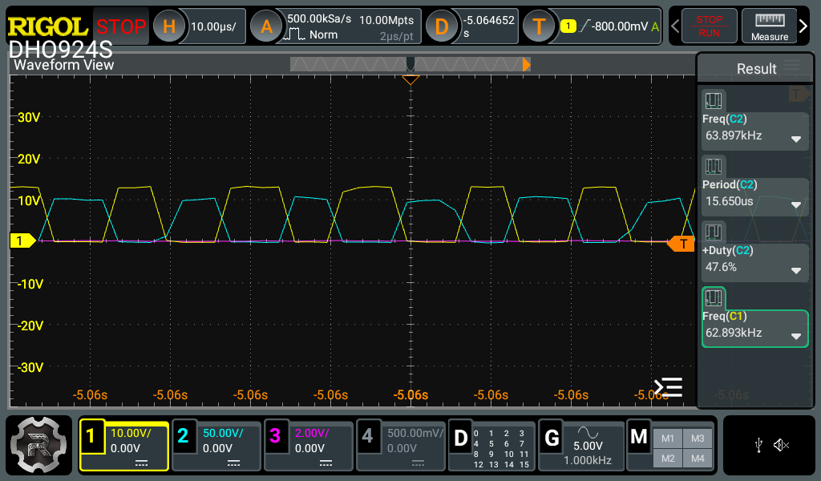
Zone 3 waveform

Slide 7
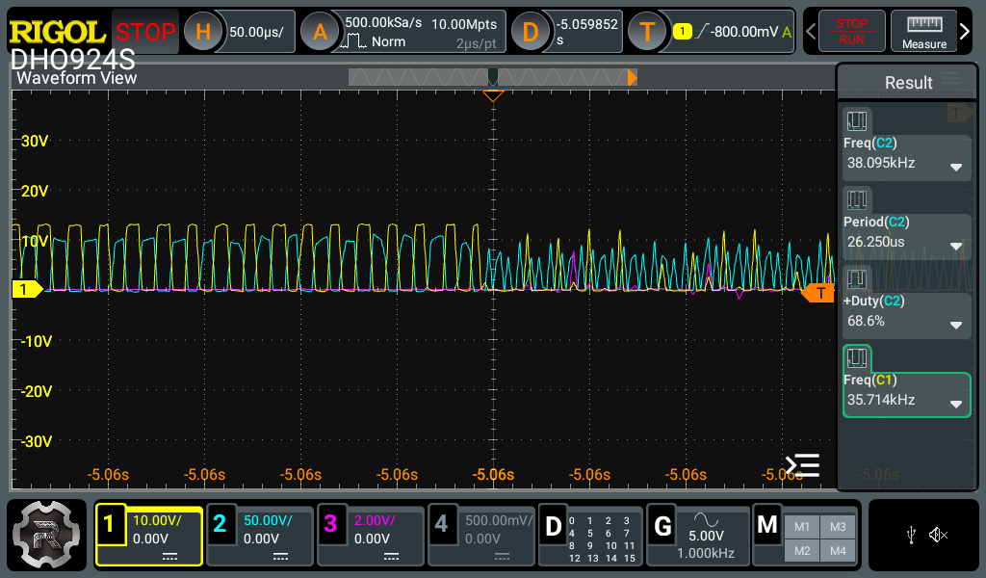
Zone 4 waveform

