Slide 1
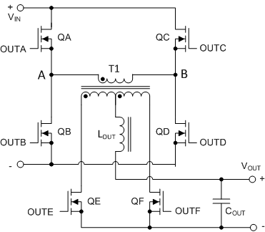
Phase Shifted Full Bridge
Active Leg
QA, QB
Passive Leg
QC, QD
Four switches, transformer, two rectifiers, inductor
  Double ended topology
Buck like output stage
Four switching states per cycle
  Two power transfer
  Two freewheeling
Four ZVS transitions per cycle
Phase between legs controls conversion ratio
  Complex control, requires IC
High power (1kW and upwards)
Can achieve zero voltage switching
  Important for high Vin applications
1
Notes:
This is the schematic of a PSFB circuit
QA, QB, QC and QD are the four primary side switches. QE and QF are the secondary side rectifiers. Other secondary rectification circuits are possible, and we will look at these later but for now we will concentrate on this centre tapped full wave rectifier.
It’s a double ended topology which means that both ends of the transformer primary are alternately switched between Vin and 0V, this allows symmetrical positive and negative flux swings in the transformer core so core reset is not an issue. The transformer primary sees the full input voltage so currents are less than in other topologies.
The PSFB is a buck derived topology so the input / output conversion is directly proportional to the duty cycle.
There are four switching states and four ZVS transitions per cycle and we will look at these in more detail shortly.
There are different terms used by different sources when describing this topology. I’m going to use the convention usually used within TI – which is the one shown here.
Just to restate – the PSFB is well suited to high input voltage, high power applications because of excellent transformer core utilisation and its ability to achieve ZVS.

Slide 2
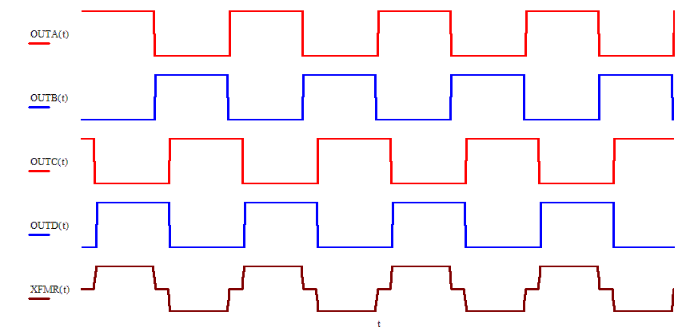

Phase Shifted Full Bridge
PA Leg
Left Leg
QA, QB
AP Leg
Right Leg
QC, QD
$$V_{OUT}=D V_{IN} \frac{N_{S}}{N_{P}}$$
Buck Derived topology
OUTA, OUTB – reference pair
D controlled by phase shifting OUTC & OUTD
QE, QF are SRs, Diode rectification is possible
Mouse over the waveforms to play the animation
2
Notes:
The graphic shows the gate drives to QA and QB (red and blue) on top. QC and QD (red and blue) in the middle.
The voltage across the transformer is shown in brown at the bottom.
These waveforms are all at 50% duty cycle – less 1% or 2% to allow time for ZVS transitions.
OUTA and OUTB are the reference pair, they don’t change.
OUTC and OUTD are phase shifted with respect to the reference pair to control the duty cycle.
Power transfer from primary to secondary happens when ‘diagonal pairs’ of switches are on. – QA and QD or QB and QC
The transformer duty cycle is simply the proportion of the switching cycle for which voltage is applied to the transformer
I’m going to play the animation now –

