Slide 1
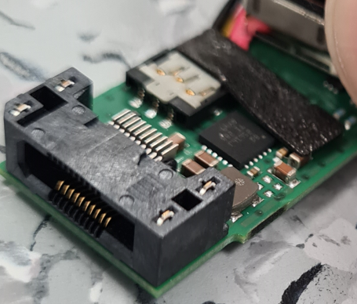
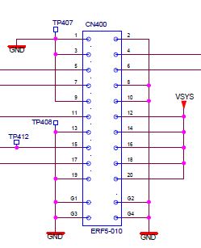
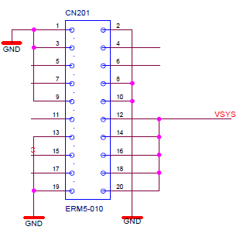
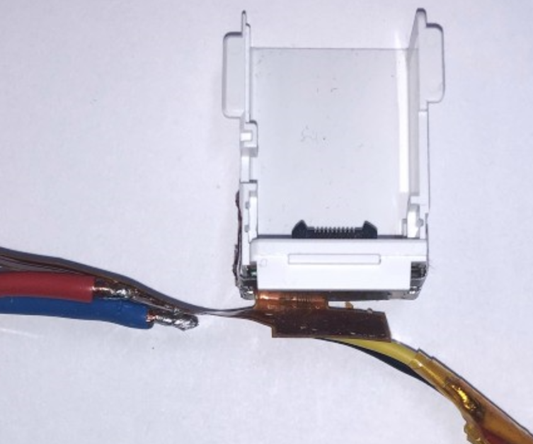
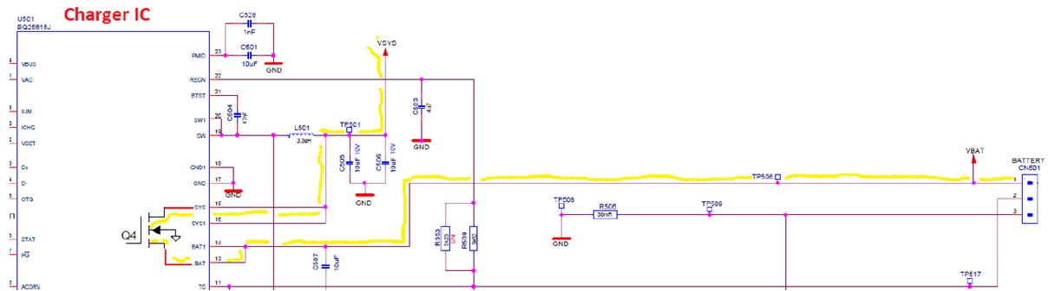
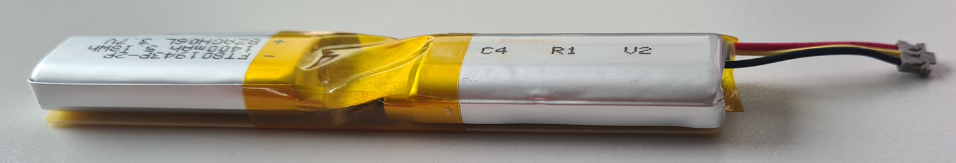
SETUP BATTERY UNIT LOAD TEST:
Battery conn. CN501
receptacle
plug
Indirect current measurement
V
Batt Volt Conn
Receptacle CN400
10mohm/0.5%
Charger IC
V
Electronic load
Plug CN201
Chg IC Volt
FT801943P-2P/1400mAh
SERAZ001-02058-2

Slide 2
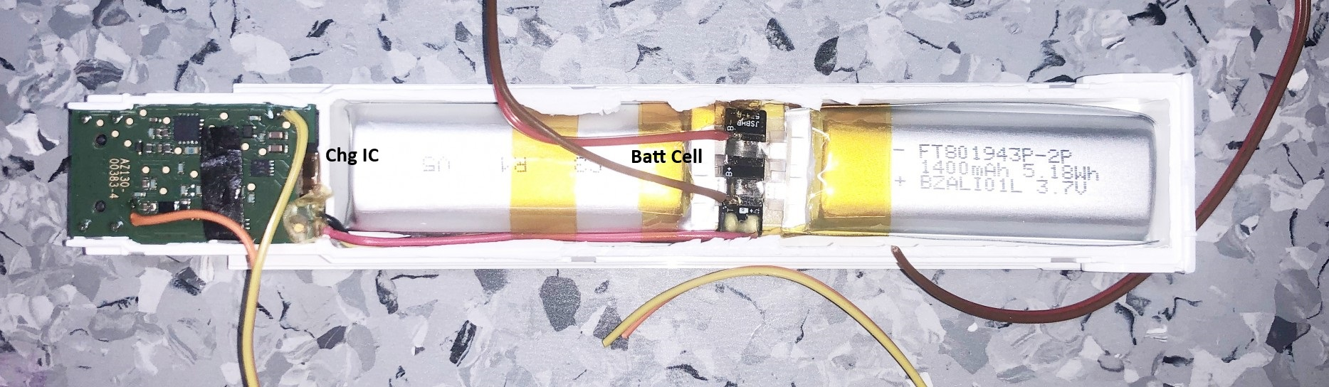
Chg IC Volt
Cell Volt

Slide 3
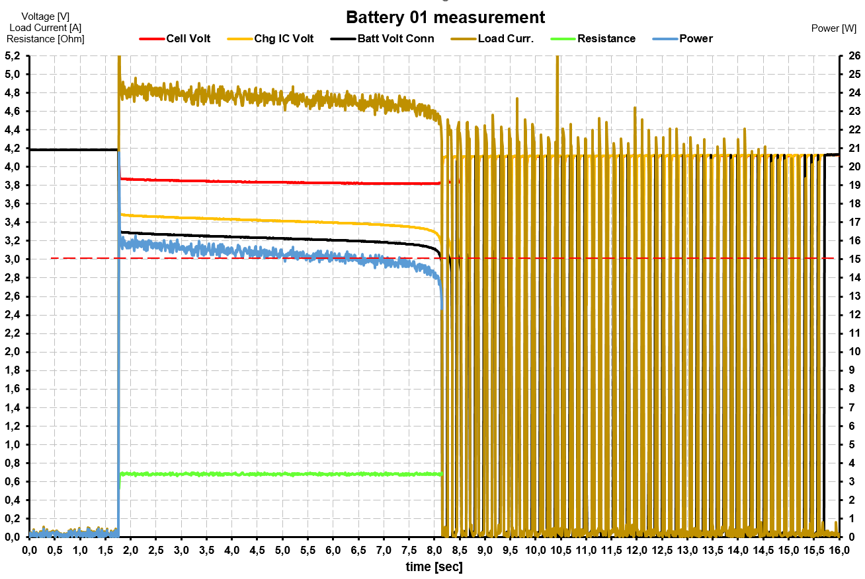
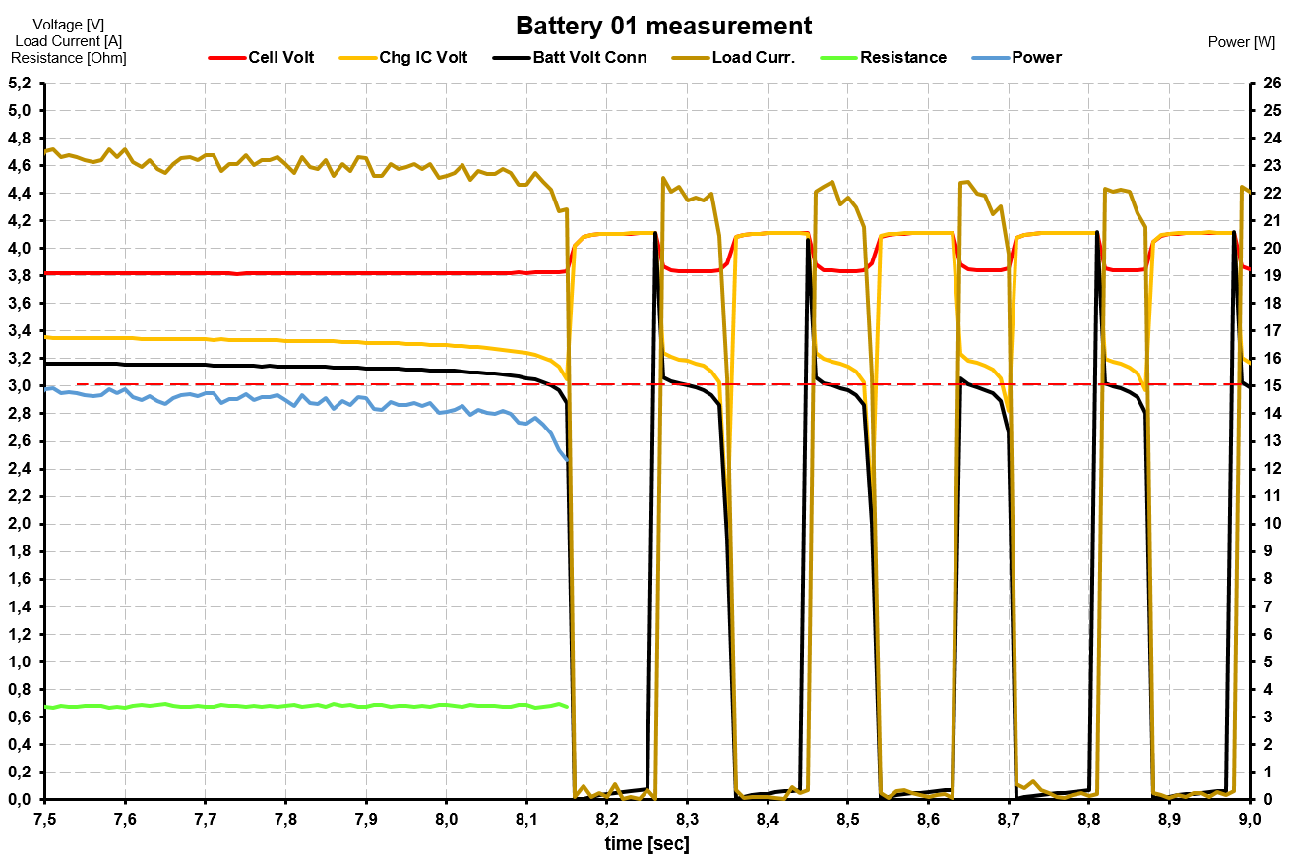
The cut-off after 8.15 sec. is not related to an overcurrent protection.
Rather any voltage detection threshold reached?

