Slide 1
Fly-Buck-Boost Converters
Buck-boost D/(1–D) Transfer Function
Feedback of 2x VOUT
Low VIN operation possible
Notes:
Flow and format same as the fly-Buck

Slide 2
Fly-Buck-Boost Operation
TON
TOFF

Slide 3
Fly-Buck-Boost Operation
TON
TOFF

Slide 4


“Fly-Buck-Boost” Details
 | Fly-Buck-Boost
 | Lower D than Fly-Buck ⇒ Fly-buck-boost can operate at lower VIN if needed Transformer SEC-to-PRI turns ratio can be lower fewer winding turns lower leakage inductance & DCR less current ringing caused by transformer parasitics improved load regulation
 | Buck-boost primary-side inductor current is higher: I_{Lp} = (I_{PRI} + N*I_{SEC})/(1 – D) Effective VIN(max) is higher: V_{IN} + V_{PRI} Input UVLO is not easily set as the IC references –V_{PRI} as GND

Slide 5
Typical Fly-Buck-Boost Circuit with LM5017
Inverting Fly-Buck-Boost
Note the change in the schematic
Fly-Buck

Slide 6
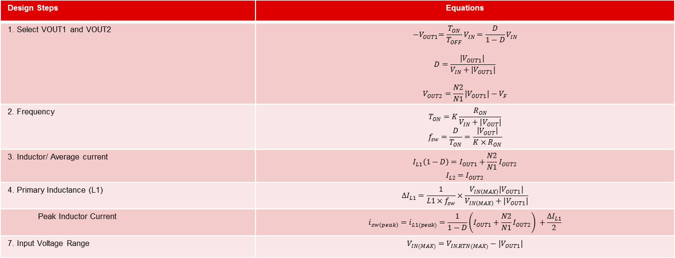
Fly-Buck-Boost Design Equations
Design Steps | Equations
1. Select VOUT1 and VOUT2 | $${−V}_{OUT1}=\frac{T_{ON}}{T_{OFF}}V_{IN}=\frac{D}{1−D}V_{IN}$$ $$D=\frac{{|V}_{OUT1}| }{V_{IN}+{|V}_{OUT1}|}$$ $$V_{OUT2}=\frac{N2}{N1}{|V}_{OUT1}|−V_{F}$$
2. Frequency | $$T_{ON}=K\frac{R_{ON}}{V_{IN}+{|V}_{OUT}|}$$ $$f_{sw}=\frac{D}{T_{ON}}=\frac{\left|V_{OUT}\right|}{K×R_{ON}}$$
3. Inductor/ Average current | $$I_{L1}\left(1−D\right)=I_{OUT1}+\frac{N2}{N1}I_{OUT2}$$ $$I_{L2}=I_{OUT2}$$
4. Primary Inductance (L1) | $$∆I_{L1}=\frac{1}{L1×f_{sw}}×\frac{V_{IN\left(MAX\right)}{|V}_{OUT1}|}{V_{IN\left(MAX\right)}+|V_{OUT1}|}$$
Peak Inductor Current | $$i_{sw\left(peak\right)}=i_{L1(peak)}=\frac{1}{1−D}\left(I_{OUT1}+\frac{N2}{N1}I_{OUT2}\right) +\frac{∆I_{L1}}{2}$$
7. Input Voltage Range | $$V_{IN(MAX)}=V_{IN,RTN(MAX)}−|V_{OUT1}|$$

