Slide 1
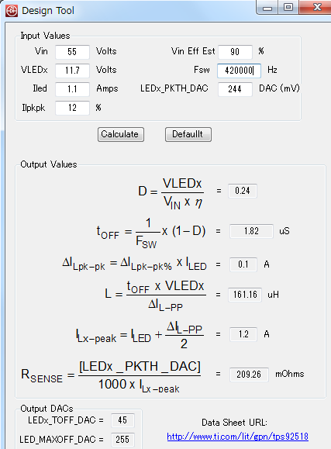
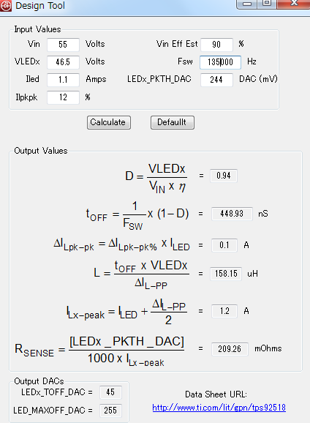
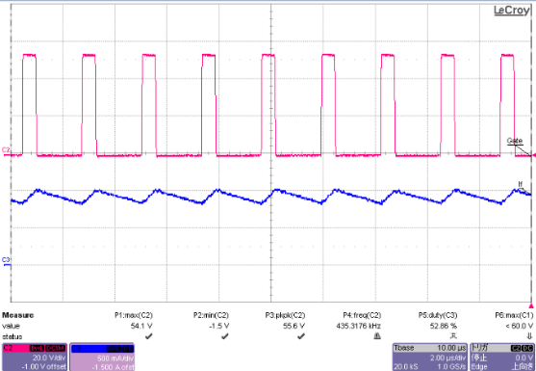
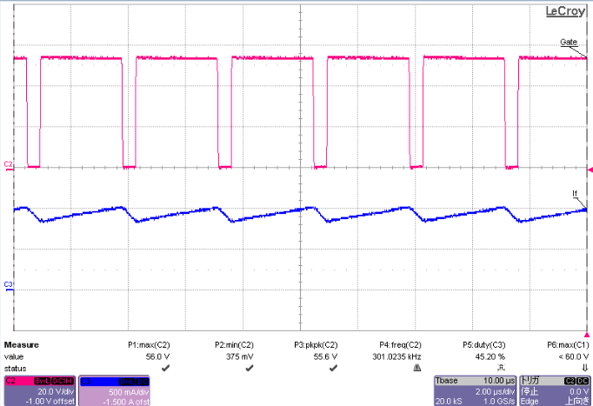
Case 1
VLEDx=11.7V
Case 2
VLEDx=46.5V
Fsw=420KHz( calc)
TOFF=45(calc)
Fsw=135KHz( calc)
TOFF=45(calc)
SW ( approx. 430KHz )
SW ( approx. 300KHz )
Inductor current
Inductor current

