Slide 1
Fusion verification for TPS65400 report
June 6, 2017

Slide 2
Result summary
Code | Name | Testing Result
D0 | USER_DATA_BYTE_00 | Not test
D1 | USER_DATA_BYTE_01 | Not test
D2 | PIN_CONFIG_00 | Not test
D3 | PIN_CONFIG_01 | OK
D4 | SEQUENCE_CONFIG | OK
D5 | SEQUENCE_ORDER | OK
D6 | IOUT_MODE | OK
D7 | FREQUENCY_PHASE | OK
D8 | VREF_COMMAND | OK
D9 | IOUT_MAX | OK
DA | USER_RAM_00 | OK
DC | RESET_DELAY | OK
DD | TON_TOFF_DELAY | OK
DE | TON_TRANSITION_RATE | OK
DF | VREF_TRANSITION_RATE | OK
F0 | SLOPE_COMPENSATION | OK
F1 | ISENSE_GAIN | OK
10 | WAITE_PROTECT | OK
19 | CAPABILITY | OK
98 | PMBUS_REVISION | OK
01 | OPERATION | OK

Slide 3
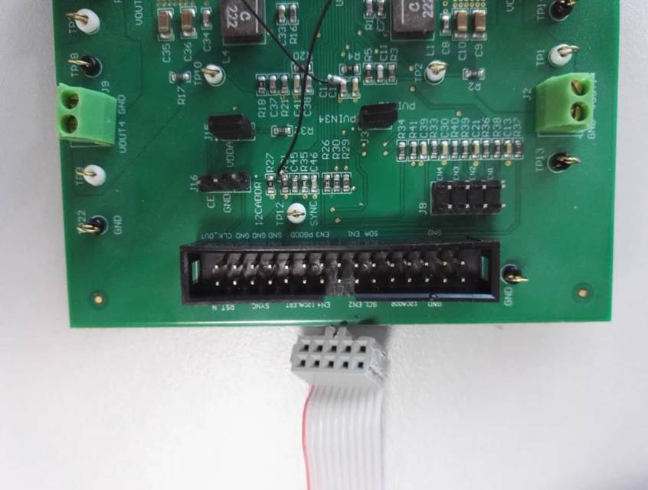
Result summary
1, USB2ANY that TPS65400 EVM adopted has 30 pin and USB interface adapter has 10 pin. So, these two connector isn’t compatible just as the follow picture.

Slide 4
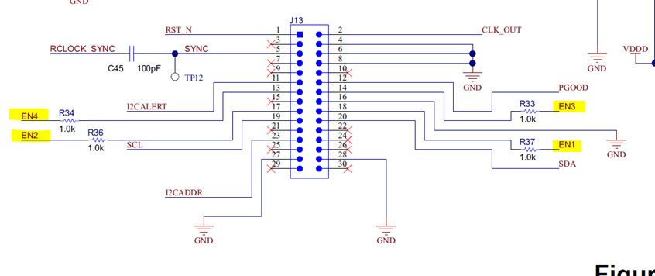
Result summary
2, The connector that TPS56400 adopted has IIC signal(SCL,SDA) and 4 Enable signal as the follow picture. When the part connecting with USB interface adapter is powered on, the default of USB interface adapter is that EN1 is high and EN2,EN3,EN4 are low. So even I successfully write data to rail2,rail3,rail4, there isn’t any response about Buck2,Buck3,Buck4.

Slide 5
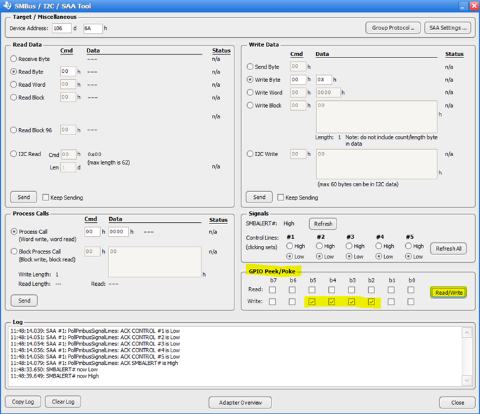
Result summary
3,when I set the GPIO high as the bellow picture, EN2,EN3,EN4 is enable on. Then Buck2 and Buck3 has right response when I write data to rail2 and rail3.

Slide 6
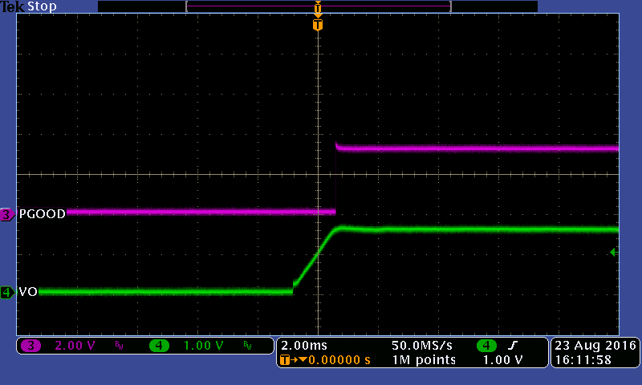
PIN_CONFIG_01
SSx/PG is set to power good out pin
Buck1 output

Slide 7
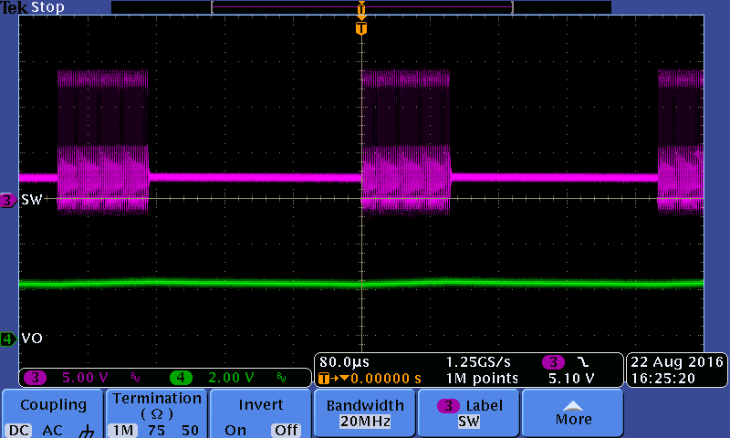
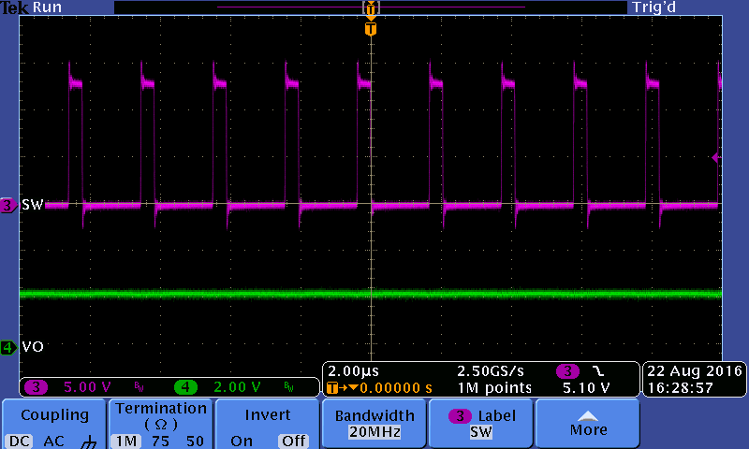
Iout mode
PSM mode empty load
CCM mode empty load

Slide 8
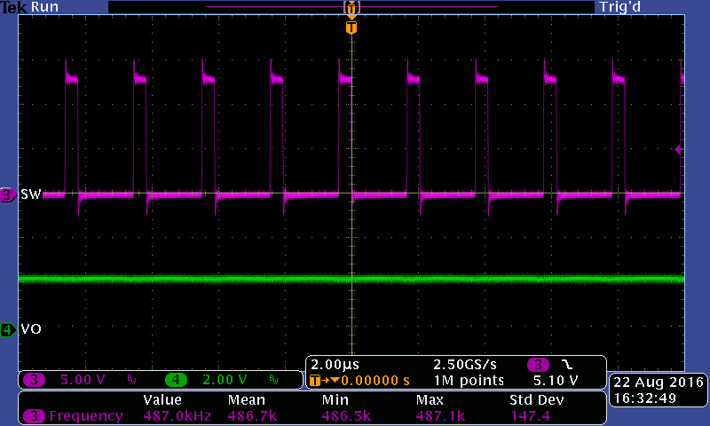
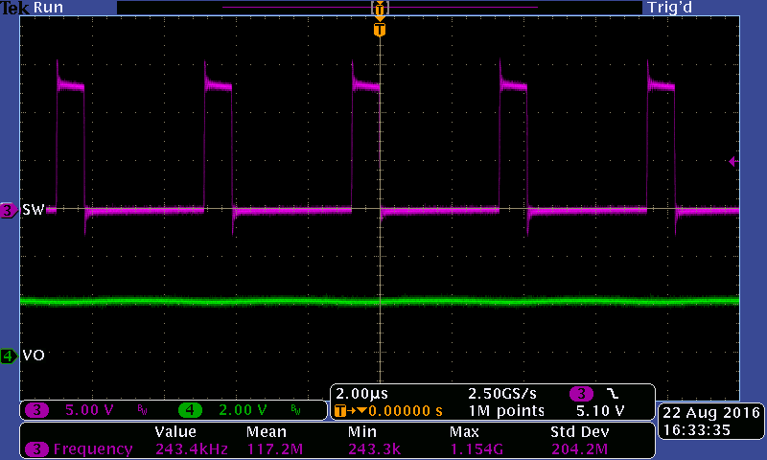
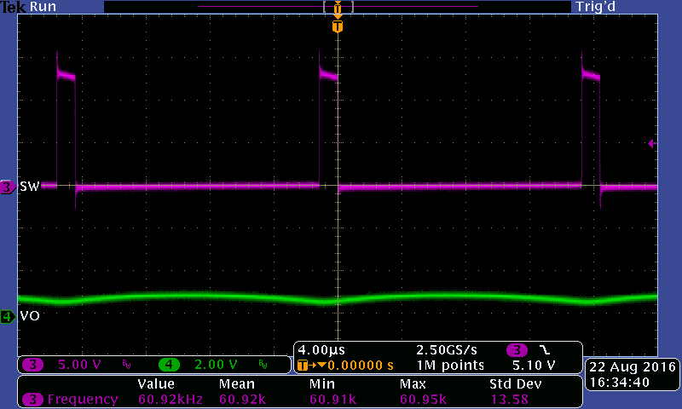
Frequency phase
Frequency/1
Frequency/2
Frequency/8

Slide 9
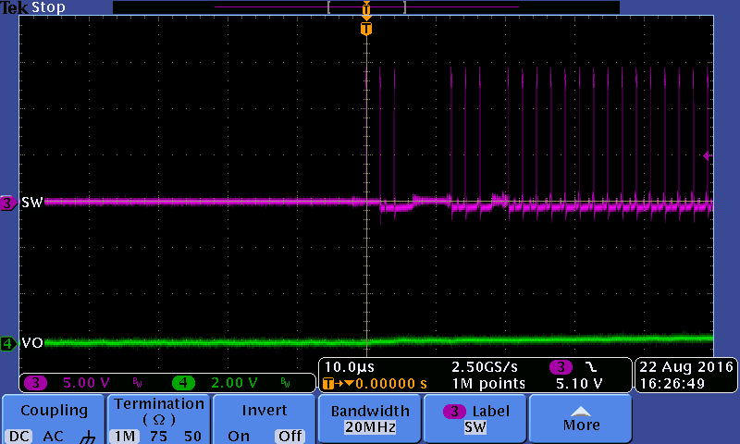
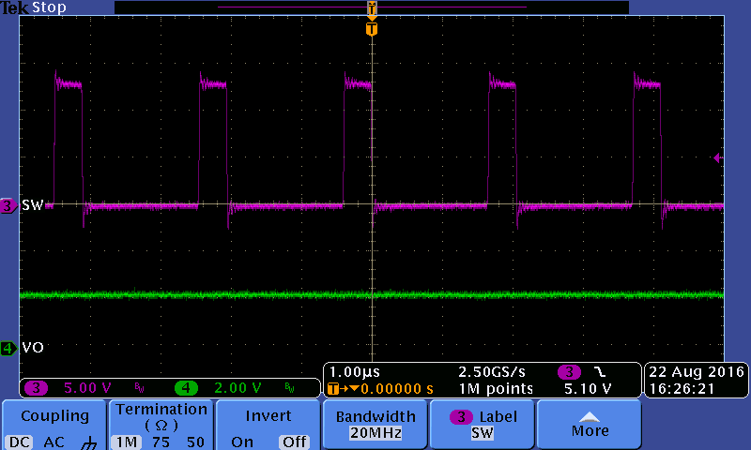
Iout max
Set Iout max is 2A
When Iout is 2A, the part goes to OC protection
PSMmode_2Aout
PSMmode_1Aout

Slide 10
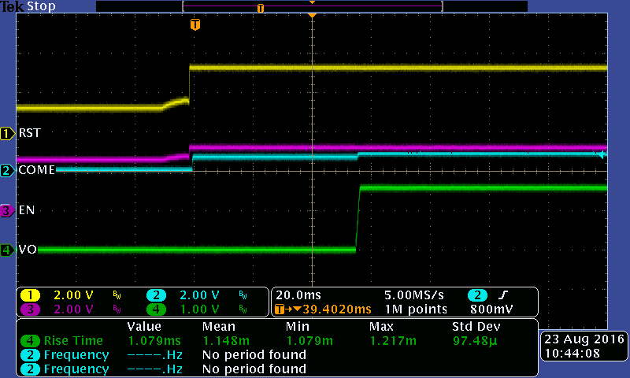
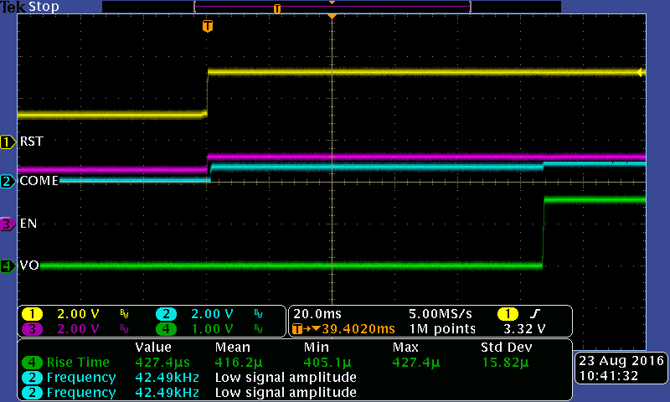
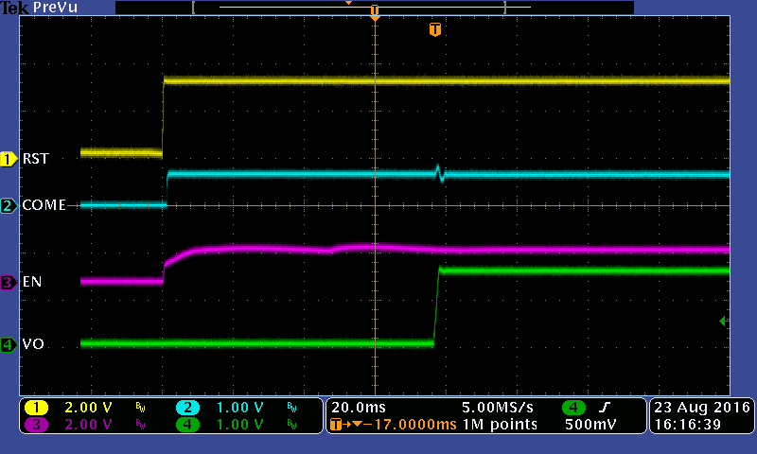
Reset delay and Ton/Toff delay
Reset delay 50ms, Ton delay 5ms
Reset delay 100ms, Ton delay 5ms
Reset delay 50ms, Ton delay 25ms

Slide 11
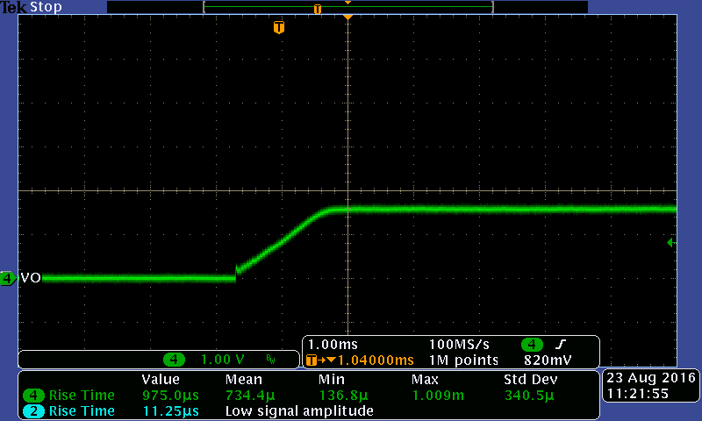
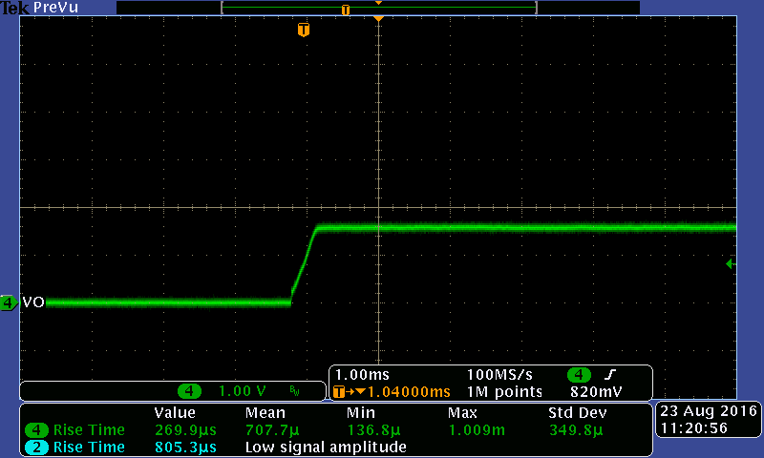
Ton transition rate
Vref=0.6V
Tss 0.5v/ms
Tss 2v/ms

Slide 12
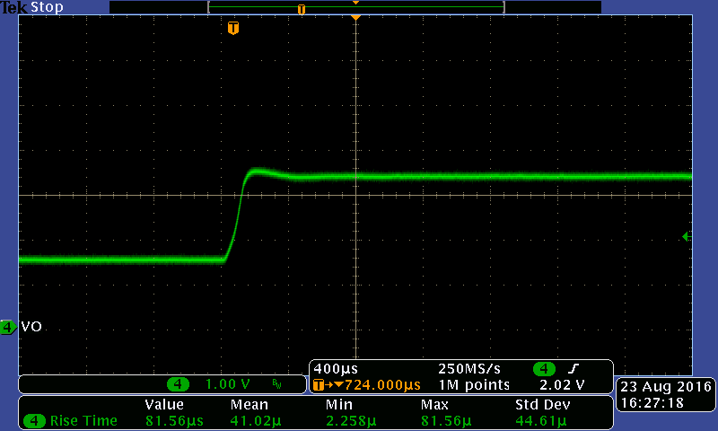
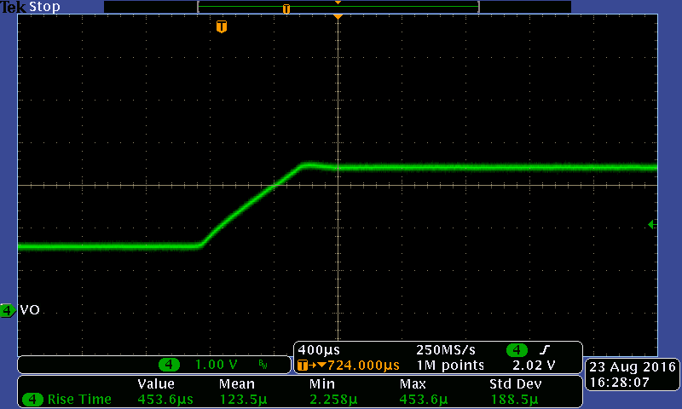
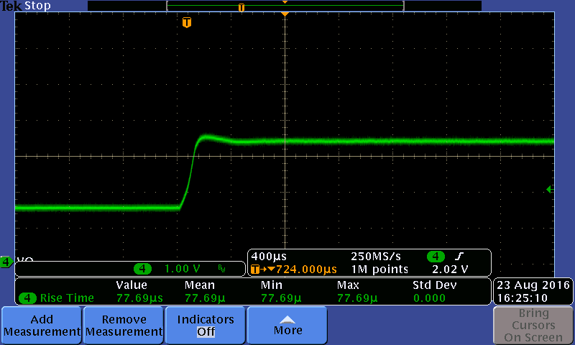
Verf transition rate
opt1_1us
opt1_8us
opt5_1us

