Slide 1
Gauge Design Configurations for High Charge / Discharge Rate Applications
Thomas Cosby

Slide 2
Agenda
Special pack applications
High charge and discharge rates
High capacity packs
High cell count packs
Hardware considerations
Design consideration for boards
Sense Resistor Choices
FET selection for gauge + protectors
Calibration
Parameter configuration
Products (bq78350, bq34z100-G1)

Slide 3
Special Pack Applications
High charge and discharge rates
The current reporting registers can support up to 32A charge or discharge current.
Current scaling can be used to support higher current applications.
High capacity packs
The gauge can typically support up to 29Ah Design Capacity.
Current scaling can be used to support higher capacity applications.
High cell count packs
The bq34z100-G1 can support up to 65V pack voltage and the bq78350 can support up to 15S application with VSCALE.
Voltage scaling can be used to support higher voltage applications.

Slide 4
High Charge and Discharge Rates (> 32A)
If we need to support a 48A discharge current, then that pack will be scale by 48A/32A = 1.5 ⇒ Scale factor rounded up to 2x.
We can fool the gauge by current calibration: for a 5 mohm Rsense, if we calibrate at an actual current of 4A, we can use the value 2A for calibration so the CC Gain and CC Delta would become 10 mohm. We now have a calibration ratio of 50%
Modify all current and capacity related data flash values by the scale factor, example: 1st level OC from 6000mA to 3000mA; pay attention to sleep current/quit current, as these are impacted as well; also modify DesignCapacity, DesignEnergy
Exception is AFE OC Dsg, AFE SC Chg and Dsg: calculate these values based on the voltage = true Rsense * true current
All reported current and capacity parameters will need to be scaled up by the scale factor to restore the true values.

Slide 5
High Capacity Packs (>29Ah)
If we need to support a 80Ah capacity, then that pack will be scale by 80Ah/29Ah = 2.75 ⇒ Scale factor rounded up to 3x or 4x.
You will scale the current during calibration: for a 5 mohm Rsense, if we calibrate at an actual current of 20A, we can use the value 5A for calibration so the CC Gain and CC Delta would become 20 mohm. We now have a calibration ratio of 25% for a 4x scale factor.
Modify all current and capacity related data flash values by the scale factor, example: 1st level OC from 6000mA to 3000mA; pay attention to sleep current/quit current, as these are impacted as well; also modify DesignCapacity, DesignEnergy
Exception is AFE OC Dsg, AFE SC Chg and Dsg: calculate these values based on the voltage = true Rsense * true current
All reported current and capacity parameters will need to be scaled up by the scale factor to restore the true values.

Slide 6
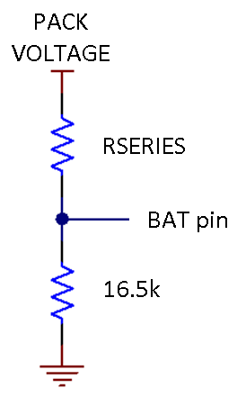
High Cell Count Packs (>65V)
The bq34z100-G1 can support a pack voltage up to 65V.
The input to the IC (BAT pin) must be <1V, so the external divider ratio will be set to support the Maximum Pack Voltage. As an example, if we have an 18S Li-Ion pack, then we should set the Maximum Pack Voltage to the Recommended Single Cell Maximum Voltage (eg: 5V) x Actual Number of Series Cells (e.g: 18) = 90V
Setup the voltage divider to support a 90V pack voltage using the equation:
Rseries = 16500 Ω x (Maximum Pack Voltage mV – 900 mV) / 900 mV
The bottom leg of the divider resistor should be in the range of 15 KΩ to 25 K, using 16.5 KΩ:
Rseries = 16500 Ω x (90000mV – 900 mV) / 900 mV = 1.634 Mohm
A standard value 1.62 Mohm resistor will support an 89V pack voltage. This will provide adequate cell voltage measurement margin for a Li-Ion cell.

Slide 7
High Cell Count Packs (>65V)
The data flash configuration must be scaled to ensure that the maximum reported voltage does not exceed 65535mV.
This additional scaling is created by scaling the value stored in Number of Series Cells. The calculation is: Maximum Pack Voltage (e.g.: 90000mV) / Maximum Reportable Value (65535mV) = 1.38 The Number of Series Cells are an integer units so the value will be rounded up, use a 2x scaling factor.
Stored Number of Series Cells = actual number of series cells / scaling factor ⇒ 18 / 2 = 9
You will need to divide the voltage by 2x when calibrating. E.g. If the applied voltage is 80V, then you will enter 40000mV in the program.
In this configuration, the host device that is reading the reported voltage value must also know that the voltage is scaled so that it can rescale the voltage to the true pack voltage.
Note: There is a limitation as to the actual number of series cells that can be scaled. The result of the equation must be an integer. The result cannot rounded up or down, because this would cause the gauge to calculate the wrong cell voltage. As an example, if the actual number of series cells were 17, then the Number of Series Cells must be set to 17 and the voltage will be reported as a single cell. The VOLTSEL bit must be set in the Pack Configuration register.

Slide 8
Hardware considerations
Design consideration for boards
Layout for high current paths.
ESD
Sense resistor choices and layout
FET selection for gauge + protectors
Calibration

Slide 9
Design Consideration for Boards
The coulomb counting network is probably the most important section to consider in the layout.
The high current paths are the next most important.
The gauge should be not placed inside the current loop for the best gauging accuracy. Transients and fields can induce error into current and voltage measurements.
Use high frequency bypass capacitors and spark gaps to shunt ESD transients.

Slide 10
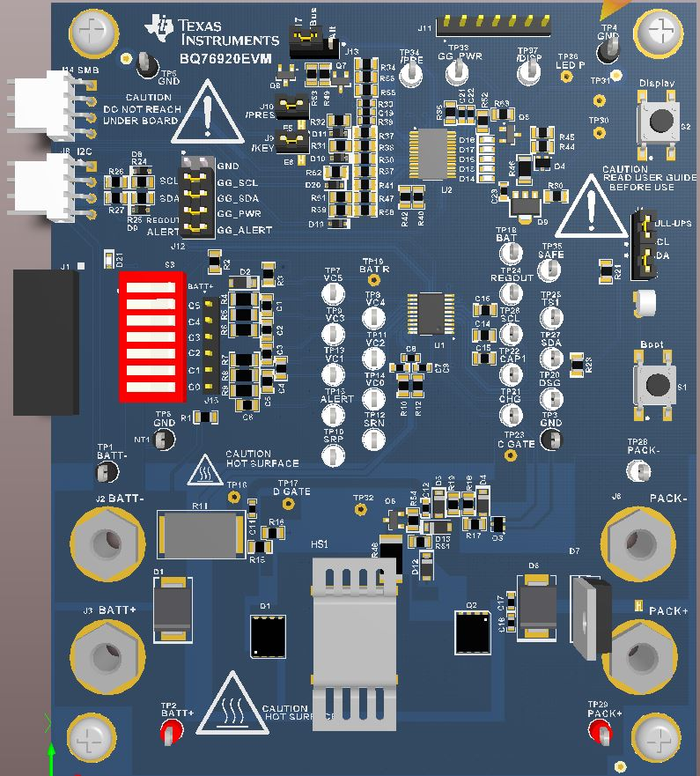
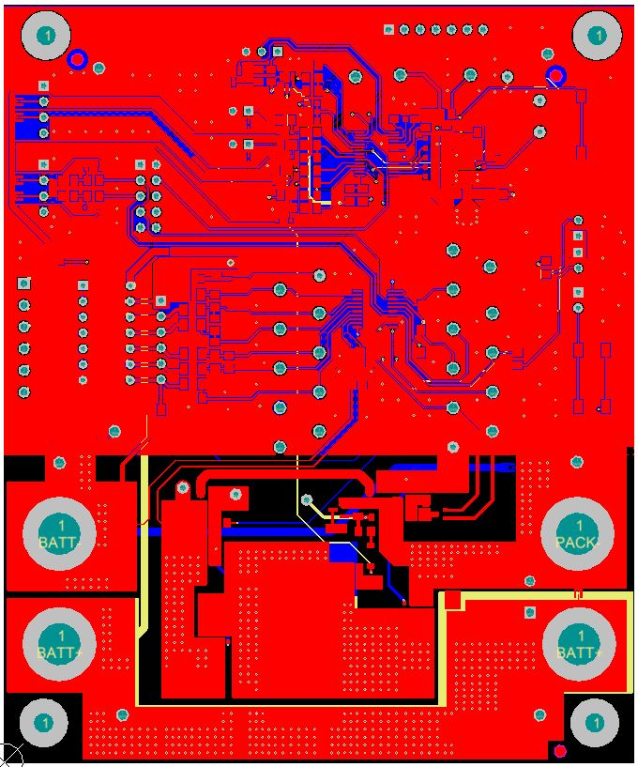
bq76920 / bq78350 EVM Layout
CELLS
LOAD
Discharge current path
10/24/2012
10

Slide 11
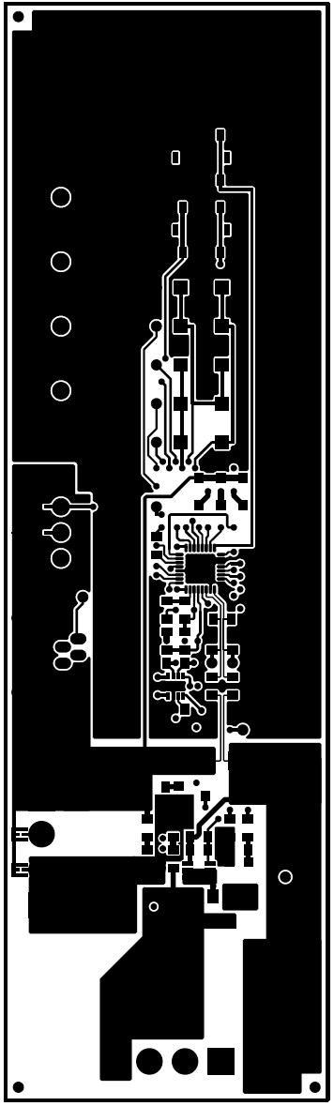
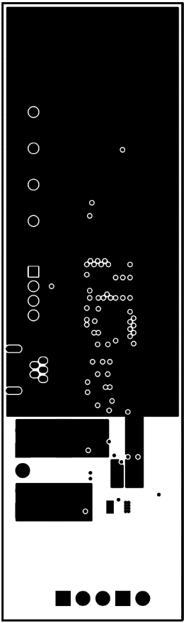
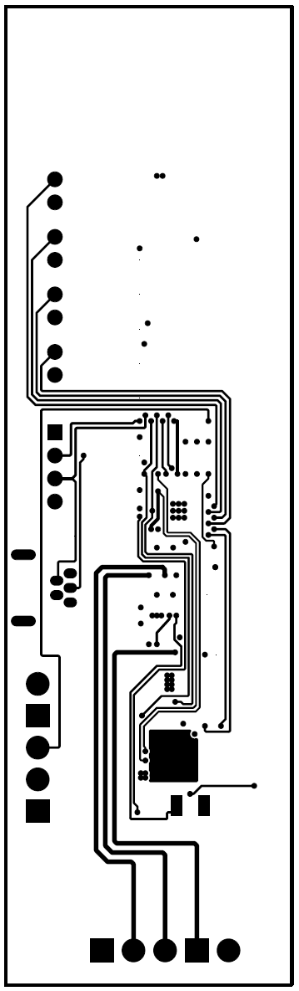
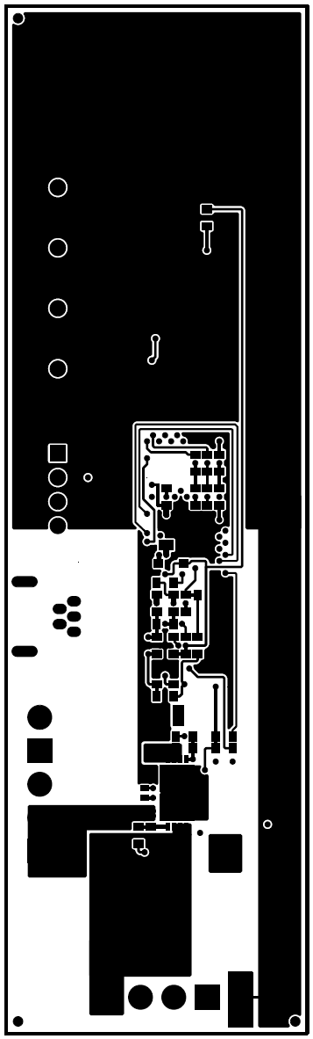
bq40z50 EVM Layout
Signal
Plane
GND
Plane
Gas
Gauge
GND
Plane
Power
Stage
High
Temp
Section
Cell Inputs
Top Layer
2nd Layer
3rd Layer
Bottom Layer
10/24/2012
11

Slide 12
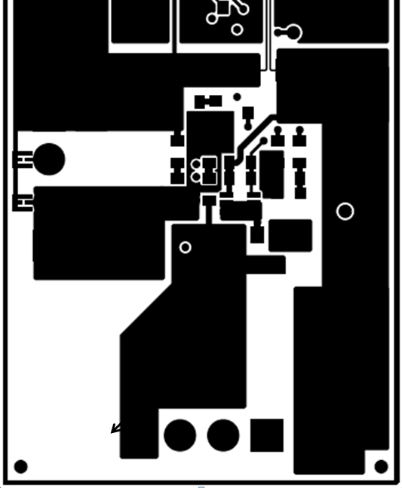
bq40z50 EVM Layout
DISCHARGE CURRENT EXAMPLE
Sense
Resistor
FET caps
PACK-
SYSPRES
PACK+
Spark gaps
VCC
Resistor
FETs
(back side)
4P 3P 2P 1P 1N
10/24/2012
12

Slide 13
bq40z50 EVM Layout
DISCHARGE CURRENT EXAMPLE
Sense
Resistor
FET caps
PACK-
SYSPRES
PACK+
Spark gaps
VCC
Resistor
FETs
(back side)
4P 3P 2P 1P 1N
10/24/2012
13

Slide 14
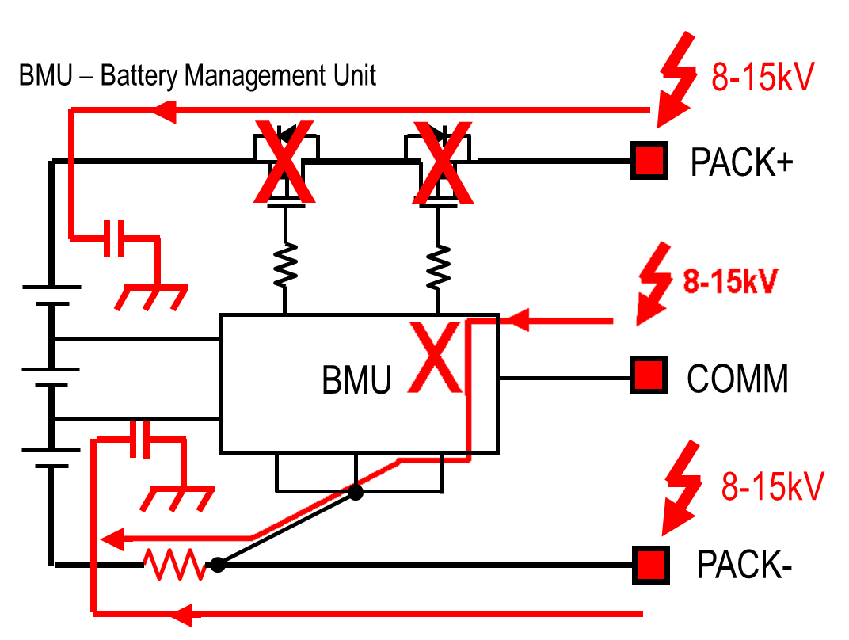
Battery Pack ESD Hit
Pin Exposure will get ESD Hit
ESD damages Protection FETs and BMU
10/24/2012
14
Notes:
So the end result is: the protection FETs, or the BMU will be damaged

Slide 15
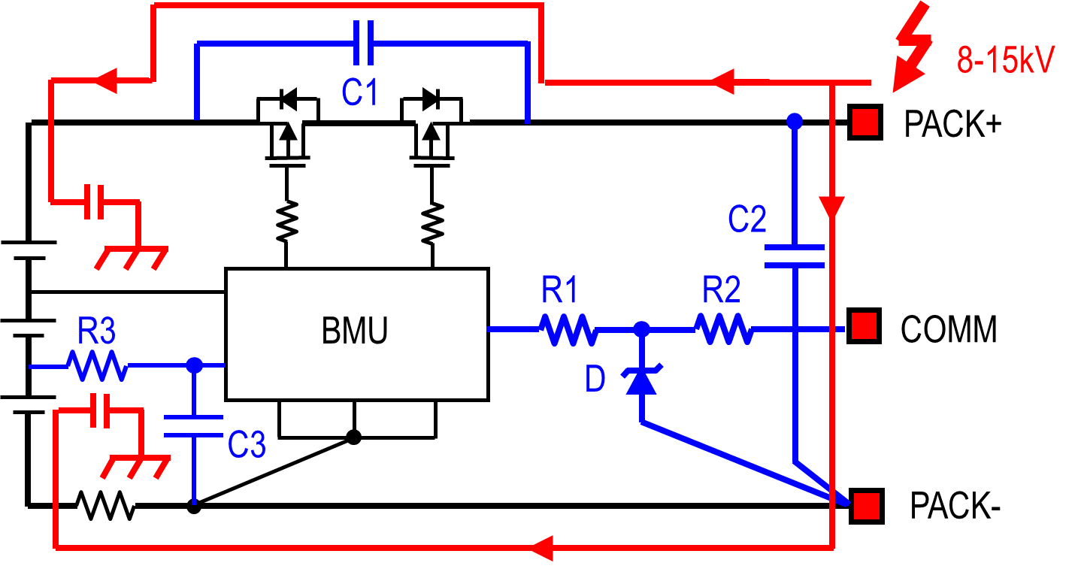
Battery Pack ESD Protection – PACK+
Preferred diverting path for a ZAP to Pack +: Capacitors C1 & C2
Ensure caps can absorb 2.5 micro coulombs
10/24/2012
15

Slide 16
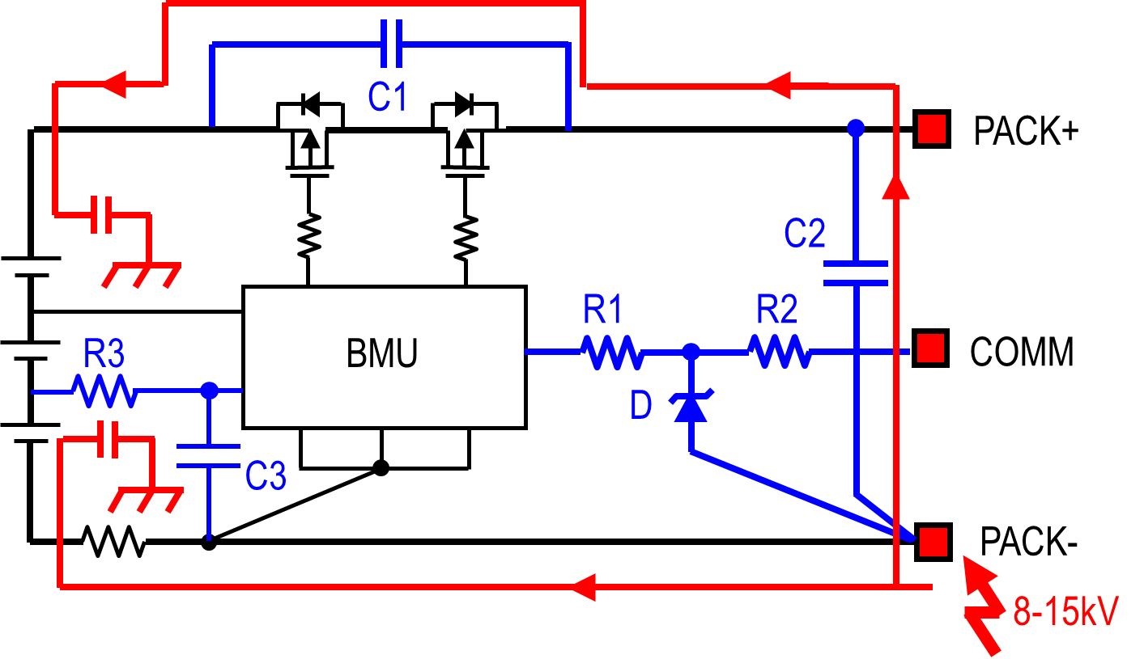
Battery Pack ESD Protection – PACK-
Preferred diverting path for a ZAP to Pack-: Capacitors C1 & C2
10/24/2012
16

Slide 17
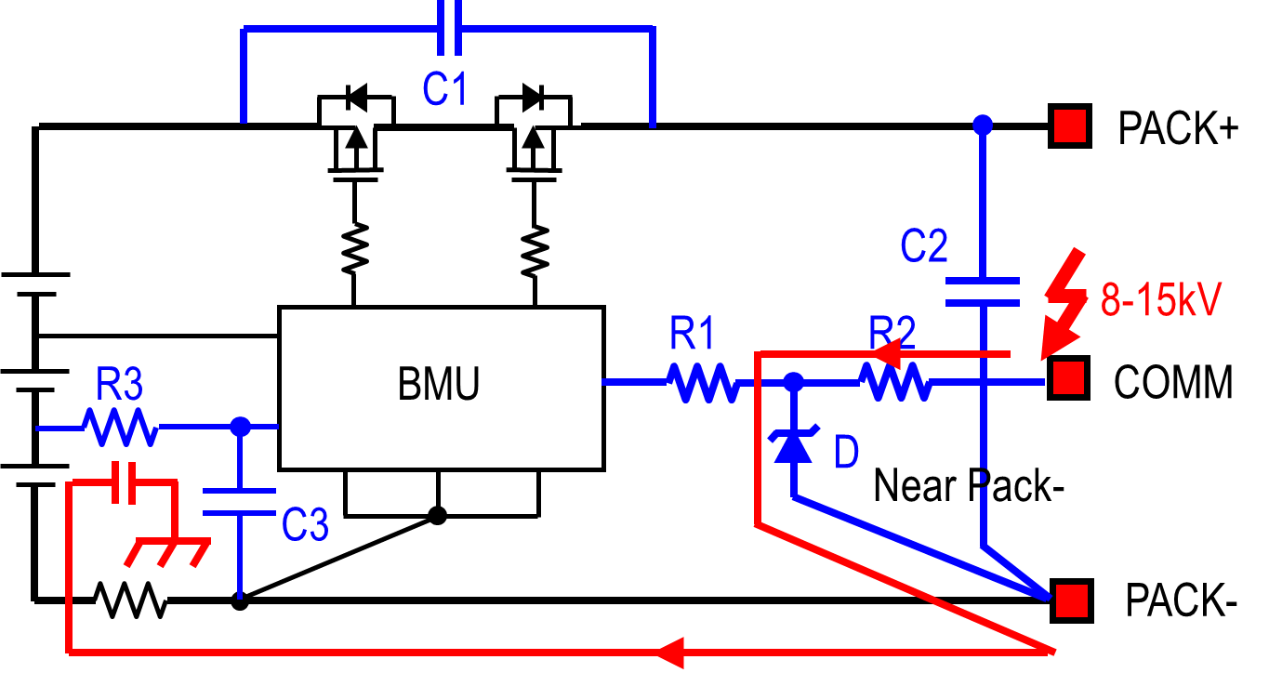
Battery Pack ESD Protection – Other
Preferred diverting path for a ZAP to COMM: R1, R2 and D
10/24/2012
17

Slide 18
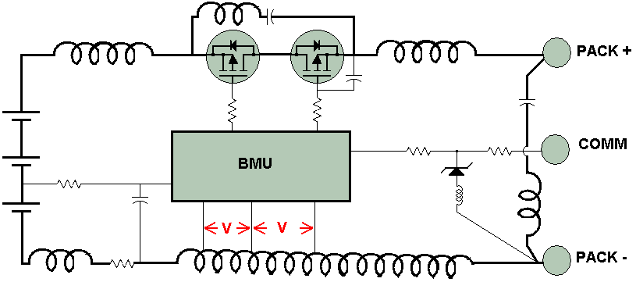
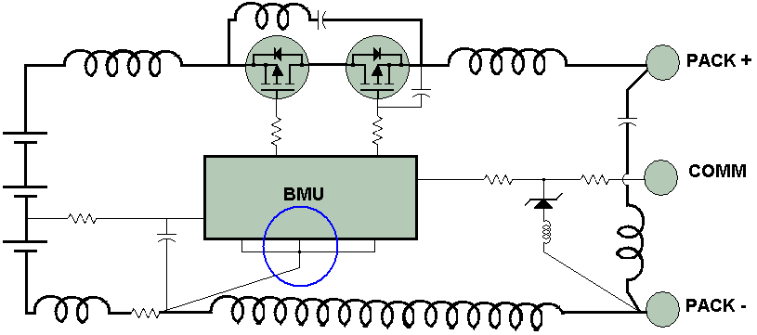
Use Proper Grounding
Avoid Inductive Voltage Drop
Wrong
V = L di/dt
Right
Low level ground systems must connect to a single point at the sense resistor
10/24/2012
18

Slide 19
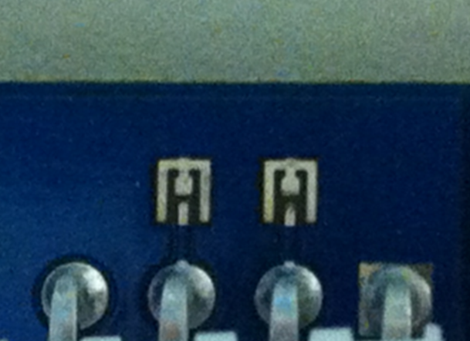

Use Spark Gaps
Spark gap after a few strikes.
PRES
T
SMD
SMC
PACK-
PACK+
Spark gap on the right has been
exposed to multiple ESD strikes.
Use a spark gap at the pack connector
Reduce Peak Voltage seen by the internal circuit (IC)
Must be PCB external Layer
Must be free of solder mask or other non-conductive coating
A 10-mil (0.2 mm) gap has a voltage breakdown about 1500 volts
10/24/2012
19

Slide 20
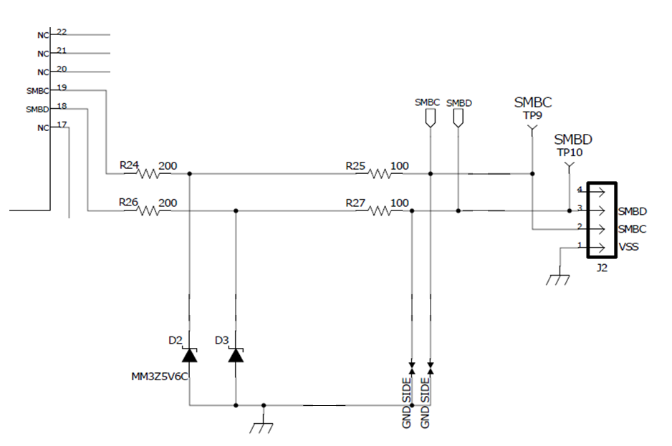
Communications Line Protection
100 ohms keeps signal edges sharp, but Zeners may not survive continuous short
Insure that diodes returns to Pack – not to low current ground
10/24/2012
20

Slide 21
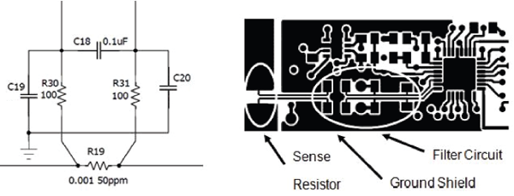
Sense Resistor Choices
The sense resistor is one of the most critical components for good gauging performance.
All of the gauge use a differential input stage to measure the voltage across the sense resistor to count coulombs.
A filter is added to reduce the effects of noise and transients on current measurements. The filter should be placed close to the device.
An additional high frequency capacitor can be placed between C18 and the device, if very fast transients are present.
The signal traces should be routed parallel to one another and an close a possible to help with common-mode rejection.

Slide 22
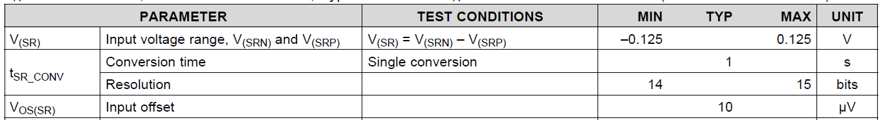
Sense Resistor Choices
We recommend that a 50ppm Temperature Coefficient of Resistance (TCR) resistor be used to improve accuracy.
The value of the resistor will depend on the device. You must consider the
voltage drop and coulomb counter offset.
R_{SENSE} < V_{(SR)} / I_{MAX}; 125mV / 100A = 1.25mΩ
Input Offset / R_{SENSE}; 10uV / 1.25mΩ = 8mA
A filter is added to reduce the effects of noise and transients on current measurements. The filter should be placed close to the device.
The signal traces should be routed parallel to one another and an close a possible to help with common-mode rejection.

Slide 23
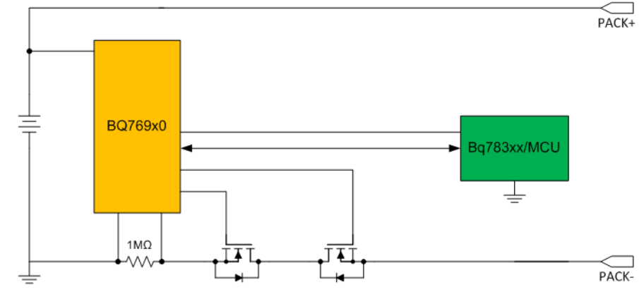
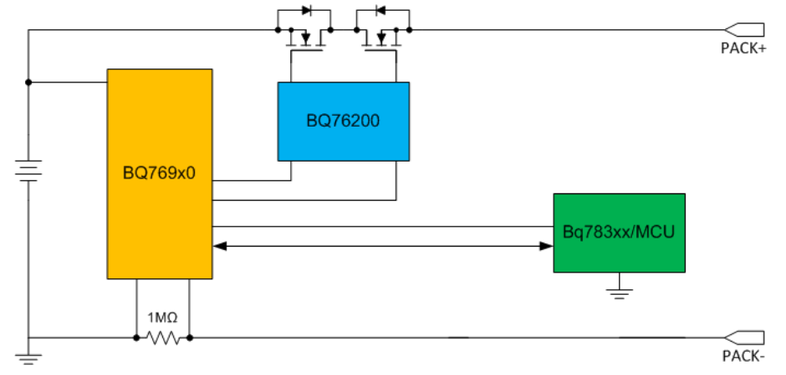
FET selection for gauge + protectors considerations
Most of the gauges support high-side n-channel FETs for the charge and discharge paths.
The gate drive current capability depends on the AFE device, but it is typically in the 20uA range.
The bq769x0 devices support a low-side CHG / DSG FET architecture. The bq76200 will be released to serve as a pre-driver to support high-side FETs and the device can support multiple FETs placed in parallel for high current applications.

Slide 24
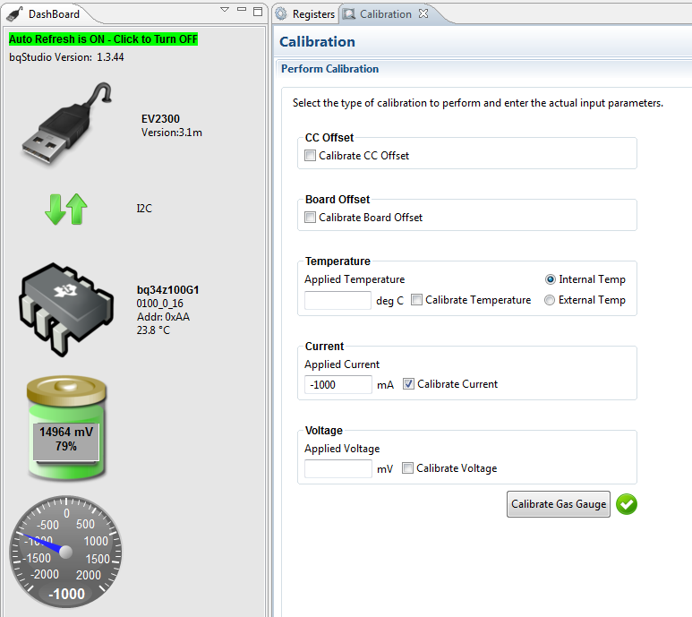
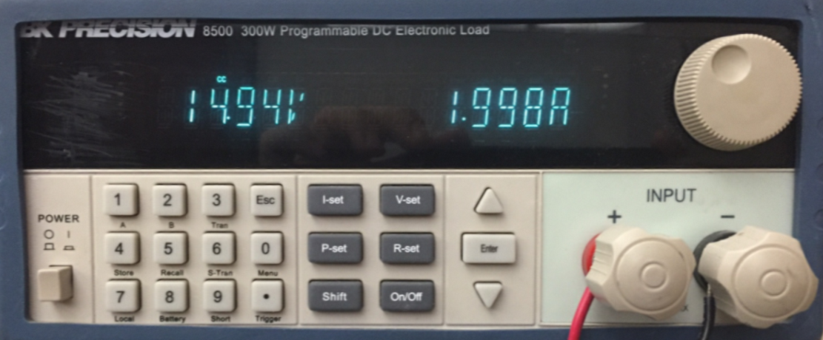
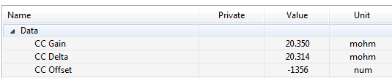
Calibration
Pack is calibrated for a 2x Scale Factor.
Apply a -2000mA discharge current.
Enter -1000mA in the Applied Current field.
CC Gain and CC Delta set to 20 mohm for a
10 mohm sense resistor.
Current reported at ½ actual value.

Slide 25
Parameter Configuration – bq34z100
Parameter name | Parameter Value | Display Units
Taper Current | 100 | mAmp
Min Taper Capacity | 25 | mAmpHr
CC Threshold | 900 | mAmpHr
Design Capacity | 1000 | MilliAmpHour
Design Energy | 5400 | MilliWattHour
SOH Load I | -400 | MilliAmp
SOC1 Set Threshold | 150 | mAh
SOC1 Clear Threshold | 175 | mAh
SOCF Set Threshold | 75 | mAh
SOCF Clear Threshold | 100 | mAh
Sleep Current | 10 | mAmp
User Rate-mA | 0 | MilliAmp
User Rate-Pwr | 0 | mW/cW
Reserve Cap-mAh | 0 | MilliAmpHour
Reserve Energy | 0 | mWh/cWh
Dsg Current Threshold | 60 | mAmp
Chg Current Threshold | 75 | mAmp
Quit Current | 40 | mAmp
Qmax Cell 0 | 1000 | mAmpHr
CC Gain | 10.123 | mohm
CC Delta | 10.147 | mohm
Deadband | 5 | mAmp
Each current and capacity parameter must be scaled by the Scale Factor.
Small values, such as Deadband may be left alone, because they will be too small.
The CC Gain and CC Delta will be scaled when the current is calibrated. Their values will be set to the Scale Factor x Rsense.

Slide 26
Parameter Configuration – bq78350
Subclass name | Parameter name | Parameter Value | Units
Current | CC Gain | 1 | mOhm
Current | Capacity Gain | 1 | mOhm
Current Deadband | Deadband | 3 | mA
OCC | Threshold | 6000 | mA
OCC | Recovery Threshold | -200 | mA
OCD | Threshold | -6000 | mA
OCD | Recovery Threshold | 200 | mA
PTO | Charge Threshold | 2000 | mA
PTO | Suspend Threshold | 1800 | mA
PTO | Reset | 2 | mAh
CTO | Charge Threshold | 2500 | mA
CTO | Suspend Threshold | 2000 | mA
CTO | Reset | 2 | mAh
OC | Threshold | 300 | mAh
OC | Recovery | 2 | mAh
SOCC | Threshold | 10000 | mA
SOCD | Threshold | -10000 | mA
VIMR | Check Current | 10 | mA
CFET | OFF Threshold | 5 | mA
DFET | OFF Threshold | -5 | mA
Fast Charging | Current | 3000 | mA
Pre-Charging | Current | 100 | mA
Subclass name | Parameter name | Parameter Value | Units
Termination Config | Charge Term Taper Current | 250 | mA
Current Thresholds | Dsg Current Threshold | 100 | mA
Current Thresholds | Chg Current Threshold | 50 | mA
Current Thresholds | Quit Current | 10 | mA
Design | Design Capacity mAh | 4400 | mAh
Design | Design Capacity cWh | 6336 | cWh
State | Learned Full Charge Capacity | 4400 | mAh
CEDV cfg | FCC Learn Up | 512 | mAh
CEDV cfg | FCC Learn Down | 256 | mAh
CEDV cfg | OverLoad Current | 5000 | mA
CEDV cfg | Electronics Load | 0 | 3uA
CEDV cfg | Near Full | 200 | mAh
CEDV cfg | Reserve Capacity | 0 | mAh
Sleep | Sleep Current | 10 | mA
Data | Remaining AH Cap. Alarm | 300 | mAh
Data | Remaining WH Cap. Alarm | 432 | cWh
THESE PARAMETERS ARE NOT SCALED.
Subclass name | Parameter name | Parameter Value | Units
AOLD | Threshold and Delay | 0 | hex
ASCD | Threshold and Delay | 0 | hex

Slide 27
Products
bq34z100-G1
Supports Li-Ion, LiFePO4, PbA, NiMH, and NiCd Chemistries
Capacity Estimation Using Patented Impedance Track™ Technology for Batteries from 3 V to 65 V
Supports Battery Capacities up to 29Ahr with Standard Configuration Options
Supports Charge and Discharge Currents up 32A with Standard Configuration Options configurations.
External NTC Thermistor Support
Supports Two-Wire I2C™ and HDQ Single-Wire Communication Interfaces with Host System
SHA-1/HMAC Authentication
One- or Four-LED Direct Display
Five-LED and Higher Display Through Port Expander
Reduced Power Modes (Typical Battery Pack Operating Range Conditions)
– Normal Operation: < 145-μA Average
– Sleep: < 84-μA Average bq34z100-G1
– Full Sleep: < 30-μA Average
bq78350
Flexible Configuration for 3 to 5 Series (bq76920), 6 to 10 Series (bq76930), and 9 to 15 Series (bq76940) Li-Ion and LiFePO4 Batteries
Compensated End-of-Discharge Voltage (CEDV) Gauging Algorithm
Supports Battery Configurations up to 320 Ahr
Supports Charge and Discharge Current Reporting up to 320 A
External NTC Thermistor Support from Companion AFE
Supports SMBus Host Communication
Offers an Optional Resistor Programmable SMBus Slave Address for up to Eight Different Bus Addresses
SHA-1 Authentication
Drives up to a 5-Segment LED or LCD Display for State-Of-Charge Indication
Full Array of Programmable Protection Features
– Voltage
– Current
– Temperature
– System Components

Slide 28
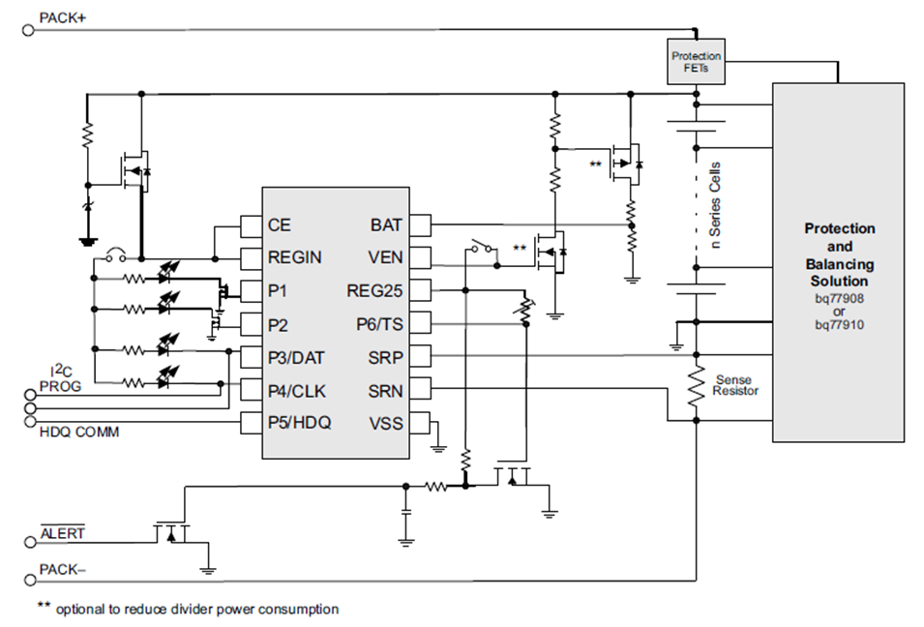
bq34z100-G1

Slide 29
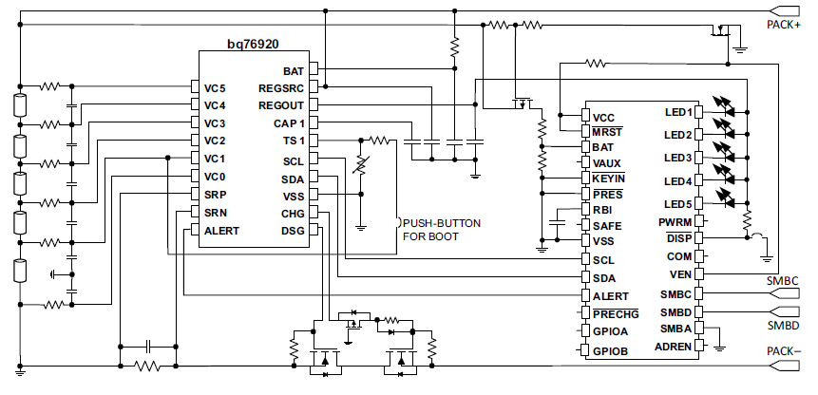
bq78350-R1 // bq76920 / bq76930 / bq76940

Slide 30
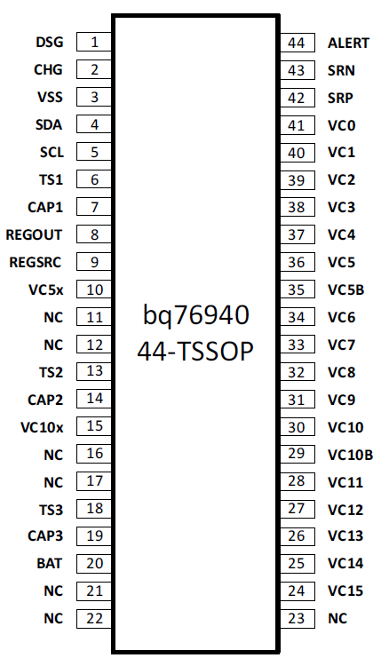
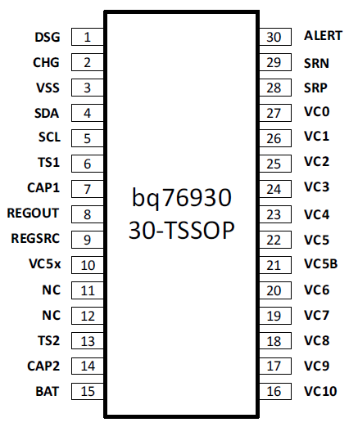
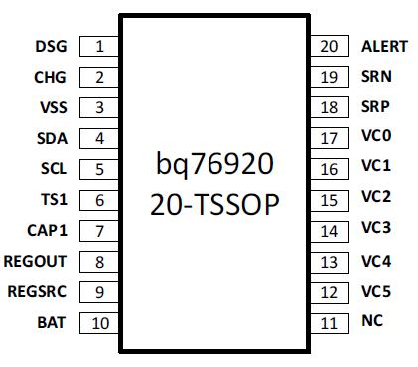
bq78350-R1 // bq76920 / bq76930 / bq76940
AFE Options:
3 - 5 cells
6 - 10 cells
9 - 15 cells

Slide 31
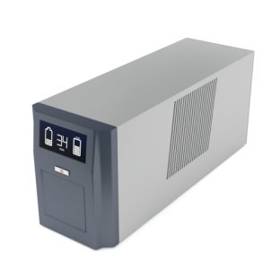
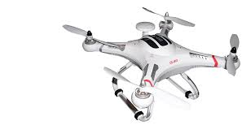
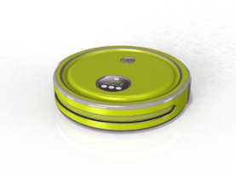
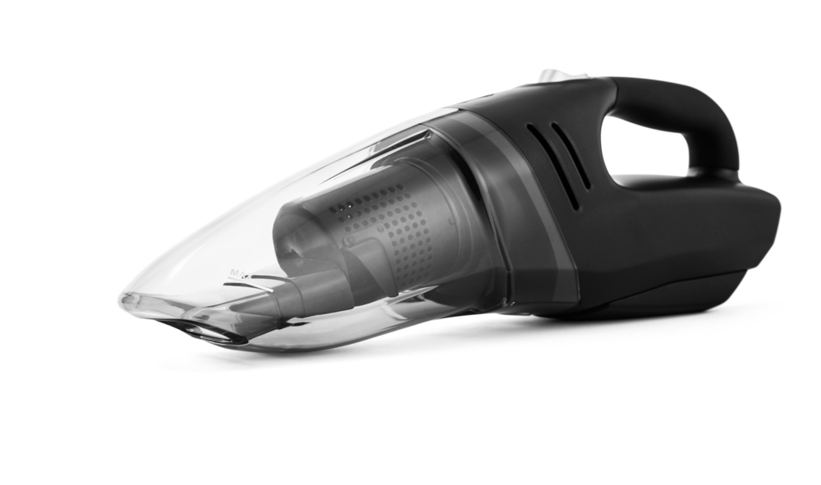
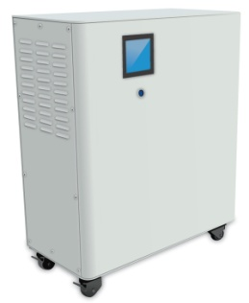
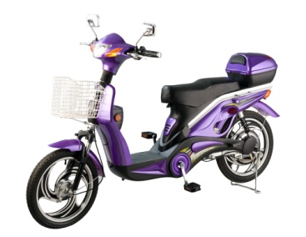
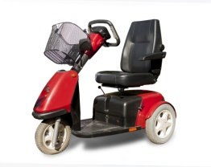
Representative equipment
Energy Storage Systems
Cordless home appliances
General 12–48V battery packs
Light electric vehicles (LEV): eBikes, eScooters, Pedelec and pedal–assist bicycles)
Battery backup/UPS systems
Telecom Power systems
Robotic or handheld vacuum cleaners, other tools
Drones
Notes:
Might be used in any larger battery application. Note voltage limitations. 3 cell part could pull to less than the 8V recommended minimum voltage. Industrial part, not automotive.

Slide 32

Questions

