Slide 1
E36 TI parts Schematic & Layout review

Slide 2
TPS61163AYFFR Schematic

Slide 3
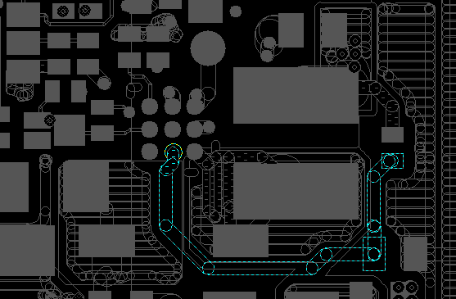
TPS61163AYFFR Layout
Layer 1
PAR122
PAC130
BL_VIN_VDD
A1
C3
PAC81
SW
PAD6-1
PAD6-2
PAC80
BL_VIN

Slide 4
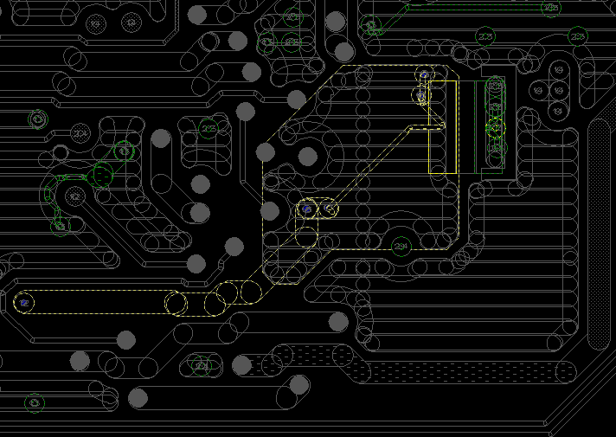
TPS61163AYFFR Layout
Layer 2
GND_BL_TPS61163
GND

