Slide 1

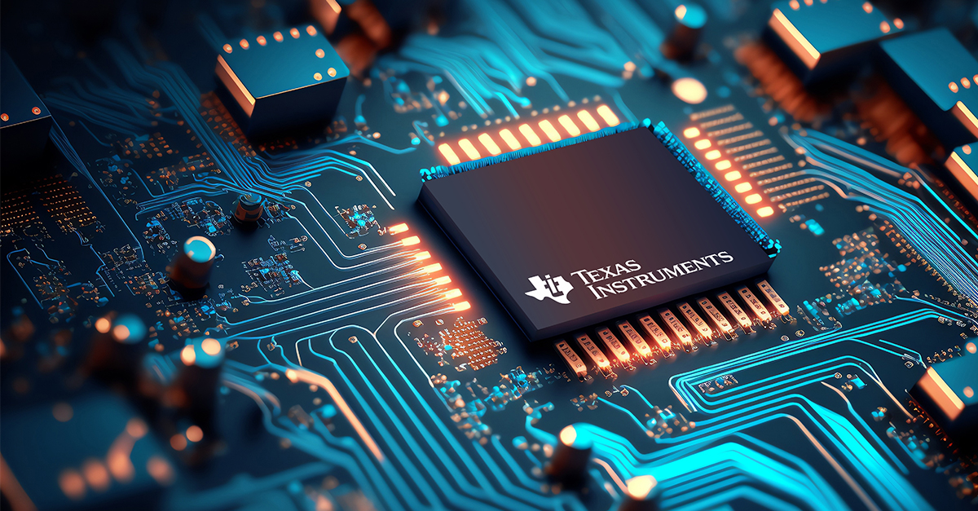
New Product Update
Enabling next generation automotive power distribution and electrification with TI's latest high side switch controllers
Diego Cortes
Product Marketing Engineer
Surya Mishra
Systems Engineer

Slide 2
Agenda
Introduction to emerging automotive architectures
  Zonal & 48 V
Key power blocks
  Typical power architecture | BMS, PDU/Zonal, DC/DC
HSS controllers overview
  Detailed product comparison
  Roadmap

Slide 3
Zone architecture vehicle diagram
Domain architecture
1st gen zonal architecture
Optimized wiring for in-vehicle network and power distribution
Increased control of electronic power consumption
  PDB and ZCM power distribution can turn-off power to ECUs to manage electronic power consumption in different vehicle states
  48V introduced

Slide 4
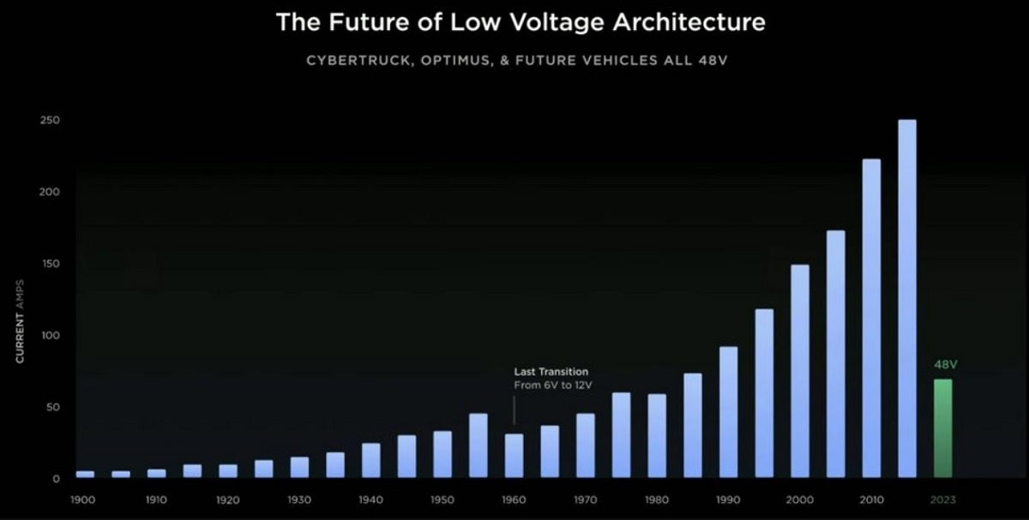
48V motivation
Why? Primarily to reduce wiring harness size, weight, and cost
  Voltage ↑, current ↓
Tesla’s Cybertruck is first 48V BEV to market, other OEMs are now investigating.
Other OEMs in the US, Japan and China have plans to develop partial or full 48V architectures.
  Thermal management in High current loads such as HVAC, power steering will convert to 48V first.
  Very few solutions for 48V power distribution exist today
    Switching transients or component margin often dictated component ratings (70 to 75V).
    Higher clearance between high and low voltage pins (>0.5mm).
Smaller wire gauge reduces cost of wire and manufacturing
  85% weight reduction, 85% cost reduction for ZCM
  60% weight reduction, 52% cost reduction for window motor
Source: Tesla investor day presentation, March 2023

Slide 5
48V power architecture: Mixed 12V/48V
Legend
DC/DC converter
Zonal distribution
HSS controller
DC
48V
DC
12V
12-V integrated HSS
DC
DC
Actuators
48-V integrated HSS
HV
battery
ECU
48V PDU
Actuators
Chassis
ground
Front window
heating
Actuators
eCat heater
Actuators
Zone power
Zone 1
48V Li-ion
EPS or HVAC compressor
Actuators
48V BMS
Zone power
Actuators
ECU
Power distribution, load driving
Zone 2

Slide 6
Typical power architecture | BMS, PDU/Zonal, DC/DC
DC/DC converter
Zonal controllers
CB switch
CB switch
12V PDU
48V
12V
DC_DC
Zone1
DC
ECU
DC
HSSC
HSSC
HSSC
HSSC
HSSC
Divert/balancer
switch
48V BMS
12V BMS
HSSC
BATT
Actuators
Front window
heating
HSSC
HSSC
HSSC
HSSC
HSSC
HSSC
Battery disconnect switch
Input protection
switches
Zone2
ECU
Battery disconnect switch
eCat heater
HSSC
HSSC
Batt Mon/ balancer
EPS
Batt mon/ balancer
HSSC
HVAC compressor
12V li-ion
battery
HSSC
Actuators
48V li-ion
battery
HSSC
HSSC
48V PDU
CCC
High current actuators
Power distribution/
load driving
Load driving
switches
HSSC
HSSC

Slide 7
BMS disconnect switch key challenges
BMS circuit breaker key considerations:
Back to back switches to interrupt current from and to the cells – Need separate CHG and DSG control
  Keep the CHG ON and DSG OFF during deep discharge state
  Keep CHG OFF and DSG ON during vehicle sleep state to keep the always ON ECUs/loads powered
High current (~150A, 1kA peak) path needing parallel FET driving – Strong gate drive outputs
Trend towards BMS ECU level IQ < 100µA –
Low IQ (<35µA) HSS controller with FETs ON
Reverse battery protection (input and output side)
Undesired opening of the switches not allowed – Gate driver diagnosis, FET diagnosis
HS, LS overcurrent protection sensing

Slide 8



FET diagnosis – System architecture
In order to allow a self diagnosis of the MOSFET disconnect switch two or more parallel paths shall be implemented
By this means one of the paths can be opened and the functionality of the disconnect switch can be verified during vehicle operation without disconnecting the vehicle loads
For verification of the availability of the discharge function the voltage in between the charge and discharge circuit breaker shall be measured.
Low IQ HSS controller with separate gate controls for B2B FETs configured in common source topology

Slide 9


Power distribution/Zone circuit breaker key challenges
12V PDU
Zonal controllers
DC_DC
Zone1
ECU
Wire protection
Programmable I²t curve and current limit
Reduce MCU overhead with embedded I²t
HSSC
HSSC
HSSC
Divert/balancer
switch
HSSC
Manage capacitive load peak current
Configurable charging methods for load inrush profiles
BATT
Actuators
HSSC
Capacitive charge mode
HSSC
HSSC
Low power mode
Reduced battery drain in low power mode, <20uA IQ
Configurable auto wake-up without MCU intervention
Input protection
switches
Zone2
ECU
HSSC
Reduce MCU IO demand, daisy chain capable
Accurate digital current, Vout, and temp diagnostics
HSSC
Actuators
SPI interface
HSSC
ASIL B
ASIL-B development per ISO 26262, Limphome
FET failure diagnostics, BIST for safety mechanism
Functional safety
High current actuators
Load driving
switches
HSSC
Notes:
Within TI we have 3 main focus areas for zonal – processors connectivity & power
Obviously you just heard all about our processor and PMIC story and how zonal is a critical aspect of these investment areas, so I’d like to focus on a few other key analog investments for connect and power – animation
Introduce the challenges that we intend to solve is the message here, zoom out and introduce the arrows back
Interface – We are continuing to invest in all of these, but I specifically want to highlight our ethernet and CAN investments to enable “dumb” or MCUless nodes – Highlight a CAN & Ethernet device, maybe 3 if 1G.
There will be a scale of interface requirements for the edge nodes. For sensors, like Radar, you may need higher data throughput from the edge to the zonal controller , so our Ethernet team is investing in ethernet PHYs that enable MCU-less edge nodes to simplify your designs.
CAN FD – only 2 layers handled by controller, TCP IP (Transmission control protocol) – more similar to computers, all nodes have IP address. Works well, automotive makes it a bit overkill sometimes – expensive a bit. Large packets less frequently. CAN is 64bytes – smaller data packets, Ethernet. Non destructive arbitration, protocol can auto resolves who controls bus. The node that wins arbitration, has no idea that they were arbitrations.
CAN FDL – Almost viewed as a way to try to make can lighter weight & cheaper to implement. LIN bus is UART – low data rate. CAN FD Light is in between CAN & Lin. MCU-less – built on FDL. BW = 5mbps. RTM roughly – End of next year
Radar with high update rates

Slide 10
DC/DC circuit breaker key challenges
DC/DC circuit breaker key considerations:
Back to back switches to interrupt current from and to 12V and 48V BMS
Integrated overvoltage protection for safe operation
High current (~150A, 1kA peak) path needing parallel FET driving – Strong gate drive outputs
Bi-directional current monitoring
Need I2T/SCP to protect converters from large inrush
DC/DC converter
CB switch
48V
12V
CB switch
DC
DC
HSSC
HSSC

Slide 11
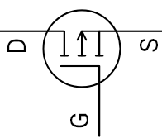


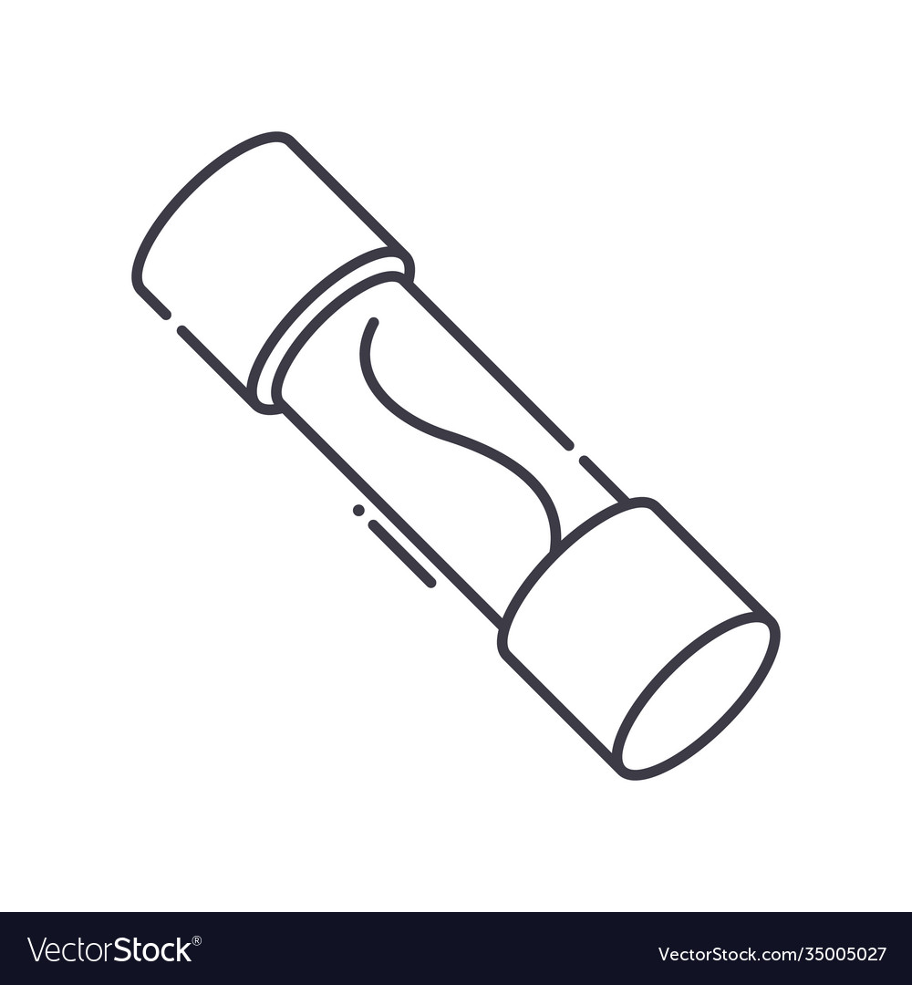
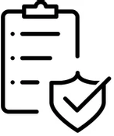

High side switch controllers | Main features
Strong & dual gate drive
Low power mode & low IQ
I2T
SPI
ASIL-B
compliant
Efficient, fast, & reliable switching
Enables paralleling MOSFETs
Charge and discharge FET control
External power path allowing minimum power consumption
Pre-charge capacitive load with gate slew rate control
Adjustable automatic load wakeup
Accurate & adjustable $i^{2}t$ current limit protection
Overcurrent protection at 5 µs response time
Integrated uni & bi-directional current sense
Multi-device serial communication
Reduced system pin count
Real-time diagnostic monitoring of SCP, I2t, UVLO, and more
Qualifies systems for stringent safety requirements
Built-in fail-safe operation to ensure safety
Strict testing & validation

Slide 12
High Side Switch Controller | Current Portfolio
High side switch Controller Portfolio
 | TPS1211-Q1 TPS4811-Q1 | TPS1200-Q1 TPS4800-Q1 | TPS1210-Q1 TPS4810-Q1 | TPS1213-Q1 TPS4813-Q1 | TPS4816-Q1 | TPS1214-Q1 | TPS1212-Q1 TPS4812-Q1
Voltage range | 3.5 – 40V, 45V abs max 3.5 - 80V, 100V abs max | 3.5 – 40V, 45V abs max 3.5 - 95V, 100V abs max | 3.5 – 40V, 45V abs max 3.5 - 95V, 100V abs max | 3.5 – 40V, 45V abs max 3.5 - 95V, 100V abs max | 3.5 - 95V, 100V abs max | 3.5 - 73V, 74V abs max | 3.5 - 73V, 74V abs max 3.5 - 95V, 100V abs max
Short circuit protection | ✓ | ✓ | ✓ | ✓ | ✓ | ✓ | ✓
Current monitoring | Uni-IMON |  |  |  | BI-IMON | Uni-IMON | BI-IMON
Sense method | High side RSNS | High/low RSNS, FET VDS | High/low RSNS, FET VDS | High/low RSNS, FET VDS | High side RSNS | High side RSNS | High side RSNS
Undervoltage lockout | ✓ | ✓ | ✓ | ✓ | ✓ | ✓ | ✓
Overvoltage | ✓ | ✓ |  |  | ✓
Temperature monitoring | ✓ |  |  |  | ✓ | ✓ | ✓
Reverse polarity protection |  | ✓ | ✓ | ✓ | ✓ | ✓ | ✓
Dual gate drive | ✓ |  | ✓ | ✓ | ✓ | ✓ | ✓
Low power mode IQ |  | 35µA | 35µA | 35µA |  | 25µA | 25µA
Automatic load wakeup |  |  |  | ✓ |  | ✓ | ✓
I2T |  |  |  |  | ✓ | ✓ | ✓
SPI |  |  |  |  | SPI expander | SPI expander | SPI expander
End equipment | DC/DC, Load Driving | DC/DC, Load Driving | BMS DC Breaker | PDB, Zonal | PDB, Zonal, DC/DC, Load Driving | PDB, Zonal DC/DC, Load Driving | PDB, Zonal DC/DC, Load Driving
Notes:
- checkmarks?

Slide 13
Roadmap | HSS Controllers
HSS Controllers
HSSC for 48V
Status
TPS4810-Q1
3.5V to 80V, 100V absmax, RPP, 2A Dual driver, 35µA IQ, SCP,UVLO
(Samples – Now, RTM – 4Q24)
TPS4813-Q1
3.5V to 80V, 100V absmax, RPP, LPM (35µA IQ), LWU, Cap charging, SCP,UVLO
(Samples – Now, RTM – 4Q24)
Production
Preview
TPS4811x-Q1
3.5V to 80V, 100V absmax, 4A driver, SCP, IMON, OV, UVLO, Precharge, Over Temp protection
TPS4816-Q1
3.5V to 80V, 100V absmax, RPP, OV, Bi-IMON, Cap charging,I2T, SCP,UVLO
TPS4800-Q1
3.5V to 80V, 100V absmax, RPP, 2A driver, 35µA IQ, SCP,UVLO, OVP
(Samples – Now, RTM – 4Q24)
TPS4812-Q1
3.5V to 80V, 100V absmax, RPP, LPM (25µA IQ), LWU, Bi-IMON, Cap charging,I2T, SCP,UVLO
(Samples – Now, RTM – 4Q24)
HSSC for 12V
TPS1210-Q1
3.5V to 40V, 45V absmax, RPP, 2A Dual driver, 35µA IQ, SCP,UVLO
(Samples – Now, RTM – 4Q24)
TPS1213-Q1
3.5V to 40V, 45V absmax, RPP, LPM (35µA IQ), LWU, Cap charging, SCP,UVLO
(Samples – Now, RTM – Now)
TPS1211x-Q1
3.5V to 40V, 45V absmax, 4A driver, SCP, IMON, OV, UVLO, Precharge, Over Temp protection
TPS1214-Q1
3.5V to 70V, 74V absmax, RPP (FET ON), LPM (25µA IQ), LWU, IMON, Cap charging, I2T, SCP,UVLO
(Samples – Now, RTM – 4Q24)
TPS1200-Q1
3.5V to 40V, 45V absmax, RPP, 2A driver, 35µA IQ, SCP,UVLO, OVP
(Samples – Now, RTM – 4Q24)
TPS1212-Q1
3.5V to 70V, 74V absmax, RPP, LPM (25µA IQ), LWU, Bi-IMON, Cap charging,I2T, SCP,UVLO
(Samples – Now, RTM – 4Q24)
2023
2024

Slide 14
Getting started
You can start evaluating this device leveraging the following:
Content type | Content title | Link to content or more details
Product folder | High side switch controller overview | https://www.ti.com/power-management/power-switches/high-side-switch-controllers/overview.html
Reference design | Smart fuse high side switch controller reference design | https://www.ti.com/tool/TIDA-020065
Technical blog content or white paper | Powering capacitive loads Reverse battery protection Remote temperature sensing and protection | https://www.ti.com/lit/an/slyt857/slyt857.pdf https://www.ti.com/lit/an/sluaan7/sluaan7.pdf https://www.ti.com/lit/ab/slvafu3/slvafu3.pdf
EVMs | TPS1211-Q1 EVM TPS48110-Q1 EVM TPS1213-Q1 EVM TPS1214-Q1EVM | https://www.ti.com/tool/TPS1211Q1EVM https://www.ti.com/tool/TPS48110Q1EVM https://www.ti.com/tool/TPS1213Q1EVM https://www.ti.com/tool/TPS1214Q1EVM

Slide 15

Visit www.ti.com/npu
For more information on the New Product Update series, calendar and archived recordings

