Slide 1
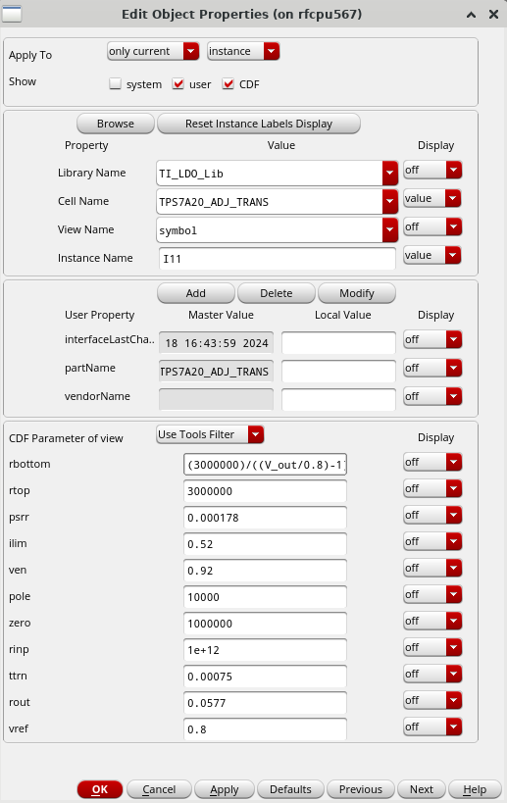
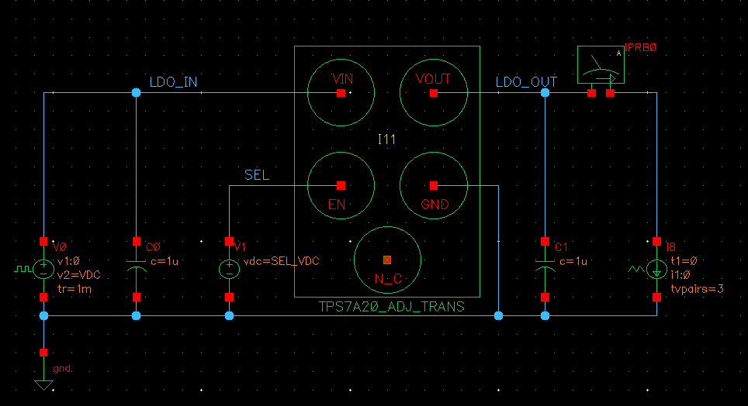
TPS7A20 Pspice model（tps7a20-adj_trans.lib）

Slide 2
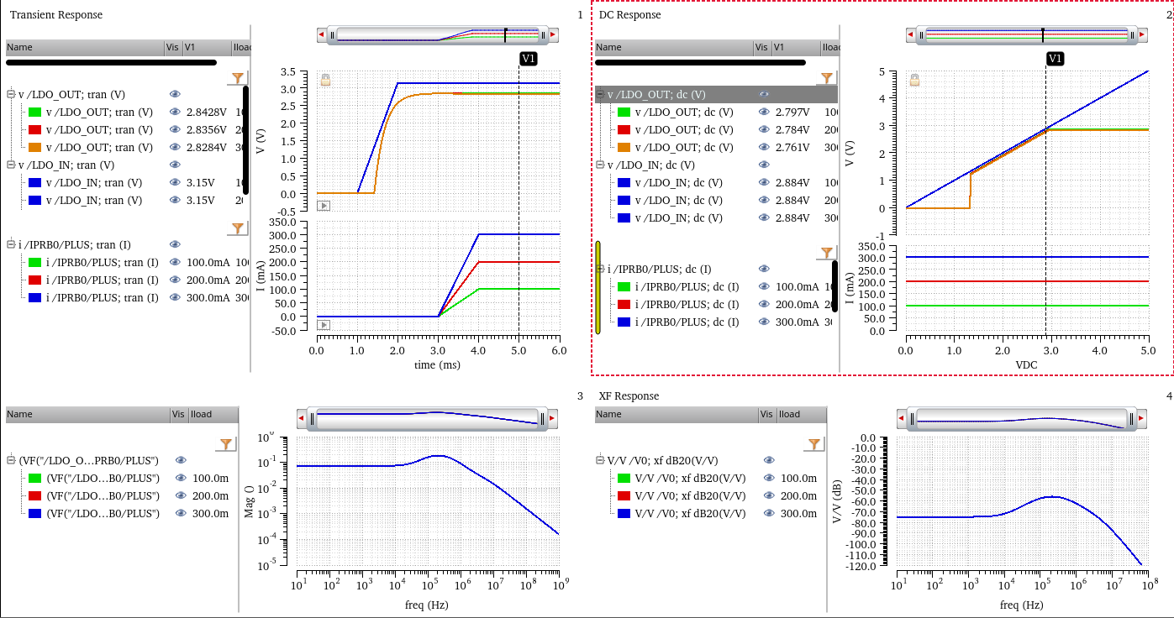
TPS7A20
TPS7A20 Characteristics using Pspice model（tps7a20-adj_trans.lib）
Transient Analysis
DC-Sweep Analysis
Load Current
Load Current
AC Analysis
XF Analysis for PSRR
Output Impedance
PSRR
No.1: No dependence on load current is observed.
No.2: No dependence on load current is observed.

Slide 3
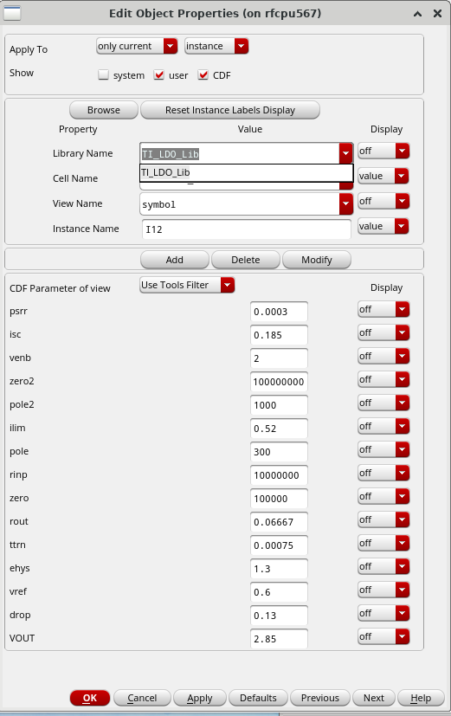
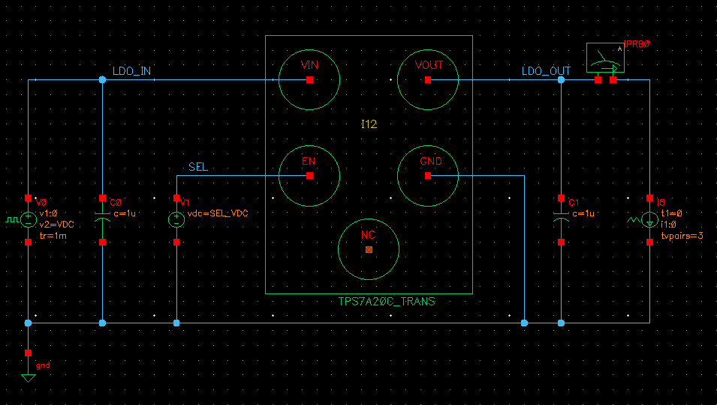
TPS7A20C Pspice model（tps7a20c_trans.lib）
No.3: If EN Voltage is 3V, it works
But EN Voltage is 1v or 2v , it does not work.
TPS7A20C Document: Low theresh 0.3v lower
high theresh 0.9v higher
It contradicts.
How can I make it work according to your TPS7A20C document?

Slide 4
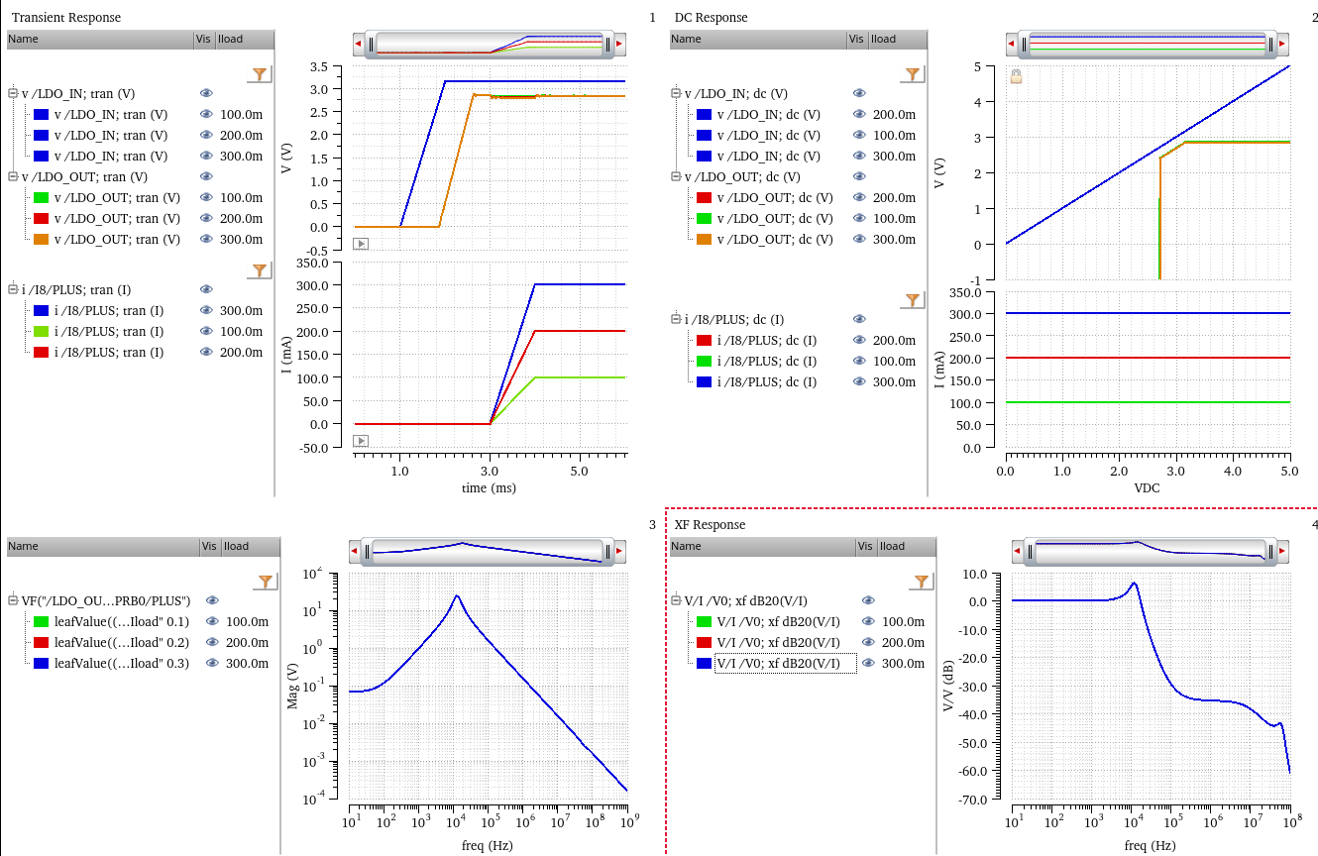
TPS7A20C Characteristics using Pspice model（tps7a20-adj_trans.lib）
Transient Analysis
DC-Sweep Analysis
Load Current
Load Current
AC Analysis
XF Analysis for PSRR
Our measurement
data
Our measurement
data
Output Impedance
PSRR
No.4: How can I make it work according to measurement data?
No.6: How can I make it work according to measurement data?
No.5: No dependence on load current is observed.
No.7: No dependence on load current is observed.

