Slide 1
SCH

Slide 2
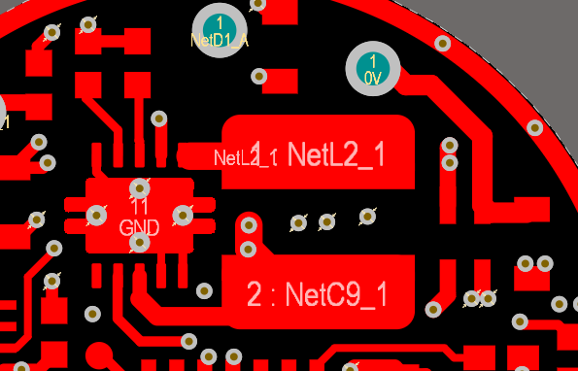
LAYOUT

Slide 3
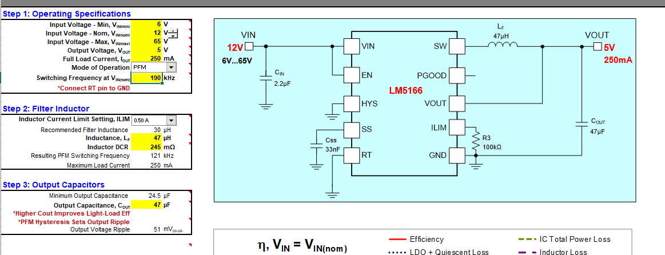
Calculator LM5166_Quick_Start_Calculator_RevB from Texas Instruments

