Slide 1
Negative Output Voltage Bucks
Typical Buck Regulator
Inverting Buck-Boost
Add Cap from V_{IN} to V_{OUT}(+)
Adjust FB resistor ratio
Change Terminal Labels:
V_{OUT}(+) GND
GND V_{OUT}(-)
Any Buck Regulator can be converted to an Inverting Buck-Boost
SWIFTTM examples in App Note SLVA317.
Evaluation Module using TPS54560 planned.
Notes:
Many circuits that have a lot of data acquisition products that require negative supplies for op amps and drivers may benefit from an easy to use non inverting buck/boost circuit. One good example is medical equipment. Here, and TPS54x0 device can be configured with a negative output voltage (we basically ground the Vout and regulate the ground). An application note has been written to show how to do this and an EVM has been prepared.
There are some boundaries to the input/output voltage and current capability which are explained in the math formulas in the slide.
Common questions: The Vin can be higher than 15V shown, and the Vout can be adjusted. Check the user’s guide for capacitor voltage ratings.

Slide 2
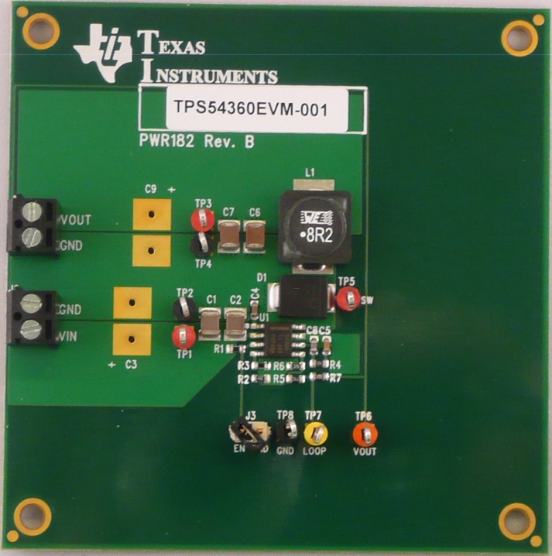
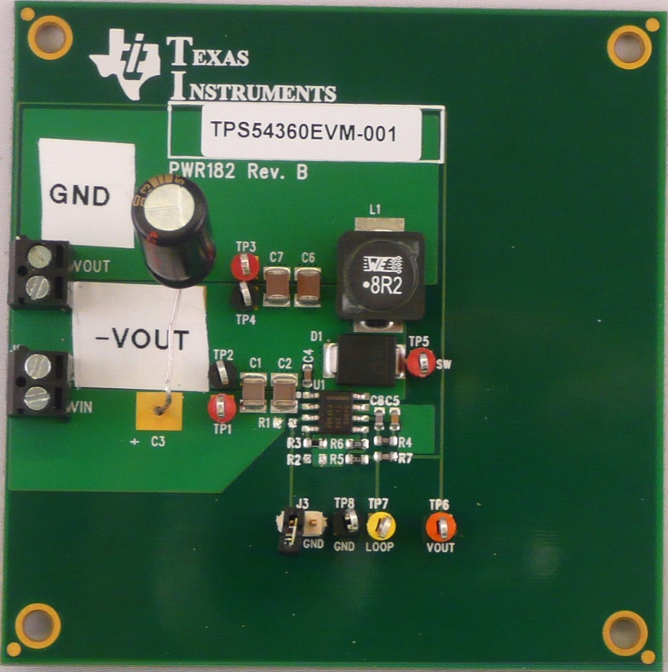
Converting TPS54360 EVM to negative output Buck-boost
TPS54360EVM-001 Inverting Buck-Boost
V_{OUT}
GND
V_{IN}
GND
V_{OUT}(-)
V_{IN}
Capacitor from VIN to new GND
Notes:
Many circuits that have a lot of data acquisition products that require negative supplies for op amps and drivers may benefit from an easy to use non inverting buck/boost circuit. One good example is medical equipment. Here, and TPS54x0 device can be configured with a negative output voltage (we basically ground the Vout and regulate the ground). An application note has been written to show how to do this and an EVM has been prepared.
There are some boundaries to the input/output voltage and current capability which are explained in the math formulas in the slide.
Common questions: The Vin can be higher than 15V shown, and the Vout can be adjusted. Check the user’s guide for capacitor voltage ratings.

Slide 3
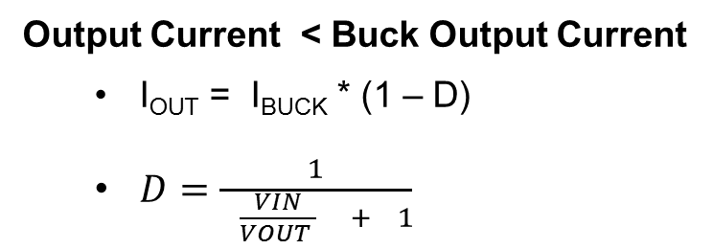
Limitations of Inverting Buck-Boost
Limited Output Voltage Range:
Voltage from V_{IN}(+) to V_{OUT}(-) < Maximum Operating Voltage of Buck IC
Wide V_{IN} SWIFT family rated to 60V
Output Current < Buck Output Current
I_{OUT} = I_{BUCK} * (1 – D)
$D=\frac{1}{ \frac{VIN}{VOUT } + 1}$
EN input and PGOOD output referenced to VOUT(-) instead of GND
Level Translators required for Logic I/O
Input UVLO requires separate comparator. See App Note SNVA425
Inverting Buck-Boost
Notes:
Many circuits that have a lot of data acquisition products that require negative supplies for op amps and drivers may benefit from an easy to use non inverting buck/boost circuit. One good example is medical equipment. Here, and TPS54x0 device can be configured with a negative output voltage (we basically ground the Vout and regulate the ground). An application note has been written to show how to do this and an EVM has been prepared.
There are some boundaries to the input/output voltage and current capability which are explained in the math formulas in the slide.
Common questions: The Vin can be higher than 15V shown, and the Vout can be adjusted. Check the user’s guide for capacitor voltage ratings.

Slide 4
Interfacing with Inverting Buck-boost
See SLVA540 for more examples
Notes:
Many circuits that have a lot of data acquisition products that require negative supplies for op amps and drivers may benefit from an easy to use non inverting buck/boost circuit. One good example is medical equipment. Here, and TPS54x0 device can be configured with a negative output voltage (we basically ground the Vout and regulate the ground). An application note has been written to show how to do this and an EVM has been prepared.
There are some boundaries to the input/output voltage and current capability which are explained in the math formulas in the slide.
Common questions: The Vin can be higher than 15V shown, and the Vout can be adjusted. Check the user’s guide for capacitor voltage ratings.

