Slide 1
LDO Thermal Performance
Kyle Van Renterghem

Slide 2
Topics
JEDEC Standard
Using θja
Guidelines For Maximum Thermal Relief

Slide 3
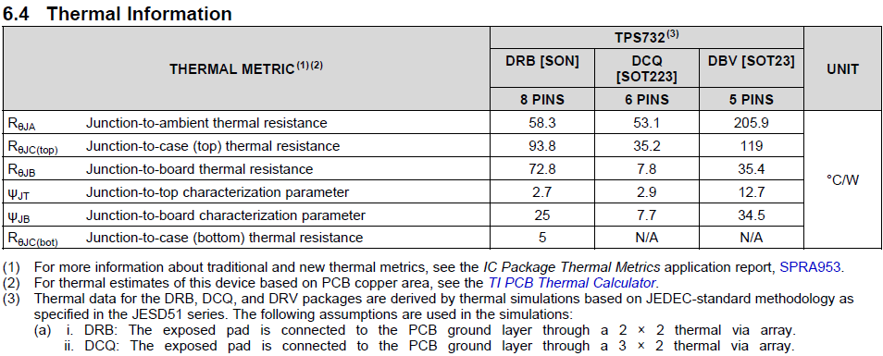
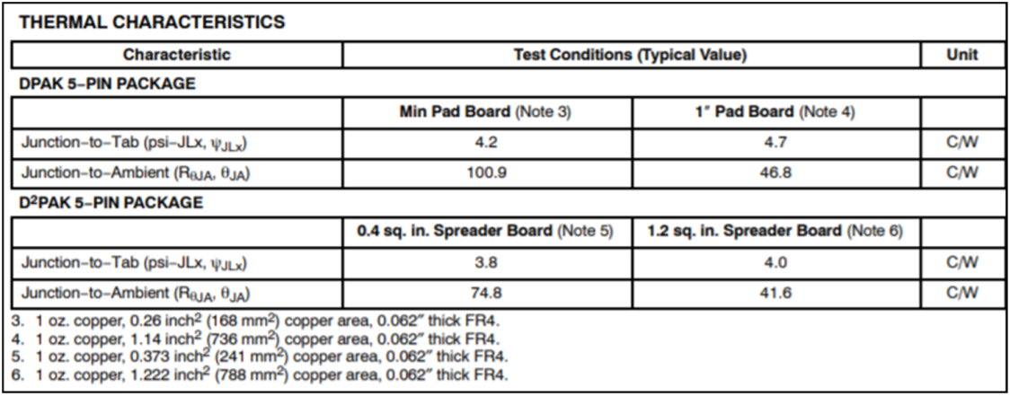
JEDEC Thermals
Because an IC’s thermal dissipation is subject to many variables we use the JEDEC standard (JESD51) for all thermal modeling.
The JEDEC standard is used so that devices can be easily compared on a similar basis.
if a competitor is not reporting the JEDEC standard the customer should consider why they don’t want to be directly compared to other devices.
Common thermal metrics: θ_{JA}, θ_{JB}, θ_{JC(top)}, θ_{JC(bot)}
TI Datasheet
Competitor Datasheet
28mm x 28mm area on the top side dedicated to only thermal dissipation?
Notes:
The junction-to-ambient thermal resistance, θ_{JA}, is the most commonly reported thermal metric and is often misused.
θ_{JA} is a measure of the thermal performance of an IC mounted on a PCB. TI uses a standard board so that the thermal performance of one device can be compared to another device.
However, comparisons are only possible when both devices use the same test setup to measure θ_{JA},
The industry standard is JEDEC’s JESD51-x series of documents.
Some competitors do not use the JEDEC conditions and the deviations from the standards are not documented.
These test variations can have a dramatic effect on the measured values of θ_{JA}.
So, unless test conditions are reported with the θ_{JA} value, they should be considered suspect.

Slide 4
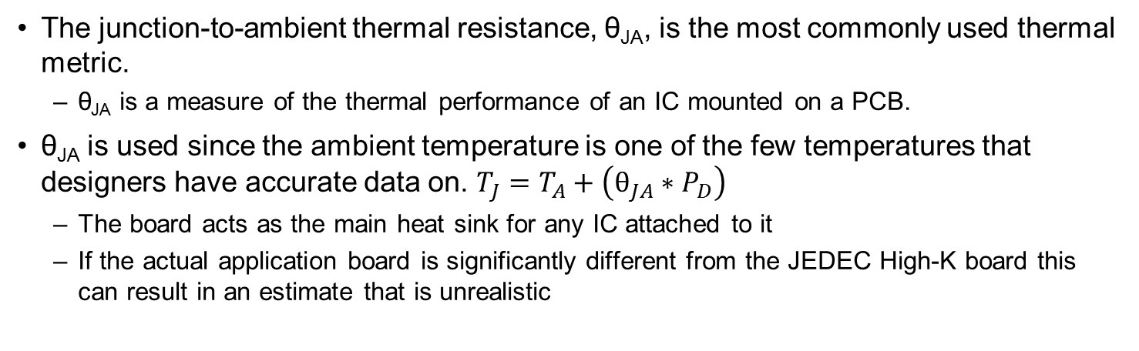
θ_{JA}: Understanding Usage and Limitations
The junction-to-ambient thermal resistance, θ_{JA}, is the most commonly used thermal metric.
θ_{JA} is a measure of the thermal performance of an IC mounted on a PCB.
θ_{JA} is used since the ambient temperature is one of the few temperatures that designers have accurate data on. $T_{J}=T_{A}+\left(θ_{JA}∗P_{D}\right)$
The board acts as the main heat sink for any IC attached to it
If the actual application board is significantly different from the JEDEC High-K board this can result in an estimate that is unrealistic
Factors Affecting θja | Strength of Influence (rule of thumb) | Relation to θja
PCB design | Very Strong | The more metal connected to the IC the lower θja due to larger thermal mass
Chip or pad size | Strong | The larger the chip and thermal pad the lower θja due to heat spreading
Altitude | Medum | The lower the altitude the lower θja due to increased cooling efficiency of air
External ambient temperature | Weak | The higher the ambient temp the lower θja due to increased radiative heat transfer
Power dissipation | Very Weak | The higher the junction temp the lower θja due to increased heat transfer

Slide 5
Less Commonly Used Thermal Metrics
θ_{JC(bot)}
The junction-to-case (power pad) thermal resistance
θ_{JC(top)}
The junction-to-case (top of case) thermal resistance
Note, if you are going to measure this temp using an IR thermal camera you must use the right settings for the emissivity of the surface and a very small spot size to get an accurate measurement.
θ_{JB}
The junction-to-board thermal resistance
Note, this is measured at the pins, most customers won’t know the temp at the LDO
ψ_{JT}
The junction-to-top-of-package characterization parameter
ψ_{JB}
The junction-to-board characterization parameter

Slide 6
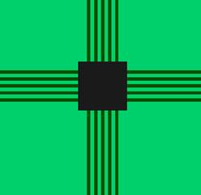
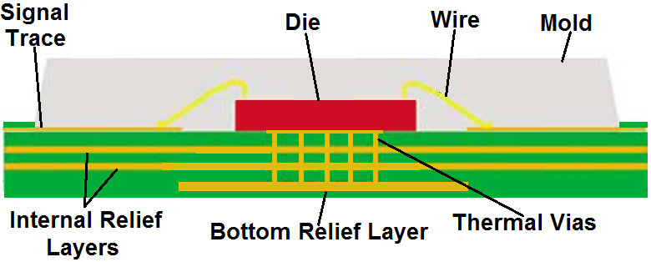
JEDEC High-K Board
TI LDO thermal metrics are modeled using the JEDEC High-K Board (2s2p)
The JEDEC High-K board has:
Two internal planes which have ~5500mm² of 1oz copper (1 GND & 1 PWR plane)
Bottom layer (opposite the IC) thermal relief layer which has ~1100mm² of 2oz copper
Internal and bottom layers are connected to the thermal pad using as many thermal vias as can be fit within the power pad dimensions.
The top layer only has traces running straight to the pins.
The JEDEC high-k board is good but not 100% optimized for maximum thermal dissipation
TEST BOARD DESIGN | JEDEC HIGH-K 2s2p | JEDEC LOW-K 1s0p
Trace thickness | 0.0028 in
Trace length | 0.98 in
PCB thickness | 0.062 in
PCB width | 4 in
PCB length | 4.5 in
Power/ground plane thickness | 0.0014in (2 planes) | No internal copper planes

Slide 7
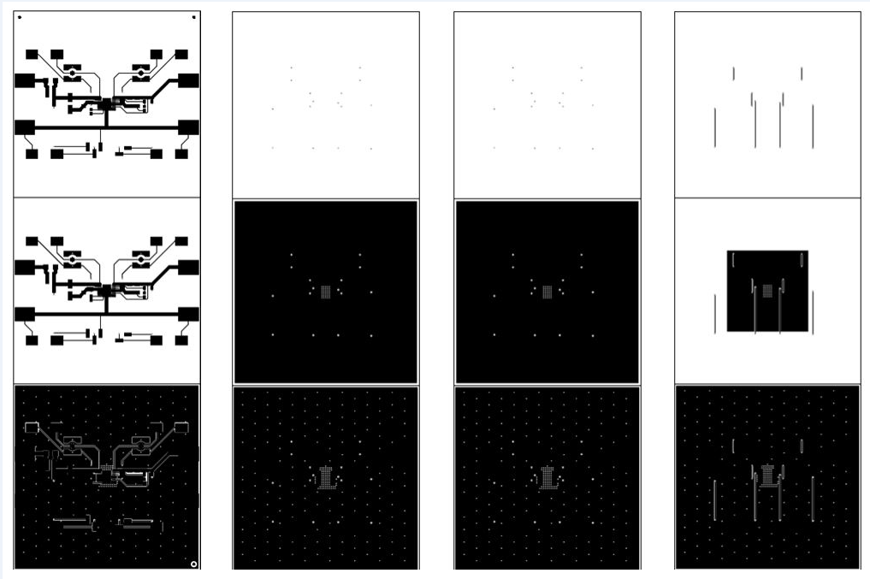
Guidelines For Maximum Thermal Relief
Have as much metal as possible in the areas around the device
(both on the same layer and the layers below it)
2oz copper is better than 1oz copper simply because there is extra metal
The more thermal vias the better spreading the heat between the different layers
A 9 x 9 array of thermal vias maximizes the amount of heat
which can be transferred from the LDO to the internal and bottom layers.
The 9 x 9 array allows the internal layers to dissipate heat almost as well as
the top layer which is often crowded with other components.
Vias should be as small as possible to decrease the amount of open space in the via hole (this maximizes the metal)
Ideally these thermal vias are all within the power pad landing pattern, but if the power pad is too small then placing extra vias as close as possible to the power pad is still helpful
If the board is large, there is a lot of metal, and the thermal vias are maximized then it is possible to reduce the θja by approximately 25%.
2s2p
JEDEC
1s0p
Notes:
➔ Have as much metal as possible in the areas around the device (both on the same layer and the layers below it)
- 2oz copper is better than 1oz copper simply because there is extra metal which will absorb heat given off by the LDO
- Even internal layers which are not connected to the power pad but are close to the device (in the x and y direction) will help dissipate heat, and the more thermal vias the better this effect.
➔ A 9 x 9 array of thermal vias maximizes the amount of heat which can be transferred from the LDO to the internal layers (as well as the layer opposite the LDO)
- Ideally these thermal vias are all within the power pad landing pattern, but if the power pad is too small and/or the PCB fab process doesn’t have small enough feature sizes then placing extra vias as close as possible to the power pad is still helpful.
- The 9 x 9 array allows the internal layers to dissipate heat almost as well as the top layer which is often crowded with other components (this reduces the copper area that can be connected to the power pad).
➔ If the board is large, there is a lot of metal, and the thermal vias are maximized then it is possible to reduce the θja (junction to ambient thermal resistance) by approximately 25%.

Slide 8
Other Thermal Considerations
Nearby heat sources on the PCB can reduce the ability of the LDO to shed heat to the board
This is because those other heat sources increase the local board temperature decreasing the temperature differential between the board to the LDO in question
Short load pulses will still heat the die significantly if there isn’t enough time between high load pulses
an increase in power dissipation will cause the die temp to stabilize on the order of tens of milliseconds.
So unless the load pulses are less than a few milliseconds, with significantly longer off times, the LDO should reach a similar internal temp as if the load was on constantly.
Forced convection and board level heatsinks can help significantly, though they are rarely a consideration for many applications which have to rely on passive cooling only
The thermal models in our datasheets assume natural convection (no forced air).

Slide 9
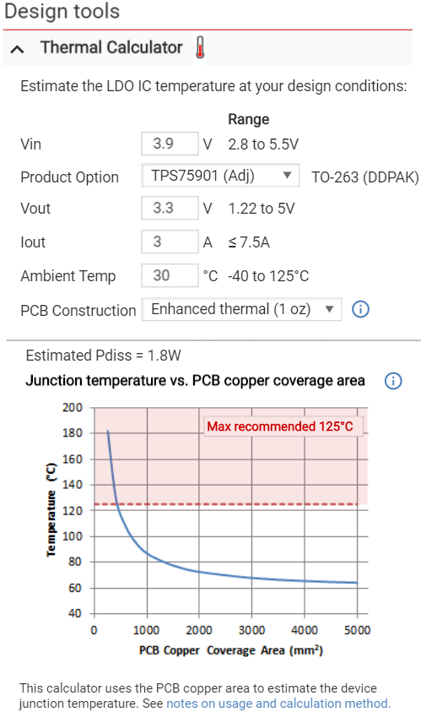
Preview: Thermal Calculator Widget
We are working with ADS to create a thermal calculator which will be on TI.com
You select your part number and plug in your Vin, Vout, Iout, and Ta
It shows a curve saying what Tj will be for various board areas
It will also warn you which board areas will result in a Tj that is higher than the recommended maximum operating temp.
This helps address the confusion regarding θ_{JA} for layouts with more or less copper than the JEDEC High-K Board

