Slide 1
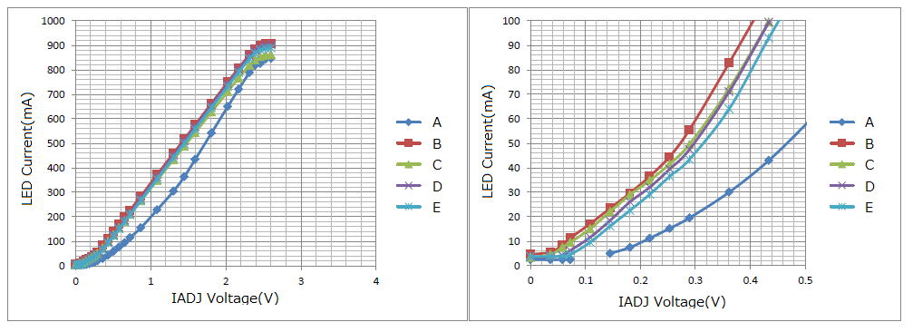
LED current per board
Board A is different condition, it doesn’t matter.

