Slide 1
LED driver with BUBO converter

Slide 2
Schematic Vin=3V 2S1P
D5 is used to achieve an additional OVP
V2 is the DC output of PWM
D1-D4 as 2S1P IR LED
Notes:
When studying a converter schematic prior to PCB layout, it’s often convenient to highlight the high current traces, the high dv/dt circuit nodes, and the noise-sensitive nets as shown in this slide. This example shows a voltage-mode controlled regulator intended for noise-sensitive communications applications that uses TI’s LM5145 100V synchronous buck controller.
Various noise reduction features integrated in the LM5145 include external clock synchronization, internal oscillator. Pulse skipping at light loads is inhibited during synchronization or when the SYNCIN pin is pulled low to reduce noise and RF interference. For added reliability, the LM5145 is rated for negative SW and gate drive transients of -5V up to 20ns duration.

Slide 3
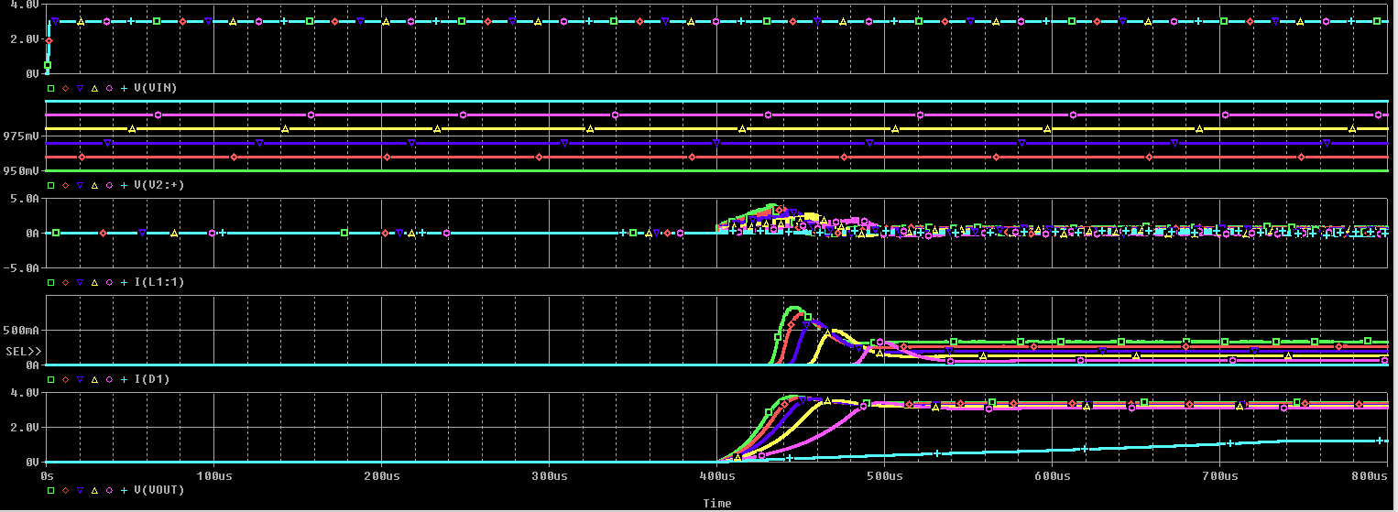
simulation results Vin=3V V2 increase from 0.95V to 1V with 0.01V step
Input voltage
V2--DC of PWM output
Current of inductor
Output current
Output voltage
Notes:
When studying a converter schematic prior to PCB layout, it’s often convenient to highlight the high current traces, the high dv/dt circuit nodes, and the noise-sensitive nets as shown in this slide. This example shows a voltage-mode controlled regulator intended for noise-sensitive communications applications that uses TI’s LM5145 100V synchronous buck controller.
Various noise reduction features integrated in the LM5145 include external clock synchronization, internal oscillator. Pulse skipping at light loads is inhibited during synchronization or when the SYNCIN pin is pulled low to reduce noise and RF interference. For added reliability, the LM5145 is rated for negative SW and gate drive transients of -5V up to 20ns duration.

Slide 4
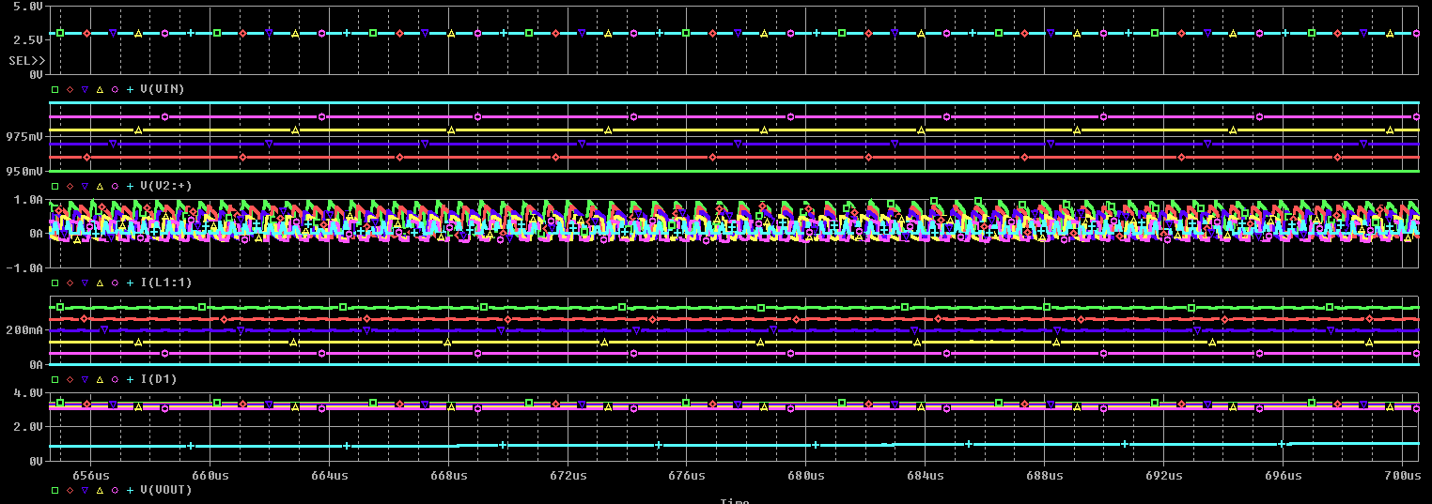
simulation results-zoom in Vin=3V V2 increase from 0.95V to 1V with 0.01V step
Input voltage
V2--DC of PWM output
Current of inductor
Output current
Output voltage
Notes:
When studying a converter schematic prior to PCB layout, it’s often convenient to highlight the high current traces, the high dv/dt circuit nodes, and the noise-sensitive nets as shown in this slide. This example shows a voltage-mode controlled regulator intended for noise-sensitive communications applications that uses TI’s LM5145 100V synchronous buck controller.
Various noise reduction features integrated in the LM5145 include external clock synchronization, internal oscillator. Pulse skipping at light loads is inhibited during synchronization or when the SYNCIN pin is pulled low to reduce noise and RF interference. For added reliability, the LM5145 is rated for negative SW and gate drive transients of -5V up to 20ns duration.

Slide 5
Schematic Vin=2.8V 2S1P
V15 is the DC output of PWM
D2-D5 as 2S1P IR LED
Notes:
When studying a converter schematic prior to PCB layout, it’s often convenient to highlight the high current traces, the high dv/dt circuit nodes, and the noise-sensitive nets as shown in this slide. This example shows a voltage-mode controlled regulator intended for noise-sensitive communications applications that uses TI’s LM5145 100V synchronous buck controller.
Various noise reduction features integrated in the LM5145 include external clock synchronization, internal oscillator. Pulse skipping at light loads is inhibited during synchronization or when the SYNCIN pin is pulled low to reduce noise and RF interference. For added reliability, the LM5145 is rated for negative SW and gate drive transients of -5V up to 20ns duration.

Slide 6
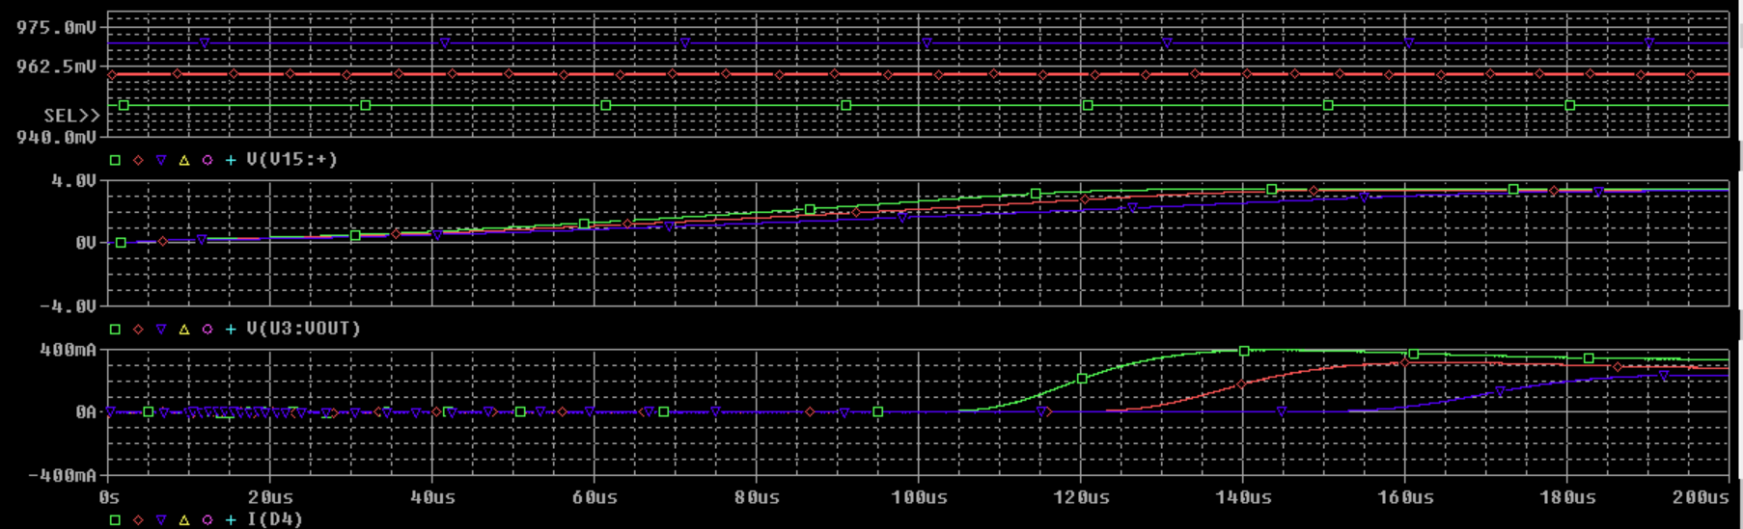
simulation results Vin=2.8V V15 increase from 0.95V to 0.97V with 0.01V step
V15--DC of PWM output
Output voltage
Output current
Notes:
When studying a converter schematic prior to PCB layout, it’s often convenient to highlight the high current traces, the high dv/dt circuit nodes, and the noise-sensitive nets as shown in this slide. This example shows a voltage-mode controlled regulator intended for noise-sensitive communications applications that uses TI’s LM5145 100V synchronous buck controller.
Various noise reduction features integrated in the LM5145 include external clock synchronization, internal oscillator. Pulse skipping at light loads is inhibited during synchronization or when the SYNCIN pin is pulled low to reduce noise and RF interference. For added reliability, the LM5145 is rated for negative SW and gate drive transients of -5V up to 20ns duration.

Slide 7
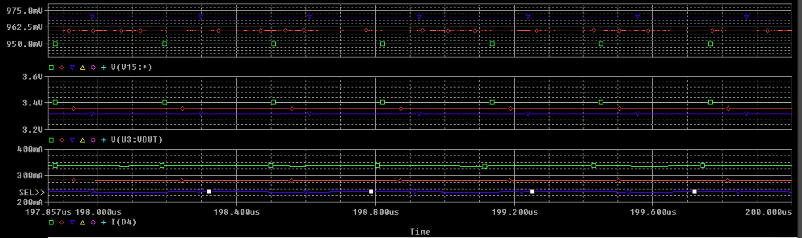
simulation results-zoom in Vin=2.8V V15 increase from 0.95V to 0.97V with 0.01V step
Notes:
When studying a converter schematic prior to PCB layout, it’s often convenient to highlight the high current traces, the high dv/dt circuit nodes, and the noise-sensitive nets as shown in this slide. This example shows a voltage-mode controlled regulator intended for noise-sensitive communications applications that uses TI’s LM5145 100V synchronous buck controller.
Various noise reduction features integrated in the LM5145 include external clock synchronization, internal oscillator. Pulse skipping at light loads is inhibited during synchronization or when the SYNCIN pin is pulled low to reduce noise and RF interference. For added reliability, the LM5145 is rated for negative SW and gate drive transients of -5V up to 20ns duration.

Slide 8
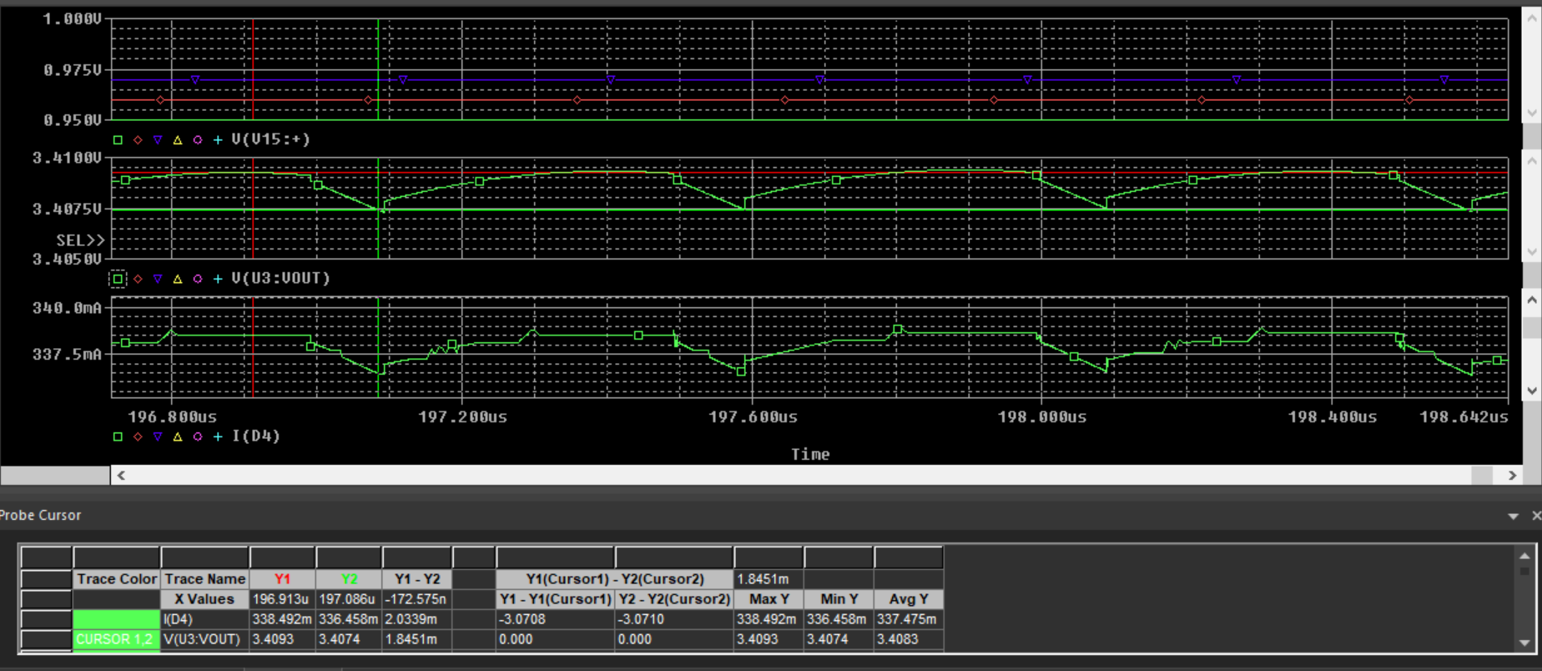
simulation results-zoom in Vin=2.8V Iout and Vout ripple—Iout=350mA Cout_effective=22uF
Notes:
When studying a converter schematic prior to PCB layout, it’s often convenient to highlight the high current traces, the high dv/dt circuit nodes, and the noise-sensitive nets as shown in this slide. This example shows a voltage-mode controlled regulator intended for noise-sensitive communications applications that uses TI’s LM5145 100V synchronous buck controller.
Various noise reduction features integrated in the LM5145 include external clock synchronization, internal oscillator. Pulse skipping at light loads is inhibited during synchronization or when the SYNCIN pin is pulled low to reduce noise and RF interference. For added reliability, the LM5145 is rated for negative SW and gate drive transients of -5V up to 20ns duration.

Slide 9
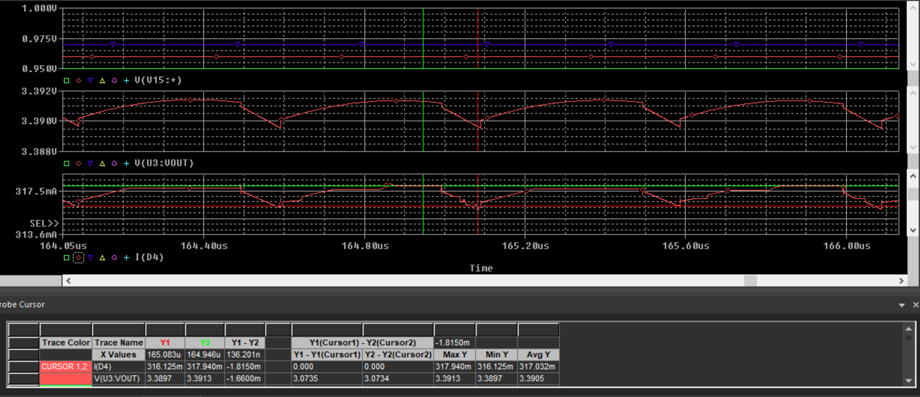
simulation results-zoom in Vin=2.8V Iout and Vout ripple—Iout=320mA Cout_effective=22uF
Notes:
When studying a converter schematic prior to PCB layout, it’s often convenient to highlight the high current traces, the high dv/dt circuit nodes, and the noise-sensitive nets as shown in this slide. This example shows a voltage-mode controlled regulator intended for noise-sensitive communications applications that uses TI’s LM5145 100V synchronous buck controller.
Various noise reduction features integrated in the LM5145 include external clock synchronization, internal oscillator. Pulse skipping at light loads is inhibited during synchronization or when the SYNCIN pin is pulled low to reduce noise and RF interference. For added reliability, the LM5145 is rated for negative SW and gate drive transients of -5V up to 20ns duration.

Slide 10
Schematic Vin=2.8V 2S1P
Change R1/R2 from 100k to 1k
Notes:
When studying a converter schematic prior to PCB layout, it’s often convenient to highlight the high current traces, the high dv/dt circuit nodes, and the noise-sensitive nets as shown in this slide. This example shows a voltage-mode controlled regulator intended for noise-sensitive communications applications that uses TI’s LM5145 100V synchronous buck controller.
Various noise reduction features integrated in the LM5145 include external clock synchronization, internal oscillator. Pulse skipping at light loads is inhibited during synchronization or when the SYNCIN pin is pulled low to reduce noise and RF interference. For added reliability, the LM5145 is rated for negative SW and gate drive transients of -5V up to 20ns duration.

Slide 11
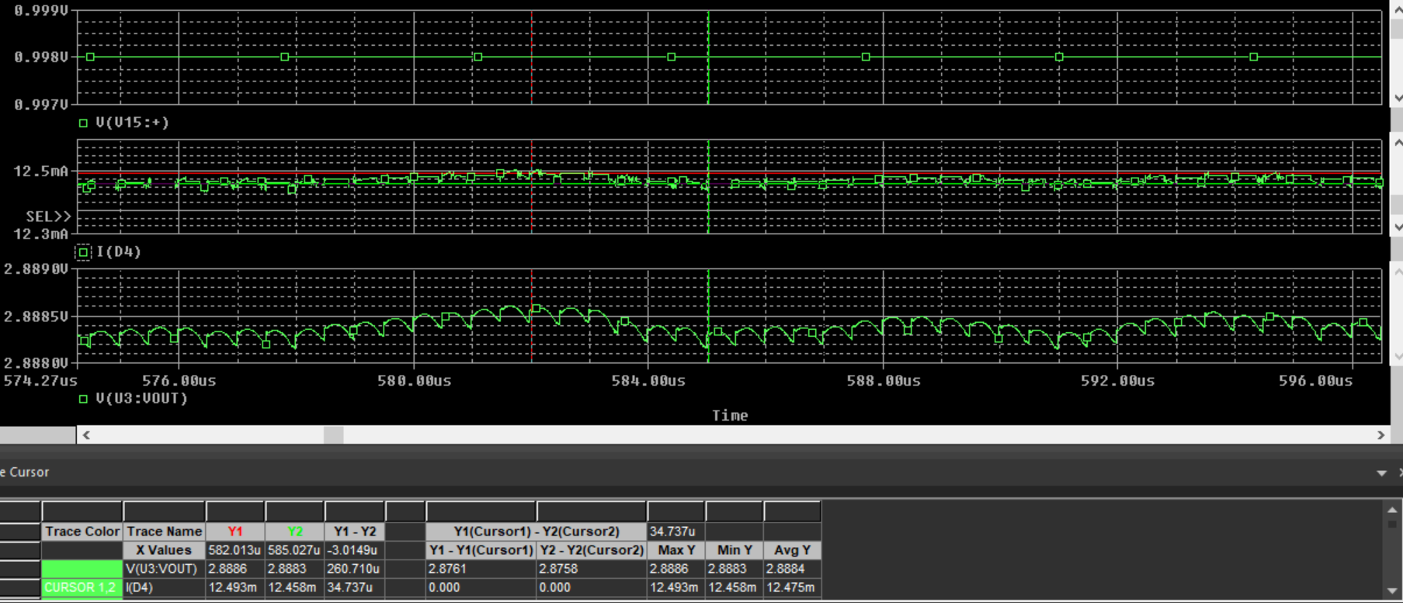
simulation results-zoom in Vin=2.8V Vdc=0.998V Iout=12.5mA
V15--DC of PWM output
Output current
Output voltage
Notes:
When studying a converter schematic prior to PCB layout, it’s often convenient to highlight the high current traces, the high dv/dt circuit nodes, and the noise-sensitive nets as shown in this slide. This example shows a voltage-mode controlled regulator intended for noise-sensitive communications applications that uses TI’s LM5145 100V synchronous buck controller.
Various noise reduction features integrated in the LM5145 include external clock synchronization, internal oscillator. Pulse skipping at light loads is inhibited during synchronization or when the SYNCIN pin is pulled low to reduce noise and RF interference. For added reliability, the LM5145 is rated for negative SW and gate drive transients of -5V up to 20ns duration.

Slide 12
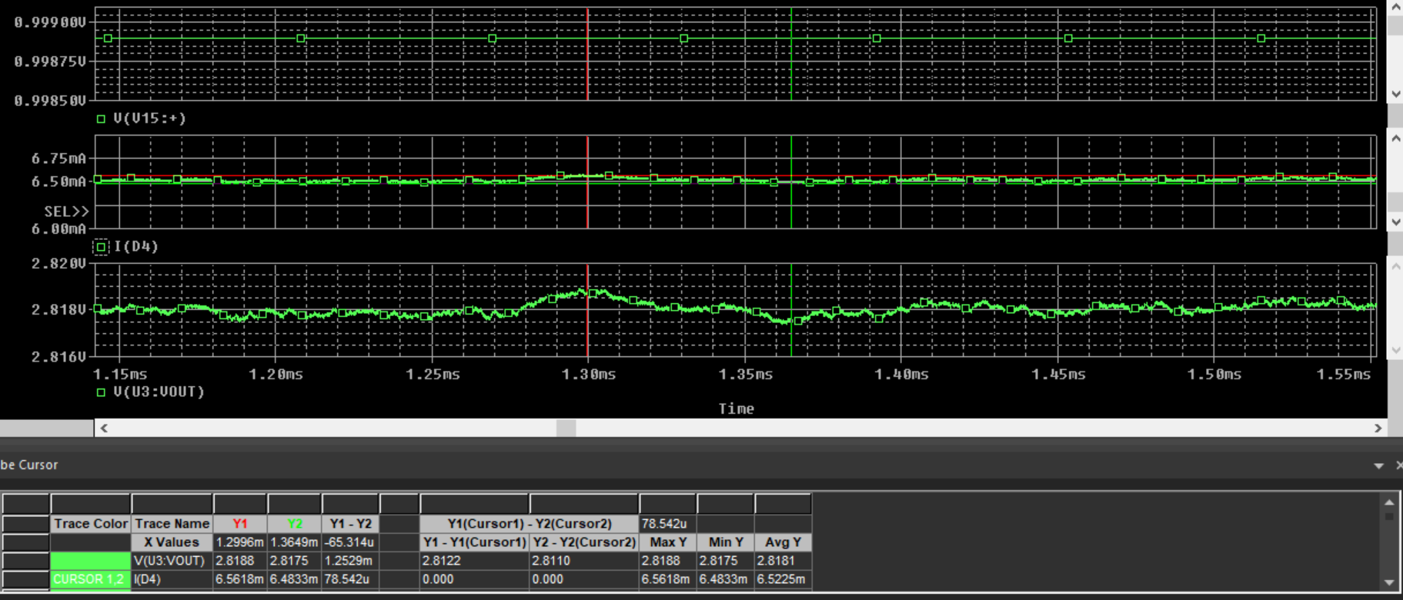
simulation results-zoom in Vin=2.8V Vdc=0.9989V Iout=6.5mA
V15--DC of PWM output
Output current
Output voltage
Notes:
When studying a converter schematic prior to PCB layout, it’s often convenient to highlight the high current traces, the high dv/dt circuit nodes, and the noise-sensitive nets as shown in this slide. This example shows a voltage-mode controlled regulator intended for noise-sensitive communications applications that uses TI’s LM5145 100V synchronous buck controller.
Various noise reduction features integrated in the LM5145 include external clock synchronization, internal oscillator. Pulse skipping at light loads is inhibited during synchronization or when the SYNCIN pin is pulled low to reduce noise and RF interference. For added reliability, the LM5145 is rated for negative SW and gate drive transients of -5V up to 20ns duration.

Slide 13
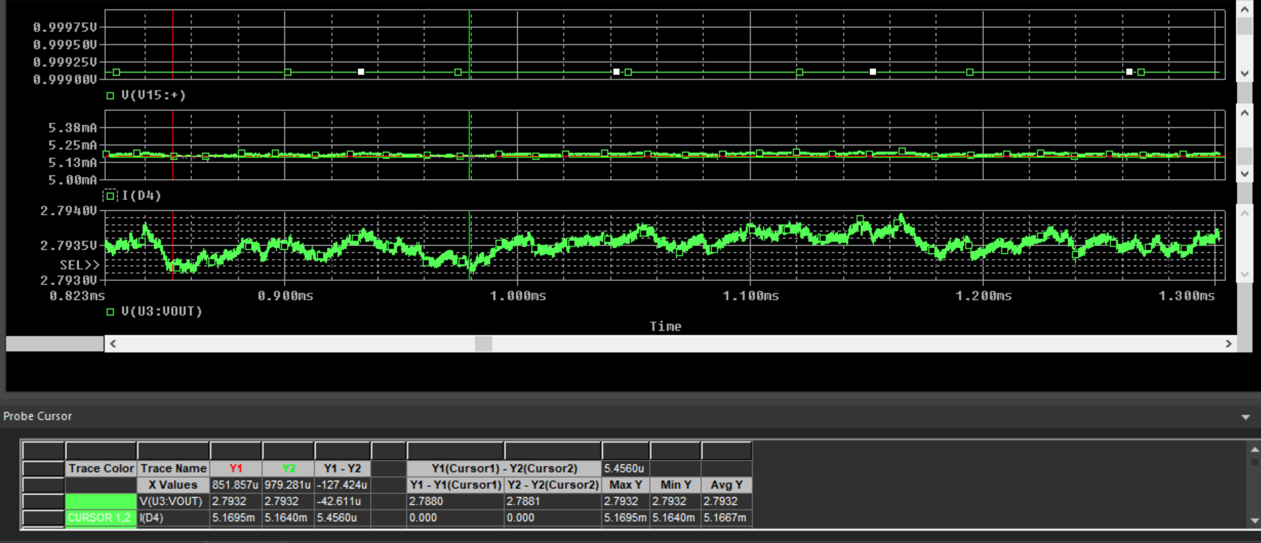
simulation results-zoom in Vin=2.8V Vdc=0.9991V Iout=5.2mA
V15--DC of PWM output
Output current
Output voltage
Notes:
When studying a converter schematic prior to PCB layout, it’s often convenient to highlight the high current traces, the high dv/dt circuit nodes, and the noise-sensitive nets as shown in this slide. This example shows a voltage-mode controlled regulator intended for noise-sensitive communications applications that uses TI’s LM5145 100V synchronous buck controller.
Various noise reduction features integrated in the LM5145 include external clock synchronization, internal oscillator. Pulse skipping at light loads is inhibited during synchronization or when the SYNCIN pin is pulled low to reduce noise and RF interference. For added reliability, the LM5145 is rated for negative SW and gate drive transients of -5V up to 20ns duration.

Slide 14
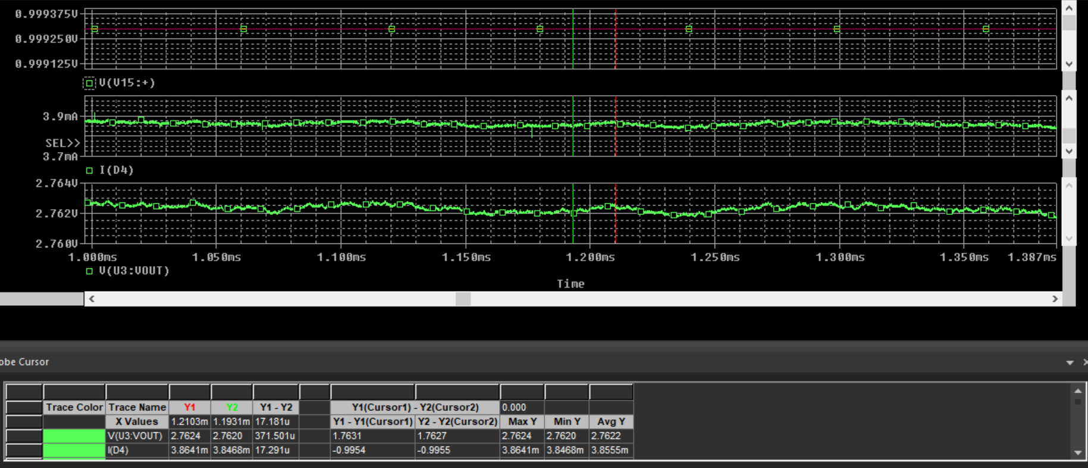
simulation results-zoom in Vin=2.8V Vdc=0.9993V Iout=3.86mA
V15--DC of PWM output
Output current
Output voltage
Notes:
When studying a converter schematic prior to PCB layout, it’s often convenient to highlight the high current traces, the high dv/dt circuit nodes, and the noise-sensitive nets as shown in this slide. This example shows a voltage-mode controlled regulator intended for noise-sensitive communications applications that uses TI’s LM5145 100V synchronous buck controller.
Various noise reduction features integrated in the LM5145 include external clock synchronization, internal oscillator. Pulse skipping at light loads is inhibited during synchronization or when the SYNCIN pin is pulled low to reduce noise and RF interference. For added reliability, the LM5145 is rated for negative SW and gate drive transients of -5V up to 20ns duration.

Slide 15
Schematic Vin=2.8V 2S1P
Soft-start of PWM
Notes:
When studying a converter schematic prior to PCB layout, it’s often convenient to highlight the high current traces, the high dv/dt circuit nodes, and the noise-sensitive nets as shown in this slide. This example shows a voltage-mode controlled regulator intended for noise-sensitive communications applications that uses TI’s LM5145 100V synchronous buck controller.
Various noise reduction features integrated in the LM5145 include external clock synchronization, internal oscillator. Pulse skipping at light loads is inhibited during synchronization or when the SYNCIN pin is pulled low to reduce noise and RF interference. For added reliability, the LM5145 is rated for negative SW and gate drive transients of -5V up to 20ns duration.

Slide 16
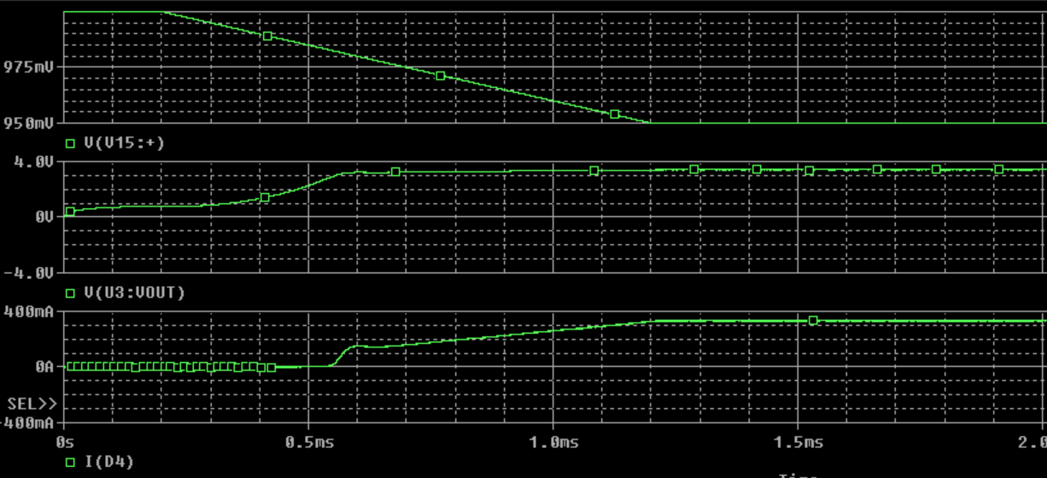
simulation results-zoom in Vin=2.8V Vdc change with a slow slew rate
Overshoot disappeared with this soft-start
Notes:
When studying a converter schematic prior to PCB layout, it’s often convenient to highlight the high current traces, the high dv/dt circuit nodes, and the noise-sensitive nets as shown in this slide. This example shows a voltage-mode controlled regulator intended for noise-sensitive communications applications that uses TI’s LM5145 100V synchronous buck controller.
Various noise reduction features integrated in the LM5145 include external clock synchronization, internal oscillator. Pulse skipping at light loads is inhibited during synchronization or when the SYNCIN pin is pulled low to reduce noise and RF interference. For added reliability, the LM5145 is rated for negative SW and gate drive transients of -5V up to 20ns duration.

