Slide 1
Test setup:
Driver board GND not connect to GND of LED board & 12V DC supply
TI EVM seems can not imitate this condition. The GND of LED is always connect to GND of driver
12V DC supply
12V
LED driver
LED board
GND
NOT connect GND
GND
After setup, power on 12V DC supply, then the LED is lighting

Slide 2
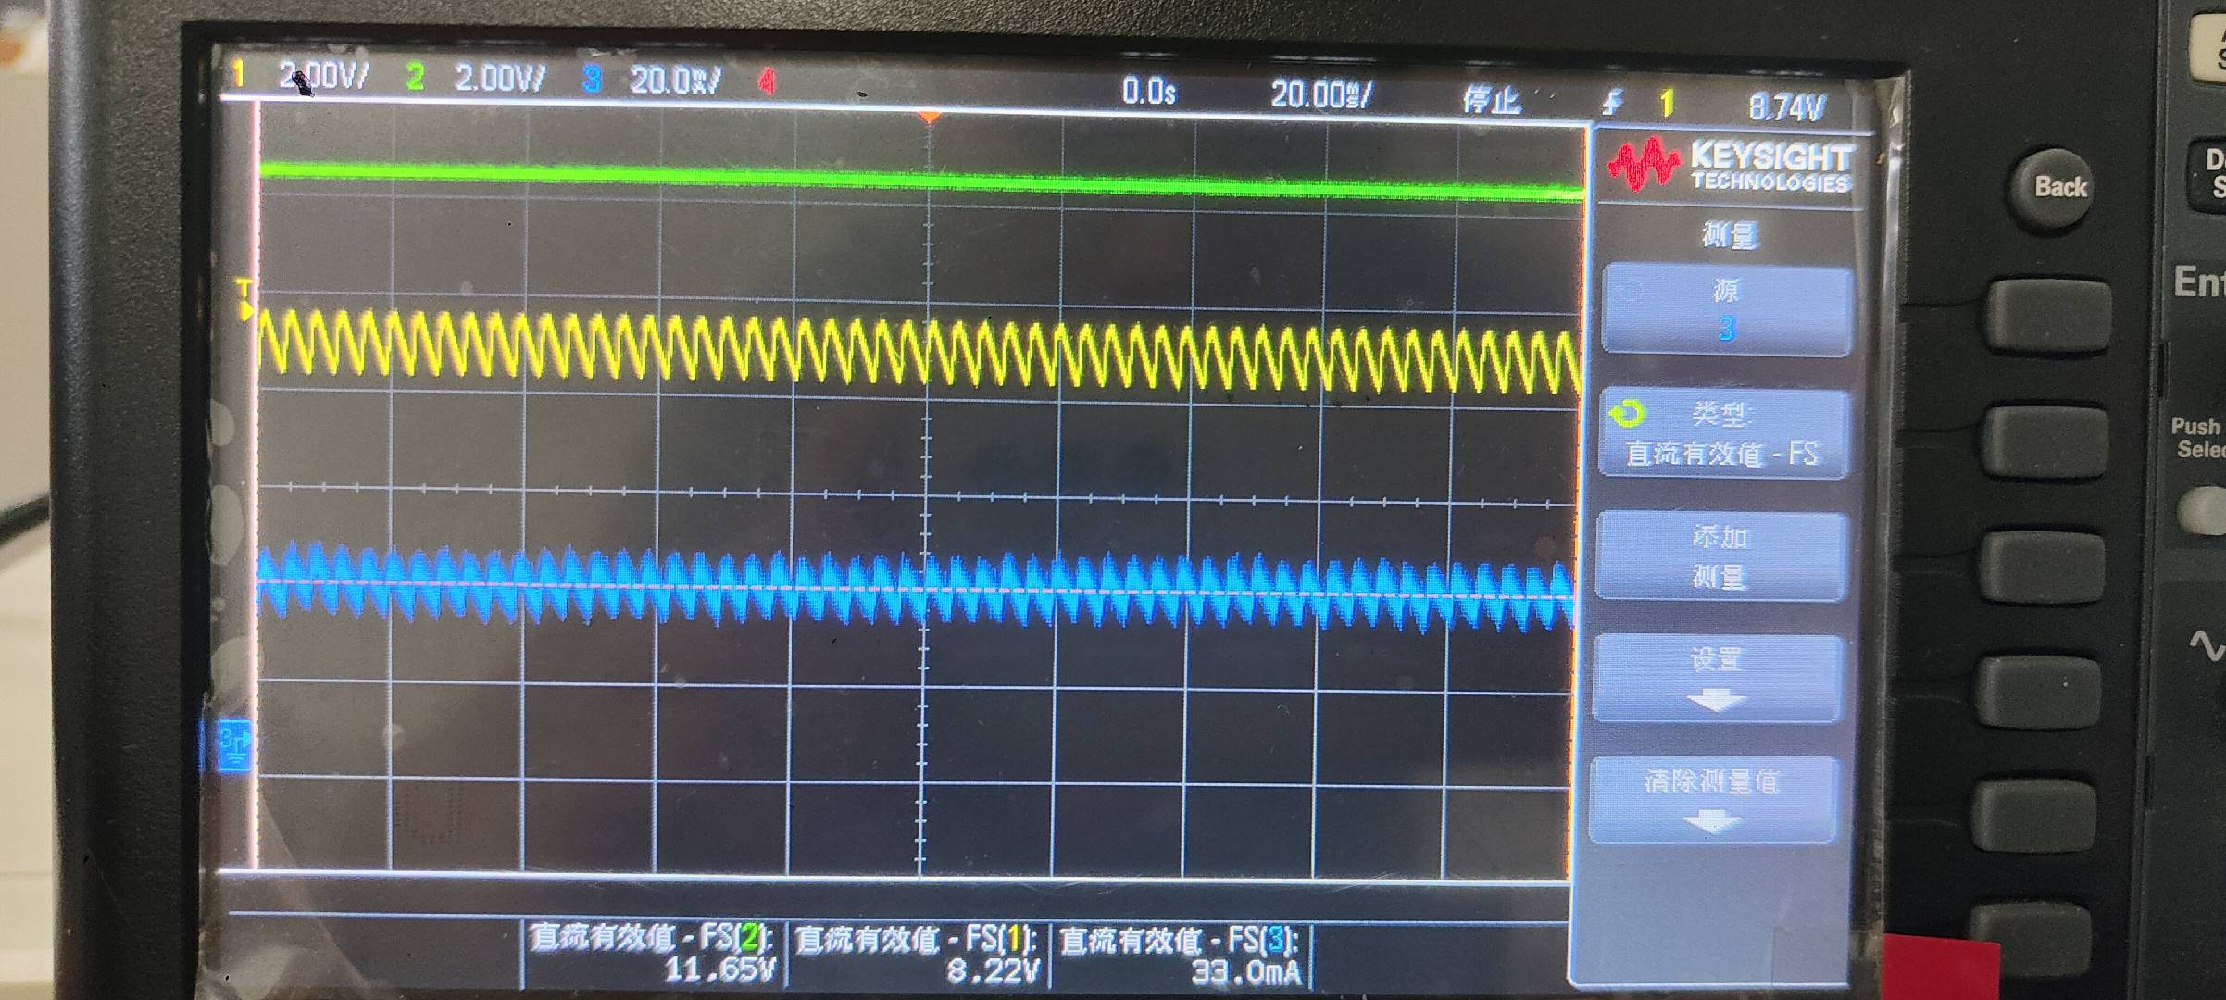
Test result
CH1: Vin of LED driver
CH2: Vo of LED driver
CH3: current of LED

Slide 3
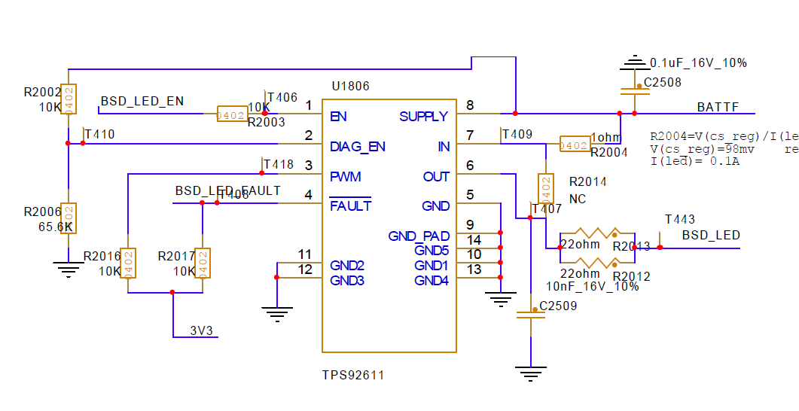
Driver schematic

Slide 4
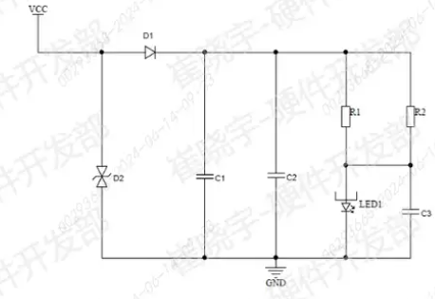
LED schematic

Slide 5
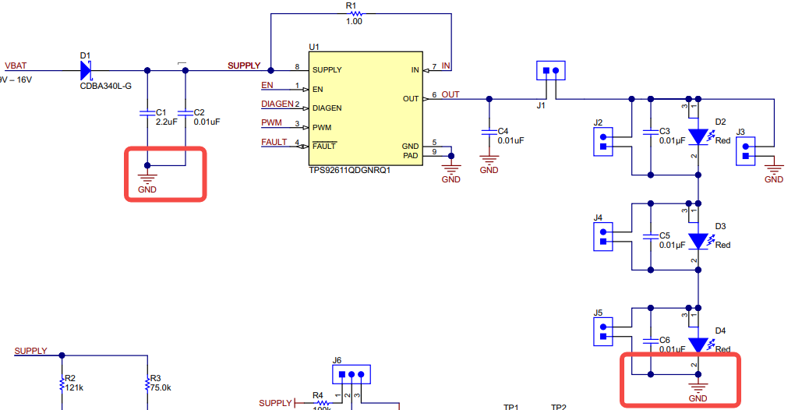

In TI EVM, the GND of driver and GND of LED is always connect together, it can not imitate driver not connect GND while LED connect LED
Not connect to GND
connect to GND

Slide 6
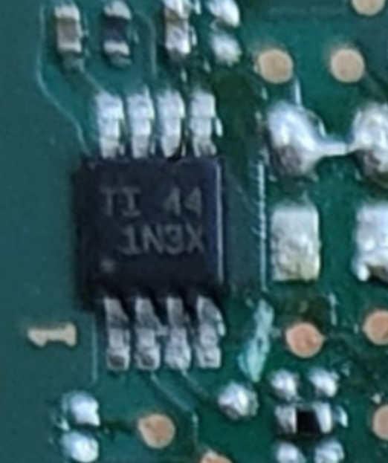
IC marking

