Slide 1
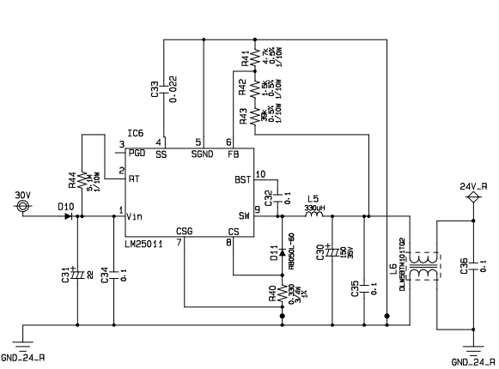
R44 = 5.1Mohm

Slide 2
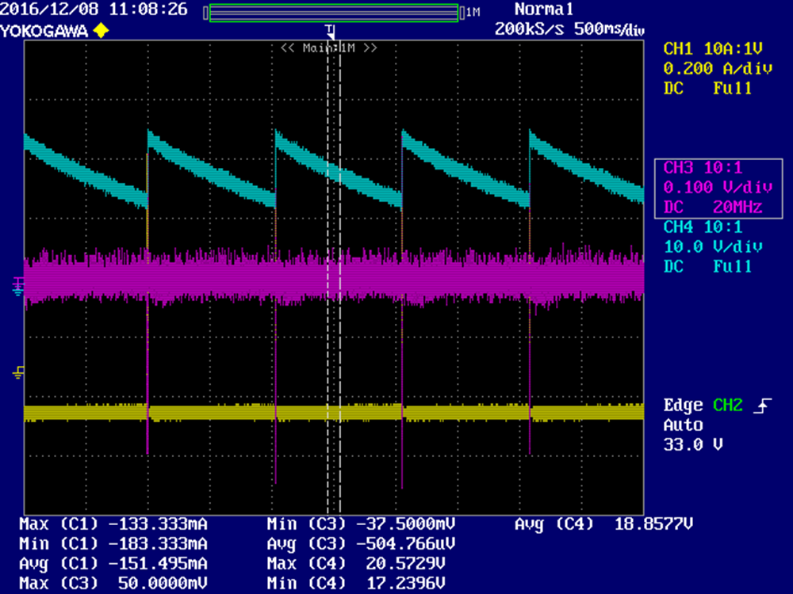
DCM mode
This waveform is at no load. Output voltage has wave. (17V~20.5)
Blue : Output voltage
Pink : CS voltage
Yellow : L current
*Please see the color circle of the previous page circuit about confirm point.

Slide 3
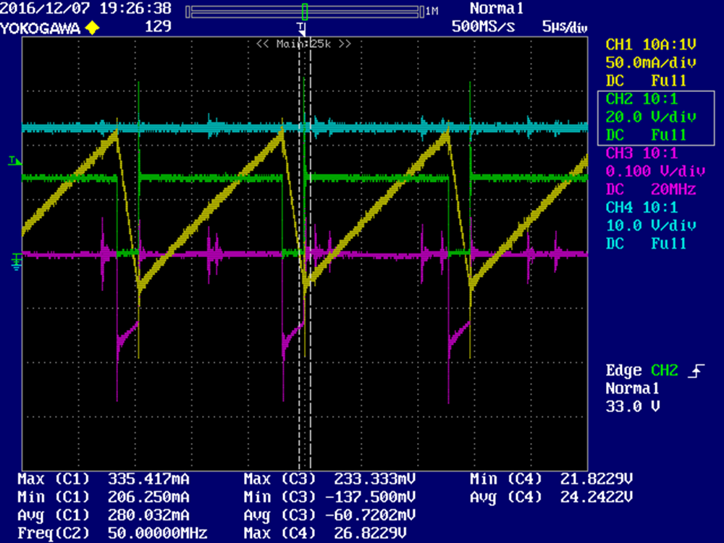
CCM mode
This waveform is at 11W load.
Blue : Output voltage
Pink : CS pin voltage
Yellow : L current
Green : SW pin voltage
*Please see the color circle of P1 circuit about confirm point.

