Slide 1
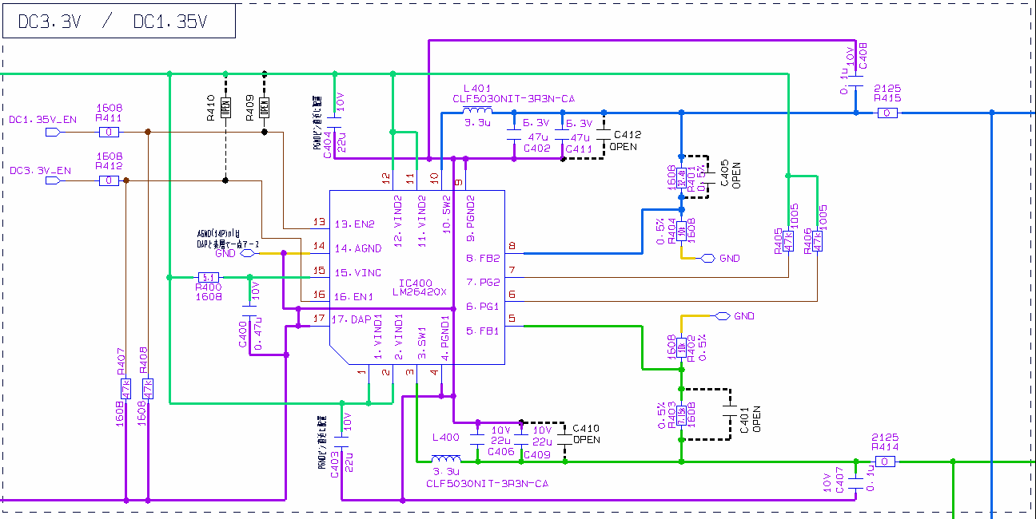
DC3.3V/DC1.35V
Phase margin , Gain margin
Connect to electronic load
DC5V
DC3.3V
DC1.35V
Noise injection resister is 51ohms

Slide 2
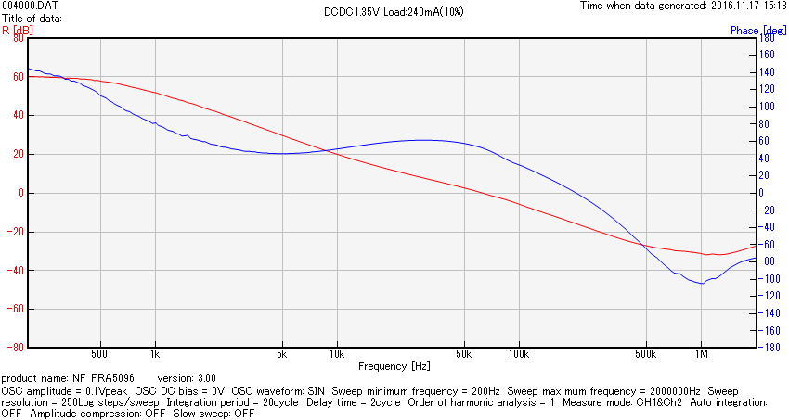
DC1.35V Load 240mA (10%)
Phase margin:52.17deg, Gain margin:35.79dB, fc:60.35kHz

Slide 3
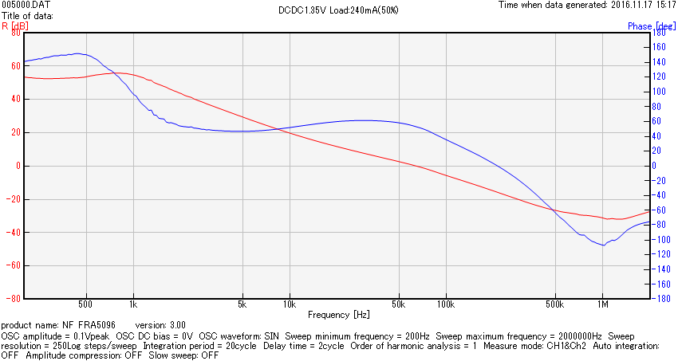
DC1.35V Load 1200mA(50%)
Phase margin:52.47deg, Gain margin:15.90dB, fc:63.25kHz

Slide 4
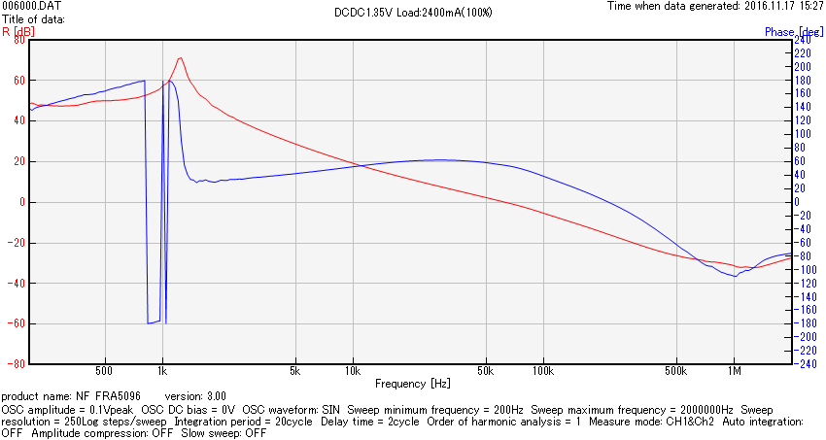
DC1.35V Load 2400mA(100%)
？
Phase margin:53.54deg, Gain Margin:15.90dB, fc:63.25kHz？

Slide 5
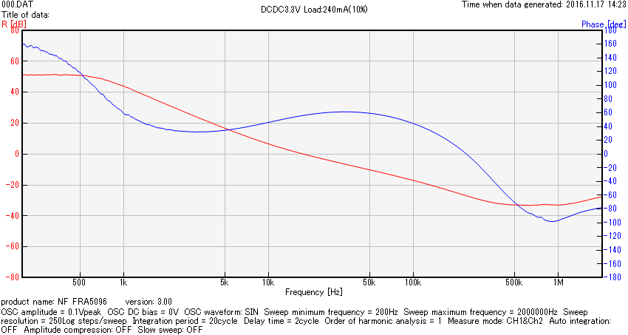
DC3.3V Load 240mA(10%)
Phase margin:55.70deg, Gain margin:26.91dB, fc:17.60kHz

Slide 6
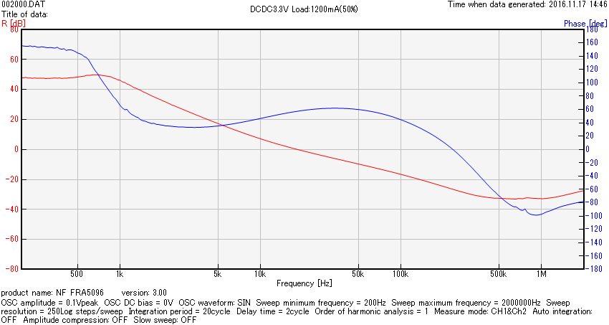
DC3.3V Load 1200mA(50%)
Phase margin:55.70deg, Gain margin:26.91dB, fc:18.44kHz

Slide 7
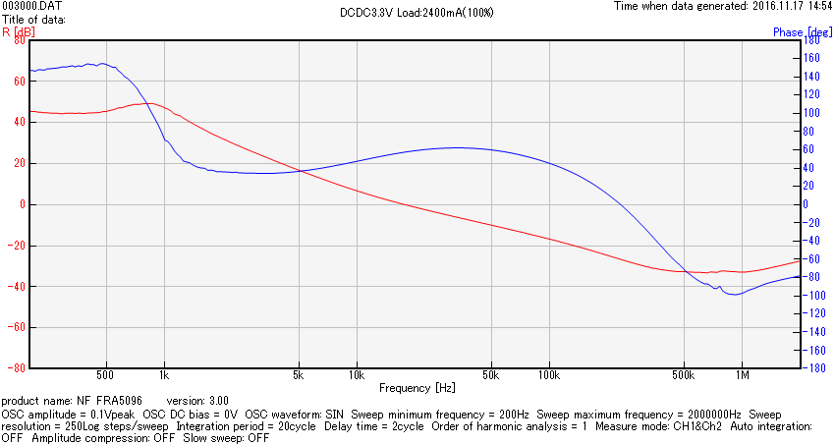
DC3.3V Load 2400mA(100%)
Phase margin:55.70deg, Gain Margin:26.91dB, fc:18.02kHz

