Slide 1

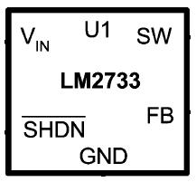
LM2733 constant current control
Vf=36V, If=60mA
VIN=12V
constant current
feedback
GND
My customer want to design LED application. He designed it using LM2733. It is constant current control like this figure. Is there any problem this schematic?

